Slide 1
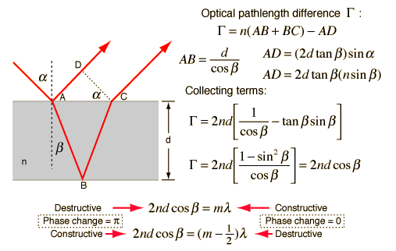
Reflection from thin layers
Source of figure: http://hyperphysics.phy-astr.gsu.edu/hbase/phyopt/interf.html#c1

Slide 2
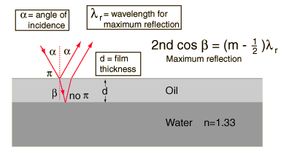
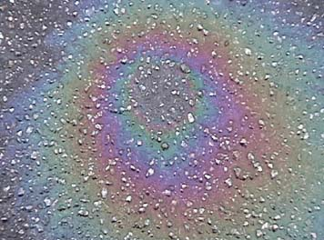
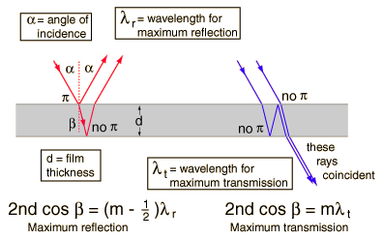
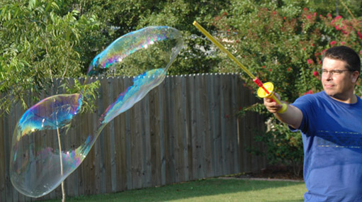
Reflection from thin layers
Source of figures: http://hyperphysics.phy-astr.gsu.edu/hbase/phyopt/oilfilm.html#c1
http://hyperphysics.phy-astr.gsu.edu/hbase/phyopt/soapfilm.html#c1

Slide 3
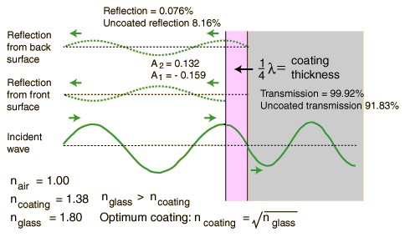
Anti-reflection coatings
Source of figure: http://hyperphysics.phy-astr.gsu.edu/hbase/phyopt/antiref.html#c1

Slide 4
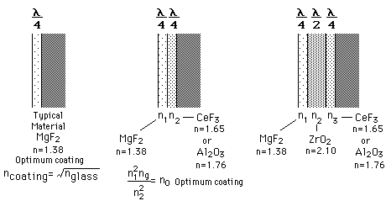
Anti-reflection coatings
Source of figure: http://hyperphysics.phy-astr.gsu.edu/hbase/phyopt/antiref.html#c1

Slide 5
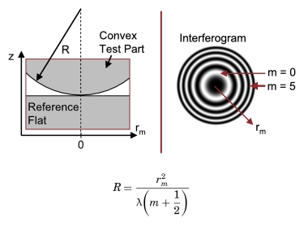
Newton rings
Source of figure: http://spie.org/x32482.xml

Slide 6
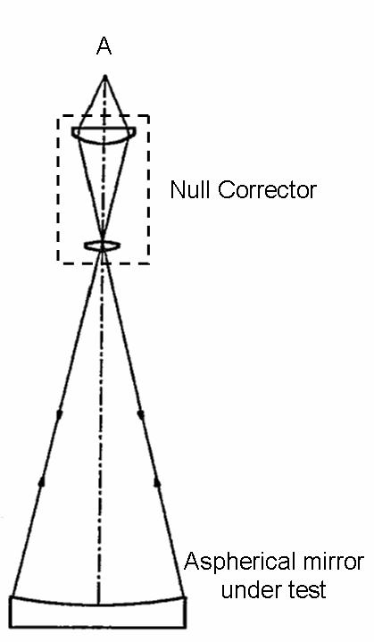
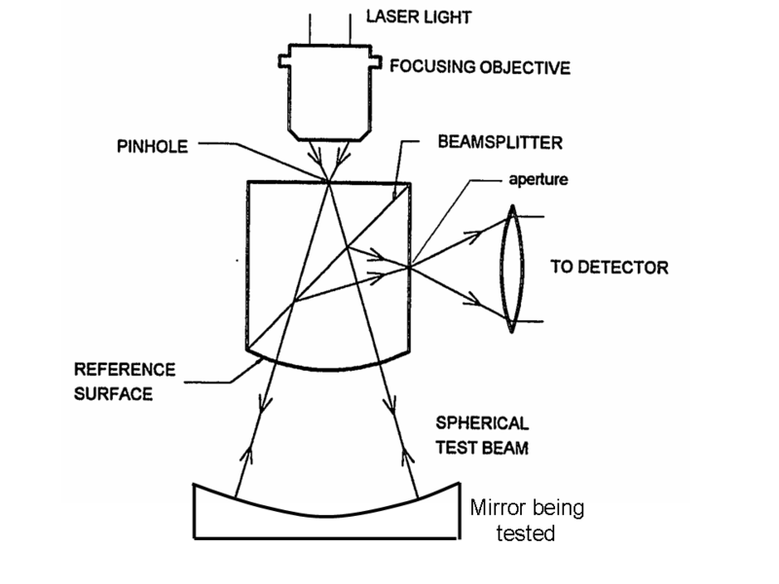
Null corrector
Source of figure: www.wikipedia.org

Slide 7
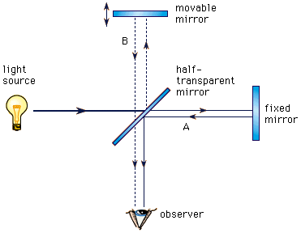
Michelson interferometer
Source of figure: http://kspark.kaist.ac.kr/Twin%20Paradox/Relativity%20Facts.files/Michelson%20interferometer.gif

Slide 8
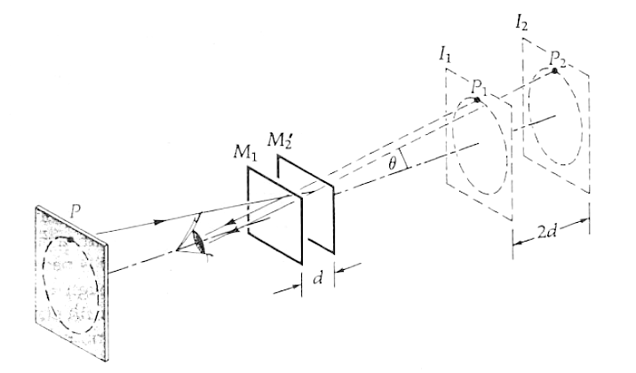
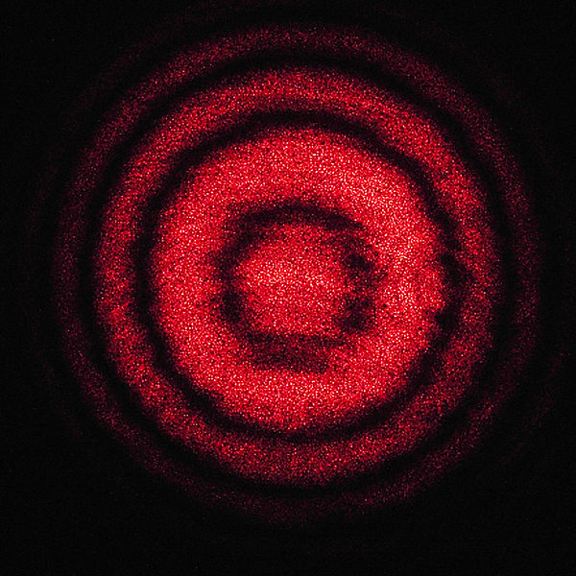
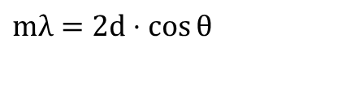
Michelson interferometer
$$mλ=2d⋅\cos{θ}$$
Source of figure: Hudson-Nelson: Útban a modern fizikához
www.wikipedia.org

Slide 9


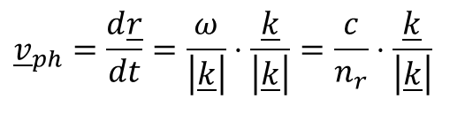
Phase velocity, group velocity
Velocity of a point of a given phase:
$$\underline{E}={\underline{E}}_{0}⋅e^{i\left(\underline{k}⋅\underline{r}−ωt\right)}$$
$$\underline{k}⋅\underline{r}−ωt=φ$$
$${\underline{v}}_{ph}=\frac{d\underline{r}}{dt}=\frac{ω}{\left|\underline{k}\right|}⋅\frac{\underline{k}}{\left|\underline{k}\right|}=\frac{c}{n_{r}}⋅\frac{\underline{k}}{\left|\underline{k}\right|}$$

Slide 10
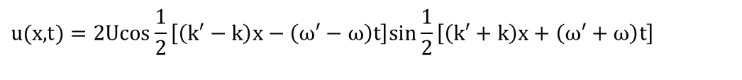
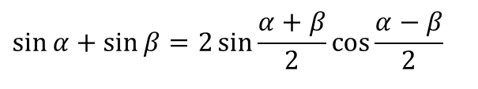
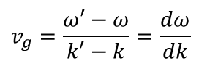
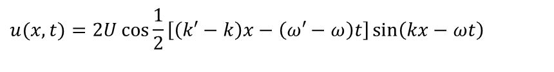
Phase velocity, group velocity
Superposition of two waves of slightly different frequency:
$$u(x,t)=U\sin\left(kx−ωt\right)+U\sin\left(k′x−ω′t\right)$$
$$\sin{α}+\sin{β}=2\sin{\frac{α+β}{2}}\cos{\frac{α−β}{2}}$$
$$u(\text{x}\text{,}\text{t})=\text{2}\text{Ucos}\frac{1}{2}\left[\left(\text{k}\text{′}−k\right)x−\left(\text{ω}\text{′}−ω\right)t\right]\text{sin}\frac{1}{2}\left[\left(\text{k}\text{′}+k\right)x+\left(\text{ω}\text{′}+ω\right)t\right]$$
$$u(x,t)=2U\cos{\frac{1}{2}}\left[\left(k′−k\right)x−\left(ω′−ω\right)t\right]\sin\left(kx−ωt\right)$$
$$v_{g}=\frac{ω′−ω}{k′−k}=\frac{dω}{dk}$$
v_{g} : group velocity
v : phase velocity
Source of figure: www.wikipedia.org

Slide 11
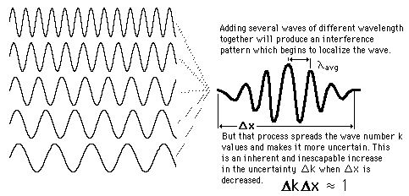
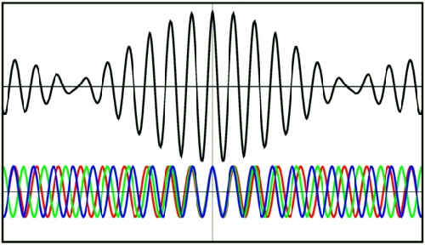
Wave packet
Source of figures: http://hyperphysics.phy-astr.gsu.edu/hbase/waves/wpack.html
http://scienceblogs.com/principles/2007/03/basic_concepts_measurement.php

Slide 12
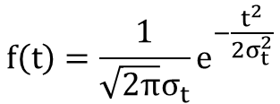
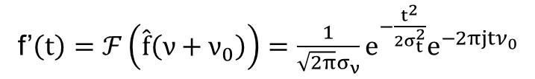
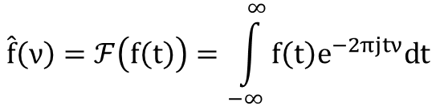
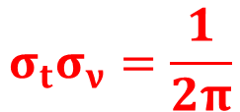

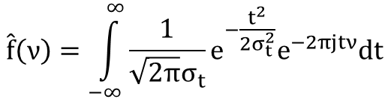
$$\hat{f}\left(ν\right)=ℱ\left(f\left(t\right)\right)=\int_{−∞}^{∞}{f\left(t\right)e^{−2πjtν}dt}$$
$$f\left(t\right)=\frac{1}{\sqrt{2π}σ_{t}}e^{−\frac{t^{2}}{2σ_{t}^{2}}}$$
$$\hat{f}\left(ν\right)=\int_{−∞}^{∞}{\frac{1}{\sqrt{2π}σ_{t}}e^{−\frac{t^{2}}{2σ_{t}^{2}}}e^{−2πjtν}dt}$$
$$\hat{f}\left(ν\right)=e^{−2π^{2}σ_{t}^{2}ν^{2}}$$
f’$\left(t\right)=ℱ\left(\hat{f}\left(ν+ν_{0}\right)\right)=\frac{1}{\sqrt{2π}σ_{ν}}e^{−\frac{t^{2}}{2σ_{t}^{2}}}e^{−2πjtν_{0}}$
$$σ_{t}σ_{ν}=\frac{1}{2π}$$

Slide 13
Modern Physics

Slide 14
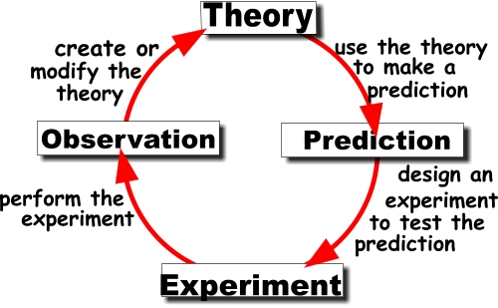
The Scientific Method
Source of figure: http://www.tomatosphere.org/teacher-resources/teachers-guide/principal-investigation/scientific-method.cfm

Slide 15
The Scientific Method
Our knowledge is limited
Science deals with models
We try to find the best, and simplest models, that fit all the available data
The models are imperfect
When new information is acquired the old model might be replaced by a new, more precise one
The new model must not contradict earlier results
The new model must be able to explain how the old model worked

Slide 16
The Scientific Method

Slide 17
The Scientific Method

Slide 18
The Scientific Method

Slide 19
The Scientific Method

Slide 20
The Scientific Method

Slide 21
The Scientific Method

Slide 22
The Scientific Method

Slide 23
The Scientific Method

Slide 24
The Scientific Method

Slide 25
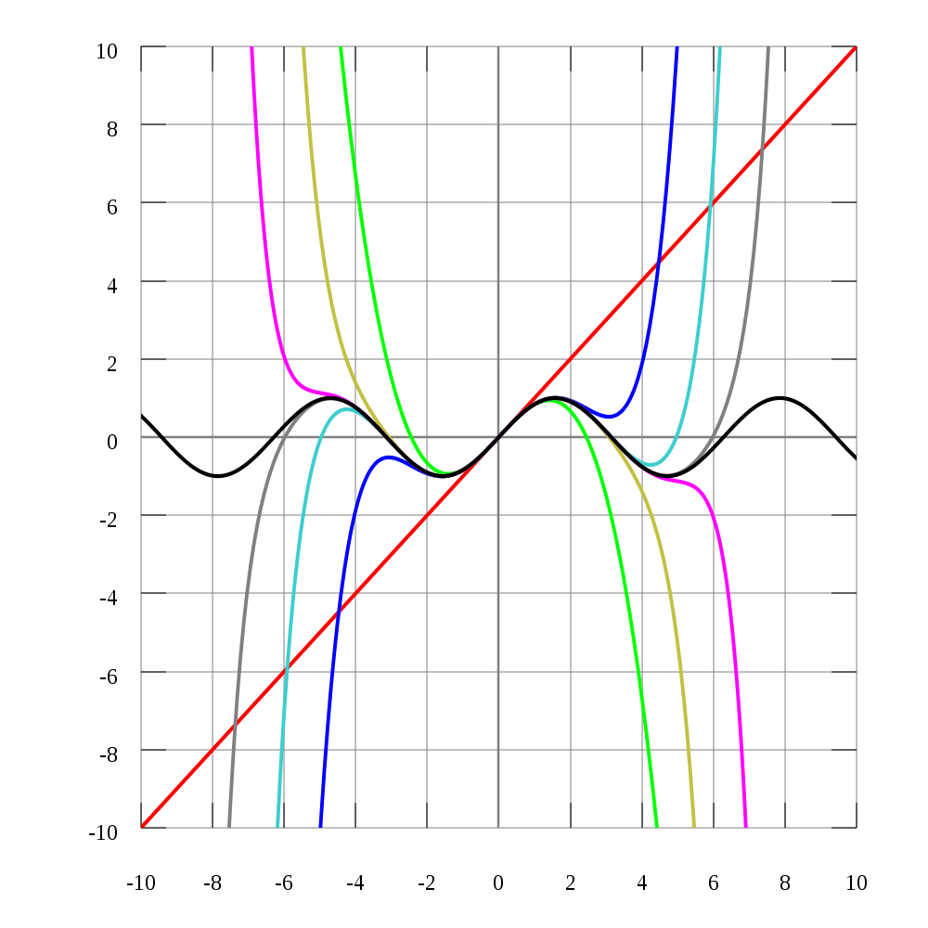
The Scientific Method
Source of figure: http://en.wikipedia.org/wiki/Taylor_series

Slide 26
The Scientific Method

Slide 27
The Scientific Method

Slide 28
The Scientific Method

Slide 29
The Scientific Method
Models are based on
a limited number of measurements
of limited precision
in a limited range of parameters
As science and technology advances, more and better experiments/observations can be performed
New, previously unknown effects can be observed
New, more general models must be constructed
The new model shall integrate the old one

Slide 30
Theory of Relativity

Slide 31
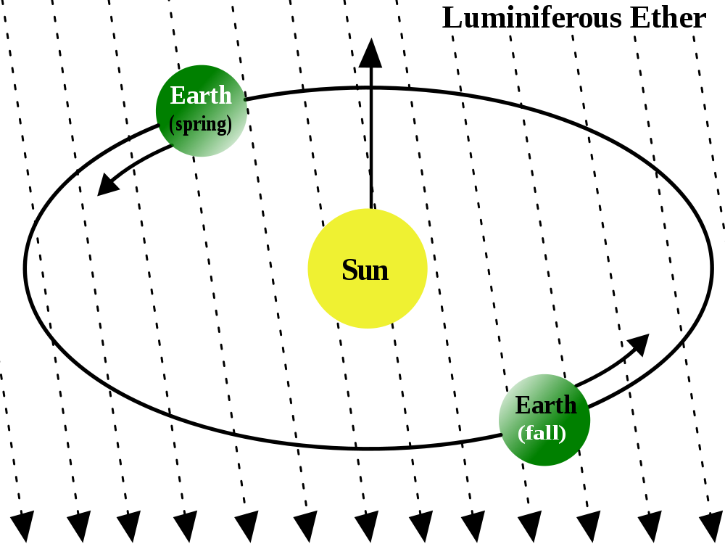
Michelson-Morley experiment (1887)
Earth’s orbital velocity is approximately 30 km/s ≈ 10⁵ km/h
The speed of light is approximately 300 000 km/s → 4 orders of magnitude faster
Source of figure: http://en.wikipedia.org/wiki/Luminiferous_aether

Slide 32
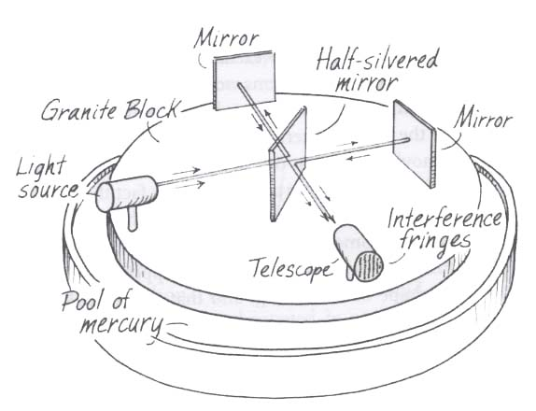
Michelson-Morley experiment (1887)
Source of figure: Introductory Physics, A Problem Solving Approach (p. 559), Jesse David Wall & Elender Wall,
1997, Analog Press, 225 Edna Street, San Francisco, CA 94112

Slide 33
Michelson-Morley experiment (1887)
Expected shift: 0.4 fringe
Precision: 0.01 fringe
No significant effect
Today: maximum anisotropy ≤ 10⁻¹⁷
The speed of light is the same in all directions
There is no Ether!!!

Slide 34
Special Theory of Relativity
Einstein (1905):
The laws by which the states of physical systems undergo change are not affected, whether these changes of state be referred to the one or the other of two systems in uniform translatory motion relative to each other.
"... light is always propagated in empty space with a definite velocity [speed] c which is independent of the state of motion of the emitting body.„

Slide 35
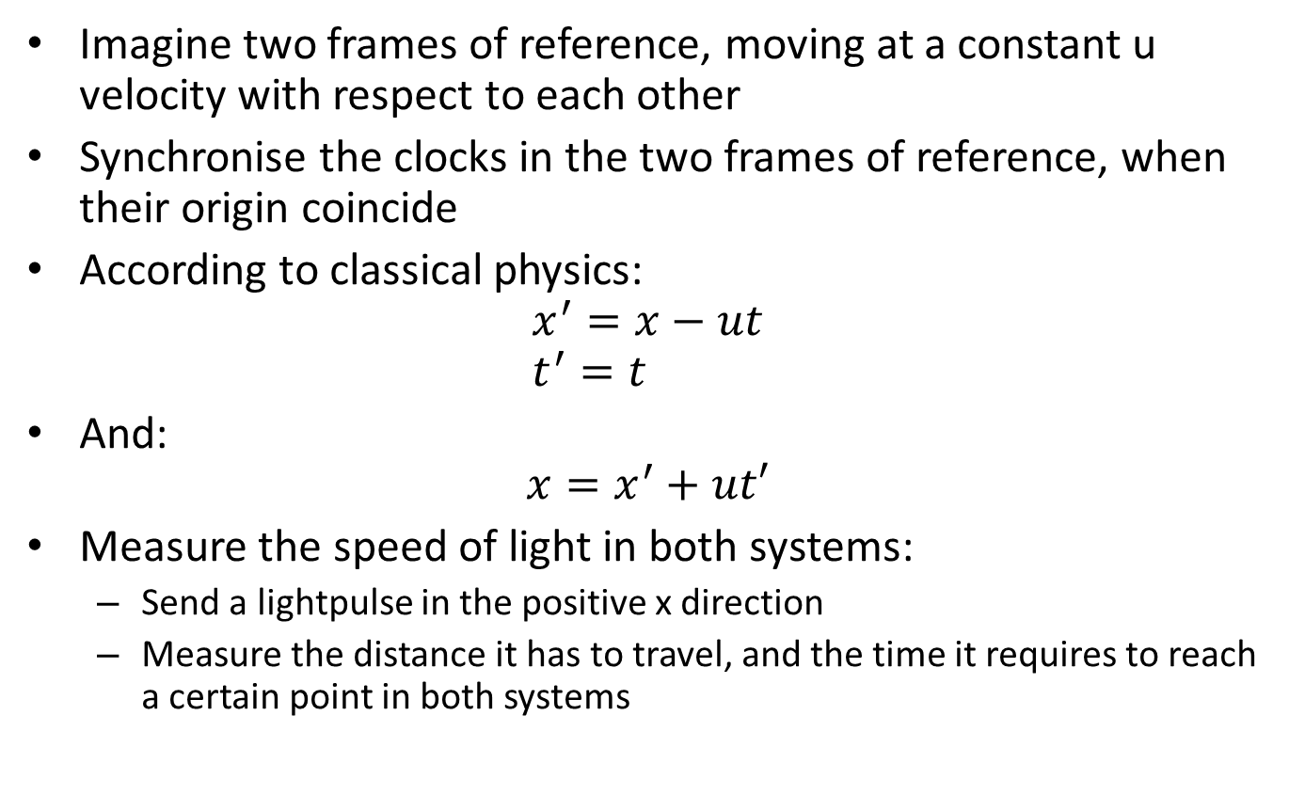
Special Theory of Relativity
Imagine two frames of reference, moving at a constant u velocity with respect to each other
Synchronise the clocks in the two frames of reference, when their origin coincide
According to classical physics: $x^{′}=x−ut$ $t^{′}=t$
And: $x=x^{′}+ut′$
Measure the speed of light in both systems:
Send a lightpulse in the positive x direction
Measure the distance it has to travel, and the time it requires to reach a certain point in both systems

Slide 36
Special Theory of Relativity
K
K’
x’ = x - ut
ut
x
Light pulse
K: (0, 0)
K: (x, t)
K’: (0, 0)
K’: (x’, t’)

Slide 37
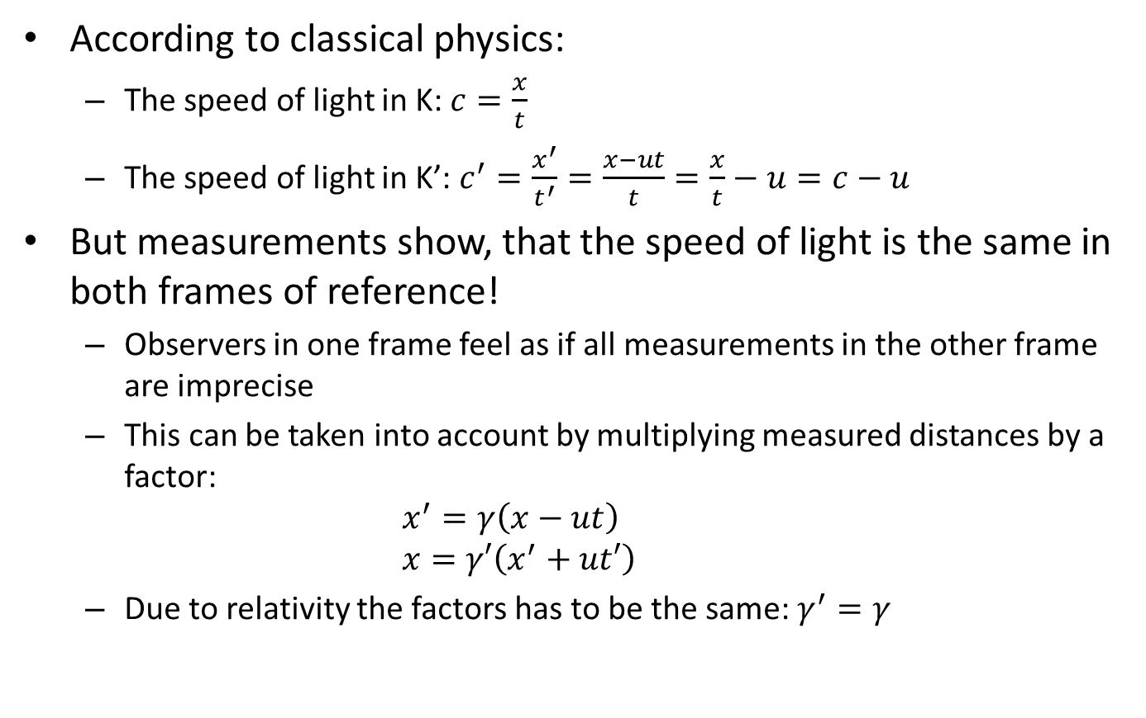
Special Theory of Relativity
According to classical physics:
The speed of light in K: $c=\frac{x}{t}$
The speed of light in K’: $c^{′}=\frac{x^{′}}{t^{′}}=\frac{x−ut}{t}=\frac{x}{t}−u=c−u$
But measurements show, that the speed of light is the same in both frames of reference!
Observers in one frame feel as if all measurements in the other frame are imprecise
This can be taken into account by multiplying measured distances by a factor: $x^{′}=γ\left(x−ut\right)$ $x=γ′\left(x^{′}+ut′\right)$
Due to relativity the factors has to be the same: $γ^{′}=γ$

Slide 38




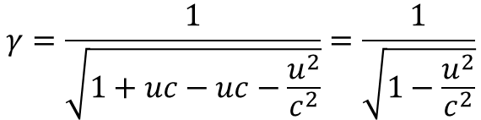
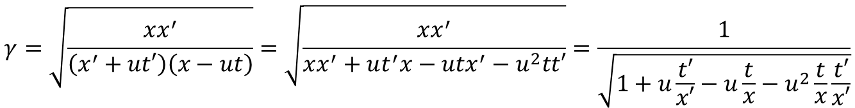
Special Theory of Relativity
$$xx^{′}=γ^{2}\left(x^{′}+ut′\right)\left(x−ut\right)$$
$$γ=\sqrt{\frac{xx^{′}}{\left(x^{′}+ut′\right)\left(x−ut\right)}}=\sqrt{\frac{xx^{′}}{xx^{′}+ut^{′}x−utx^{′}−u^{2}tt′}}=\frac{1}{\sqrt{1+u\frac{t′}{x′}−u\frac{t}{x}−u^{2}\frac{t}{x}\frac{t′}{x′}}}$$
But the speed of light is the same in both frames: $\frac{t′}{x′}=\frac{t}{x}=\frac{1}{c}$
From this:
$$γ=\frac{1}{\sqrt{1+uc−uc−\frac{u^{2}}{c^{2}}}}=\frac{1}{\sqrt{1−\frac{u^{2}}{c^{2}}}}$$
$$t^{′}=\frac{t−\frac{ux}{c^{2}}}{\sqrt{1−\frac{u^{2}}{c^{2}}}}$$
$$x^{′}=\frac{x−ut}{\sqrt{1−\frac{u^{2}}{c^{2}}}}$$

Slide 39
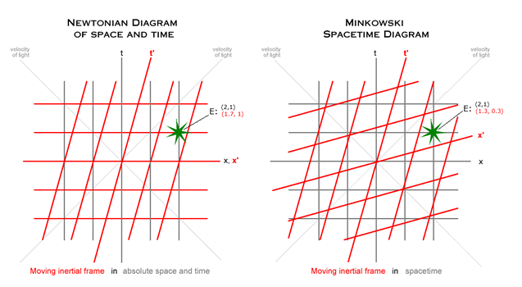
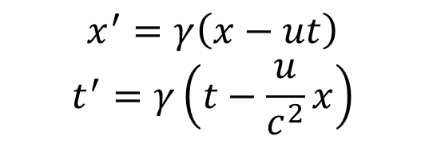

Special Theory of Relativity
Galilei transformation
Lorentz transformation
$$x^{′}=x−ut$$
$$t^{′}=t$$
$$x^{′}=γ\left(x−ut\right)$$
$$t^{′}=γ\left(t−\frac{u}{c^{2}}x\right)$$
Source of figure: http://www.twow.net/ObjText/OtkCaLbStrB.htm

Slide 40
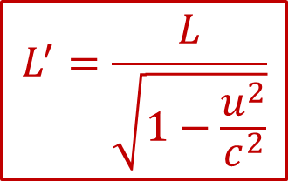
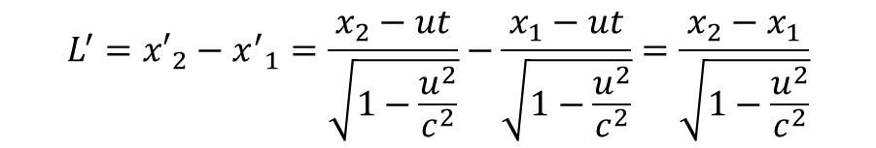
Lorentz-Fitzgerald contraction
K’
K
K: (x₁, t)
L
K: (x₂, t)
K’: (x’₁, t’)
L’
K’: (x’₂, t’)
$$L^{′}={x′}_{2}−{x^{′}}_{1}=\frac{x_{2}−ut}{\sqrt{1−\frac{u^{2}}{c^{2}}}}−\frac{x_{1}−ut}{\sqrt{1−\frac{u^{2}}{c^{2}}}}=\frac{x_{2}−x_{1}}{\sqrt{1−\frac{u^{2}}{c^{2}}}}$$
$$L^{′}=\frac{L}{\sqrt{1−\frac{u^{2}}{c^{2}}}}$$

Slide 41
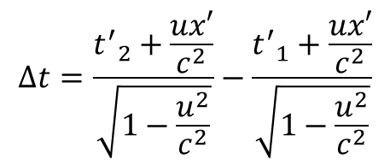

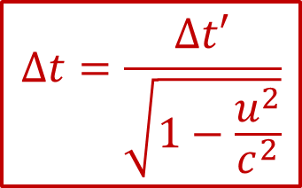
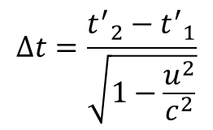
Time dialation
$$Δt=t_{2}−t_{1}$$
$$Δt=\frac{{t^{′}}_{2}+\frac{ux′}{c^{2}}}{\sqrt{1−\frac{u^{2}}{c^{2}}}}−\frac{{t^{′}}_{1}+\frac{ux′}{c^{2}}}{\sqrt{1−\frac{u^{2}}{c^{2}}}}$$
$$Δt=\frac{{t^{′}}_{2}−{t^{′}}_{1}}{\sqrt{1−\frac{u^{2}}{c^{2}}}}$$
$$Δt=\frac{Δt′}{\sqrt{1−\frac{u^{2}}{c^{2}}}}$$

Slide 42

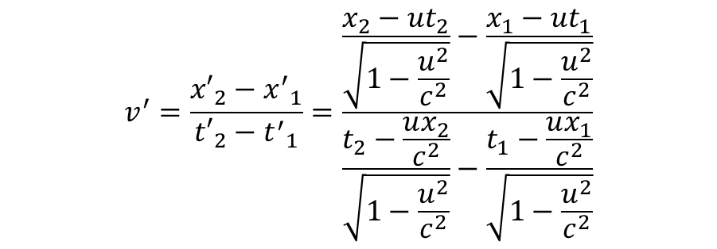
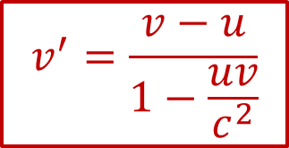

Velocity addition
$$v^{′}=\frac{{x′}_{2}−{x^{′}}_{1}}{{t′}_{2}−{t^{′}}_{1}}=\frac{\frac{x_{2}−ut_{2}}{\sqrt{1−\frac{u^{2}}{c^{2}}}}−\frac{x_{1}−ut_{1}}{\sqrt{1−\frac{u^{2}}{c^{2}}}}}{\frac{t_{2}−\frac{ux_{2}}{c^{2}}}{\sqrt{1−\frac{u^{2}}{c^{2}}}}−\frac{t_{1}−\frac{ux_{1}}{c^{2}}}{\sqrt{1−\frac{u^{2}}{c^{2}}}}}$$
$$v^{′}=\frac{{x′}_{2}−{x^{′}}_{1}}{{t′}_{2}−{t^{′}}_{1}}=\frac{x_{2}−ut_{2}−\left(x_{1}−ut_{1}\right)}{t_{2}−\frac{ux_{2}}{c^{2}}−\left(t_{1}−\frac{ux_{1}}{c^{2}}\right)}$$
$$v^{′}=\frac{{x′}_{2}−{x^{′}}_{1}}{{t′}_{2}−{t^{′}}_{1}}=\frac{Δx−uΔt}{Δt−\frac{u}{c^{2}}Δx}$$
$$v^{′}=\frac{v−u}{1−\frac{uv}{c^{2}}}$$

Slide 43
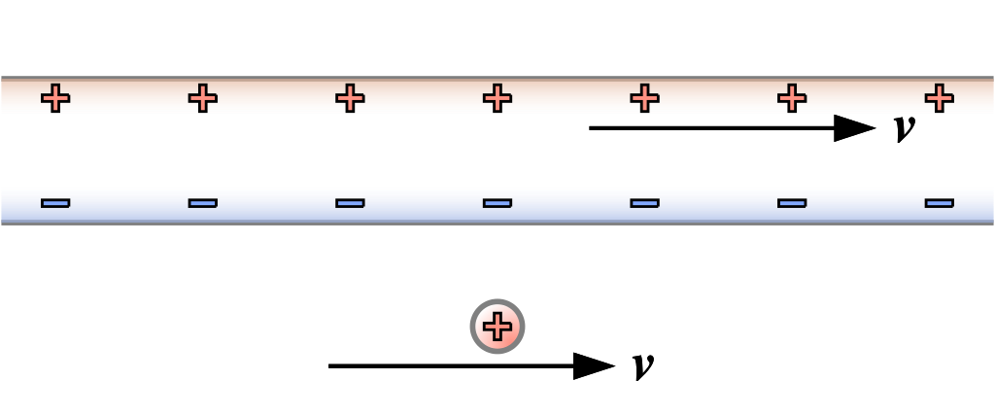
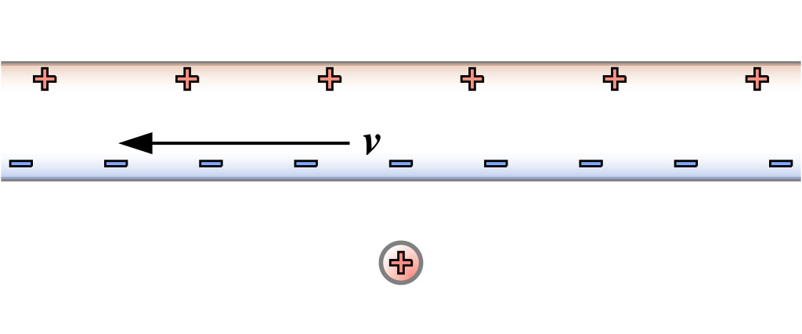
Origin of magnetism
Imagine that a current is flowing in a wire and a positive test charge is flying in the same direction
The same phenomena may be described from the laboratory frame ant the comoving frame
In the laboratory frame a Lorentz force is acting on the test charge due to the magnetic field of the wire
In the comoving frame an electrostatic force is acting on the test charge (It is at rest in this frame, and feels no magnetic force…)
The two description should give the same result…
Source of figures: www.wikipedia.org

Slide 44








$$F=q\left(E+v×B\right)$$
The wire has a neutral charge
The linear charge densities of the + and - charges are the same
There is no electrostatic force
Due to Lorentz contraction, the distance between both + and - charges change
Charge densities also change, thus the wire has a negative charge
$$l_{−}=l\sqrt{1−\frac{v^{2}}{c^{2}}}$$
$$l_{+}=\frac{l}{\sqrt{1−\frac{v^{2}}{c^{2}}}}$$
$$F=Qv×B$$
$$B_{t}=\frac{μ_{0}I}{2πr}$$
$$F_{m}=\frac{μ_{0}QvI}{2πr}$$
$$λ= \frac{q}{l_{+}}−\frac{q}{l_{−}}=\frac{q}{l}\left(\sqrt{1−\frac{v^{2}}{c^{2}}}−\frac{l}{\sqrt{1−\frac{v^{2}}{c^{2}}}}\right)≈−\frac{q}{l}\frac{v^{2}}{c^{2}}$$
$$F_{e}=QE=Q\frac{λ}{2πε_{0}r}≈\frac{Qqv^{2}}{2πε_{0}c^{2}rl}$$
$$=\frac{μ_{0}QvI}{2πr}$$
Source of figures: www.wikipedia.org

Slide 45

Relativistic momentum and mass
Consider a particle moving with u velocity with respect to the observer
$t=γτ$, where $τ$ is the proper time (= the time measured in the co-moving frame)
$p=m_{0}\frac{dx}{dτ}$=$m_{0}\frac{dx}{dt}\frac{dt}{dτ}=m_{0}\frac{dx}{dt}γ=m_{0}uγ=\frac{m_{0}u}{\sqrt{1−\frac{u^{2}}{c^{2}}}}$
As u approaches c, p approaches infinity: $p\overset{→}{u→c}∞$
The velocity can not exceed the speed of light
As the velocity approaches the speed of light, it becomes increasingly harder to keep accelerating the body
It feels as if the mass is increasing
Relativistic mass: $m=m_{0}γ=\frac{m_{0}}{\sqrt{1−\frac{u^{2}}{c^{2}}}}$

Slide 46

Relativistc energy
$$E_{k}=\int{Fdx}=\int{\frac{dp}{dt}vdt}=\int{v⋅dp}$$
$$E_{k}=\int{v⋅dp}=\int{v⋅d\left(m_{0}γv\right)}=m_{0}γv⋅v−\int{m_{0}γv⋅dv}$$
$$E_{k}=m_{0}γv^{2}−\frac{m_{0}}{2}\int{γ⋅d\left(v^{2}\right)}$$
$$E_{k}=m_{0}γv^{2}−\frac{−m_{0}c^{2}}{2}\int{γ⋅d\left(1−\frac{v^{2}}{c^{2}}\right)}$$
$$E_{k}=m_{0}γv^{2}−\frac{−m_{0}c^{2}}{2}\int{{\left(1−\frac{v^{2}}{c^{2}}\right)}^{−1/2}⋅d\left(1−\frac{v^{2}}{c^{2}}\right)}$$
$$E_{k}=m_{0}γv^{2}+m_{0}c^{2}{\left(1−\frac{v^{2}}{c^{2}}\right)}^{1/2}−E_{0}$$
$$E_{k}=m_{0}γ\left[v^{2}+c^{2}\left(1−\frac{v^{2}}{c^{2}}\right)\right]−E_{0}$$
$$E_{k}=m_{0}γ\left[v^{2}+c^{2}−v^{2}\right]−E_{0}=m_{0}γc^{2}−E_{0}$$

Slide 47





Relativistc energy
$$E_{k}=m_{0}γc^{2}−E_{0}$$
$$if v=0 \underset{⇒}{} γ=1 and E_{k}=0 \underset{⇒}{} E_{0}=m_{0}c^{2}$$
$$E_{k}=\frac{m_{0}c^{2}}{\sqrt{1−\frac{v^{2}}{c^{2}}}}−m_{0}c^{2}$$
$$p=\frac{m_{0}v}{\sqrt{1−\frac{v^{2}}{c^{2}}}}$$
$$m_{rel}=\frac{m_{0}}{\sqrt{1−\frac{v^{2}}{c^{2}}}}$$
Low velocity limit (classical mechanics):
$$E_{k}=\frac{m_{0}}{\sqrt{1−\frac{v^{2}}{c^{2}}}}−m_{0}c^{2}≈m_{0}c^{2}\left(1+\frac{1}{2}\frac{v^{2}}{c^{2}}\right)−m_{0}c^{2}=\frac{1}{2}m_{0}v^{2}$$

Slide 48

Twin paradox
Source of figure: https://en.wikipedia.org/wiki/Twin_paradox

Slide 49

Relativistic Doppler Effect
Imagine, that the light source and the observer are moving away from each other at some $v$ velocity
Description form the source’s point of view:
When a wavefront arrives to the observer, the next one is $λ$ distance away ($λ$ is the wavelength of the light)
It requires $t$ time to arrive: $t_{s}=\frac{λ}{c−v}=\frac{c}{\left(c−v\right)f}=\frac{1}{\left(1−\frac{v}{c}\right)f}$
The observer will measure this time to be:
$$t_{o}=t_{s}\sqrt{1−\frac{v^{2}}{c^{2}}}=\frac{1}{\left(1−\frac{v}{c}\right)f}\sqrt{1−\frac{v^{2}}{c^{2}}}=\sqrt{\frac{1+\frac{v}{c}}{1−\frac{v}{c}}}\frac{1}{f_{s}}$$
$$f_{o}=\sqrt{\frac{1−\frac{v}{c}}{1+\frac{v}{c}}}f_{s}$$

