Slide 1
QUANTUM PHYSICS

Slide 2
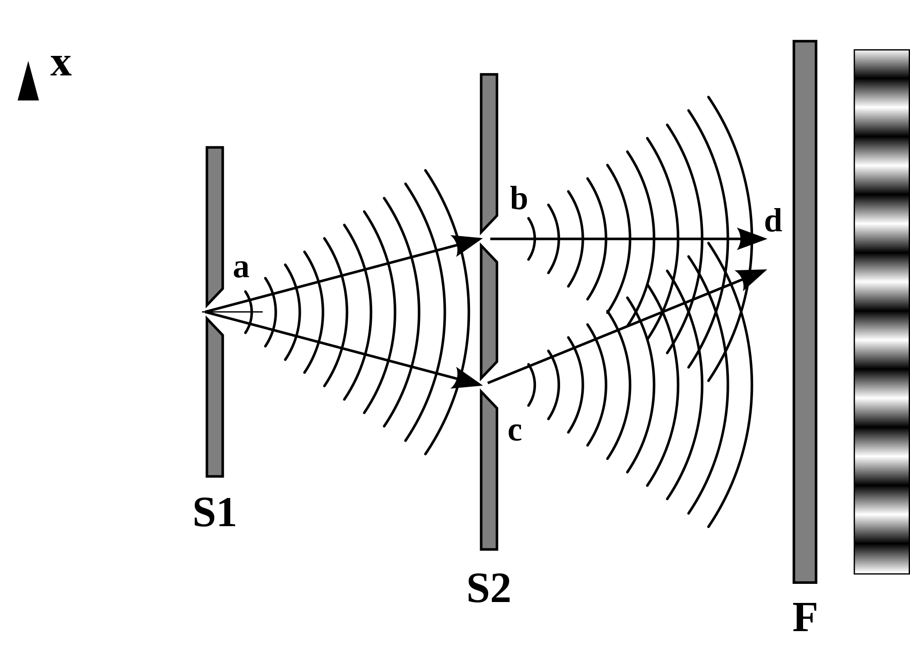
Double slit experiment
Young (1803): Light is a wave
Source of figure: www.wikipedia.org

Slide 3
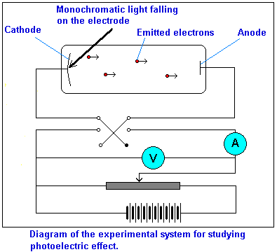
Photoelectric effect
Source of figure: http://library.thinkquest.org/28383/nowe_teksty/htmla/2_8a.html

Slide 4
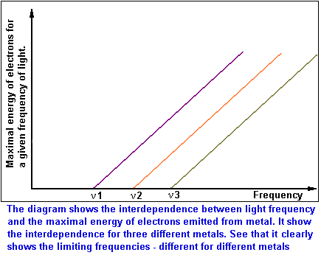
Photoelectric effect
No time lag
Increasing light intensity → The maximal energy of electrons does not change → The number of electrons increase
Red light → No electron emission (light intensity doesn’t matter)
Weak UV light → Emission of a few high energy electrons
Minimal frequency is different for different metals
Maximal electron energy is a linear function of the frequency
Source of figure: http://library.thinkquest.org/28383/nowe_teksty/htmla/2_8a.html

Slide 5
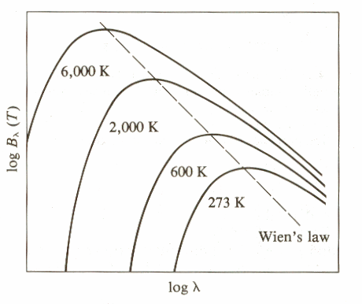
Blackbody radiation
Kirchoff:
Stefan-Boltzmann:
Wien:

Slide 6
Blackbody radiation
Rayleigh and Jeans
Electromagnetic waves inside a cavity
Thermal equilibrium
Standing waves inside the cavity
3 dimensions:

Slide 7
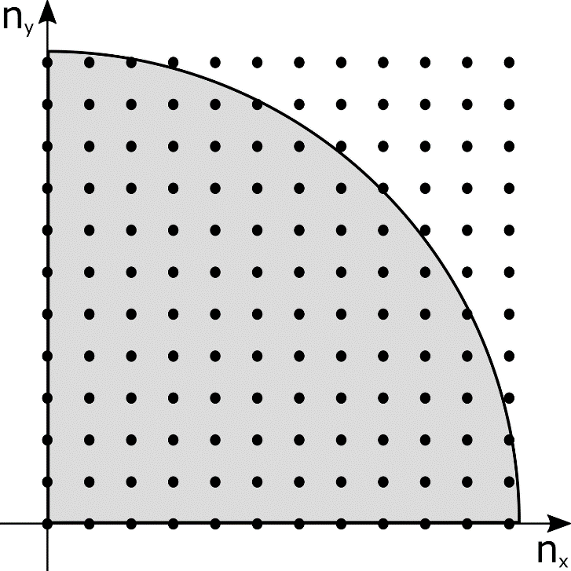
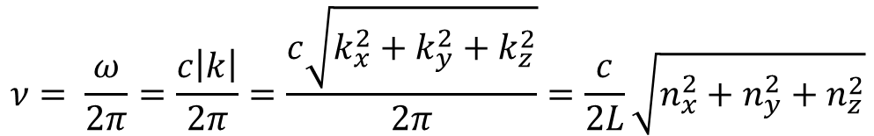
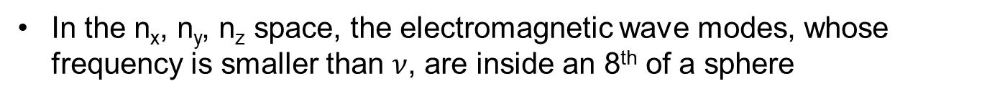

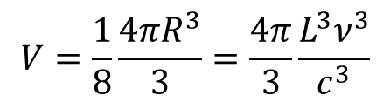
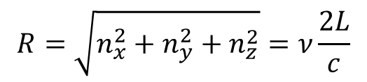
The frequency of an electromagnetic wave is:
$$ν= \frac{ω}{2π}=\frac{c\left|k\right|}{2π}=\frac{c\sqrt{k_{x}^{2}+k_{y}^{2}+k_{z}^{2}}}{2π}=\frac{c}{2L}\sqrt{n_{x}^{2}+n_{y}^{2}+n_{z}^{2}}$$
In the n_{x}, n_{y}, n_{z} space, the electromagnetic wave modes, whose frequency is smaller than $ν$, are inside an 8th of a sphere
$$R=\sqrt{n_{x}^{2}+n_{y}^{2}+n_{z}^{2}}=ν\frac{2L}{c}$$
$$V=\frac{1}{8}\frac{4πR^{3}}{3}=\frac{4π}{3}\frac{L^{3}ν^{3}}{c^{3}}$$
Electromagnetic waves are transverse waves → 2 independent polarizations belong to each point of the n_{x}, n_{y}, n_{z} space
The number of modes:
$$Z=\frac{8π}{3}\frac{L^{3}ν^{3}}{c^{3}}$$

Slide 8

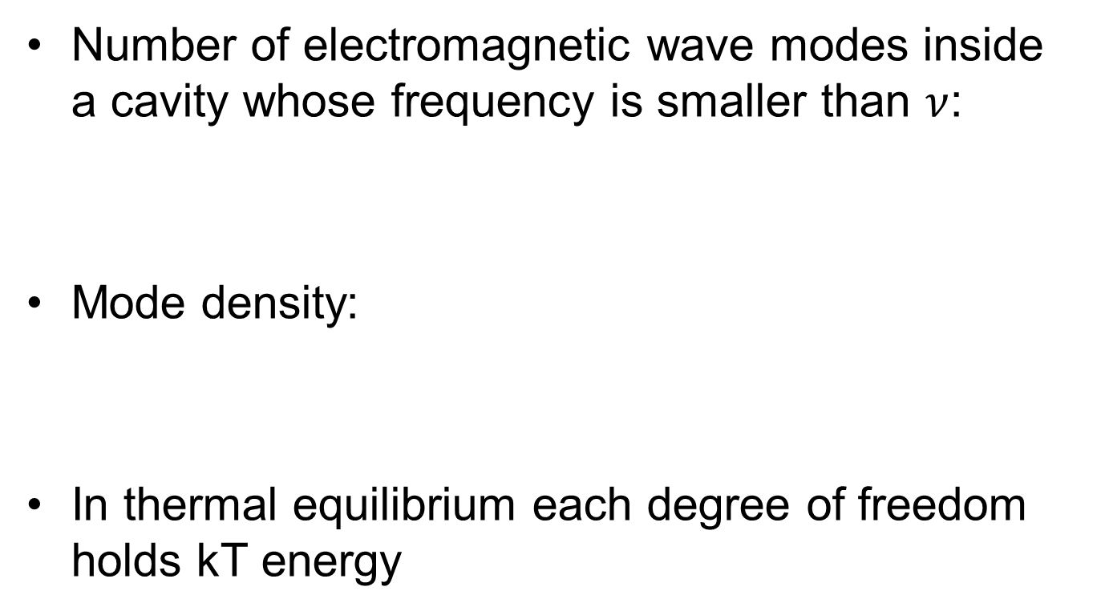
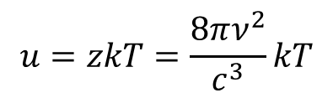
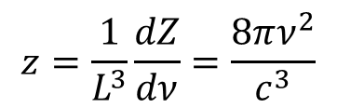
Rayleigh-Jeans
Number of electromagnetic wave modes inside a cavity whose frequency is smaller than $ν$:
Mode density:
In thermal equilibrium each degree of freedom holds kT energy
$$Z=\frac{8π}{3}\frac{L^{3}ν^{3}}{c^{3}}$$
$$z=\frac{1}{L^{3}}\frac{dZ}{dν}=\frac{8πν^{2}}{c^{3}}$$
$$u=zkT=\frac{8πν^{2}}{c^{3}}kT$$

Slide 9
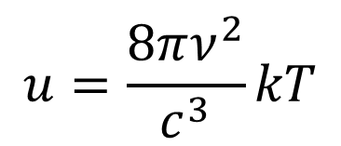
Ultraviolet catastrophe
$$u=\frac{8πν^{2}}{c^{3}}kT$$
Rayleigh-Jeans law predicts infinite emitted power

Slide 10
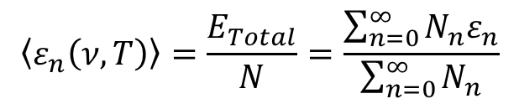
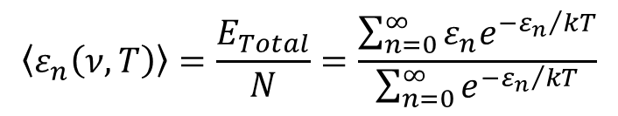
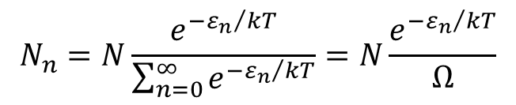
Planck (1899)
Energy of each mode is:
Average energy of a mode:
Boltzmann distribution:
Thus:
$$ε_{n}\left(ν,T\right)=nε_{0}\left(ν,T\right) n=0, 1, 2, 3,…$$
$$\left\langle ε_{n}\left(ν,T\right)\right\rangle =\frac{E_{Total}}{N}=\frac{\sum_{n=0}^{∞}{N_{n}ε_{n}}}{\sum_{n=0}^{∞}{N_{n}}}$$
$$N_{n}=N\frac{e^{−{ε_{n}}/{kT}}}{\sum_{n=0}^{∞}{e^{−{ε_{n}}/{kT}}}}=N\frac{e^{−{ε_{n}}/{kT}}}{Ω}$$
$$\left\langle ε_{n}\left(ν,T\right)\right\rangle =\frac{E_{Total}}{N}=\frac{\sum_{n=0}^{∞}{ε_{n}e^{−{ε_{n}}/{kT}}}}{\sum_{n=0}^{∞}{e^{−{ε_{n}}/{kT}}}}$$

Slide 11
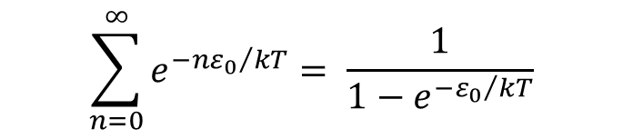
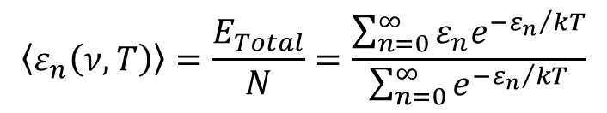
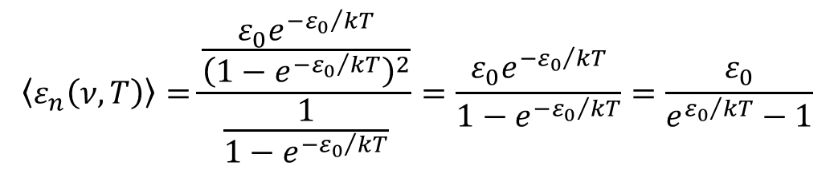
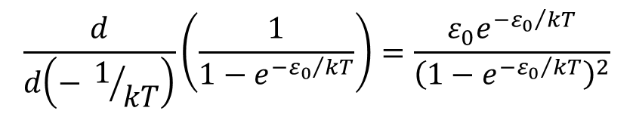
$$\left\langle ε_{n}\left(ν,T\right)\right\rangle =\frac{E_{Total}}{N}=\frac{\sum_{n=0}^{∞}{ε_{n}e^{−{ε_{n}}/{kT}}}}{\sum_{n=0}^{∞}{e^{−{ε_{n}}/{kT}}}}$$
The denominator is the sum of a geometric sequence
The nominator may be calculated by differentiating the denominator by
Thus the average energy of an oscillator is:
$$\sum_{n=0}^{∞}{e^{−{{nε}_{0}}/{kT}}}= \frac{1}{1−e^{−{ε_{0}}/{kT}}}$$
$$\frac{d}{d\left(− 1/{kT}\right)}\left(\frac{1}{1−e^{−{ε_{0}}/{kT}}}\right)=\frac{ε_{0}e^{−{ε_{0}}/{kT}}}{{\left(1−e^{−{ε_{0}}/{kT}}\right)}^{2}}$$
$$\left\langle ε_{n}\left(ν,T\right)\right\rangle =\frac{\frac{ε_{0}e^{−{ε_{0}}/{kT}}}{{\left(1−e^{−{ε_{0}}/{kT}}\right)}^{2}}}{\frac{1}{1−e^{−{ε_{0}}/{kT}}}}=\frac{ε_{0}e^{−{ε_{0}}/{kT}}}{1−e^{−{ε_{0}}/{kT}}}=\frac{ε_{0}}{e^{{ε_{0}}/{kT}}−1}$$

Slide 12
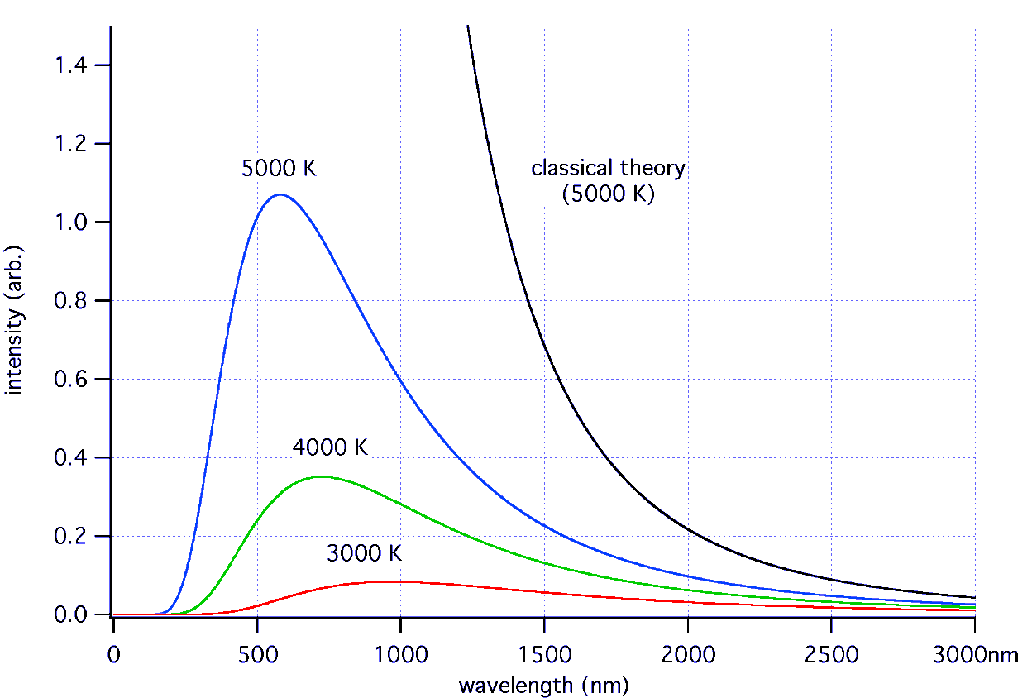
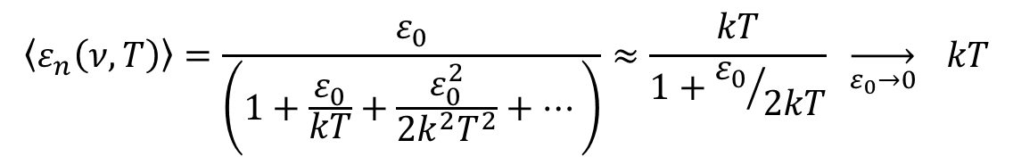

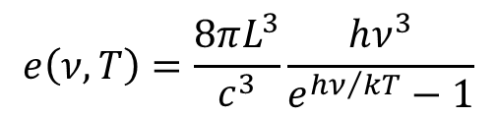
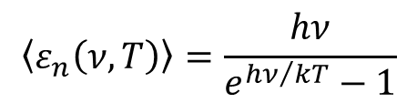
Planck:${ ε}_{0}=hν$
Classical limit: $ε_{0}→0$
$$\left\langle ε_{n}\left(ν,T\right)\right\rangle =\frac{hν}{e^{{hν}/{kT}}−1}$$
$$e\left(ν,T\right)=\frac{8πL^{3}}{c^{3}}\frac{hν^{3}}{e^{{hν}/{kT}}−1}$$
$$\left\langle ε_{n}\left(ν,T\right)\right\rangle =\frac{ε_{0}}{\left(1+\frac{ε_{0}}{kT}+\frac{ε_{0}^{2}}{2k^{2}T^{2}}+…\right)}≈\frac{kT}{1+{ε_{0}}/{2kT}} \overset{→}{ε_{0}→0} kT$$

Slide 13
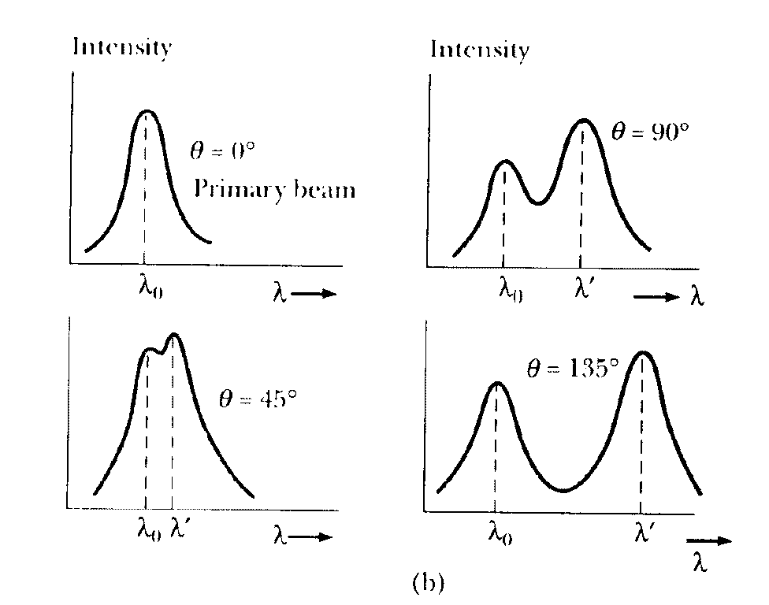
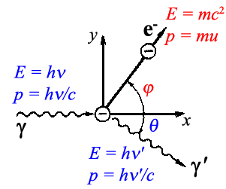
Compton effect
Source of figures: http://faculty.gvsu.edu/majumdak/public_html/OnlineMaterials/ModPhys/QM/Compton/Comptonpeaks.gif
http://www.chem.elte.hu/sandor.nagy/NewClearGlossy/Java/Compton_HU/compton.gif

Slide 14
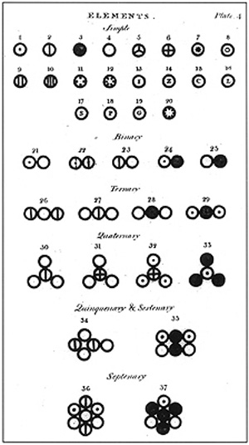
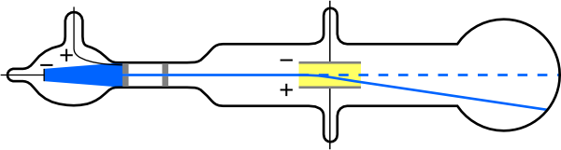
Atomic theory
Democtritus
Lavoisier: chemical elements
Dalton: Atoms
J. J. Thomson: cathode rays
→ Plum pudding model
Source of figures: www.wikipedia.org

Slide 15
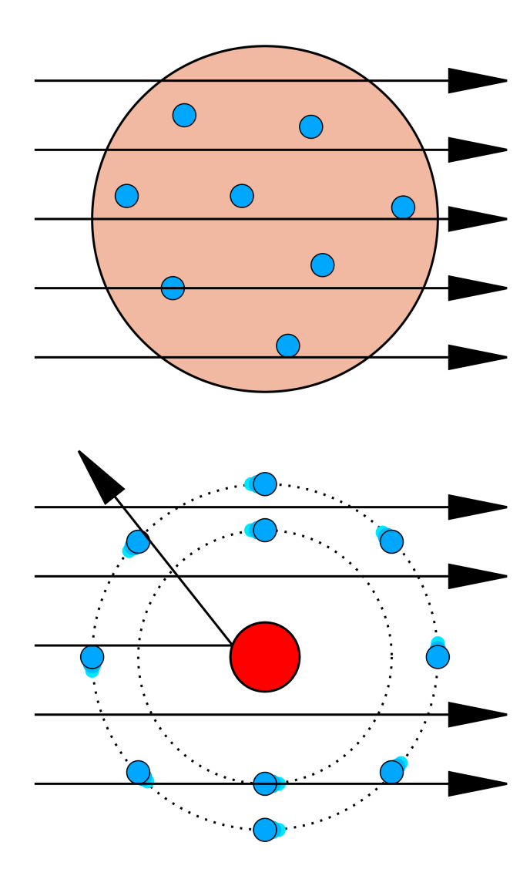
Atomic theory
Democtritus
Lavoisier: chemical elements
Dalton: Atoms
J. J. Thomson: cathode rays
→ Plum pudding model
Rutherford: scattering of α particles
→ + charge concentrated to the center of the atom
Source of figures: www.wikipedia.org

Slide 16
Atomic theory
Democtritus
Lavoisier: chemical elements
Dalton: Atoms
J. J. Thomson: cathode rays
→ Plum pudding model
Rutherford: scattering of α particles
→ + charge concentrated to the center of the atom
Bohr: Electrons orbiting around the core should produce electromagnetic radiation, loose energy and fell into the core…
Source of figures: http://library.thinkquest.org/28383/nowe_teksty/htmla/2_12a.html

Slide 17
Atomic theory

Slide 18
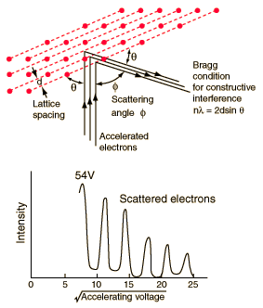
Davison-Germer experiment
Einstein:
For a foton: (m₀ = 0)
Bragg law:
de Broglie:
Source of figure: http://hyperphysics.phy-astr.gsu.edu/hbase/quantum/davger2.html

Slide 19
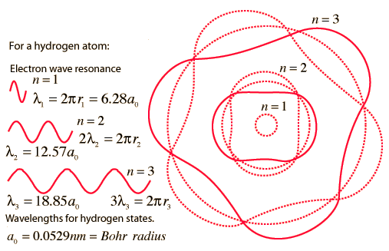
Bohr model
Source of figure: http://hyperphysics.phy-astr.gsu.edu/Hbase/bohr.html#c4

Slide 20
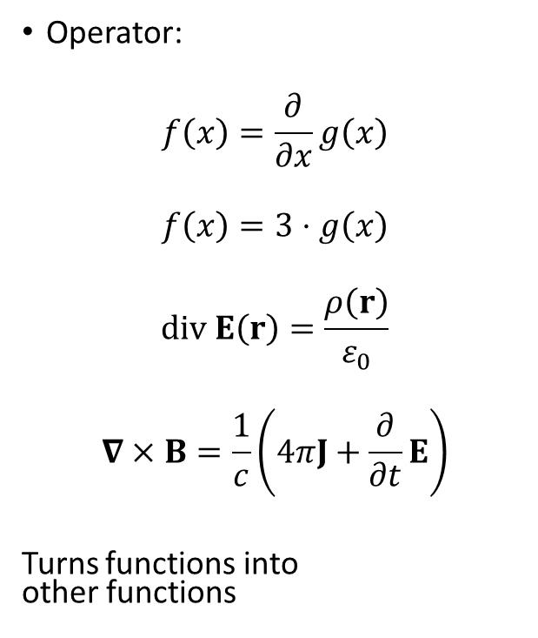
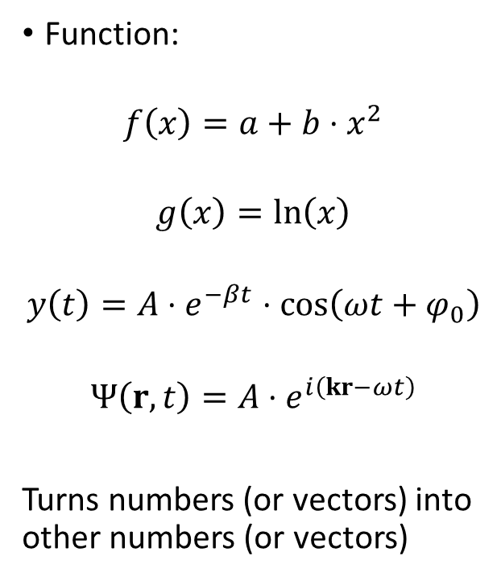
Function:
$$f\left(x\right)=a+b⋅x^{2}$$
$$g\left(x\right)=\ln\left(x\right)$$
$$y\left(t\right)=A⋅e^{−βt}⋅\cos\left(ωt+φ_{0}\right)$$
$$Ψ\left(r,t\right)=A⋅e^{i\left(kr−ωt\right)}$$
Turns numbers (or vectors) into other numbers (or vectors)
Operator:
$$f\left(x\right)=\frac{∂}{∂x}g\left(x\right)$$
$$f\left(x\right)=3⋅g\left(x\right)$$
$$div E\left(r\right)=\frac{ρ\left(r\right)}{ε_{0}}$$
$$∇×B=\frac{1}{c}\left(4πJ+\frac{∂}{∂t}E\right)$$
Turns functions into other functions

Slide 21

Eigenvalue equation
$$f\left(t\right)=e^{kt}$$
$$\frac{∂}{∂t}f\left(t\right)={ke}^{kt}=kf\left(t\right)$$
$$\frac{∂}{∂t}f\left(t\right)=kf\left(t\right)$$
In general:
$$\hat{A} f=c f$$
Eigenfunction
Operator
Eigenvalue

Slide 22

Some operators, you should know:
Nabla/Del:
$$∇=\left(\frac{∂}{∂x},\frac{∂}{∂y},\frac{∂}{∂z}\right)$$
Example:
$$∇⋅E=\frac{ρ}{ε_{0}}$$
$$\left(\frac{∂}{∂x},\frac{∂}{∂y},\frac{∂}{∂z}\right)⋅\left(E_{x},E_{y},E_{z}\right)=\frac{ρ}{ε_{0}}$$
$$\frac{∂E_{x}}{∂x}+\frac{∂E_{y}}{∂y}+\frac{∂E_{z}}{∂z}=\frac{ρ}{ε_{0}}$$
Laplace:
$$Δ=∇⋅∇=\left(\frac{∂}{∂x},\frac{∂}{∂y},\frac{∂}{∂z}\right)⋅\left(\frac{∂}{∂x},\frac{∂}{∂y},\frac{∂}{∂z}\right)=\frac{∂^{2}}{∂x^{2}}+\frac{∂^{2}}{∂y^{2}}\text{+} \frac{∂^{2}}{∂z^{2}}$$
Example
$$\frac{∂^{2}u}{∂t^{2}}=c^{2}Δu$$
$$\frac{∂^{2}u}{∂t^{2}}=c^{2}\left(\frac{∂^{2}u}{∂x^{2}}+\frac{∂^{2}u}{∂y^{2}}\text{+} \frac{∂^{2}u}{∂z^{2}}\right)$$

Slide 23
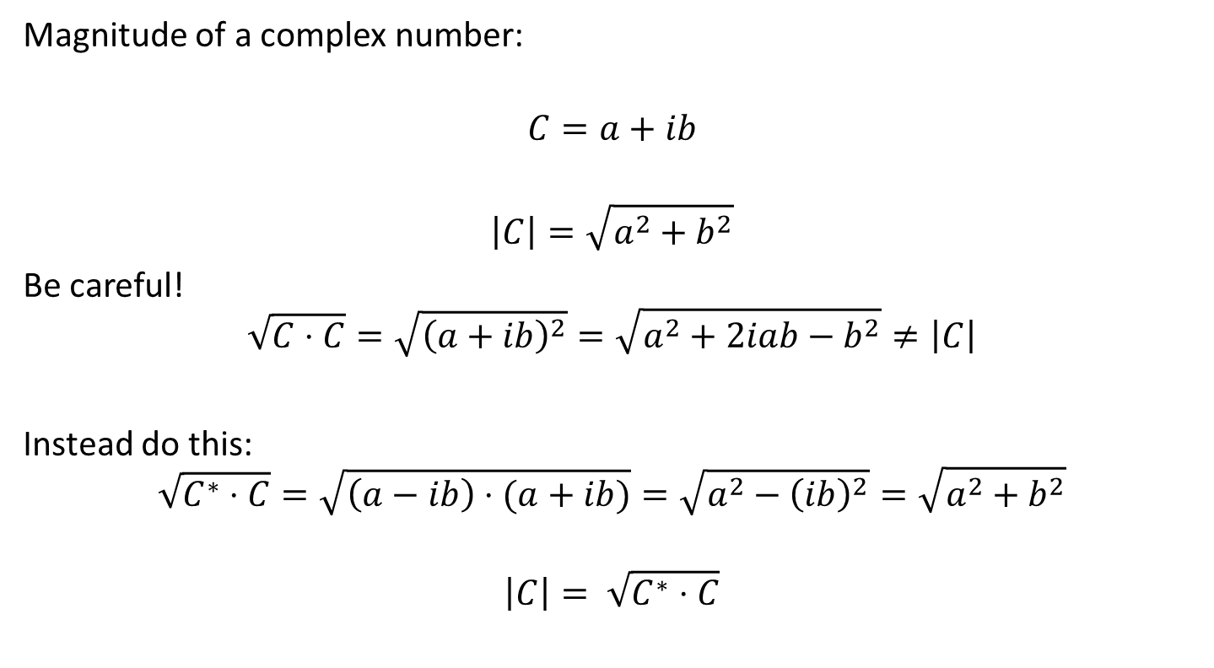
Magnitude of a complex number:
$$C=a+ib$$
$$\left|C\right|=\sqrt{a^{2}+b^{2}}$$
Be careful!
$$\sqrt{C⋅C}=\sqrt{{\left(a+ib\right)}^{2}}=\sqrt{a^{2}+2iab−b^{2}}≠\left|C\right|$$
Instead do this:
$$\sqrt{C^{∗}⋅C}=\sqrt{\left(a−ib\right)⋅(a+ib)}=\sqrt{a^{2}−{\left(ib\right)}^{2}}=\sqrt{a^{2}+b^{2}}$$
$$\left|C\right|= \sqrt{C^{∗}⋅C}$$

Slide 24
Bohr model
Source of figure: http://hyperphysics.phy-astr.gsu.edu/Hbase/bohr.html#c4

Slide 25
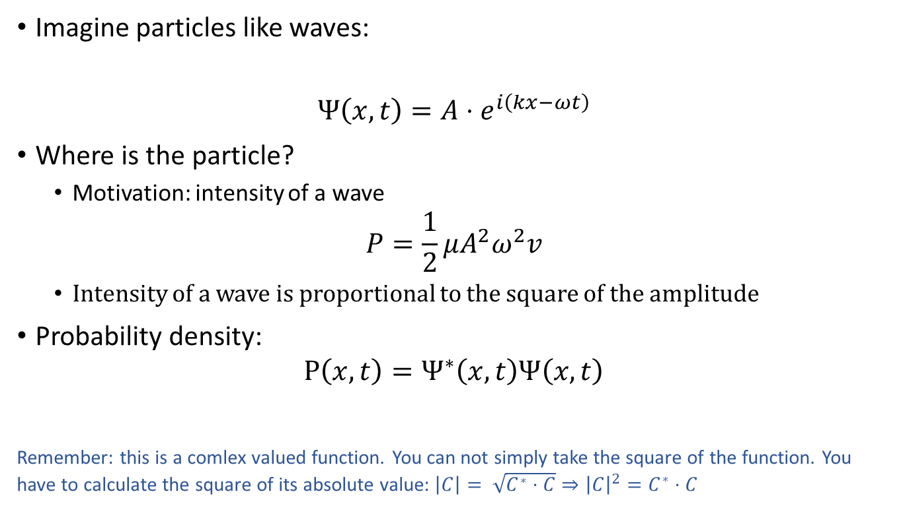
Imagine particles like waves:
$$Ψ\left(x,t\right)=A⋅e^{i\left(kx−ωt\right)}$$
Where is the particle?
Motivation: intensity of a wave
$$P=\frac{1}{2}μA^{2}ω^{2}v$$
Intensity of a wave is proportional to the square of the amplitude
Probability density:
$$P\left(x,t\right)=Ψ^{∗}\left(x,t\right)Ψ\left(x,t\right)$$
Remember: this is a comlex valued function. You can not simply take the square of the function. You have to calculate the square of its absolute value: $\left|C\right|= \sqrt{C^{∗}⋅C}⇒{\left|C\right|}^{2}=C^{∗}⋅C$

Slide 26
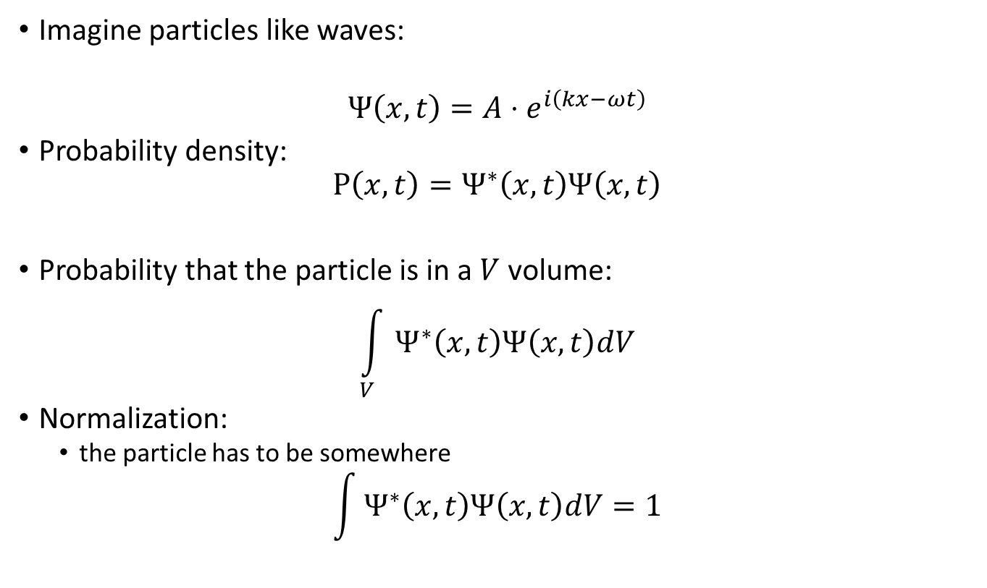
Imagine particles like waves:
$$Ψ\left(x,t\right)=A⋅e^{i\left(kx−ωt\right)}$$
Probability density:
$$P\left(x,t\right)=Ψ^{∗}\left(x,t\right)Ψ\left(x,t\right)$$
Probability that the particle is in a $V$ volume:
$$\int_{V}{Ψ^{∗}\left(x,t\right)Ψ\left(x,t\right)dV}$$
Normalization:
the particle has to be somewhere
$$\int{Ψ^{∗}\left(x,t\right)Ψ\left(x,t\right)dV}=1$$

Slide 27
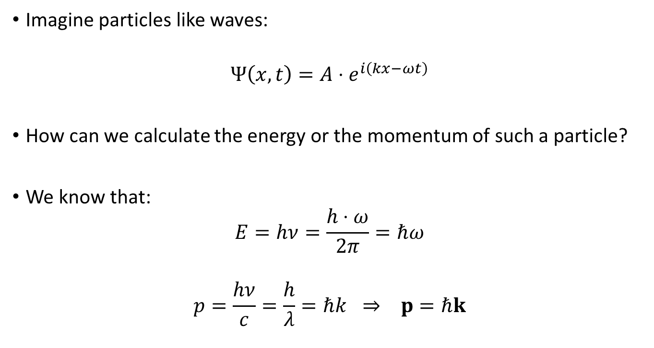
Imagine particles like waves:
$$Ψ\left(x,t\right)=A⋅e^{i\left(kx−ωt\right)}$$
How can we calculate the energy or the momentum of such a particle?
We know that:
$$E=hν=\frac{h⋅ω}{2π}=ℏω$$
$$p=\frac{hν}{c}=\frac{h}{λ}=ℏk ⇒ p=ℏk$$

Slide 28
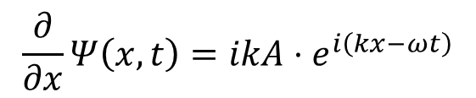

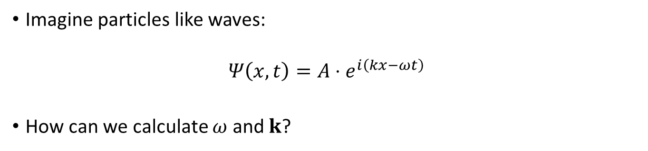
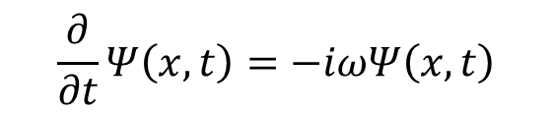
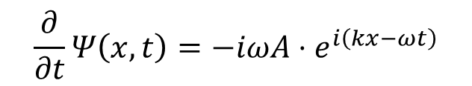
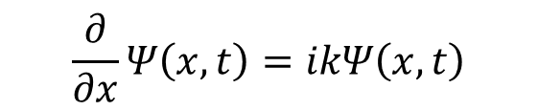
Imagine particles like waves:
$$Ψ\left(x,t\right)=A⋅e^{i\left(kx−ωt\right)}$$
How can we calculate $ω$ and $k$?
$$\frac{∂}{∂x}Ψ\left(x,t\right)=ikA⋅e^{i\left(kx−ωt\right)}$$
$$\frac{∂}{∂t}Ψ\left(x,t\right)=−iωA⋅e^{i\left(kx−ωt\right)}$$
$$\frac{∂}{∂x}Ψ\left(x,t\right)=ikΨ\left(x,t\right)$$
$$\frac{∂}{∂t}Ψ\left(x,t\right)=−iωΨ\left(x,t\right)$$
Eigenfunction
$$\hat{A}Ψ=cΨ$$
Operator
Eigenvalue

Slide 29

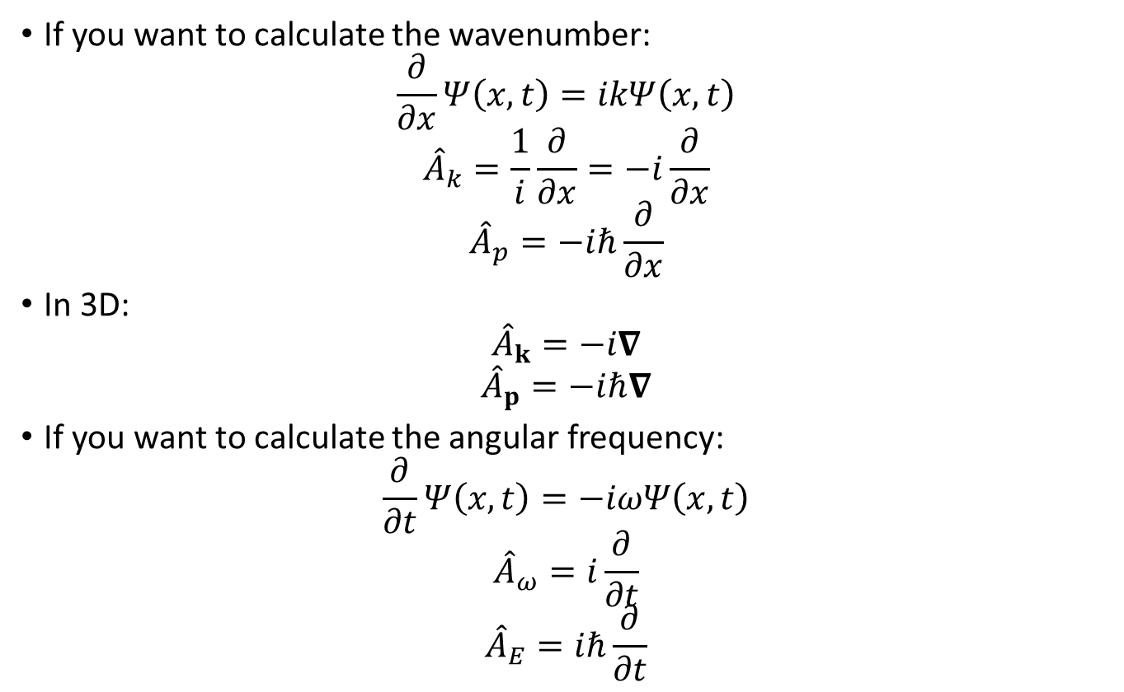
$$\hat{A}Ψ=cΨ$$
If you want to calculate the wavenumber:
$$\frac{∂}{∂x}Ψ\left(x,t\right)=ikΨ\left(x,t\right)$$
$${\hat{A}}_{k}=\frac{1}{i}\frac{∂}{∂x}=−i\frac{∂}{∂x}$$
$${\hat{A}}_{p}=−iℏ\frac{∂}{∂x}$$
In 3D:
$${\hat{A}}_{k}=−i∇$$
$${\hat{A}}_{p}=−iℏ∇$$
If you want to calculate the angular frequency:
$$\frac{∂}{∂t}Ψ\left(x,t\right)=−iωΨ\left(x,t\right)$$
$${\hat{A}}_{ω}=i\frac{∂}{∂t}$$
$${\hat{A}}_{E}=iℏ\frac{∂}{∂t}$$

Slide 30
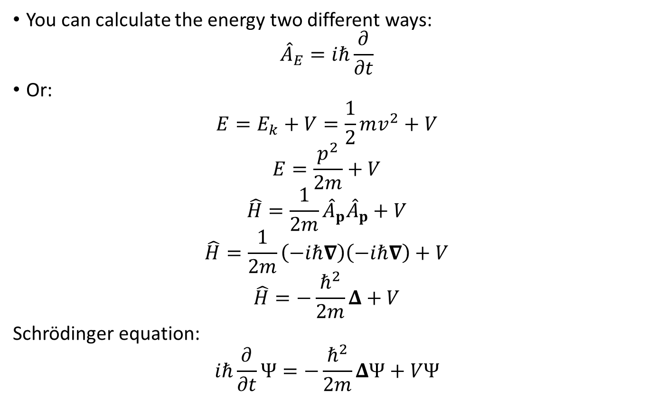
You can calculate the energy two different ways:
$${\hat{A}}_{E}=iℏ\frac{∂}{∂t}$$
Or:
$$E=E_{k}+V=\frac{1}{2}mv^{2}+V$$
$$E=\frac{p^{2}}{2m}+V$$
$$\hat{H}=\frac{1}{2m}{\hat{A}}_{p}{\hat{A}}_{p}+V$$
$$\hat{H}=\frac{1}{2m}\left(−iℏ∇\right)\left(−iℏ∇\right)+V$$
$$\hat{H}=−\frac{ℏ^{2}}{2m}Δ+V$$
Schrödinger equation:
$$iℏ\frac{∂}{∂t}Ψ=−\frac{ℏ^{2}}{2m}ΔΨ+VΨ$$

Slide 31
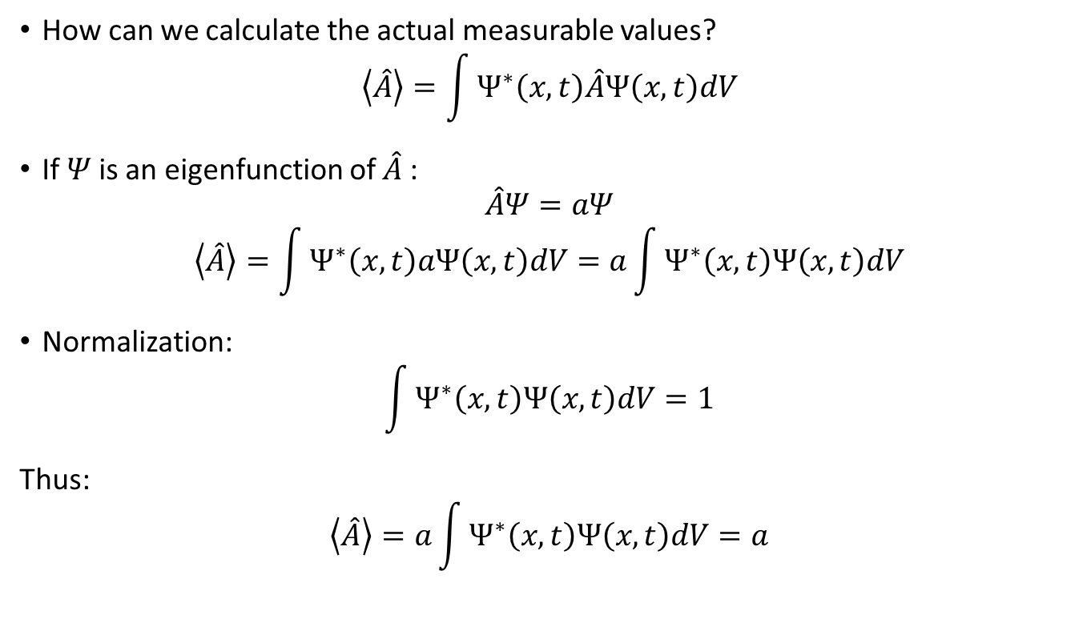
How can we calculate the actual measurable values?
$$\left\langle \hat{A}\right\rangle =\int{Ψ^{∗}\left(x,t\right)\hat{A}Ψ\left(x,t\right)dV}$$
If $Ψ$is an eigenfunction of $\hat{A}$:
$$\hat{A}Ψ=aΨ$$
$$\left\langle \hat{A}\right\rangle =\int{Ψ^{∗}\left(x,t\right)aΨ\left(x,t\right)dV}=a\int{Ψ^{∗}\left(x,t\right)Ψ\left(x,t\right)dV}$$
Normalization:
$$\int{Ψ^{∗}\left(x,t\right)Ψ\left(x,t\right)dV}=1$$
Thus:
$$\left\langle \hat{A}\right\rangle =a\int{Ψ^{∗}\left(x,t\right)Ψ\left(x,t\right)dV}=a$$

Slide 32

The Schrödinger equation is a linear differential equation:
$$iℏ\frac{∂}{∂t}Ψ=−\frac{ℏ^{2}}{2m}ΔΨ+VΨ$$
Linear combinations of of its solutions are also valid solutions:
$$Ψ=\sum{c_{i}Ψ_{i}}$$
What if we try to calculate $\left\langle \hat{A}\right\rangle$ with this wave function?
$$\left\langle \hat{A}\right\rangle =\int{Ψ^{∗}\left(x,t\right)\hat{A}Ψ\left(x,t\right)dV}$$
You may expect, that if we do a measurement, we get:
$$\left\langle \hat{A}\right\rangle =\sum{{\left|c_{i}\right|}^{2}a_{i}} where {\hat{A}Ψ}_{i}={a_{i}Ψ}_{i}$$
BUT IT IS A BIT MORE COMPLICATED…

Slide 33


$$Ψ=\sum{c_{i}Ψ_{i}}$$
$$\left\langle \hat{A}\right\rangle =\int{Ψ^{∗}\left(x,t\right)\hat{A}Ψ\left(x,t\right)dV}=\sum{{\left|c_{i}\right|}^{2}a_{i}}$$
Collapse of the wavefunction:
If we perform a measurement, the wavefunction collapses to one of the eigenfunctions
Each individual measurement gives one of the eigenvalues ($a_{i}$)
${\left|c_{i}\right|}^{2}$is the probability of getting $a_{i}$
$\left\langle \hat{A}\right\rangle =\sum{{\left|c_{i}\right|}^{2}a_{i}}$ is the average value that we get, when we perform a lot of measuements
Source of figure: www.wikipedia.org

Slide 34
Postulates
State → wave function
single-valued
finite
normalization condition:
continous
its slope must also be continous
antisymmetric with respect to the interchange of all coordinates of one fermion with those of another
For every physical observable there is a linear, Hermetian operator
In any measurement of the observable associated with an operator, the only values that will ever be obsereved are the eigenvalues of the operator The state does not have to be an eigenstate The probability of measuring a_{i} is |c_{i}|² After the measurement, the wavefunction collapses to the corresponding eignestate
The average value can be calcualted as:
The time evolution of the wavefunction is given by the time dependent Schrödinger equation
For example:

Slide 35
Time independent Schrödinger equation

Slide 36


Particle in a box
$$−\frac{ℏ^{2}}{2m}∆^{2}Ψ+V\left(\vec{r}\right)Ψ=EΨ \\ −\frac{ℏ^{2}}{2m}\frac{d^{2}Ψ}{{dx}^{2}}+V\left(\vec{r}\right)Ψ=EΨ$$
$$Ψ\left(x\right)=Ae^{jkx}+Be^{−jkx} for 0<x<L \\ Ψ\left(x\right)=0 for x<0 and x>L$$
$$To obtain Ψ=0 at x=0\underset{⇒}{}A+B=0$$
$$A=−B \underset{⇒}{} Ψ\left(x\right)=Csin\left(kx\right)$$
$$To obtain Ψ=0 at x=L\underset{⇒}{}Csin\left(kL\right)=0$$
$$k=\frac{nπ}{L} where n=1, 2, 3, … \\ E=\frac{p^{2}}{2m}=\frac{ℏ^{2}k^{2}}{2m}=\frac{ℏ^{2}n^{2}π^{2}}{2mL^{2}}$$
Source of figure: http://hyperphysics.phy-astr.gsu.edu/hbase/quantum/pbox.html

Slide 37
Phase velocity, group velocity
Velocity of a point of a given phase:

Slide 38
Phase velocity, group velocity
Superposition of two waves of slightly different frequency:
v_{g} : group velocity
v : phase velocity
Source of figure: www.wikipedia.org

Slide 39


Wave packet
Source of figures: http://hyperphysics.phy-astr.gsu.edu/hbase/waves/wpack.html
http://scienceblogs.com/principles/2007/03/basic_concepts_measurement.php

Slide 40






$$\hat{f}\left(ν\right)=ℱ\left(f\left(t\right)\right)=\int_{−∞}^{∞}{f\left(t\right)e^{−2πjtν}dt}$$
$$f\left(t\right)=\frac{1}{\sqrt{2π}σ_{t}}e^{−\frac{t^{2}}{2σ_{t}^{2}}}$$
$$\hat{f}\left(ν\right)=\int_{−∞}^{∞}{\frac{1}{\sqrt{2π}σ_{t}}e^{−\frac{t^{2}}{2σ_{t}^{2}}}e^{−2πjtν}dt}$$
$$\hat{f}\left(ν\right)=e^{−2π^{2}σ_{t}^{2}ν^{2}}$$
f’$\left(t\right)=ℱ\left(\hat{f}\left(ν+ν_{0}\right)\right)=\frac{1}{\sqrt{2π}σ_{ν}}e^{−\frac{t^{2}}{2σ_{t}^{2}}}e^{−2πjtν_{0}}$
$$σ_{t}σ_{ν}=\frac{1}{2π}$$

Slide 41
Timeline
1897 – Discovery of the electron (J.J. Thomson, Zeeman)
1900 – Explanation of blackbody radiation (Planck)
1905 – Explanation of photoeffect (Einstein)
1911 – Rutherford’s atom model
1913 – Bohr model
1923 – Compton effect
– De Broglie
1924 – Bose-Einstein statistics
1925 – Electron diffraction (Davison-Germer experiment, G.P. Thomson)
– Exclusion principle (Pauli)
– Matrix mechanics (Heisenberg, Born, Jordan)
1926 – Schrödinger equation
– Fermi-Dirac statistics
1927 – Uncertanity principle (Heisenberg)
1928 – Relativistic theory of an electron (Dirac) (Predicts antimatter)
1932 – Discovery of the positron (Anderson)
1934 – Yukawa potential
1947 – First bipolar transistor (Bardeen, Brattain, Shockley)
1948 – Quantum electrodinamics (Feynman)
1954 – First silicon transistor
1957 – BCS theory (Bardeen, Cooper, Schrieffer)
1959 – Aharonov-Bohm effect
1960 – First LASER (Maiman) (Townes, Schlawlow,…)
– First MOS transistor
1970s – Standard model
1995 – first Bose-Einstein condensate
1997 – First confirmed quantum teleportation

