Slide 1
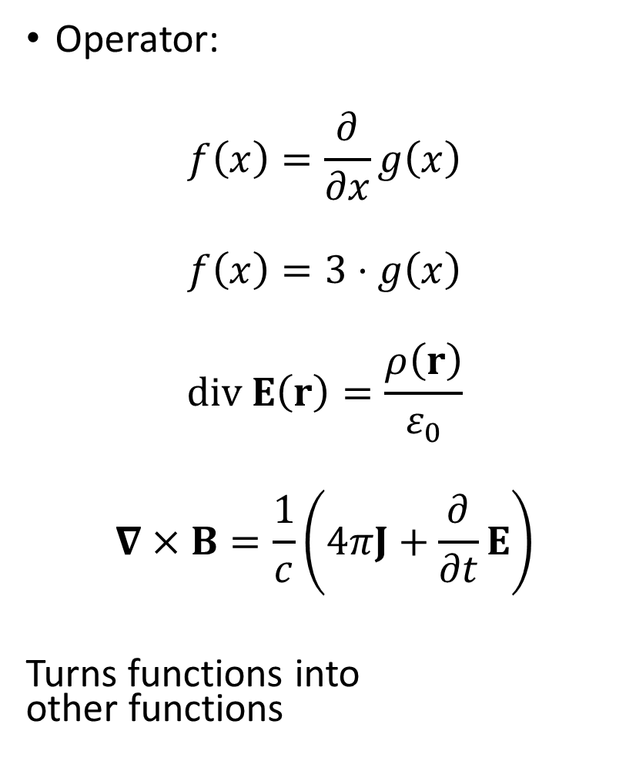
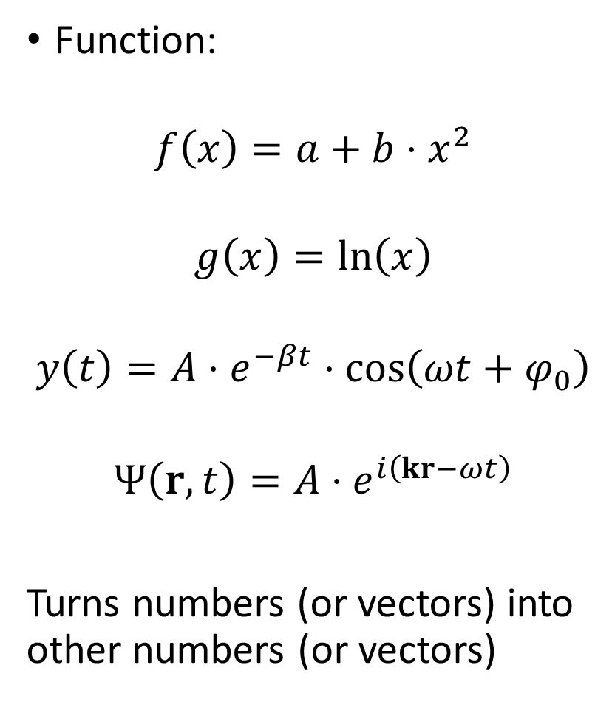
Function:
$$f\left(x\right)=a+b⋅x^{2}$$
$$g\left(x\right)=\ln\left(x\right)$$
$$y\left(t\right)=A⋅e^{−βt}⋅\cos\left(ωt+φ_{0}\right)$$
$$Ψ\left(r,t\right)=A⋅e^{i\left(kr−ωt\right)}$$
Turns numbers (or vectors) into other numbers (or vectors)
Operator:
$$f\left(x\right)=\frac{∂}{∂x}g\left(x\right)$$
$$f\left(x\right)=3⋅g\left(x\right)$$
$$div E\left(r\right)=\frac{ρ\left(r\right)}{ε_{0}}$$
$$∇×B=\frac{1}{c}\left(4πJ+\frac{∂}{∂t}E\right)$$
Turns functions into other functions

Slide 2

Eigenvalue equation
$$f\left(t\right)=e^{kt}$$
$$\frac{∂}{∂t}f\left(t\right)={ke}^{kt}=kf\left(t\right)$$
$$\frac{∂}{∂t}f\left(t\right)=kf\left(t\right)$$
In general:
$$\hat{A} f=c f$$
Eigenfunction
Operator
Eigenvalue

Slide 3

Some operators, you should know:
Nabla/Del:
$$∇=\left(\frac{∂}{∂x},\frac{∂}{∂y},\frac{∂}{∂z}\right)$$
Example:
$$∇⋅E=\frac{ρ}{ε_{0}}$$
$$\left(\frac{∂}{∂x},\frac{∂}{∂y},\frac{∂}{∂z}\right)⋅\left(E_{x},E_{y},E_{z}\right)=\frac{ρ}{ε_{0}}$$
$$\frac{∂E_{x}}{∂x}+\frac{∂E_{y}}{∂y}+\frac{∂E_{z}}{∂z}=\frac{ρ}{ε_{0}}$$
Laplace:
$$Δ=∇⋅∇=\left(\frac{∂}{∂x},\frac{∂}{∂y},\frac{∂}{∂z}\right)⋅\left(\frac{∂}{∂x},\frac{∂}{∂y},\frac{∂}{∂z}\right)=\frac{∂^{2}}{∂x^{2}}+\frac{∂^{2}}{∂y^{2}}\text{+} \frac{∂^{2}}{∂z^{2}}$$
Example
$$\frac{∂^{2}u}{∂t^{2}}=c^{2}Δu$$
$$\frac{∂^{2}u}{∂t^{2}}=c^{2}\left(\frac{∂^{2}u}{∂x^{2}}+\frac{∂^{2}u}{∂y^{2}}\text{+} \frac{∂^{2}u}{∂z^{2}}\right)$$

Slide 4

Magnitude of a complex number:
$$C=a+ib$$
$$\left|C\right|=\sqrt{a^{2}+b^{2}}$$
Be careful!
$$\sqrt{C⋅C}=\sqrt{{\left(a+ib\right)}^{2}}=\sqrt{a^{2}+2iab−b^{2}}≠\left|C\right|$$
Instead do this:
$$\sqrt{C^{∗}⋅C}=\sqrt{\left(a−ib\right)⋅(a+ib)}=\sqrt{a^{2}−{\left(ib\right)}^{2}}=\sqrt{a^{2}+b^{2}}$$
$$\left|C\right|= \sqrt{C^{∗}⋅C}$$

Slide 5
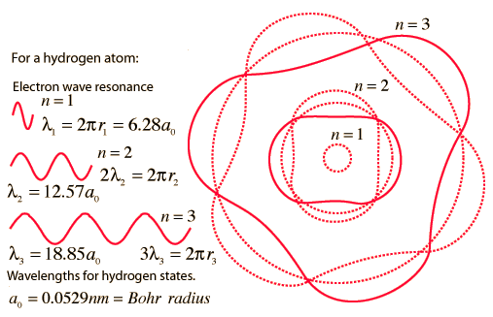
Bohr model
Source of figure: http://hyperphysics.phy-astr.gsu.edu/Hbase/bohr.html#c4

Slide 6
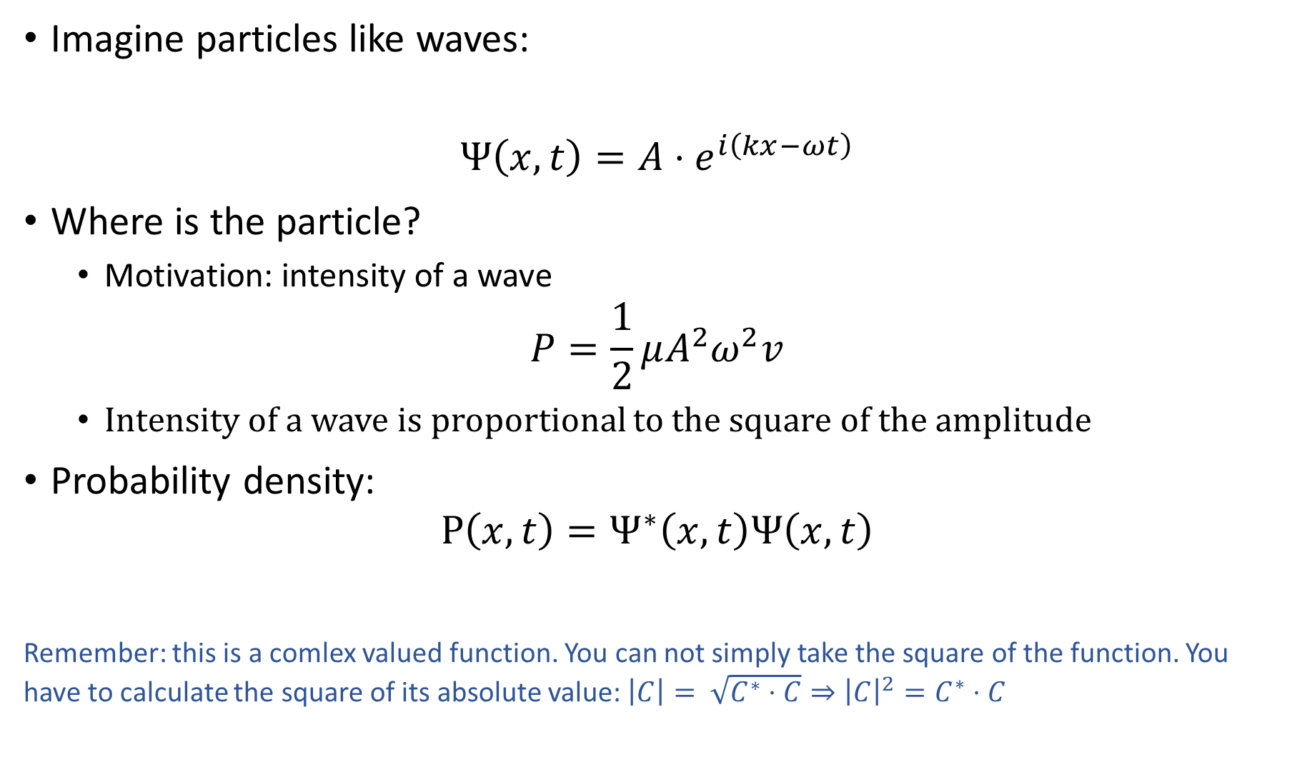
Imagine particles like waves:
$$Ψ\left(x,t\right)=A⋅e^{i\left(kx−ωt\right)}$$
Where is the particle?
Motivation: intensity of a wave
$$P=\frac{1}{2}μA^{2}ω^{2}v$$
Intensity of a wave is proportional to the square of the amplitude
Probability density:
$$P\left(x,t\right)=Ψ^{∗}\left(x,t\right)Ψ\left(x,t\right)$$
Remember: this is a comlex valued function. You can not simply take the square of the function. You have to calculate the square of its absolute value: $\left|C\right|= \sqrt{C^{∗}⋅C}⇒{\left|C\right|}^{2}=C^{∗}⋅C$

Slide 7
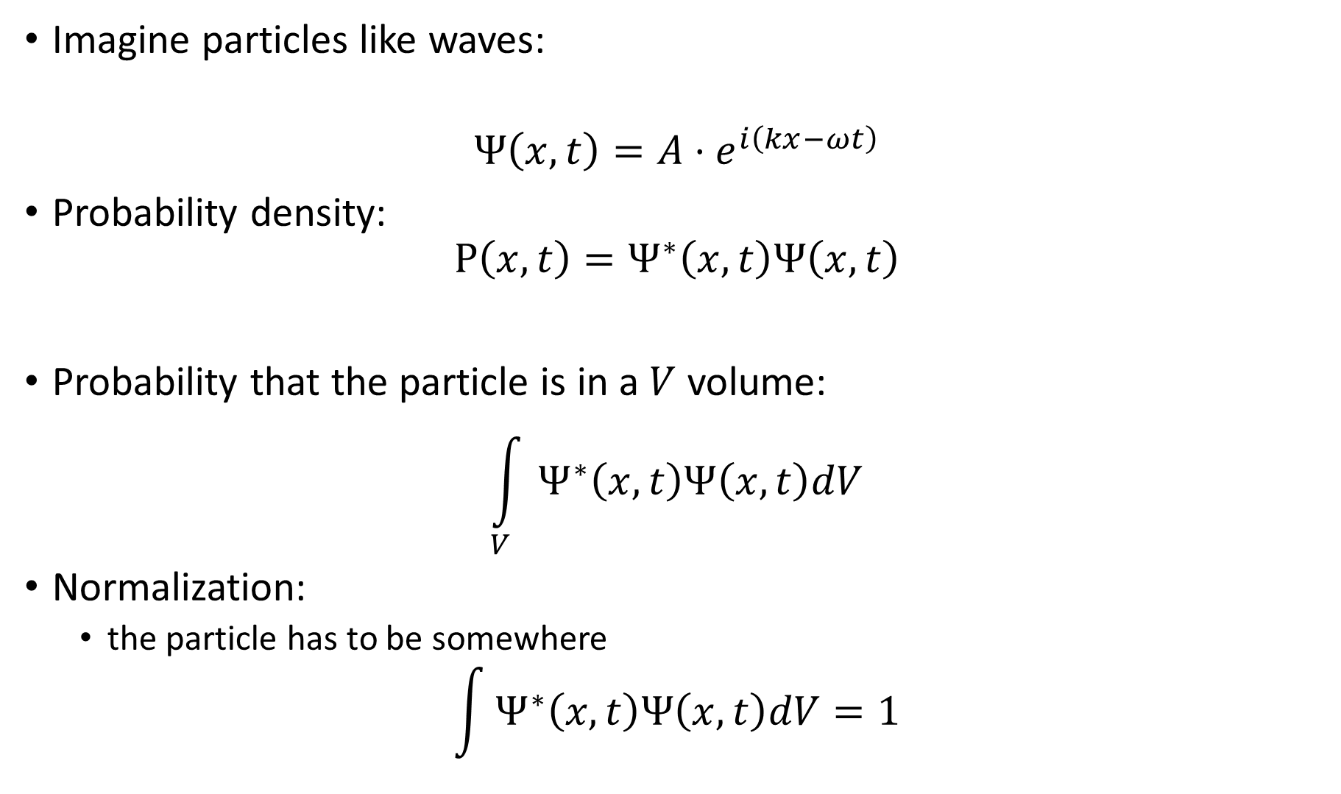
Imagine particles like waves:
$$Ψ\left(x,t\right)=A⋅e^{i\left(kx−ωt\right)}$$
Probability density:
$$P\left(x,t\right)=Ψ^{∗}\left(x,t\right)Ψ\left(x,t\right)$$
Probability that the particle is in a $V$ volume:
$$\int_{V}{Ψ^{∗}\left(x,t\right)Ψ\left(x,t\right)dV}$$
Normalization:
the particle has to be somewhere
$$\int{Ψ^{∗}\left(x,t\right)Ψ\left(x,t\right)dV}=1$$

Slide 8

Imagine particles like waves:
$$Ψ\left(x,t\right)=A⋅e^{i\left(kx−ωt\right)}$$
How can we calculate the energy or the momentum of such a particle?
We know that:
$$E=hν=\frac{h⋅ω}{2π}=ℏω$$
$$p=\frac{hν}{c}=\frac{h}{λ}=ℏk ⇒ p=ℏk$$

Slide 9
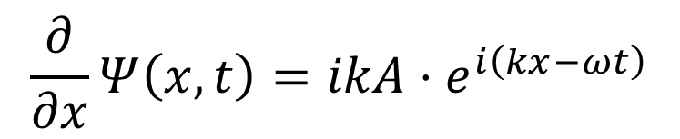

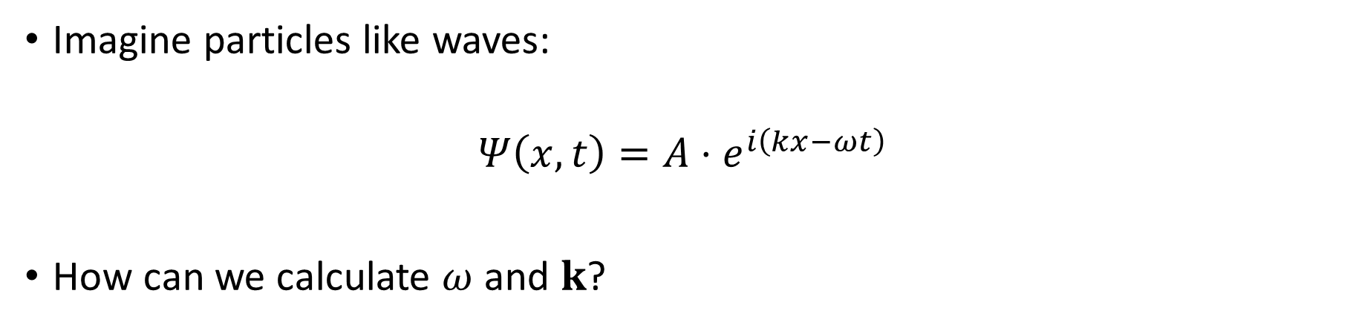
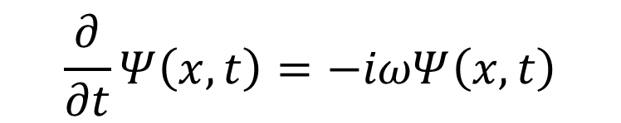
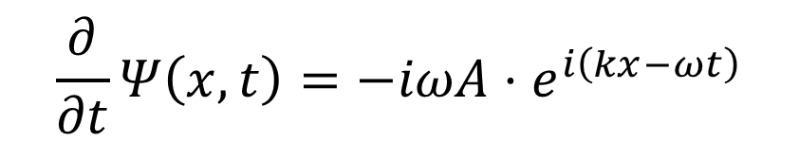
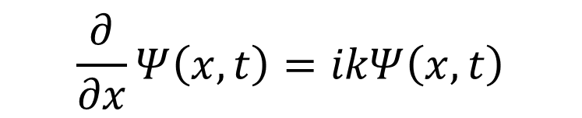
Imagine particles like waves:
$$Ψ\left(x,t\right)=A⋅e^{i\left(kx−ωt\right)}$$
How can we calculate $ω$ and $k$?
$$\frac{∂}{∂x}Ψ\left(x,t\right)=ikA⋅e^{i\left(kx−ωt\right)}$$
$$\frac{∂}{∂t}Ψ\left(x,t\right)=−iωA⋅e^{i\left(kx−ωt\right)}$$
$$\frac{∂}{∂x}Ψ\left(x,t\right)=ikΨ\left(x,t\right)$$
$$\frac{∂}{∂t}Ψ\left(x,t\right)=−iωΨ\left(x,t\right)$$
Eigenfunction
$$\hat{A}Ψ=cΨ$$
Operator
Eigenvalue

Slide 10
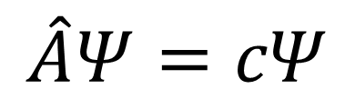

$$\hat{A}Ψ=cΨ$$
If you want to calculate the wavenumber:
$$\frac{∂}{∂x}Ψ\left(x,t\right)=ikΨ\left(x,t\right)$$
$${\hat{A}}_{k}=\frac{1}{i}\frac{∂}{∂x}=−i\frac{∂}{∂x}$$
$${\hat{A}}_{p}=−iℏ\frac{∂}{∂x}$$
In 3D:
$${\hat{A}}_{k}=−i∇$$
$${\hat{A}}_{p}=−iℏ∇$$
If you want to calculate the angular frequency:
$$\frac{∂}{∂t}Ψ\left(x,t\right)=−iωΨ\left(x,t\right)$$
$${\hat{A}}_{ω}=i\frac{∂}{∂t}$$
$${\hat{A}}_{E}=iℏ\frac{∂}{∂t}$$

Slide 11

You can calculate the energy two different ways:
$${\hat{A}}_{E}=iℏ\frac{∂}{∂t}$$
Or:
$$E=E_{k}+V=\frac{1}{2}mv^{2}+V$$
$$E=\frac{p^{2}}{2m}+V$$
$$\hat{H}=\frac{1}{2m}{\hat{A}}_{p}{\hat{A}}_{p}+V$$
$$\hat{H}=\frac{1}{2m}\left(−iℏ∇\right)\left(−iℏ∇\right)+V$$
$$\hat{H}=−\frac{ℏ^{2}}{2m}Δ+V$$
Schrödinger equation:
$$iℏ\frac{∂}{∂t}Ψ=−\frac{ℏ^{2}}{2m}ΔΨ+VΨ$$

Slide 12
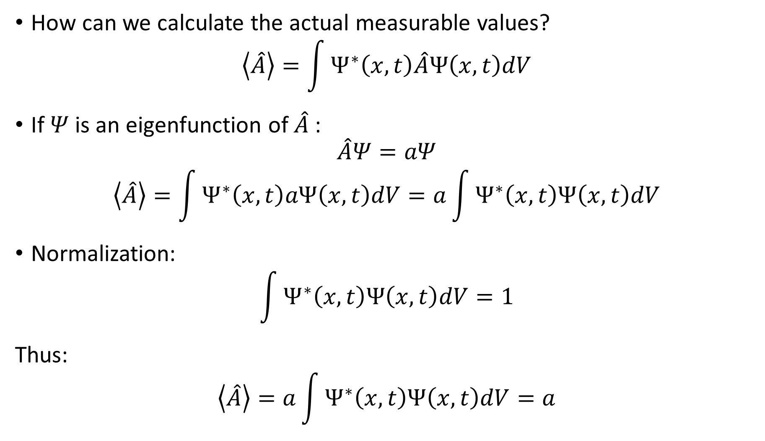
How can we calculate the actual measurable values?
$$\left\langle \hat{A}\right\rangle =\int{Ψ^{∗}\left(x,t\right)\hat{A}Ψ\left(x,t\right)dV}$$
If $Ψ$is an eigenfunction of $\hat{A}$:
$$\hat{A}Ψ=aΨ$$
$$\left\langle \hat{A}\right\rangle =\int{Ψ^{∗}\left(x,t\right)aΨ\left(x,t\right)dV}=a\int{Ψ^{∗}\left(x,t\right)Ψ\left(x,t\right)dV}$$
Normalization:
$$\int{Ψ^{∗}\left(x,t\right)Ψ\left(x,t\right)dV}=1$$
Thus:
$$\left\langle \hat{A}\right\rangle =a\int{Ψ^{∗}\left(x,t\right)Ψ\left(x,t\right)dV}=a$$

Slide 13
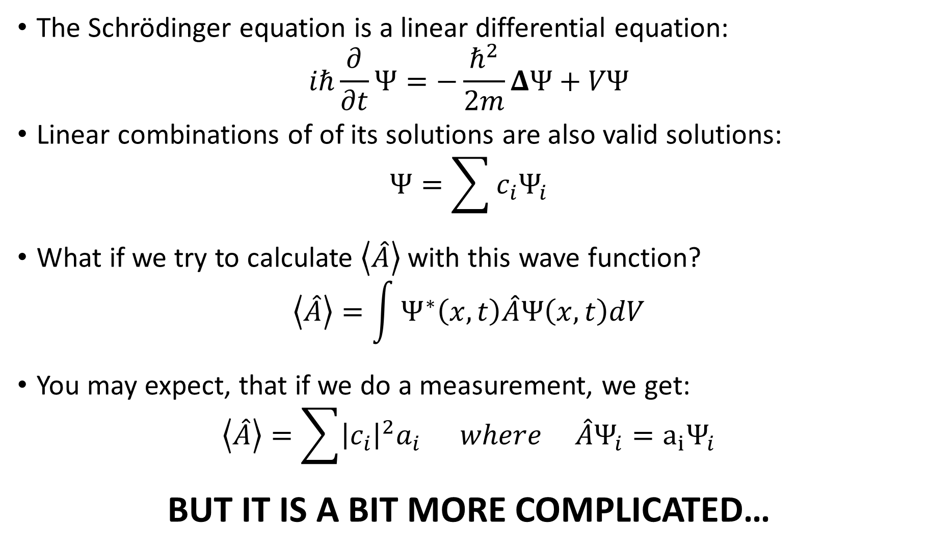
The Schrödinger equation is a linear differential equation:
$$iℏ\frac{∂}{∂t}Ψ=−\frac{ℏ^{2}}{2m}ΔΨ+VΨ$$
Linear combinations of of its solutions are also valid solutions:
$$Ψ=\sum{c_{i}Ψ_{i}}$$
What if we try to calculate $\left\langle \hat{A}\right\rangle$ with this wave function?
$$\left\langle \hat{A}\right\rangle =\int{Ψ^{∗}\left(x,t\right)\hat{A}Ψ\left(x,t\right)dV}$$
You may expect, that if we do a measurement, we get:
$$\left\langle \hat{A}\right\rangle =\sum{{\left|c_{i}\right|}^{2}a_{i}} where {\hat{A}Ψ}_{i}={a_{i}Ψ}_{i}$$
BUT IT IS A BIT MORE COMPLICATED…

Slide 14
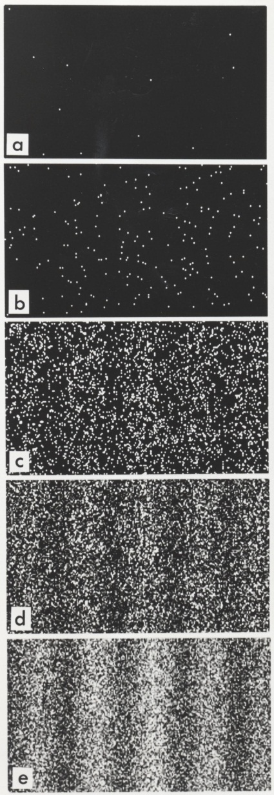
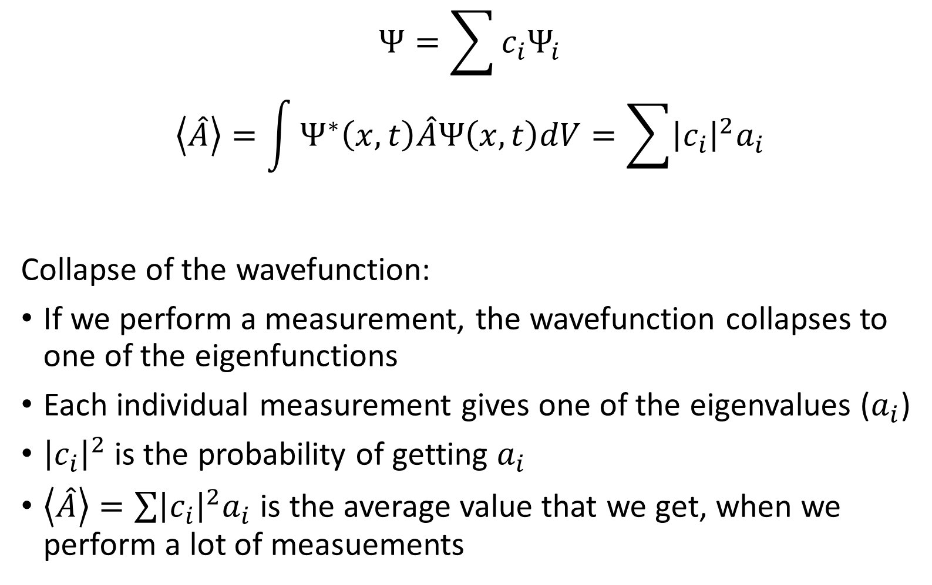
$$Ψ=\sum{c_{i}Ψ_{i}}$$
$$\left\langle \hat{A}\right\rangle =\int{Ψ^{∗}\left(x,t\right)\hat{A}Ψ\left(x,t\right)dV}=\sum{{\left|c_{i}\right|}^{2}a_{i}}$$
Collapse of the wavefunction:
If we perform a measurement, the wavefunction collapses to one of the eigenfunctions
Each individual measurement gives one of the eigenvalues ($a_{i}$)
${\left|c_{i}\right|}^{2}$is the probability of getting $a_{i}$
$\left\langle \hat{A}\right\rangle =\sum{{\left|c_{i}\right|}^{2}a_{i}}$ is the average value that we get, when we perform a lot of measuements
Source of figure: www.wikipedia.org

Slide 15
Postulates
State → wave function
single-valued
finite
normalization condition:
continous
its slope must also be continous
antisymmetric with respect to the interchange of all coordinates of one fermion with those of another
For every physical observable there is a linear, Hermetian operator
In any measurement of the observable associated with an operator, the only values that will ever be obsereved are the eigenvalues of the operator The state does not have to be an eigenstate The probability of measuring a_{i} is |c_{i}|² After the measurement, the wavefunction collapses to the corresponding eignestate
The average value can be calcualted as:
The time evolution of the wavefunction is given by the time dependent Schrödinger equation
For example:

Slide 16
Time independent Schrödinger equation

Slide 17
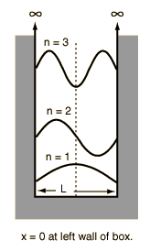
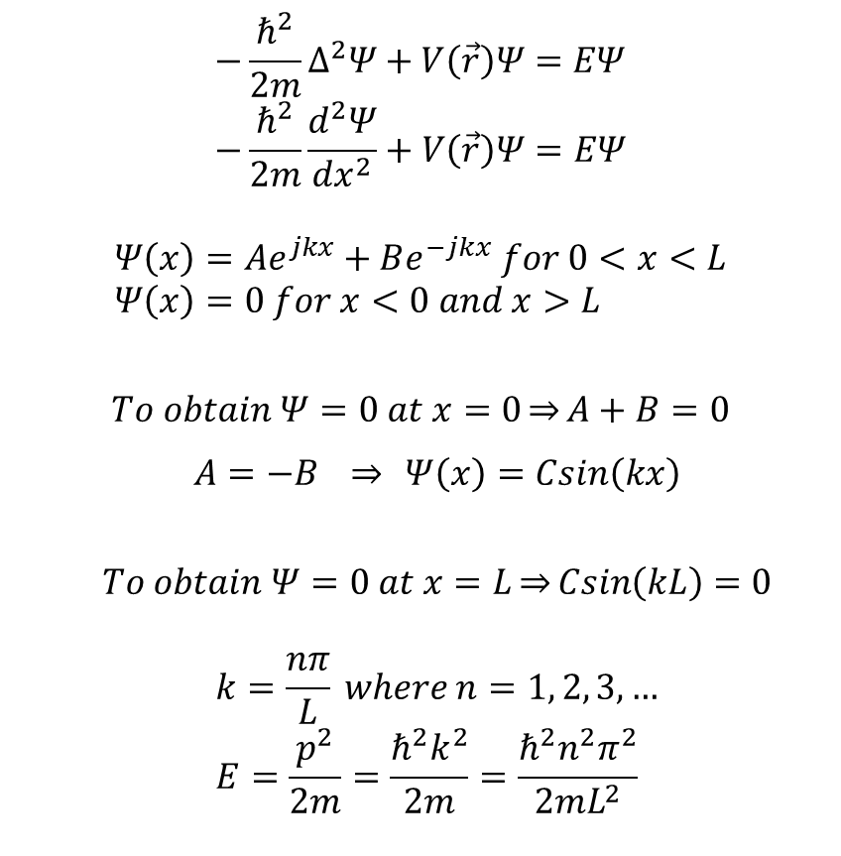
Particle in a box
$$−\frac{ℏ^{2}}{2m}∆^{2}Ψ+V\left(\vec{r}\right)Ψ=EΨ \\ −\frac{ℏ^{2}}{2m}\frac{d^{2}Ψ}{{dx}^{2}}+V\left(\vec{r}\right)Ψ=EΨ$$
$$Ψ\left(x\right)=Ae^{jkx}+Be^{−jkx} for 0<x<L \\ Ψ\left(x\right)=0 for x<0 and x>L$$
$$To obtain Ψ=0 at x=0\underset{⇒}{}A+B=0$$
$$A=−B \underset{⇒}{} Ψ\left(x\right)=Csin\left(kx\right)$$
$$To obtain Ψ=0 at x=L\underset{⇒}{}Csin\left(kL\right)=0$$
$$k=\frac{nπ}{L} where n=1, 2, 3, … \\ E=\frac{p^{2}}{2m}=\frac{ℏ^{2}k^{2}}{2m}=\frac{ℏ^{2}n^{2}π^{2}}{2mL^{2}}$$
Source of figure: http://hyperphysics.phy-astr.gsu.edu/hbase/quantum/pbox.html

Slide 18
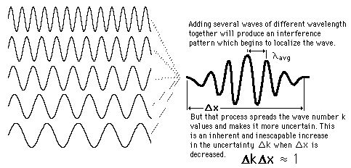
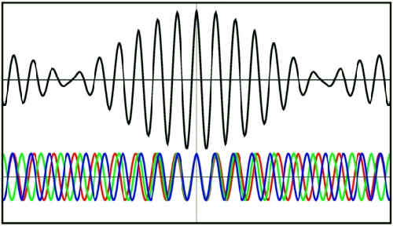
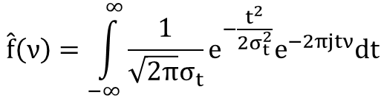
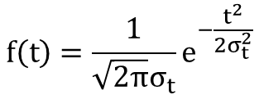
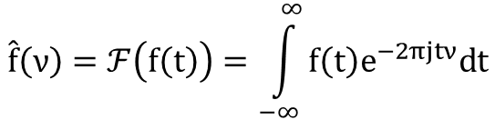
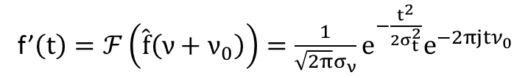
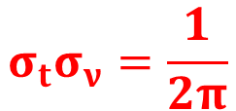

Wave packet
$$\hat{f}\left(ν\right)=ℱ\left(f\left(t\right)\right)=\int_{−∞}^{∞}{f\left(t\right)e^{−2πjtν}dt}$$
$$f\left(t\right)=\frac{1}{\sqrt{2π}σ_{t}}e^{−\frac{t^{2}}{2σ_{t}^{2}}}$$
$$\hat{f}\left(ν\right)=\int_{−∞}^{∞}{\frac{1}{\sqrt{2π}σ_{t}}e^{−\frac{t^{2}}{2σ_{t}^{2}}}e^{−2πjtν}dt}$$
$$\hat{f}\left(ν\right)=e^{−2π^{2}σ_{t}^{2}ν^{2}}$$
f’$\left(t\right)=ℱ\left(\hat{f}\left(ν+ν_{0}\right)\right)=\frac{1}{\sqrt{2π}σ_{ν}}e^{−\frac{t^{2}}{2σ_{t}^{2}}}e^{−2πjtν_{0}}$
$$σ_{t}σ_{ν}=\frac{1}{2π}$$
Source of figures: http://hyperphysics.phy-astr.gsu.edu/hbase/waves/wpack.html
http://scienceblogs.com/principles/2007/03/basic_concepts_measurement.php

