Slide 1
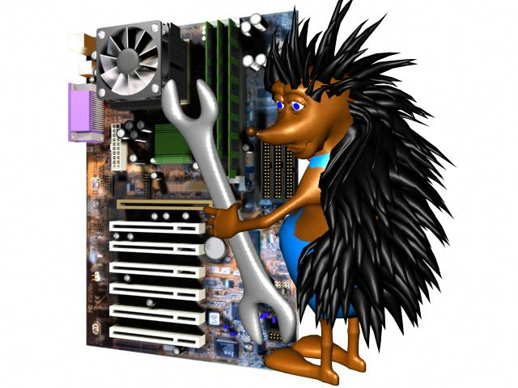
Graphics hardware and software
”In theory, there is no difference between theory and practice.
In practice, there is.”
Benjamin Brewster
Szirmay-Kalos László
Notes:
This lecture presents the architecture of an interactive 2D graphics system, identifies the roles of the important libraries like OpenGL and GLUT, introduces a simple view of the GPU, and provides the first OpenGL programs.

Slide 2
Interactive graphics systems
Input pipeline
Device
To
Screen
Inv.
Viewport
transf
Inv.
Proj.
transf
Inv.
View
transf
Inv.
Model
transf.
CPU:
op sys
Upside
down!
camera
Virtual world
Screen
refresh
vectorization
CPU: app
GPU hw
Pixel
proc
Rasteri-
zation
Viewport
transf
Clip
Proj.
transf
View
transf
Model
transf
Frame
buffer
Output pipeline: GPU
Shader processors
Notes:
From system point of view, a graphics application handles the user input, changes the virtual world by modeling or animating it, and then immediately renders the updated model presenting the image to the user. This way, the user immerses into the virtual world, i.e. he feels that he is promptly informed about its current state.
The process from the input to the virtual world is called the input pipeline. Similarly, the process mapping the virtual world to the screen is the output pipeline.
The complete system is a (control) loop with two important points, the virtual world and the user. In the output pipeline, the virtual world is vectorized first since only points, lines and polygons can be transformed with homogeneous linear transformations. Then modeling, view and projection transformations are executed moving the current object to normalized device space. Here clipping is done, then the object is transformed to the screen, where it is rasterized. Before being written in the frame buffer, pixels can undergo pixel operations, needed, for example, to handle transparent colors. The frame buffer is read periodically to refresh the screen. The user can see the screen and interact with the content by moving the cursor with input devices and starting actions like pressing a button. Such actions generate events taking also the screen space position with them.
Screen space is the whole screen in full-screen mode or only the application window. The unit is the pixel. Note that screen space is different for the operating system and for OpenGL. For MsWindows and XWindow, axis y points downward while in OpenGL axis y points upward. Thus, y must be flipped, i.e. subtracted from the vertical resolution. The input pixel coordinate goes from the screen to modeling space, thus inverse transformations are applied in the reverse order. With input devices not only the virtual world can be modified but also the camera can be controlled.

Slide 3
Software architecture
glut…( )
Operating
System
(Windows)
Application
(CPU)
onDisplay()
onMouse()
onKeyboard()
freeglut
Graphics library: OpenGL
Frame
buffer
gl…3dv( )
Drawing (GPU)
Notes:
Our graphics application runs under the control of an operating system together with other applications. The operating system handles shared resources like input devices and the frame buffer as well, so a pixel data in the frame buffer can be changed only via the operating system. Modifying pixels one by one from the application would be too slow, so a new hardware element, called the GPU, shows up that is responsible for many time consuming steps of rendering. The GPU is also a shared device that can be accessed via the operating system. Such accesses are calls to a library for the application program. We shall control the GPU through a C graphics library called OpenGL.
On the other hand, to catch input events handled by the operating system, we need another library. We shall utilize the freeGLUT for this purpose, due to its simplicity and the portability (it runs on MsWindows, Xwindow, etc.)
The operating system separates the hardware from the application. The operating system is responsible for application window management and also letting the application give commands to the GPU via OpenGL, not to mention the re-programming of the GPU with shader programs.
OpenGL is collection of C functions of names starting with gl. The second part of the name shows what the function does, and the final part allows to initiate the same action with different parameter numbers and types (note that there is not function overloading in C).
To get an access to the GPU via OpenGL, the application should negotiate this with the operating system, for which operating system dependent libraries, like the wgl for MsWindows and glX for Xwindow are available. Using them is difficult, and more importantly, it makes our application not portable. So, to hide operating system dependent features, we use GLUT, which translates generic commands to the operating system on which it runs. It is simple and our application will be portable. GLUT function names start with glut.

Slide 4
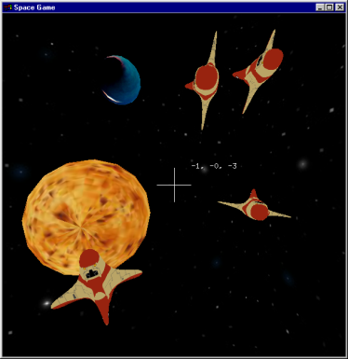
Event handling (GLUT)
AppWindow setup
Callback registration
main
Operating
system
DisplayFunc
freeglut
KeyboadFunc
KeyboadUpFunc
SpecialFunc
callbacks
Reshape
MouseFunc
Graphics
hardware
OpenGL
MotionFunc
IdleFunc
application
Notes:
The graphics output is implemented by OpenGL. The application window management and the input are the responsibilities of GLUT. Our application consists of a main function and a set of event handlers (we use event driven programming paradigm in interactive systems). In main, our application program interacts with GLUT and specifies the properties of the application window (e.g. initial resolution and what a single pixel should store), and also the event handlers.
An event handler is a C function that should be programmed by us. This function is connected to a specific event of GLUT, and having established this connection we expect GLUT to call our function when the specific event occurs. A partial list of possible events are:
Display event that occurs when the application window becomes invalid and thus GLUT asks the application to redraw the window to restore its content.
Keyboard event occurs when the user presses a key having ASCII code.
Special event is like Keyboard event but is triggered by a key press having no ASCII code (e.g. arrows and function keys).
Reshape handler is called when the dimensions of the application window are changed by the user.
Mouse event means the pressing or releasing the button of the mouse.
Idle event indicates the time elapsed and our virtual world model should be updated to reflect the new time.
Event handler registration is optional with the exception of the Display event. If we do not register a handler function, nothing special happens when this event occurs.

Slide 5
OpenGL 3.3 … 4.6
CPU program
VAO
VBO
Vertex
Buffer
Object
VBO
Vertex
Buffer
Object
Texture
memory
glUniform
glTexParameter
glUniform
glPointSize, glLineWidth
glViewport
Sampler
Pixel color
Vertex shader
reg1
reg2
reg3
reg4
…
gl_FragCoord
reg1, reg2, reg3 …: AttribArray
reg1
reg2
reg3
reg4
…
gl_Position
Pixel
shader
Vágás,
Homogén
osztás
Clip, homdiv
Viewport tr.
Rasterization
Pixel szín
Viewport
transzform
Raszterizáció
frame buffer
Compositing
Normalized
screen
Screen
Pixel address
Notes:
Primitives (e.g. a line or a triangle mesh) go down the pipeline, each having multiple vertices associated with their homogeneous coordinates and possible attributes (e.g. vertex color). Primitives must be transformed to normalized device space for clipping, which requires the transformation of its vertices with the modeling, viewing and projection transformation matrices. Clipping is done, so is homogeneous division if the fourth homogeneous coordinate is not 1. Then the primitive is transformed to screen space taking into account the viewport position and size. The primitive is rasterized in screen space.
For performance reasons, OpenGL 3 retained mode requires the application to prepare the complete data of the vertices and attributes of a single object rather than passing them one by one. These data are to be stored in arrays on the GPU, called Vertex Buffer Object (VBO). An object can have multiple VBOs, for example, we can put coordinates in a single array and vertex colors in another. Different VBOs are encapsulated into a Vertex Array Object (VAO) that also stores information about how the data should be fetched from the VBOs and sent to the input registers of the Vertex Shader. A single input register can store four 32 bit long words (4 floats called vec4, or four integers) and is called Vertex Attrib Array. The responsibility of the Vertex Shader is to transform the object to normalized device space. If the concatenation of model, view and projection matrices is given to the Vertex Shader, it is just a single matrix-vector multiplication. The output of the Vertex Shader goes to output registers including gl_Position storing the vertex position in normalized device space and other registers storing vertex attributes. Clipping, homogeneous division, viewport transformation and rasterization are performed by the fixed function hardware of the GPU, so these steps cannot be programmed. The output of the rasterization step is the sequence of pixels with pixel coordinates and interpolated vertex attributes. Pixel coordinates select the pixel that is modified in the frame buffer. From other vertex attributes and global variables, the pixel color should be computed by another programmable unit called the Fragment Shader.

Slide 6
Vertex data streaming
interleaved
VAO
VAO
VB0 0
x1, y1
x2, y2
x3, y3
VBO 1
R1, G1, B1
R2, G2, B2
R3, G3, B3
VBO 0
x1, y1
R1, G1, B1
x2, y2
R2, G2, B2
x3, y3
R3, G3, B3
glVertexAttribPointer
Vertex shader
Input registers
AttribArray 0
AttribArray 1
AttribArray …
in var1
in var2
Vertex Shader
Notes:
Let us zoom out the connection of the vertex buffer objects, vertex shader input registers called AttribArrays, and vertex shader input variables. The object is described in arrays called VBOs. For example, coordinates can be stored in one array, colors in another (this strategy is called Structure Of Arrays, or SOA for short). To allow the Vertex Shader to process a vertex, its input registers must be filled with the data of that particular vertex, one vertex at a time. Function glVertexAttribPointer tells the GPU how to interpret the data in VBOs, from where the data of a single vertex can be fetched, and in which AttribArray a data element should be copied. For example, coordinates can be copied to AttribArray0 while colors to AttribArray1 (a single register can store 4 floats).
When the Vertex Shader runs, it can fetch its input registers. It would not be too elegant if we had to refer to the name of the input register, e.g. AttribArray 0, so it is possible to assign variable names to it. For example, AttribArray0 can be the ”vertexPosition”.
Note that this was only one possibility of data organization. For example, it is also perfectly reasonable to put all data in a single array where coordinates and attributes of a single vertex are not separated (this strategy is the Array Of Structures, or AOS). In this case glVertexAttribPointer should tell the GPU where an attribute starts in the array and what the step size (stride) is.

Slide 7

My first OpenGL program
(100,100)
#include <windows.h> // Only in MsWin
#include <GL/glew.h> // download
#include <GL/freeglut.h> // download
int main(int argc, char * argv[]) {
glutInit(&argc, argv); // init glut
glutInitContextVersion(3, 3);
glutInitWindowSize(600, 600);
glutInitWindowPosition(100, 100);
glutInitDisplayMode(GLUT_RGBA|GLUT_DOUBLE);
glutCreateWindow(“Hi Graphics"); //show AppWindow
glewExperimental = true; // magic
glewInit(); // init glew, no opengl before this
glViewport(0, 0, 600, 600); //photo
onInitialization(); // next slide
glutDisplayFunc(onDisplay); //event handler
glutMainLoop();
return 1;
}
600
600
(1,1)
(-0.6,1)
(0.8,-0.2)
(-0.8,-0.8)
(-1,-1)
Notes:
In the main function of a graphics application, we set up the application window with the help of GLUT telling the initial position, size, what data should be stored in a pixel, and also what functions should be called when different events happen. At the end, the message loop is started, which checks whether any event occurred for which we have registered an event handler, and if this is the case, it calls the respective event handler.
The main function can also be used to initialize data in OpenGL (on the GPU), especially those which are needed from the beginning of the program execution and which do not change during the application. We need shader programs from the beginning, so this is a typical place to compile and link shader programs and upload them to the GPU.
Let us start with the main function. Two header files are needed.
GLEW is the opengl Extension Wrangler library that finds out what extensions are supported by the current GPU in run time. It is our interface to OpenGL, which works even if we select a higher OpenGL version that is supported by the header file in our computer (If you have a MsWindows system, it is very likely that your opengl header and library files support only OpenGL 1.0, while we work in OpenGL 3.3 or higher versions. The difference is made by GLEW).
GLUT is a windowing utility toolkit to set up the application window and to manage events.
In the main functions, first the application window is set up with glut calls:
- glutInit initializes glut and allows use to communicate with the GPU via OpenGL.
- glutInitContextVersion sets the required OpenGL version. In this case, we want OpenGL 3.3.
- glutInitWindowSize specifies the initial resolution of the application window.
- glutInitWindowPosition specifies where it is initially placed relative to the upper left corner of the screen.
- glutInitDisplayMode tells glut what to store in a single pixel. In the current case, we store 8 bit (default) R,G,B, and A (opacity) values, in two copies to support double buffering.
- glutCreateWindow creates the window, which shows up.
The Extension Wrangler is initialized
glewExperimental = true: GLEW obtains information on the supported extensions from the graphics driver, so if it is not updated, then it might not report all features the GPU can deliver. Setting glewExperimental to true gets GLEW to try the extension even if it is not listed by the driver. This is indeed magic.
glewInit makes the initialization
From here, we can ha an initialized OpenGL. Do not call any OpenGL functions before this point!
- glViewport sets the render target, i.e. the photograph inside the application window
- onInitialization is our custom initialization function discussed on the next slide.
The remaining functions register event handlers and start the message loop. For the time being, only the onDisplay is relevant, which is called whenever the application window becomes invalid. We use this function to render the virtual world, which consists of a single green triangle, directly given in normalized device space.

Slide 8
onInitialization()
vao
vbo
vbo
24 bytes
vbo
3 vertices
2 floats/vertex
unsigned int shaderProgram;
unsigned int vao; // virtual world on the GPU
void onInitialization() {
glGenVertexArrays(1, &vao);
glBindVertexArray(vao); // make it active
unsigned int vbo;// vertex buffer object
glGenBuffers(1, &vbo); // Generate 1 buffer
glBindBuffer(GL_ARRAY_BUFFER, vbo);
// Geometry with 24 bytes (6 floats or 3 x 2 coordinates)
float vertices[] = {-0.8,-0.8, -0.6,1.0, 0.8,-0.2};
glBufferData(GL_ARRAY_BUFFER, // Copy to GPU target
sizeof(vertices), // # bytes
vertices, // address
GL_STATIC_DRAW); // we do not change later
glEnableVertexAttribArray(0); // AttribArray 0
glVertexAttribPointer(0, // vbo -> AttribArray 0
2, GL_FLOAT, GL_FALSE, // two floats/attrib, not fixed-point
0, NULL); // stride, offset: tightly packed
AttribArray 0
Notes:
In onInitialization those OpenGL data are initialized that are typically constant during the application, so they do not have to be set in every drawing. In our program, this includes the constant geometry (the triangle), and the GPU shader programs. The shaderProgram and the vao are set here but also used in the onDisplay, therefore they are global variables.
First we allocate one vertex array object and its id is vao. With Binding, this is made active, which means that all subsequent operations belong to this vao until another vao is bound or the current one is unbound with binding 0.
In the second step, one vertex buffer object is allocated, which will be part of the active vao (we have just one, which is active). This vertex buffer object is made active, so all subsequent operations are related to this until another is bound.
Array ”vertices” stores the geometry of our triangle, and is obviously in the CPU memory. It contains 6 floats, i.e. 24 bytes. With glBufferData the 24 bytes are copied to the GPU. With the last parameter of glBufferData we can specify which type of GPU memory should be used (the GPU has different types of memory with different write and read speeds and capacity, so the driver may decide where to copy this 24 bytes based on our preference). We say that the 24 bytes will not be modified but it would be great if it could be fetched fast (constant memory would be an ideal choice). So far we said nothing about the organization and the meaning of the data, it is simply 24 bytes, the GPU does not know that it defines 3 vertices, each with 2 Cartesian coordinates, which are in float format.
glVertexAttribPointer() defines the interpretation of the data and also that the data associated with a single vertex goes to the input register (AttribArray) number 0. It specifies that a single vertex have two floats, i.e. 8 bytes. If it was non floating point value, it would also be possible to put the binary point to the most significant bit, but we set this parameter to GL_FALSE.
The last two parameters tell the GPU how many bytes should be stepped from one vertex to the other (if it is 0, it means that the step size is equal to the data size, 2 floats in this case), and where the first element is (at the beginning of the array, so the pointer offset is zero). Stride and offset are essential if interleaved vbos are used.

Slide 9
#version 330
precision highp float;
uniform mat4 MVP;
layout(location = 0) in vec2 vp; //AttribArray 0
void main() {
gl_Position = vec4(vp.x,vp.y,0,1) * MVP;
}
#version 330
precision highp float;
uniform vec3 color;
out vec4 outColor;
void main() {
outColor = vec4(color,1);
}
static const char * vertexSource = R"( … )“;
static const char * fragmentSource = R"( … )“;
unsigned int vertexShader = glCreateShader(GL_VERTEX_SHADER);
glShaderSource(vertexShader, 1, &vertexSource, NULL);
glCompileShader(vertexShader);
unsigned int fragmentShader=glCreateShader(GL_FRAGMENT_SHADER);
glShaderSource(fragmentShader, 1, &fragmentSource, NULL);
glCompileShader(fragmentShader);
shaderProgram = glCreateProgram();
glAttachShader(shaderProgram, vertexShader);
glAttachShader(shaderProgram, fragmentShader);
glBindFragDataLocation(shaderProgram, 0, "outColor");
glLinkProgram(shaderProgram);
glUseProgram(shaderProgram);
}
Notes:
The remaining part of the onInitialization gets the shader programs ready. The source of the shader programs can be read from a file or directly copied from a string. We use here the latter option. As programs are typically written in more than one line, the string cannot be simple “…” but should be special and hold new line characters, which is possible with the R”( … )” C++ feature.
The vertex shader source code starts with the version number that tells the compiler how matured GPU is assumed during execution.
Uniform parameters are like constants that cannot change during the drawing of a single primitive. MVP is a 4x4 matrix (type mat4), which represents the model-view-projection matrix. The vertex shader has one per-vertex attribute, defined with variable name vp and storing the x, y coordinates of the current vertex. The vertex shader code computes the multiplication of 4 element vector that is the conversion of vp to 3D homogeneous coordinates and the 4x4 MVP matrix, and the result is written into a specific output register called gl_Position, which should get the point transformed to normalized device space. The vertex shader could output other variables as well, which would follow the point during clipping and rasterization, and would be interpolated during these operations. Clipping, homogeneous division, viewport transform and rasterization are fixed function elements that cannot be programmed.
The output of the fixed function part is the sequence of pixels (called fragments) belonging to the current primitive and also the variables that are output by the vertex shader, having interpolated for the current pixel. The pixel address is in register gl_FragCoord, which cannot be modified, but from the other registers and uniform variables, the color of this fragment can be obtained by the fragment shader processor. It has one uniform input called the color, which will determine the output color stored in variable outColor.
The very beginning of the pipeline, vertex coordinate variable vp is connected to the vertex shader input register (AttribArray) number 0 as told by the layout(location = 0) statement. The output of the fragment shader goes to the frame buffer as requested by glBindFragDataLocation.
Finally, the shader program is linked, copied to the shader processors to be executed by them.

Slide 10
uniform mat4 MVP;
layout(location = 0) in vec2 vp;
void main() {
gl_Position = vec4(vp.x,vp.y,0,1) * MVP;
}
uniform vec3 color;
out vec4 outColor;
void main() {
outColor = vec4(color,1);
}
void onDisplay( ) {
glClearColor(0, 0, 0, 0); // background color
glClear(GL_COLOR_BUFFER_BIT); // clear frame buffer
// Set vertexColor to (0, 1, 0) = green
int location = glGetUniformLocation(shaderProgram, “color");
glUniform3f(location, 0.0f, 1.0f, 0.0f); // 3 floats
float MVPtransf[4][4] = { 1, 0, 0, 0, // MVP matrix,
0, 1, 0, 0, // row-major!
0, 0, 1, 0,
0, 0, 0, 1 };
location = glGetUniformLocation(shaderProgram, "MVP");
glUniformMatrix4fv(location, 1, GL_TRUE, &MVPtransf[0][0]);
glBindVertexArray(vao); // Draw call
glDrawArrays(GL_TRIANGLES, 0 /*startIdx*/, 3 /*# Elements*/);
glutSwapBuffers( ); // exchange buffers for double buffering
}
row-major
Notes:
We have registered a single event handler (onDisplay) that reacts to the event occurring when the application window gets invalid (DisplayFunc).
In this function, the virtual world (consisting of the single green triangle) is rendered.
glClearColor sets the color with which the pixels of the application window is cleared. This color is black. The actual clearing is done by glClear. GL_COLOR_BUFFER_BIT stands for the frame buffer storing color values.
Drawing consists of setting the values of uniform variables of shaders and then forcing the geometry through the pipeline, which is called the draw call. Finally, the buffer used for drawing so far is swapped with the buffer the user could see so far by glutSwapBuffers, so the result will be visible to the user.
The fragment shader has a single uniform variable called color and of type vec3, which can be set with function glUniform3f(location, 0.0f, 1.0f, 0.0f) to value (0,1,0)=green. Note that ”3f” at the end of the function name indicates that this function takes 3 float parameters. Parameter location is the serial number of this uniform variable, which can be found with glGetUniformLocation(shaderProgram, “color") which returns the serial number of uniform variable called “color” in the shader programs.
The vertex shader has uniform variable MVP of type mat4, i.e. it is a 4x4 matrix. First, its serial number must be obtained, then its value can be set with glUniformMatrix4fv. Here fv means that matrix elements are floats (f) and instead of passing the 16 floats by value, the address of the CPU array is given (v) from which the values can be copied (pass by address). The second parameter of glUniformMatrix4fv says that 1 matrix is passed, the third parameter that this is a row-major matrix and should be kept this way.
This issue can cause a lot of confusion:
In C or C++ two-dimensional matrices are of row-major.
In GLSL two-dimensional matrices are of column-major.
So if we use them without caution, we might apply the transpose of the matrix and not what we wanted. There are many solutions for this problem:
Use an own 2D matrix class in C++ that follows the column-major indexing scheme, and consider vectors of points as row vectors both on the CPU and on the GPU.
Use an own 2D matrix class in C++ that follows the column-major indexing scheme, and consider vectors of points as column vectors both on the CPU and on the GPU. The matrices will be transposed with respect to the previous solution.
Use the standard 2D matrix indexing on the CPU (row-major) and the standard 2D matrix indexing on the GPU (column-major), but consider points as row vector in the CPU program (and therefore put on the left side of the transformation matrix) and column vector in the GPU program (and put on the right side of the matrix).
Use the standard 2D matrix indexing on the CPU (row-major) but transpose the matrix when passed to the GPU, and consider points as row vector both in the CPU program and in the GPU program.
We use option 4, and setting the third parameter of glUniformMatrix4fv to TRUE enables just the required transpose.
Vertex Array Objects are our virtual world objects already uploaded to the GPU. With glBindVertexArray(vao) we can select one object for subsequent operations (drawing) and finally glDrawArrays gets the current VAO to feed the pipeline, i.e. this object is rendered. We may not send all vertices of this object, so with startIdx and number of elements a subset can be selected. Setting startIdx to 0 and sending all 3 points, our whole triangle is rendered. The first parameter of glDrawArrays tells the GPU the topology of the primitive, that is, what the vertices define. In our case, triangles, and as we have only 3 vertices, a single triangle.

Slide 11
OpenGL primitives
glDrawArrays( primitiveType, startIdx, numOfElements);
Vectorized parametric curve
GL_POINTS
GL_LINES
GL_LINE_STRIP
GL_LINE_LOOP
Tessellated
parametric surface
Output of Ear clipping
„Convex” polygon
GL_TRIANGLES
GL_TRIANGLE_STRIP
GL_TRIANGLE_FAN
Notes:
This is the set of possible primitive types. Basically points, line segments and triangles, but in sophisticated options sharing vertices is also possible.
GL_LINE_STRIP assumes that the end point of a line segment is the start of the next, so shared points should be specified only once. GL_LINE_LOOP is similar to GL_LINE_STRIP, but adds one more edge between the last and first vertices. GL_TRIANGLES require vertices of multiples of three, and each three vertices define a new triangle. We use it, for example, when a polygon is decomposed to triangles with the ear clipping algorithm. GL_TRIANGLE_STRIP needs three vertices for the first triangle, then any additional vertex introduces a new triangle of the last, previous, and previous of the previous vertices. GL_TRIANGLE_FAN can be used for convex polygons. Here again the first three vertices define the first triangle and any new vertex adds a new triangle of the last vertex, previous vertex and first vertex.

Slide 12

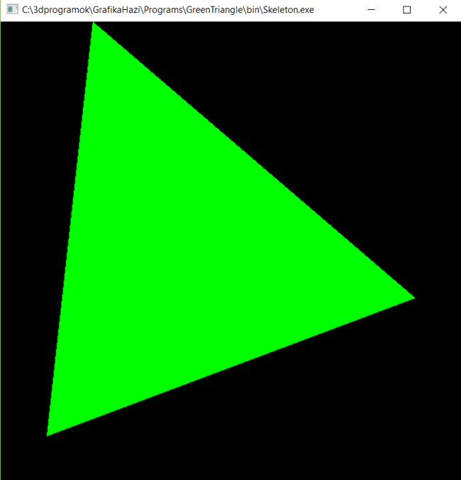
Graphics hardware and software Program: Framework and green triangle
Szirmay-Kalos László

Slide 13
OpenGL starters’ kit: Shader programs
glCreate[Shader|Program]() creation
glShaderSource() source upload
glCompileShader() compilation
glAttachShader() add shader to program
glBindFragDataLocation() what goes to frame buffer?
glLinkProgram() linking
glUseProgram() select for execution
glGetUniformLocation() uniform variable address
glUniform*() uniform variable set value
class GPUProgram {
bool create(char * vertShader, char * fragShader,
char * OutputName, char * geomShader = 0);
void Use();
void setUniform(…);
};

Slide 14
OpenGL starters’ kit
Resource generation, binding, uploading
glGen[VertexArrays|Buffers|Textures](1, &id);
glBind[VertexArray|Buffer|Texture](id);
glBufferData(GL_ARRAY_BUFFER, …);
glTexImage2D(GL_TEXTURE_2D, …);
Connect VBO to input registers
glEnableVertexAttribArray(reg) enable register
glVertexAttribPointer(reg, …) buffer to register
Drawing and pipeline management
glDrawArrays(type, start, num) draw call
glClearColor(r, g, b, a) bacground clear color
glClear(buffer) clear background
glViewport(vx, vy, vw, vh) viewport
glPointSize(s) point size
glLineWidth(w) line width

Slide 15
framework.h
include: <stdio.h>, <stdlib.h>, <math.h>, <vector>, <string>
if windows <windows.h>
<GL/glew.h>, <GL/freeglut.h> // must be downloaded
const unsigned int windowWidth = 600, windowHeight = 600;
struct vec2;
struct vec3;
struct vec4;
struct mat4;
struct Texture {
unsigned int textureId;
void create(…);
};
class GPUProgram {
bool create(char * vertShader,
char * fragShader, char * OutputName,
char * geomShader = nullptr);
void Use();
void setUniform(…);
};

Slide 16
framework.cpp
#include "framework.h"
void onInitialization(); // Init
void onDisplay(); // Redraw
void onKeyboard(unsigned char key, int pX, int pY); // Key pressed
void onKeyboardUp(unsigned char key, int pX, int pY); // Key released
void onMouseMotion(int pX, int pY); // Move mouse with key pressed
void onMouse(int button, int state, int pX, int pY); // Mouse click
void onIdle(); // Time elapsed
int main(int argc, char * argv[]) {
glutInit(&argc, argv); glutInitContextVersion(3, 3);
glutInitWindowSize(windowWidth, windowHeight);
glutInitWindowPosition(100, 100);
glutInitDisplayMode(GLUT_RGBA | GLUT_DOUBLE | GLUT_DEPTH);
glutCreateWindow(argv[0]);
glewExperimental = true; glewInit(); // no opengl calls before this
onInitialization();
glutDisplayFunc(onDisplay); // Register event handlers
glutMouseFunc(onMouse);
glutIdleFunc(onIdle);
glutKeyboardFunc(onKeyboard);
glutKeyboardUpFunc(onKeyboardUp);
glutMotionFunc(onMouseMotion);
glutMainLoop(); return 1;
}

Slide 17
Skeleton.cpp
#include "framework.h"
const char * const vertexSource;
const char * const fragmentSource;
GPUProgram gpuProgram; // vertex and fragment shaders
void onInitialization() {
…
gpuProgram.create(vertexSource, fragmentSource, "outColor");
}
void onDisplay() {
glClearColor(0, 0, 0, 0); // background color
glClear(GL_COLOR_BUFFER_BIT); // clear frame buffer
…
glutSwapBuffers(); // exchange buffers for double buffering
}
void onKeyboard(unsigned char key, int pX, int pY) { … }
void onKeyboardUp(unsigned char key, int pX, int pY) { … }
void onMouseMotion(int pX, int pY) { … }
void onMouse(int button, int state, int pX, int pY) { … }
void onIdle() { … }

Slide 18
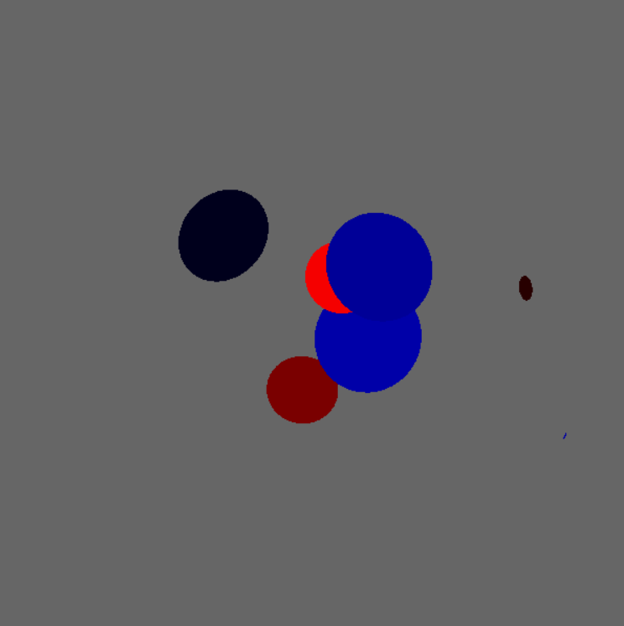
Charges in Soup
Homework 1

Slide 19
Specification
Particles of random charge and mass swim in a fluid of no charge in 2D Euclidean space. Particles are circles in this space, where the radius is proportional to the mass, the intensity is proportional to the absolute value of the charge, the hue is red for positive and green or blue for negative charges. Particles are moving according to the 2D Coulomb force and a soup friction that is proportional to the velocity. Our microscope projects the 2D Euclidean space to 2D hyperbolic space, then transforms it to a unit circle with the Beltrami-Poincaré disc model. This unit circle is shown in the viewport of 600x600 resolution. Pressing the s,d,x,e keys, the virtual world can be translated to left, right, down and up with 0.1 unit. The timestep of the simulation is 0.01 sec even if the onIdle events come slower.
Initially 2 particles exist, by each pressing of the SPACE, a new particle is introduced.

Slide 20

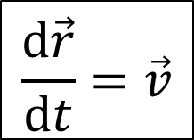
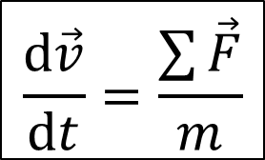
Simulation
$$\frac{d\vec{v}}{dt}=\frac{\sum{\vec{F}}}{m}$$
State: $r_{i}$, $v_{i}$
for($t$= 0; $t$< T; $t$+= $dt$) { // onIdle
for each node $i$ {
$\sum{\vec{F}}=$ $\sum{\frac{q_{i}q_{j}}{2πεd_{ji}}\vec{e_{ji}}−}ρ\vec{v_{i}}$
$v_{i}+=\sum{\vec{F}}/m∙$ $dt$
$r_{i}+=v_{i}∙$ $dt$
}
}
$$\frac{d\vec{r}}{dt}=\vec{v}$$

Slide 21







View V and Projection P transformation (vertex shader)
V: translation that moves the camera to (0,0,1)
P: maps the plane to a unit circle
w
$$x2+y2−w2=−1$$
$$\left(x,y,w\right) :x2+y2−w2=−1$$
$$w=1$$
$$(x,y,1)$$
$$y$$
$$\left(x′,y′,0\right) :\left(0,0,−1\right)+\left(x,y,w+1\right)t=(x^{′},y^{′},0)$$
$$x$$
Beltrami-Poincaré disc
$$w=−1$$

Slide 22
Steps of solution
Atom: transformed circle (triangle-fan)
own or shared vao/vbo
Properties: mass, charge, (color)
State: position, velocity, force
Virtual world: collection of atoms
Simulation in onIdle
Rendering in onDisplay
World coordinates: Euclidean space
Vertex shader:
Modeling transformation: (scaling +) translation
View transformation: translation
Projection transformation: hyperbolic/Poincaré
Pixel shader: constant color

Slide 23
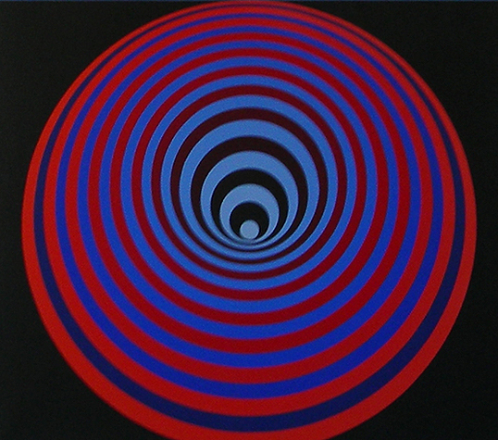
Graphics hardware and software Program: Vasarely painting
Szirmay-Kalos László

Slide 24
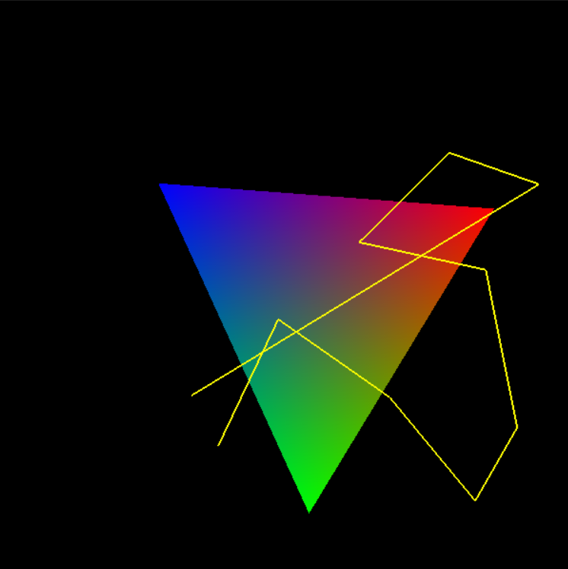
Graphics hardware and software Program: Animation and interaction
Szirmay-Kalos László

Slide 25
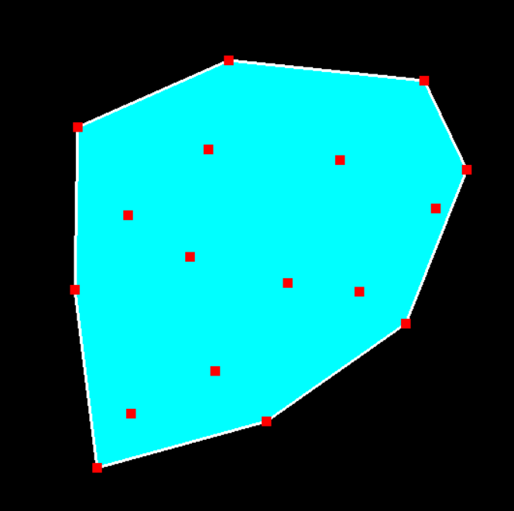
Graphics hardware and software Program: Convex hull, interaction
Szirmay-Kalos László

Slide 26
Convex hull
Minimal convex set that contains the given points
Start the lowest point, initial direction is to right
While (not back to start) {
Next point with minimal turn.
}

Slide 27
Vertex and fragment shaders
Vertex shader:
layout(location = 0) in vec2 vertexPosition;
void main() {
gl_Position = vec4(vertexPosition, 0, 1);
}
Fragment shader:
uniform vec3 color;
out vec4 fragmentColor;
void main() {
fragmentColor = vec4(color, 1);
}

Slide 28
Object
struct Object {
unsigned int vao, vbo; // gpu
std::vector<vec2> vtx; // cpu
Object() {
glGenVertexArrays(1, &vao); glBindVertexArray(vao);
glGenBuffers(1, &vbo); glBindBuffer(GL_ARRAY_BUFFER, vbo);
glEnableVertexAttribArray(0);
glVertexAttribPointer(0, 2, GL_FLOAT, GL_FALSE, 0, NULL);
}
void updateGPU() {
glBindVertexArray(vao); glBindBuffer(GL_ARRAY_BUFFER,vbo);
glBufferData(GL_ARRAY_BUFFER, vtx.size() * sizeof(vec2),
&vtx[0], GL_DYNAMIC_DRAW);
}
void Draw(int type, vec3 color) {
if (vertices.size() > 0) {
glBindVertexArray(vao);
gpuProgram.setUniform(color, "color");
glDrawArrays(type, 0, vertices.size());
}
}
};

Slide 29
Convex hull
class ConvexHull {
Object p, h; // points and hull
public:
void addPoint(vec2 pp) { p.vtx.push_back(pp); }
void update() {
if (p.vtx.size() >= 3) findHull();
p.updateGPU();
h.updateGPU();
}
vec2 * pickPoint(vec2 pp) {
for (auto& v : p.vtx) if (length(pp-v) < 0.05f) return &v;
return nullptr;
}
void findHull();
void Draw() {
h.Draw(GL_TRIANGLE_FAN, vec3(0, 1, 1));
h.Draw(GL_LINE_LOOP, vec3(1, 1, 1));
p.Draw(GL_POINTS, vec3(1, 0, 0));
}
};

Slide 30
Convex hull generation
void ConvexHull::findHull() {
h.vtx.clear();
vec2 * vStart = &p.vtx[0]; // Find lowest point
for (auto& v : p.vtx) if (v.y < vStart->y) vStart = &v;
vec2 vCur = *vStart, dir(1, 0), *vNext;
do { // find convex hull points one by one
float maxCos = -1;
for (auto& v : p.vtx) { // find minimal left turn
float len = length(v – vCur);
if (len > 0) {
float cosPhi = dot(dir, v – vCur) / len;
if (cosPhi > maxCos) { maxCos = cosPhi; vNext = &v;}
}
}
h.vtx.push_back(*vNext); // save as convex hull
dir = normalize(*vNext – vCur); // prepare for next
vCur = *vNext;
} while (vStart != vNext);
}

Slide 31
Virtual world, initialization and display
ConvexHull * hull;
vec2 * pickedPoint = nullptr;
void onInitialization() {
glViewport(0, 0, windowWidth, windowHeight);
glLineWidth(2);
glPointSize(10);
hull = new ConvexHull;
gpuProgram.create(vertexSrc, fragmentSrc, "fragmentColor");
}
void onDisplay() {
glClearColor(0, 0, 0, 0);
glClear(GL_COLOR_BUFFER_BIT);
hull->Draw();
glutSwapBuffers();
}

Slide 32
Controller
vec2 PixelToNDC(int pX, int pY) { // if full viewport
return vec2(2.0f * pX / windowWidth - 1; // flip y axis
1.0f - 2.0f * pY / windowHeight);
}
void onMouse(int button, int state, int pX, int pY) {
if (button==GLUT_LEFT_BUTTON && state==GLUT_DOWN) {
hull->addPoint(PixelToNDC(pX, pY));
hull->update(); glutPostRedisplay(); // redraw
}
if (button==GLUT_RIGHT_BUTTON && state==GLUT_DOWN)
pickedPoint = hull->pickPoint(PixelToNDC(pX, pY));
if (button==GLUT_RIGHT_BUTTON && state==GLUT_UP)
pickedPoint = nullptr;
}
void onMouseMotion(int pX, int pY) {
if (pickedPoint) {
*pickedPoint = vec2(PixelToNDC(pX, pY));
hull->update(); glutPostRedisplay(); // redraw
}
}

Slide 33
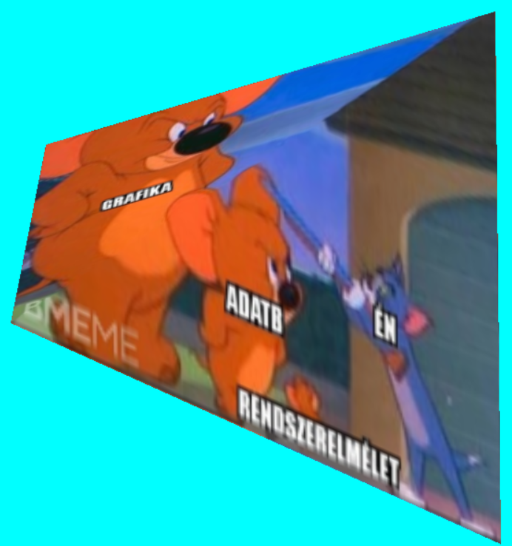
“Everything must be made as simple as possible. But not simpler.” Albert Einstein
2D texturing
Szirmay-Kalos László

Slide 34
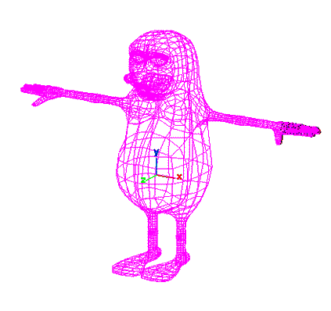
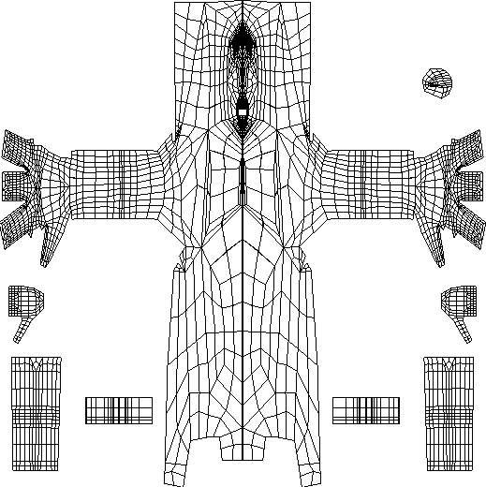
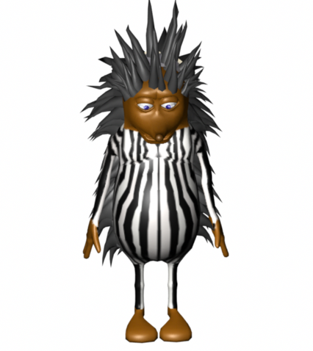
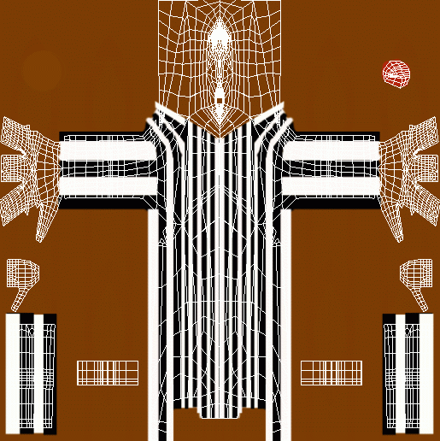
2D texturing

Slide 35



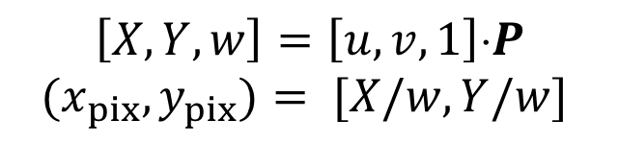


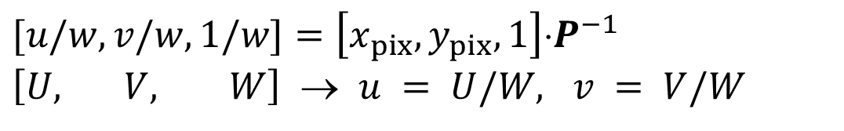



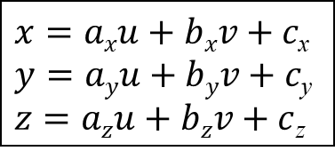

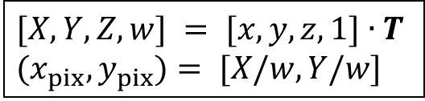



2D texturing
Paraméterezés
$$\left[X, Y, w\right]=\left[u,v,1\right]⋅P$$
$$(x_{pix},y_{pix})= [X/w, Y/w]$$
$$x=axu+bxv+c\text{x}$$
$$y=ayu+byv+c\text{y}$$
$z=azu+bzv+c$_{z}
Képszintézis
$$[X, Y, Z,w] = [x,y,z,1]∙T$$
$$(x_{pix},y_{pix})= [X/w, Y/w]$$
v
1
$$(x1,y1,z1)$$
$$(u1,v1)$$
$$y_{pix}$$
$$[X_{1},Y_{1},w_{1}]$$
$$(x2,y2,z2)$$
$$(u3,v3)$$
$$(u2,v2)$$
z
$$(x3,y3,z3)$$
$$[X_{3},Y_{3},w_{3}]$$
$$[X_{2},Y_{2},w_{2}]$$
y
u
x
$$x_{pix}$$
Texture space:
Unit square
1
Model
Image
$$[u/w, v/w, 1/w]=\left[x_{pix},y_{pix},1\right]⋅P^{−1}$$
$\left[U, V, W\right]$ → $u = U/W, v = V/W$
Notes:
2D texture mapping can be imagined as wallpapering. We have a wallpaper that defines the image or the function of a given material property. This image is defined in texture space as a unit rectangle. The wallpapering process will cover the region with this image. This usually implies the distortion of the texture image. To execute texturing, we have to find a correspondence between the region and the 2D texture space. After vectorization, the region is a triangle mesh, so for each triangle, we have to identify a 2D texture space triangle, which will be painted onto the model triangle. The definition of this correspondence is called parameterization. A triangle can be parameterized with an affine transformation (x, y are linear functions of u, v). This can be seen by counting the number of unknowns in a pair of linear functions (6) and counting the number of constraints for an affine transformation to map one given triangle onto another given triangle (this is also 6). So for unknown a_{x} , b_{x} , c_{x} , a_{y} , b_{y} , c_{y} parameters, we can establish a system of equations where the number of unknowns is the same as the number of equations.
Screen space coordinates (X,Y) are obtained with affine or to be general with homogeneous linear transformation from x, y. Thus the mapping between texture space and screen space is also a homogeneous linear transformation:
The triangle is rasterized in screen space. When a pixel is processed, texture coordinate pair u, v must be determined from pixel coordinates X,Y, which requires the execution of the inverse of this homogeneous linear transformation. If we need the result in Cartesian coordinates, homogeneous division is also needed. In other words, homogeneous coordinates [U, V, H] depend linearly on pixel coordinates X and Y, and then Cartesian texture coordinates are obtained as u = U/H, v = V/H.

Slide 36





Interpolation
Screen
$$U$$
$$U(x_{pix},y_{pix})=Aux_{pix}+Buy_{pix}+Cu$$
$$y_{pix}$$
$$x_{pix}$$
$$U(x_{pix}+1,y_{pix})=U(x_{pix},y_{pix})+Au$$
Notes:
The crucial problem is then the linear interpolation of the color, properties in general, or texture coordinates for internal pixels. This interpolation must be fast as we have just a few nanoseconds for each pixel. Let us denote the interpolated property by U. Linear interpolation means that U is a linear function of pixel coordinates X, Y. Linear function U(X,Y) = A_{u} X+B_{u}Y+C_{u} evaluation would require two multiplications and two additions. This can be reduced to a single addition if we use the incremental concept and focus on the difference between the U values of the current and previous pixels in this scanline: U(X+1,Y) = U(X,Y) + A_{u}.

Slide 37


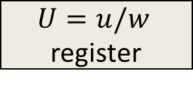


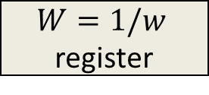
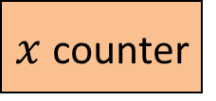


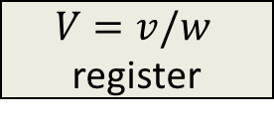
Interpolation hardware
$$x_{pix}$$
$$u(x_{pix},y_{pix})$$
$$v(x_{pix},y_{pix})$$
Div
Div
$x$ counter
$$W=1/w$$
register
$$U=u/w$$
register
$$V=v/w$$
register
CLK
Σ
Σ
Σ
$$Aw$$
$$Au$$
$$Av$$
Notes:
Such an incremental algorithm is easy to be implemented directly in hardware. A counter increments its value to generate coordinate X for every clock cycle. A register that stores the actual U coordinate in fixed point, non-integer format (note that increment A is usually not an integer). This register is updated with the sum of its previous value and A for every clock cycle. For a texture coordinate, we execute linear interpolation for the three homogeneous coordinates [U, V, H].
From these, the u, v Cartesian texture coordinates are obtained by two additional division.

Slide 38




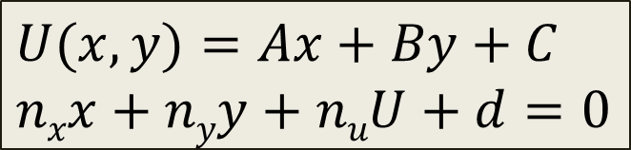


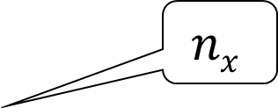
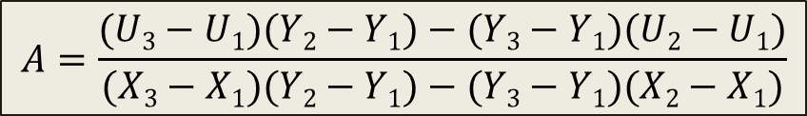


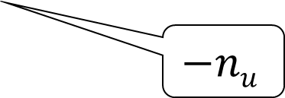
Triangle setup
$$(x2,y2,U2)$$
$$U$$
$$U1=Ax1+By1+C$$
$$U2=Ax2+By2+C$$
$$U3=Ax3+By3+C$$
$$n$$
$$(x1,y1,U1)$$
$$nx$$
$$y$$
$$(x3,y3,U3)$$
$$A=\frac{(U3−U1)(Y2−Y1)−(Y3−Y1)(U2−U1)}{(X3−X1)(Y2−Y1)−(Y3−Y1)(X2−X1)}$$
$$x$$
$$−nu$$
$$U(x,y)=Ax+By+C$$
$$nxx+nyy+nuU+d=0$$
$$n=(X2−X1,Y2−Y1,U2−U1)  (X3−X1,Y3−Y1,U3−U1)$$
Notes:
The final problem is how increment A is calculated. One way of determining it is to satisfy the interpolation constraints at the three vertices. It means that substituting the X, Y coordinates of the vertices into the linear expression, we should obtain the value to be interpolated at the three vertices. This is a system of linear equations for unknown A, B, C.
The other way is based on the recognition that we work with the plane equation where X,Y,U coordinates are multiplied by the coordinates of the plane’s normal. The normal vector, in turn, can be calculated as a cross product of the edge vectors.

Slide 39
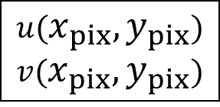
Texture filtering (GL_NEAREST)
Magnification
Minification
$$u(x_{pix},y_{pix})$$
$$v(x_{pix},y_{pix})$$
v
Y
u
X
Texture space
Screen
Notes:
Rasterization visits pixels inside the projection of the triangle and maps the center of the pixel from screen space to texture space to look up the texture color. This mapping will result in a point that is in between the texel centers.
Suppose that we step onto the next pixel. Consequently, the transformed u, v texture coordinates also change. This change can be smaller than a texel or bigger than a texel. Looking at this situation from the other direction, the first case is when a texel covers multiple pixels. This is called magnification. The second case is when many texels are mapped to a single pixel and the pixel color is determined by that texel which is lucky enough to be mapped onto the pixel center. This case is called minification.
From signal processing point of view, the texture can be considered as a signal, which is sampled at the pixel centers. In the optimal case, one texel corresponds to one pixel. In case of magnification, texels will be large, which is oversampling. In case of minification, texels are too small and are undersampled and the result will be a mess or noise.

Slide 40
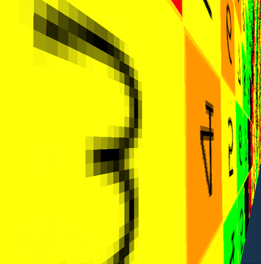
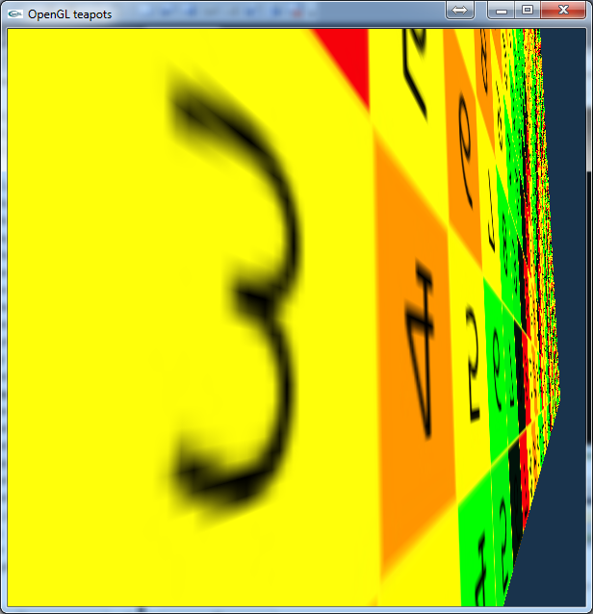
Correspondence of texture and image spaces
Magnification
Minification
glTexParameteri(GL_TEXTURE_2D,GL_TEXTURE_MAG_FILTER,GL_NEAREST);
glTexParameteri(GL_TEXTURE_2D,GL_TEXTURE_MIN_FILTER,GL_NEAREST);
Notes:
In case of oversampling or undersampling artifacts occur. Magnification makes the individual texels obvious. Minification converts the pattern to a noise. When these images were rendered, the pixel is colored with the texel covering its center. This sampling strategy is called GL_NEAREST in OpenGL. The sampling strategy can be set with the glTexParameter function separately for the minification (GL_TEXTURE_MIN_FILTER) and magnification (GL_TEXTURE_MAG_FILTER).

Slide 41
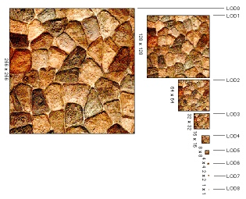
Mip-map (multum in parvo) Good for minification
Y
X
a) glTexParameteri(GL_TEXTURE_2D, GL_TEXTURE_MIN_FILTER,
GL_LINEAR_MIPMAP_NEAREST); // Mip-mapping
b) glTexParameteri(GL_TEXTURE_2D, GL_TEXTURE_MIN_FILTER,
GL_LINEAR_MIPMAP_LINEAR); // Tri-linear filtering
Notes:
The solution for the undersampling problem is filtering. Instead of mapping just the center of the pixel, the complete pixel rectangle must be mapped to texture space at least approximately, and the average of texel colors in this region should be returned as a color. However, it would be too time consuming.
One efficient approximation is to prepare the texture not only in its original resolution, but also in half resolution, quarter resolution, etc. where a texel represents the average color of a square of the original texel. During rasterization, OpenGL estimates the magnification factor, and looks up the appropriate version of filtered, downsample texture. The collection of the original and downsampled textures is called mip-map.

Slide 42
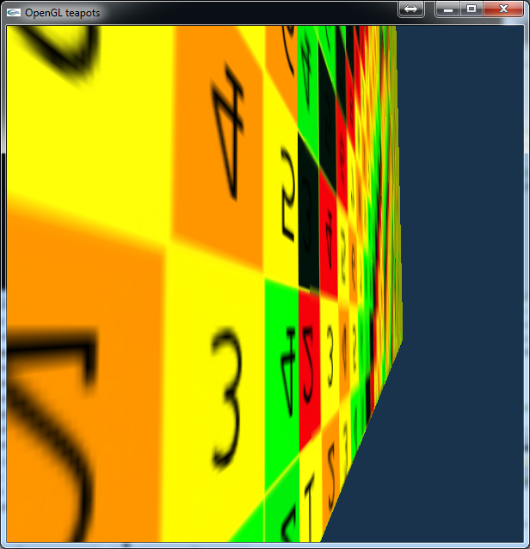
Mip-map (GL_LINEAR_MIPMAP_...)
GL_NEAREST
GL_LINEAR_MIPMAP_NEAREST
Notes:
Indeed, with mip-mapping undersampling artifacts disappear. Mip-mapping can be selected with GL_LINEAR_MIPMAP_NEAREST texture sampling strategy.

Slide 43
Bi-linear texture filtering (GL_LINEAR) Good for magnification
glTexParameteri(GL_TEXTURE_2D,
GL_TEXTURE_MIN_FILTER, GL_LINEAR);
glTexParameteri(GL_TEXTURE_2D,
GL_TEXTURE_MAG_FILTER, GL_LINEAR);
Notes:
There is another simpler filtering scheme, which is particularly good for magnification, i.e. to reduce oversampling artifacts. In this method, when a pixel center is mapped to texture space, not only the closest texel is obtained but the four closest ones, and the filtered color is computed as the bi-linear interpolation of their colors.

Slide 44
Bi-linear filtering (GL_LINEAR)
GL_NEAREST
GL_LINEAR
Notes:
As these images demonstrate, bi-linear filtering smears the ugly texel edges.

Slide 45
Texturing support of the GPU
VAO
Vertex
Shader
CPU
glTexParameter
Rasterizer
Texture
Sampler
Texture
textureId
Sampler
GL_TEXTURE0
glTexImage2D
FragmentShader
SamplerUnit
Notes:
If we wish to use texturing, four steps should be executed. In this slide we show how to upload an image to the GPU that is to be used as a 2D texture. Additionally, texture sampling/filtering is also specified, which is neareast neighbor in case of minification and bi-linear filtering in case of magnification.
Note that OpenGL is an output library, so it gives no help to create or read a texture from a file. This is the programmers’ responsibility, which should be done in the LoadImage function.

Slide 46
Texturing 1: Upload to GPU
CPU
VAO
Vertex
Shader
glTexParameter
Texture
Sampler
FragmentShader
SamplerUnit
Texture
textureId
Sampler
GL_TEXTURE0
glTexImage2D
unsigned int textureId;
void UploadTexture(int width, int height, vector<vec4>& image) {
glGenTextures(1, &textureId);
glBindTexture(GL_TEXTURE_2D, textureId); // binding
glTexImage2D(GL_TEXTURE_2D, 0, GL_RGBA, width, height, 0,
GL_RGBA, GL_FLOAT, &image[0]); //Texture -> GPU
glTexParameteri(GL_TEXTURE_2D, GL_TEXTURE_MIN_FILTER, GL_NEAREST);
glTexParameteri(GL_TEXTURE_2D, GL_TEXTURE_MAG_FILTER, GL_LINEAR);
}
Your responsibility
Mip-map level
Border
Notes:
If we wish to use texturing, four steps should be executed. Here we show how to upload an image to the GPU that is to be used as a 2D texture.
A texture is a resource, so first a resource id should be generated similarly to VAOs and VBOs. Texture ids are generated with the glGenTextures function. The first parameter, similarly to VAOs and VBOs is the number of ids to be generated, and the second is an array where ids are given back. Now we generate a single id, so the second parameter is just a single element array, i.e. a single unsigned integer. We bind the generated texture id to render target GL_TEXTURE_2D. It means that from this point all operations that use a GL_TEXTURE_2D resource will refer to this texture until another id is bound.
With glTexImage2D we can upload the image into the texture. The parameters are as follows:
1. GL_TEXTURE_2D: the particular target texture is the one that is bound to GL_TEXTURE the most recently (this is our texture of ide textureId).
2. Mip-map level, which is 0 in this case.
3. Target format, which is GL_RGBA, i.e. this is a color texture also containing the alpha channel so transparent colors are also allowed.
4.-5. The width and the height of the texture in texels.
6. Border, which is 0. This border parameter may add extra pixel at the boundary to support, for example, bi-linear filtering even at the edge of the texture.
7.-8. Source format, which is GL_RGBA and all of them in GL_FLOAT in this example. This specifies the organization of the data in source image array called image.
- 9. Source address, which is the starting address of the image array.
Additionally, texture sampling/filtering is also specified with the glTexParameter function, which is nearest neighbor in case of minification and bi-linear filtering in case of magnification.
Note that OpenGL is an output library, so it gives no help to create or read a texture from a file. The preparation of input parameter ”image” is the programmers’ responsibility.

Slide 47
Texturing 2: Equip objects with texture coordinates
glGenVertexArrays(1, &vao);
glBindVertexArray(vao);
glGenBuffers(2, vbo);// Generate 2 vertex buffer objects
// vertex coordinates: vbo[0] -> Attrib Array 0 -> vertices
glBindBuffer(GL_ARRAY_BUFFER, vbo[0]);
float vtxs[] = {x1, y1, x2, y2, …};
glBufferData(GL_ARRAY_BUFFER, sizeof(vtxs),vtxs, GL_STATIC_DRAW);
glEnableVertexAttribArray(0);
glVertexAttribPointer(0, 2, GL_FLOAT, GL_FALSE, 0, NULL);
// vertex coordinates: vbo[1] -> Attrib Array 1 -> uvs
glBindBuffer(GL_ARRAY_BUFFER, vbo[1]);
float uvs[] = {u1, v1, u2, v2, …};
glBufferData(GL_ARRAY_BUFFER, sizeof(uvs), uvs, GL_STATIC_DRAW);
glEnableVertexAttribArray(1);
glVertexAttribPointer(1, 2, GL_FLOAT, GL_FALSE, 0, NULL);
Notes:
The second step equips the object to be textured with texture coordinates or so called uvs. That is, for every vertex we also specify a texture space point from where the color or data should be fetched if this vertex is rendered.
In the shown program our VAO has two VBOs, one stores the modeling space Cartesian coordinates of the vertices and the second the texture space coordinates of the same vertices. We direct modeling space coordinates to input register 0 and texture space coordinates to input register 1.

Slide 48
Texturing 3: Vertex és Pixel Shader
layout(location = 0) in vec2 vtxPos;
layout(location = 1) in vec2 vtxUV;
out vec2 texcoord;
void main() {
gl_Position = vec4(vtxPos, 0, 1) * MVP;
texcoord = vtxUV;
…
}
uniform sampler2D samplerUnit;
in vec2 texcoord;
out vec4 fragmentColor;
void main() {
fragmentColor = texture(samplerUnit, texcoord);
}
Notes:
When the object is rendered, the content of the VBOs flows to the vertex shader.
The vertex shader gets the location of the vertex in input register 0, which is called vtxPos, and also the uv associated with this vertex in input register 1, which is called vtxUV. The location is transformed to normalized device space by the vertex shader and written into the output register gl_Position. The input texture coordinate vtxUV is only copied to the output called texcoord by the vertex shader.
The fixed function hardware interpolates the texture coordinates and generates a sequence of pixels for which the fragment shader is run. The fragment shader looks up the texture memory using the interpolated texture coordinate texcoord via the texture sampler unit, called samplerUnit with the texture function.

Slide 49
Texturing 4: Active texture and sampler
CPU
Texture
Sampler
Shader
Processor
samplerUnit
Texture
textureId
Sampler
GL_TEXTURE0
unsigned int textureId;
void Draw( ) {
int sampler = 0; // which sampler unit should be used
int location = glGetUniformLocation(shaderProg, "samplerUnit");
glUniform1i(location, sampler);
glActiveTexture(GL_TEXTURE0 + sampler); // = GL_TEXTURE0
glBindTexture(GL_TEXTURE_2D, textureId);
glBindVertexArray(vao);
glDrawArrays(GL_TRIANGLES, 0, nVtx);
}
Notes:
When the object is rendered, we should select the active texture and also connect the shader processor to this texture via a sampler unit. The samplerUnit variable of the shader program gets the id of the sampler unit (zero in this example). This can go from zero up to the number of sampler units available in the GPU (this is at least 8, but is typically higher).
With the glActiveTexture and glBindTexture calls, we also establish the connection between the texture in the texture memory and the sampler unit.
Finally, we can send our object identified by the vao through the pipeline and enjoy its textured rendering.

Slide 50

Image viewer
float vtx = {-1,-1, 1,-1, 1,1, -1, 1};
glBufferData(GL_ARRAY_BUFFER,
sizeof(vtx), vtx, GL_STATIC_DRAW);
NDC: (+1,+1)
Tex: (1,1)
(1,1)
(vr, vt)
(u,v)
(u,v)
(vl, vb)
uniform sampler2D textureUnit;
in vec2 uv;
out vec4 fragmentColor;
void main() {
fragmentColor =
texture(textureUnit, uv);
}
NDC: (-1,-1)
Tex: (0,0)
(0,0)
Full screen
Textured
quad
Screen:
pixels
Interpolated
texCoord
Texture
layout(location = 0) in vec2 vp; // Attrib Array 0
out vec2 uv;// output attribute
void main() {
uv = (vp + vec2(1, 1)) / 2; // clipping to texture space
gl_Position = vec4(vp.x, vp.y, 0, 1);
}
Notes:
An image needs to be shown on screen, we can do it by rendering a full viewport rectangle textured with the image. On the CPU, the rectangle is defined by an appropriate coordinate system, which is preferred to be the normalized device space since vertices have to be transformed to normalized device space anyway.
The vertex shader gets the vertex in normalized device space, which is copied to the gl_Position register without any relevant modification. Additionally, the texture coordinate of the point is calculated and put in output attribute uv. In normalized device space a full viewport rectangle has opposite corners (-1, -1) and (1, 1), while in texture space these opposite corners are (0, 0) and (1, 1). So uv is computed by mapping the two different coordinates.
When the rectangle is rasterized, the uv texture coordinate is interpolated for internal pixels. So, when the fragment shader runs, its input parameter uv refers to the texel corresponding to this particular pixel. Texturing is just done by looking up the texel addressed by uv via texture sampling unit called texureUnit. Note that this unit will perform bi-linear or mip-map filtering if it is configure accordingly.

Slide 51
Image viewer
float vtx = {-1,-1, 1,-1, 1,1, -1, 1};
glBufferData(GL_ARRAY_BUFFER,
sizeof(vtx), vtx, GL_STATIC_DRAW);
NDC: (+1,+1)
Tex: (1,1)
(1,1)
(vr, vt)
(u,v)
(u*,v*)
(vl, vb)
NDC: (-1,-1)
Tex: (0,0)
(0,0)
Full screen
Textured
quad
Screen:
pixels
Interpolated
texCoord
Texture
layout(location = 0) in vec2 vp; // Attrib Array 0
out vec2 uv;// output attribute
void main() {
uv = (vp + vec2(1, 1)) / 2; // clipping to texture space
gl_Position = vec4(vp.x, vp.y, 0, 1);
}
Notes:
In the previous example, the texture was looked up at the location determined by interpolation. If we apply a distortion in the address calculation, we can distort the image itself. For example, if the texture is looked up at u* = u + 0.1, i.e. the interpolated u is increased by 0.1, then that new pixel gets the color of original pixel corresponding to u, which was associated with u*-0.1. So the image will be translated. We are not restricted to simple linear operations, which opens the room for exciting image effects.

Slide 52

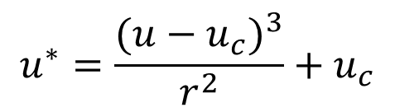
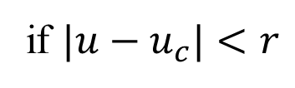
Magic lense
u*
texels
u
$$u^{∗}=\frac{{(u−u_{c})}^{3}}{r^{2}}+u_{c}$$
r
r
if $|u−u_{c}|<r$
u_{c}
pixels
uniform sampler2D textureUnit;
uniform vec2 uvc; // cursor position in texture space
in vec2 uv; // interpolated texture coordinates
out vec4 fragmentColor;
void main() {
const float r2 = 0.05f;
float d2 = dot(uv - uvc, uv - uvc);
vec2 tuv = (d2 < r2) ? (uv - uvc) * d2 / r2 + uvc : uv;
fragmentColor = texture(textureUnit, tuv);
}
Notes:
Let uvc be a point in texture space, selected by the cursor in this example. The texture coordinates are modified in the center of radius r around uvc (in this program we define the square of the radius r2). The modification is a cubic function, which has the effect that a magic lense magnifies the image around the cursor.

Slide 53

Swirl
uniform sampler2D textureUnit;
uniform vec2 uvc; // cursor position in texture space
in vec2 uv; // interpolated texture coordinates
out vec4 fragmentColor;
void main() {
const float a = 8, alpha = 15;
float ang = a * exp( -alpha * length(uv - uvc) );
mat2 rotMat = mat2( cos(ang), sin(ang),
-sin(ang), cos(ang) );
vec2 tuv = (uv - uvc) * rotMat + uvc;
fragmentColor = texture(textureUnit, tuv);
}
Notes:
Swirls is a rotation where the angle of rotation gets larger as we approach the center of rotation. The rotation angle ang is controlled by an exponential function of the distance between current pixel uv and cursor position uvc. The rotation is executed around uvc by translating the uvc first to the origin, rotating by matrix rotMat around the origin, and translating the origin back to uvc.

Slide 54

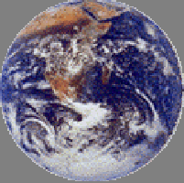
Gravity (black hole)
z=0
z=1
(1,1)
(u,v)
(u*,v*)
(0,0)
Interpolated
texCoord
Texture
Notes:
In this effect, we assume that a large mass but small size object, e.g. a black hole is in front of the image, which distorts space and also lines of sight.

Slide 55

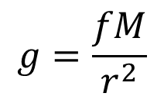



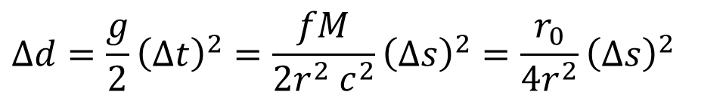



Equivalence principle
=
$$m$$
$$∆d=\frac{g}{2}{\left(∆t\right)}^{2}=\frac{fM}{{2r}^{2} c^{2}}{\left(∆s\right)}^{2}=\frac{r_{0}}{{4r}^{2}}{\left(∆s\right)}^{2}$$
$$∆s=c∆t$$
$$\frac{r_{0}}{2}$$
$$:Schwarzschild radius$$
$$g=\frac{fM}{r^{2}}$$
p
$$∆s$$
$$g$$
dir
void main() {
const float r0 = 0.09f, ds = 0.001f;
vec3 p = vec3(uv,0), dir = vec3(0,0,1), blackhole = vec3(uvc,0.5f);
float r2 = dot(blackhole - p, blackhole - p);
while (p.z < 1 && r2 > r0 * r0) {
p += dir * ds;
r2 = dot(blackhole - p, blackhole - p);
vec3 gDir = (blackhole - p)/sqrt(r2); // gravity direction
dir = normalize(dir * ds + gDir * r0 / r2 / 4 * ds * ds);
}
if (p.z >= 1) fragmentColor = texture(textureUnit,vec2(p.x,p.y));
else fragmentColor = vec4(0, 0, 0, 1);
}
Notes:
The amount of distortion can be computed exploiting the equivalence principle that states that gravity and acceleration are the same and cannot be distinguished. We can easily determine the amount of light bending when our room is accelerating in a direction. Then, the same formula is applied when the room stands still but a black hole distorts the space.

Slide 56

Wave
waveDist=c*time
waveWidth=0.03
angIn
angIn-angRefr
angRefr
d
waterDepth=1
texture
uvc
uv
tuv
uniform float time;
const float PI = 3.14159265, n = 1.33, c = 0.1, aMax = 0.1;
void main() {
float d = length(uv - uvc), waveDist = c * time;
if (abs(d - waveDist) < waveWidth) {
float angIn = aMax/waveDist * sin((waveDist-d)/waveWidth*PI);
float angRefr = asin(sin(angIn)/n);
vec2 dir = (uv - uvc)/d;
vec2 tuv = uv + dir * tan(angIn - angRefr) * waterDepth;
fragmentColor = texture(textureUnit, tuv);
} else {
fragmentColor = texture(textureUnit, uv);
}
}
Notes:
In this final demo, we assume that image is covered by water and its surface is distorted by a wave started in a single point and moving in all directions with speed c. The width of the wave is waveWidth, its amplitude is decreased with the travelled distance. The distortion is computed by applying the Snells refraction law on the water surface.

