Slide 1
Micro- and Macroeconomics
BMEGT30A001
Lecturer: Zoltán Bánhidi (Micro) (Friday) and Zsolt Gilányi (Macro) (Wednesday), Department of Economics
(banhidi.zoltan@gtk.bme.hu, gilanyi.zsolt@gtk.bme.hu)
Available: on request via mail, QA224.
Material (ppt presentation + text) available on moodle from week to week
Signature : On-line test on the 7th week in the time slot of the lecture 50%Micro+50%Macro
Offered grade: online test on the 14th week 50%Micro+50%Macro

Slide 2
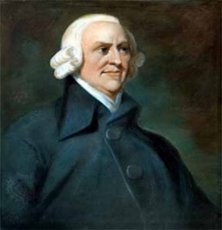
MACRO(ECONOMICS)
AIM: understand the workings of the economy in which we live
economy=economic system:
system that determines the accumulation of wealth
UNDERSTAND THE WORKINGS OF THE SYSTEM THAT DETERMINES THE ACCUMULATION OF WEALTH IN WHICH WE LIVE
A. Smith (1776):
An Inquiry into the Nature and Causes of the Wealth of Nations
Understand the workings of the system that determines the accumulation of wealth in which we live

Slide 3

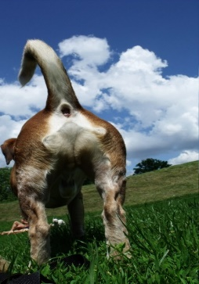
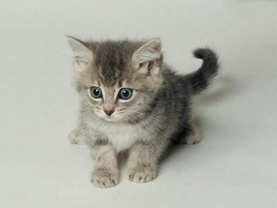

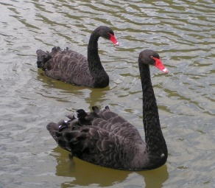
1. WAYS OF THEORIZING
► Scientifically
► Ideologically
Univocal definitions are required („check-list”)
1.1 Scientific theory building
Cats: have
tail
ears
fur
Behaviour:
- carnivore
Coherent deduction
POSTULATES
Result:
rub
hunt
Are these properties are really essential i.e. distinctive?
Test
M. Friedman!
reasonable
No
What is the behaviour of the cat/economy
Does not contradict the observations till now!
?
Reality:
yes

Slide 4



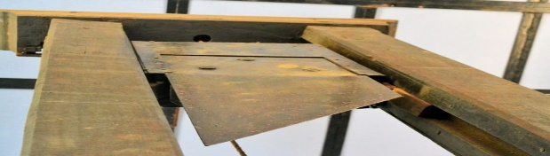

1.2 Ideology driven theorizing
„The ruling ideas of EACH AGE have ever been the ideas of its ruling class” (The Communist Manifesto, 1848)
Ideology: the explanation of the winners of the system as to why it is the "best of all worlds".
Has tail
carnivor
The system is fair and efficient
Feudalism Capitalism Socialism
Prevailing idea:
x
Liberalism
Communism
religion
Purchase on market: MONEY
CENTRAL PLANNIG BUREAU
GOD
FREE MARKET
Subordination by the force of human law
SOCIAL REFORM PROPOSAL
orchestrates the functioning of the socio-economic system with clockwork precision
end injustice
abolition of nobility
uniform people citizen
abolition of capitalists
uniform people proletarian
WHAT IS FREE MARKET?
„additional cost”
x
The univers that
The universe that GOD chose to exist is the best of all possbile worlds, otherwise it would have been unreasonable for God to create it.
(Leibnitz, 1710)
the LIBERALISTS the COMMUNISTS
chose to exist is the best of all possbile worlds …
We have the cure and the systemic characteristics without economic theory.
Then what for economic theory?

Slide 5
Understand the workings of the system that determines the accumulation of wealth in which we live
2. MINIMAL POSTULATES FOR THE STUDY OF WEALTH ACCUMULATION
► Postulate on indiviudal and social wealth (what is wealth?)
► Postulate on the ways of wealth accumulation
2.1 Nature of individual and social wealth
Social wealth = Σ individual wealth
2.1.1 Value theories / real analysis
wealthy = has many valuable possessions
valuable = exchangeable
You want it + You can only get it by giving something else to another person.
because it satisfies some human needs = useful
because you cannot have it free
= scarce
wealthy = has many useful things = commodity (good)
both individual and social wealth are manifested in goods
THUS INDIVIDUAL AND SOCIAL WEALTH ARE IDENTICAL IN NATURE (commodity)

Slide 6

2.1.2 Accounting approaches / monetary analysis
wealthy = (has many valuable possessions
+ claims – debts) expressed in monetary terms
Valuable = has positive price in terms of money
Individual wealth at time t-1 is the maximum amount of money that this individual can expect to spend in period t, ceteris paribus, after fulfilling all his contractual obligations relating to wealth and without engaging in any activity that affects his wealth (i.e. this capacity to spend money).
We call the same binding statement in the contractual obligations relating to wealth a financial asset for the holder of the statement and a financial liability for the issuer.
Binding statment
In exchange of this paper I give an apple on the spot..
agent A
signiture
Face value: quantity specified in the binding statement
All other possessions of an individual that are not financial assets (i.e. do not arise from a contractual relationship) are called real assets.

Slide 7
2.1.2
individual A
individual B
Liabilities
Binding statment
In exchange of this paper I give an apples on the spot..
agent A
Assets
Liabilities
Asset: possession (owned valuable stocks), it corresponds to some capacity to spend money
Liabilities: (your obigations)
Assets
Real asset
Financial liability
Financial asset
Individual
Wealth B
Individual
Wealth A
Real asset
Society
Financial asset//liability formally an asset/liability that is a liability/asset at the same time at another agent.
Two types: claim/debt (enforcable in terms of something other than itself) and non-claim/non-debt.
Pay (mainstream definition): honour a debt.
Real asset: formally is an asset that is not a liability at the same time at another agent (≠ good)
Assets
Liabilities
Valuable
Stocks of
the society
Real assets
Individual
Wealth A
So
ci
al
we
al
th
Individual
Wealth B
balance: the difference between the items entered into the two columns of an account
THUS INDIVIDUAL AND SOCIAL WEALTH IS OF DIFFERENT NATURE
financial assets disappear during social aggregation
The two column register on the magnitude and structure of wealth (balance sheet) or on the variation of these magnitudes expressed in a common unit of account is called account.

Slide 8
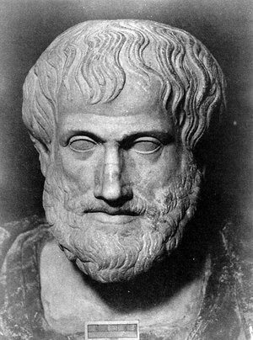

2.2 Basic behaviors that drive decisions about wealth
Aristotle: 2 major behaviors (logic/driving force) that drive individual decisions about wealth
OIKONOMIA : decision about wealth for the purpose of satisfying human needs commodity transformation for the purpose of satisfying human needs: C-(M)-C’.
Essence: C-C’
Money is inessential;
Relative prices (C/C’)
use of money for satisfaction of human needs
CRHMATISTIKÉ: the use of monetary wealth for the purpose of accumulating more
monetary wealth (money proliferation)
spending money to acquire more money: M-(C-C’)-M’
production
trade
loan
M-(C-C’)-M’
M-(C)-M’
M-M’
Money is essential;
Absolut prices (M/C)

Slide 9
2.3 The primary classification of theories on social wealth accumulation
After Adam Smith, the postulate of oikonomia became the dominant one, so the science of wealth accumulation was christened economics.
Mainstream is a synonym for dominant, which is a loose, non-scientific term.
Mikroeconomics study of individual wealth accumulation in orthodox framework
Makroeconomics study of social wealth accumulation (by postulating oikonomia + almost exclusively in orthodox framework)

