Slide 1
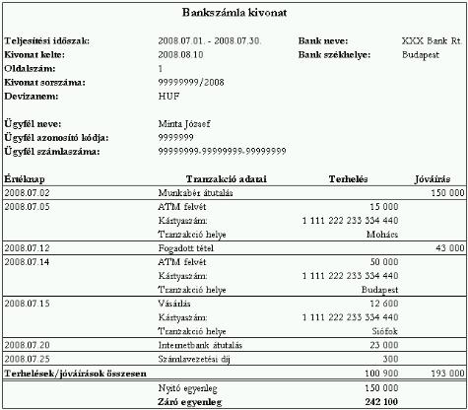
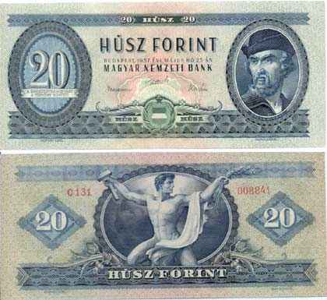
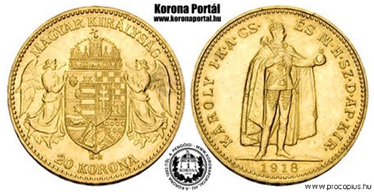
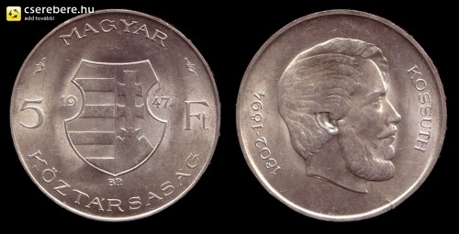
3. MONEY
Logically there is only one case where we do not need to define money: orthodox theory.
Empirically: there is money in the socio-economic system in which we live
we need money
3.1 What is money?
What are the common characteristics?
1/ its physical from does not matter
NOT PHYSICAL THING
THEN WHAT?
2/ it has a unit (HUF, $, …)
3/ it is used for payment

Slide 2
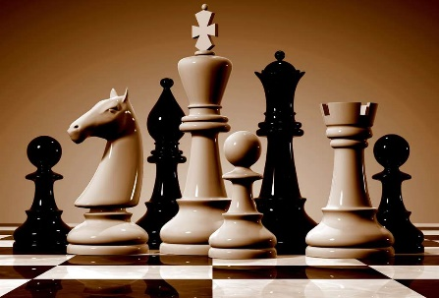
3.1
An analogy
What is rook?
1/ Without the rules of the chess it is impossible to interpret the rook! 2/ What makes the rook different from other pieces in the chess?
1/ The set of rules where money makes sense:
Payment system: social rules governing the creation and termination of contractual obligations (contractual relationship relating to wealth)
Pay: terminate this contractual obligation. In conrete terms: - honour a debt (mainstream).
2/ What makes the difference between money and other assets (means of payment)
Money is any financial assets with wich one can pay all her debts.
3
1
2
high powered money: money that is money for all the economic agents
monetary system: payment system with money
Monetary system is specified by the following rules:
Rules on payment
2. Specfication of the common unit of account
3. Rules on money creation and (destruction)

Slide 3
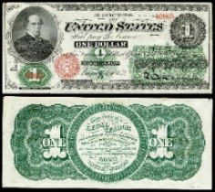
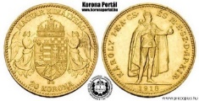
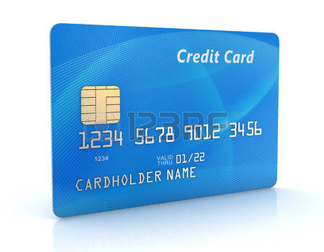
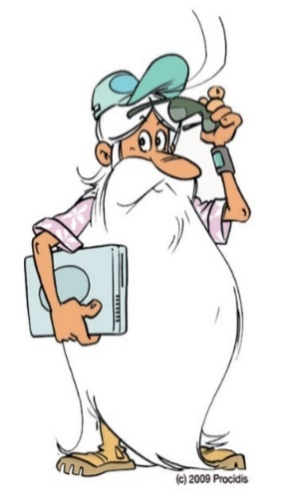
3.1
Rules on money creation and (destruction)
Two theoretical options:
► PURCHASE
Postulates
Non issuer of money
Issuer of money
A L
A L
Real asset
Real asset
Money
Money
► CREDIT (LOAN)
Bank
create money via credit operation
Non bank
Money
Loan (debt)
Loan (claim)
Money
Extinction
= return to the creator
TAX
Reimbursment of loans
Same driving force leads acceptance: the claim (loan/tax) can be paid exclusively with money.
… or petrol only for $

Slide 4



Appendix for 3.1
What is the distinctive characteristic of credit operation (financial loan)?
In money YES, but to see clearly:
agent B
Agent A
E F
E F
Non-financial loan
Statement
I owe Agent A two apples, to be paid next week.
B szereplő
debt
claim
Enforcable in terms of something other than itself– real asset!
Has maturity (must be paid in time)
asymmetric – order of execution matters
Statement
I owe Agent A a promise of two apples, to be paid next week.
B szereplő
Promise
I give an apple for this paper on the spot.
C szereplő
Financial loan
(credit operation)
debt
claim
Enforcable in terms of something other than itself– financial asset
Financial loan is not an equivalence relationship!

Slide 5
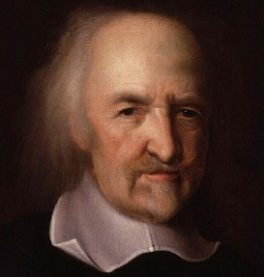
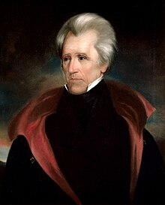
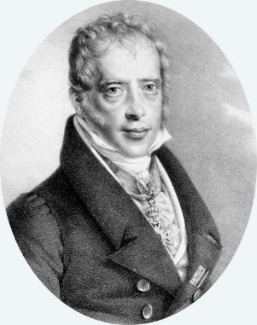
3.2 The primary importance of the control of money (monetary systm)
3.2.1 Logically
The process of wealth of accumulation is necessarily the joint action of the members of the society
Binding contractual obligations are repeatedly created and terminated.
Economics:
study of wealth accumulation
Etimology: private property
This is what economists say as production is collective: Everyone contributes to social wealth and acquires the right to appropriate part of it.
Necessarily, because of the definition of society
can get it from others
We called payment system the social rules that govern it.
which in monetary economies is
monetary system
Thomas HOBBES
(1588-1679)
Control of the money (monetary system)
Andrew Jackson (1767-1845)
7.President of the US
Wealth is power, derived from the institution of private property, to command members of society what to do through voluntary contractual obligations relating to wealth.
Command members of society
The most important power of the state is omitted:
money power
„„Give me control of a nation’s money, and I care not who makes its laws!””
Mayer Amschel Rothschild
1743-1812

Slide 6
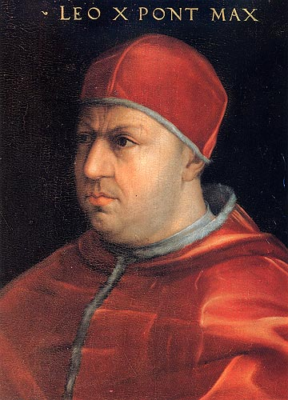
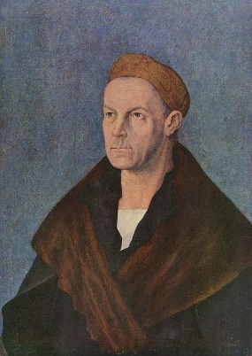
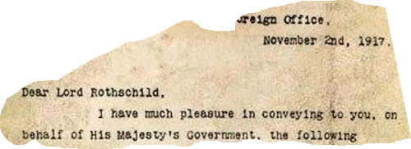
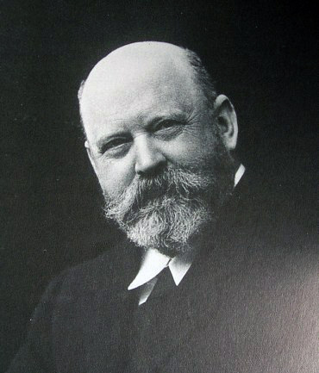

3.2.2 Some historical facts
1513: X. Leo
1513. Mars, 15: sacrificial priest,
17: bishop,
19: pope
Giovanni di Lorenzo de' Medici (1475-1521)
1519: V. (Habsburg) Karl German-Roman Emperor
Jakob Fugger
(1459–1525)
1917: Balfour declaration
Walter Rothschild (1868-1937)

Slide 7
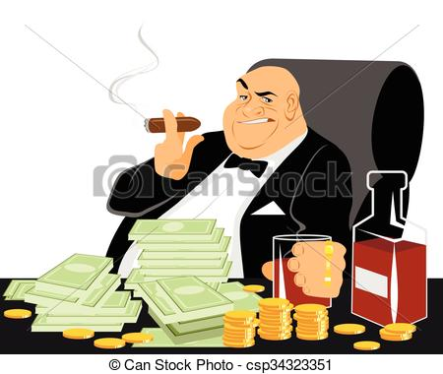
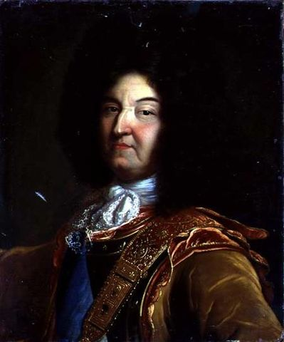
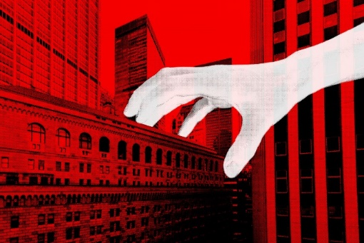
3.3 Evolution of monetary systems: from state issuance of money to private credit money system
3.3.1 Historical facts
Gold standard
Greenback
1861-1865
(Bretton Woods 1971)
Gold money system
Modern credit money
$
LOUIS XIV., Roi du Soleil (1638-1715)

