Slide 1

3.3.3 The evolution of monetary systems: the directions not taken
SOLUTION IN THE INTEREST OF THE COMMUNITY: exclusive and unlimited money power for the public, where money is not linked to anything (ex. precious metal).
SOLUTION IN THE INTEREST OF PRIVATE BANKERS: Gold standard monetary system
4. Alternative monetary systems in the past: proposals and exisiting ones
1. Chicago plan
2 Free money
3. Greenback

Slide 2
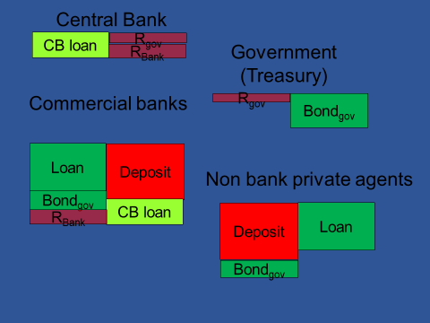
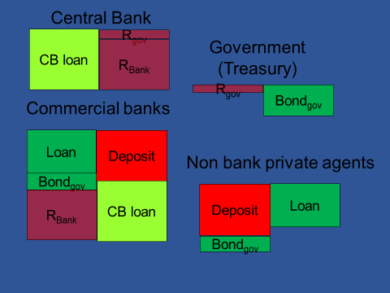
3.3.3 The evolution of monetary systems: the directions not taken
1 Chicago plan (1933)
Economic fluctuations can be reduced by separating credit and money, i.e. the existence of money does not presuppose the existence of loans.
Henry Simons, Irving Fisher
The state would take back the monopoly of money creation and its benefit.
Abolish private banks’ right to create money.
(= abolish private banks.)
Present situation
► 100% obligatory reserve rate
HOW TO IMPLEMENT?
Simplification: No cash

Slide 3
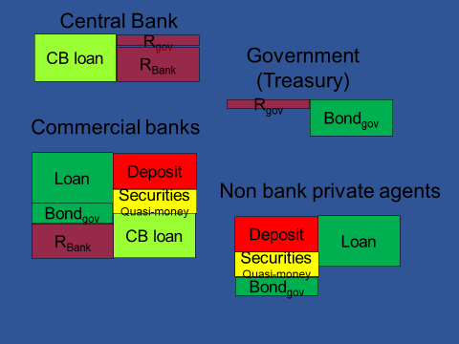
3.3.3 The evolution of monetary systems: the directions not taken
100% obligatory reserve rate is not effective: quasi-money
► 100% obligatory reserve rate +
► PROHIBITED for commercial banks to sell securities enforcable in terms of high powered money to the public

Slide 4

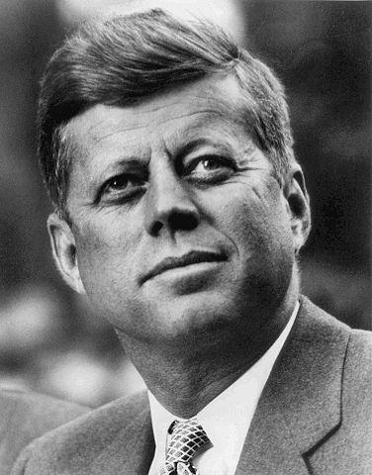
3.3.3 The evolution of monetary systems: the directions not taken
Economic fluctuations can be reduced by separating credit and money, i.e. the existence of money does not presuppose the existence of loans.
1 Chicago plan (1933)
The state would take back the monopoly of money creation and its benefit.
Abolish private banks’ right to create money.
(= abolish private banks.)
Heresy
Had he similar heretic ideas?
HOW TO IMPLEMENT?
► 100% obligatory reserve rate
► + PROHIBITED to issue bank securities encorcable in terms of high powered money to the private sector
CHICAGO SCHOOL (1970-)
AWARDED BY NOBEL PRICE
MONEY IS INESSENTIAL (Milton Friedman)
MONEY IS NEUTRAL (Robert Lucas)
Further benefic effects:
makes possible tax reduction and accordingly tax distortions;;
reduction of total outstanding loans (private+public; induced by the transactions demand for money) → credit risk decreases → loan price decreases → enhance economic activity.

Slide 5
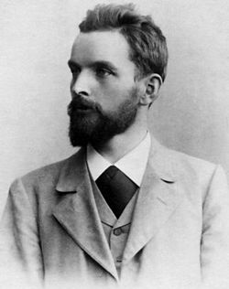
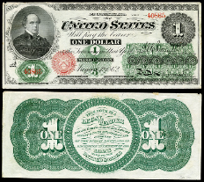
3.3.3 The evolution of monetary systems: the directions not taken
2 Free money (1916) proposal
Free money (monetary reform): money created via purchase by the state that steadily „evaporates”
make money similar to commodities to end asymmetric (monopol) situation : make it perishable
Silvio GESELL
3 Greenback, American Civil War, 1861-1865)
Money created via purchase by the state, not linked to gold
3.3.4 The evolution of monetary systems: new trends
Central Bank Issued Digital Currency CBDC)
Crypto moneies (ex. bitcoin) – not money here

Slide 6

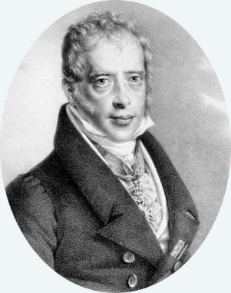

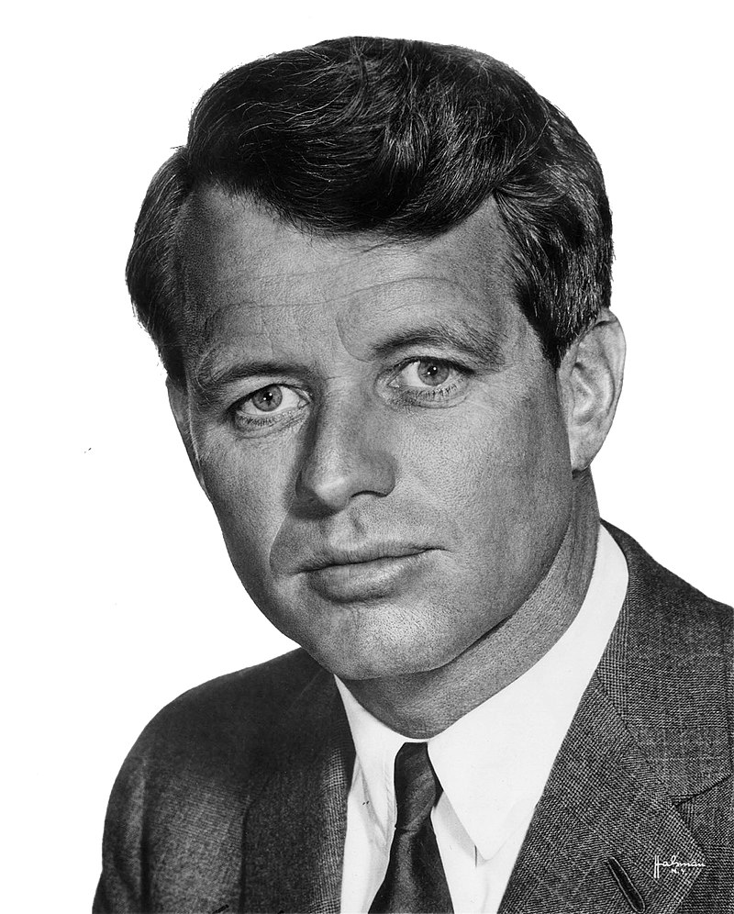
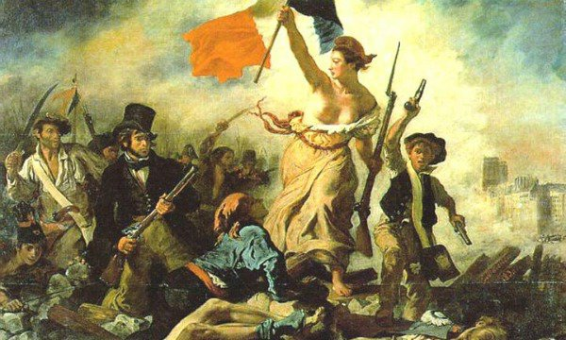
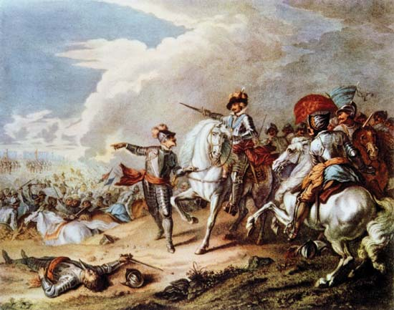
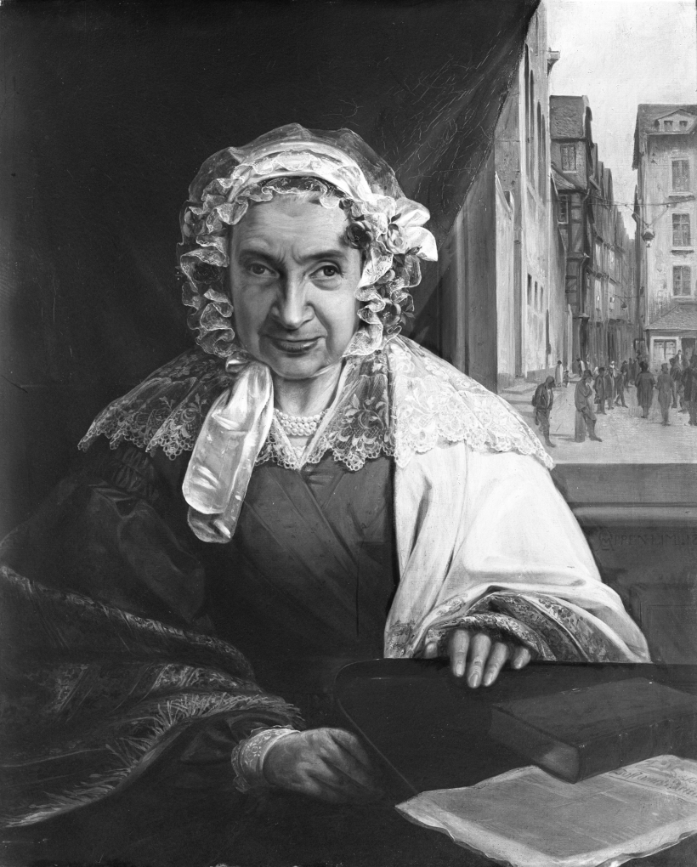


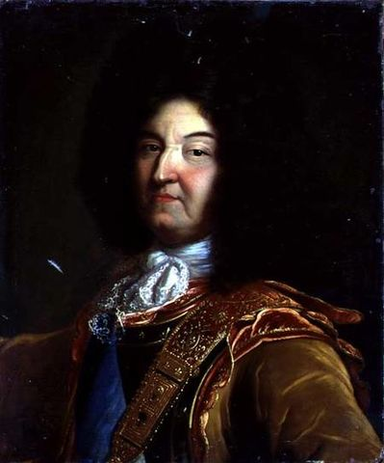
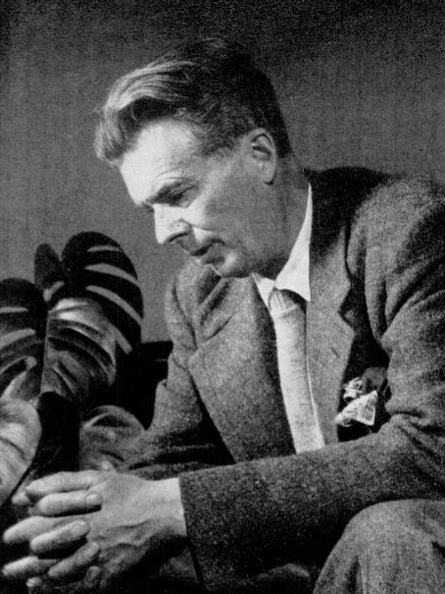
3.3.5 Historical facts: a non-mainstream narrative
„Give me control of a nation’s money, and I care not who makes its laws!”
Is the control of a nation’s money given?
thinking
Mayer Amschel Rothschild
(1744-1812)
HOW? „Do not take interest from an Israelite on anything, money or food or any other goods, which you let him have: From men of other nations you may take interest, but not from an Israelite:”
(Old Testament, Deuteronomy 23:19-20)
Gold standard
Robert Kennedy
(1925-1968)
John Fitzgerald Kennedy
(1917-1963)
Greenback
1861-1865
Modern credit money
Gold money
Gutle Schnapper
(M. A. Rothschild felesége)
1753-1849
$
„If my sons did not want wars, there would be none.”
XIV. Louis, Roi du soleil (1638-1715)
“In a capitalist democracy, … , never have so many been manipulated so much by so few.” (Brave New World Revisited, 1958)
Aldous Huxley
(1894-1963)
„L’Etat c’est moi”
Money power

Slide 7
EXERCICE Money creation
Exercice 1
Two tier banking system
Record the following activities (variations) in the balance sheets!
1/ Agent (A) takes a 100$ loan from commercial bank (A). We know that the obligatory reserve rate is 2% and bank (A) has no free reserves.
2/ Agent (A) transfers 100$ to agent (B), who has its accounts at commercial bank (B).
3/ Next day agent (B) withdraws 15$ from her account (thus to that time commercial bank A has already settled its debt).
4/ Agent (B) purchases from agent (A) for 85$ (pays with transfer). Agent (A) uses all her money to meet her debts included due interest (interest rate is 5%).
5/ Is it possible to reimburse the remaining 20$ loan?
Central Bank (CB)
RB+85
CBLA +100
RA+85
CBLA +15
C +15
Commercial Bank B (BB)
Commercial Bank A (BA)
Claim +20
CBLA+100
RB+85
+100
claim
CBLA +15
+85
D
RA+85
Individual wealth +5
RA+85
+85
D
Non bank agent B
Non bank agent A
C +15
+85
D
debt
+20
Debt
+100
+85
D

Slide 8
Exercice 2: Modern credit money system
Consider a two tier banking system with only digital currency (no cash). Government deficit is 100$ financed by treasury bonds; 80% issued to households and (20%) to commercial banks. The reserve ratio is 8% and can never drop below this level without causing the banking system’s disfunctioning. Register the events (variations: + increase; - decrease) (item name and amount) in accounts!
Emission of treasury bonds (help: similar to bank transfers)
Treasury spends
Commercial banks reimburse their debts

