Slide 1

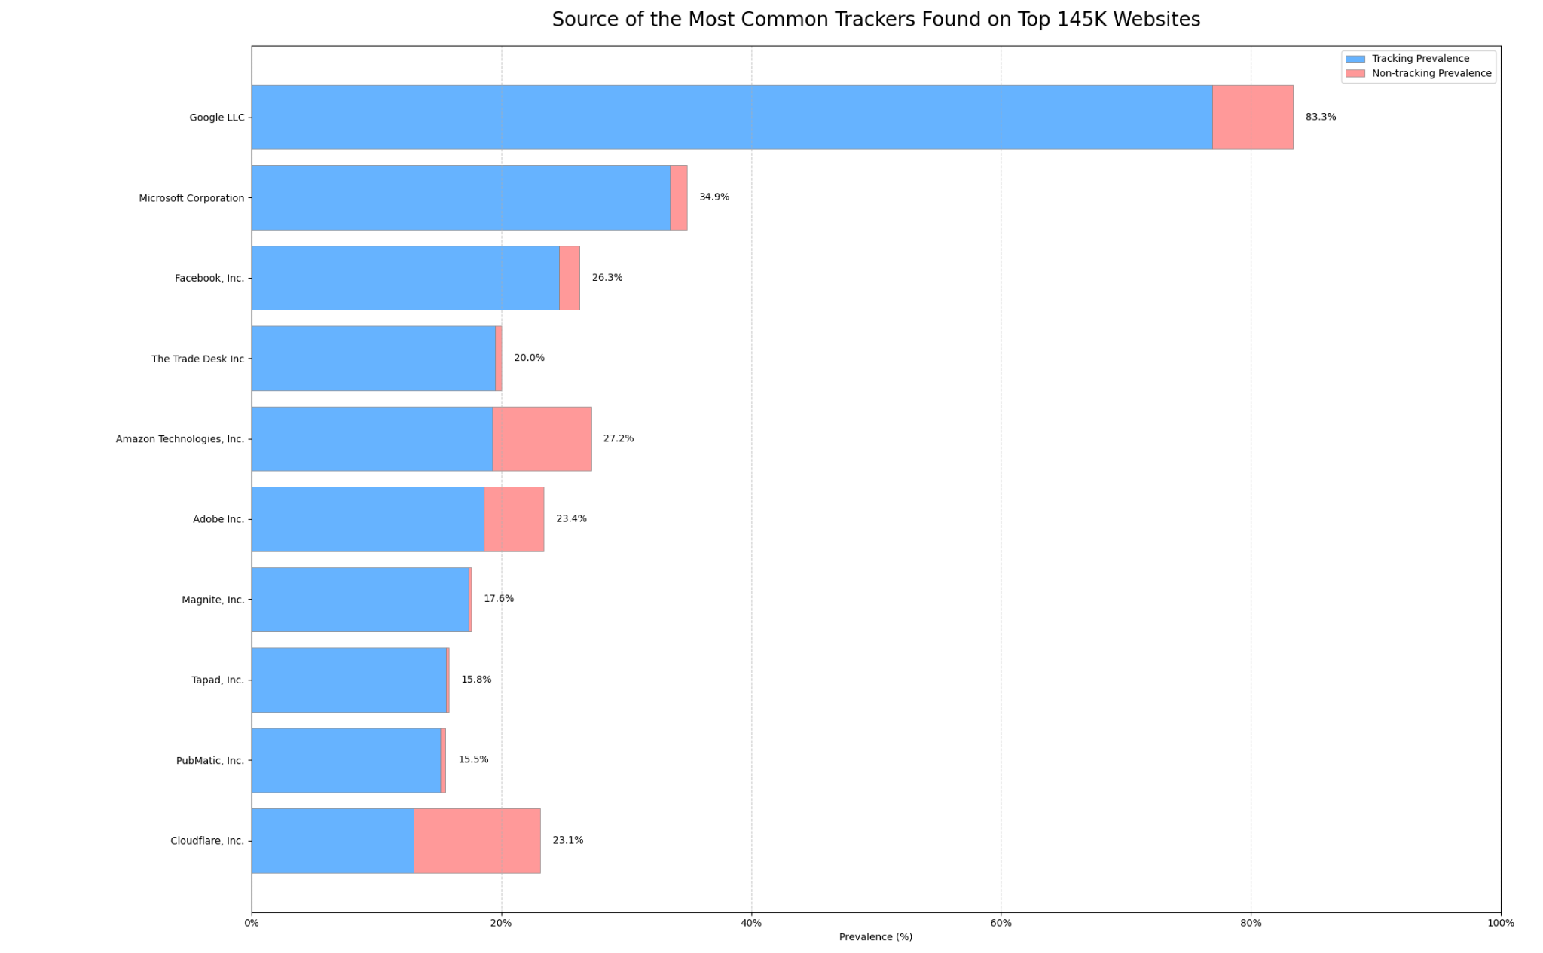
The Unbearable Presence of Tracking
Link to data: https://github.com/duckduckgo/tracker-radar

