Slide 1
Operations on the Bloch-sphere
2025. 02. 19.
2025 spring
Balázs Solymos
BME Department of Networked Systems and Services
solymosb@hit.bme.hu

Slide 2
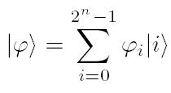


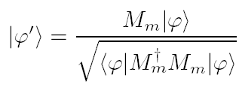

Postulates of Quantum mechanics
1. postulate: qubit
Hilbert-space
2. postulate: logical gates
Unitary transformation
Basic quantum gates
3. postulate: Q/C transformation
Measurement statistics
Post-measurement state
4. postulate: registers
Tensor product

Slide 3
1st Postulate (state space)
The actual state of any closed physical system can be described by means of a so called state vector v having complex coefficients and unit length in a Hilbert space V i.e. a complex linear vector space (state space) equipped with inner product.

Slide 4



qubit
Dirac ‘ket’ and ‘bra’ notation
Qubit: Contains both classical states (base states): superposition
where a and b are complex probability amplitudes. Their squared absolute values give the probability of a measurement result:
Operations: inner and outer product

Slide 5


Bloch-sphere (1)
Describes a qubit:

Slide 6


Bloch-sphere (2)
$$α$$
$$β$$
Copyright © 2005 John Wiley & Sons Ltd.

Slide 7
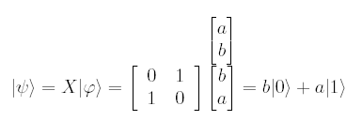
Pauli-gates
Pauli-X (bit-flip) gate:

Slide 8
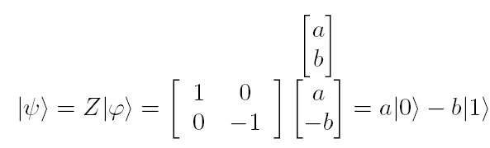
Pauli-gates
Pauli X (bit-flip) gate:
Pauli Z (phase-flip) gate:

Slide 9
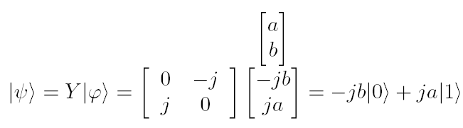

Pauli-gates
Pauli Y (???-flip) gate:
Geometrical interpretation of Pauli X gate: rotation around axis x in the Bloch sphere

Slide 10
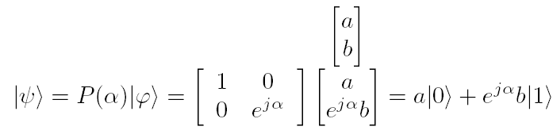
Phase-gate

Slide 11
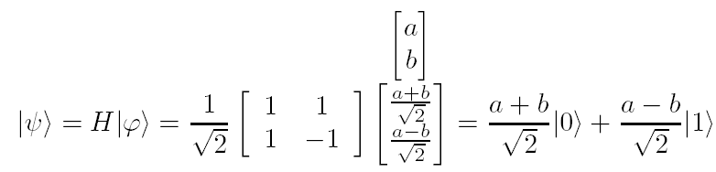


Hadamard-gate
Hadamard-gate is hermitian: ,
továbbá:

Slide 12
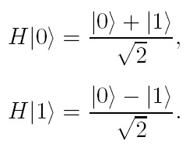
Hadamard-gate
Hadamard-kapu is hermitian: ,
furthermore:
Worth noting:

Slide 13


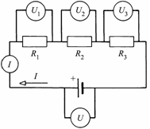

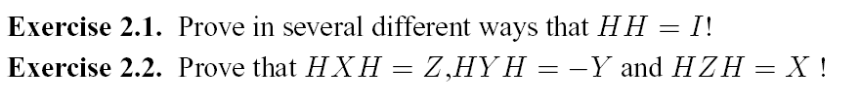
Hadamard gate and superposition

