Slide 1
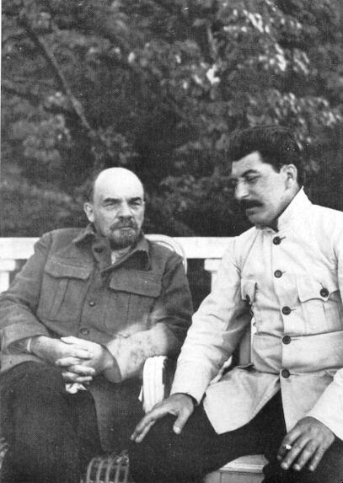
Understand the workings of the system that determines the accumulation of wealth in which we live
4. DESCRIPTION OF THE MODERN MARKET ECONOMY
4. 1 Market economy: definition
What are the essential, i.e. DISTINCTIVE, characteristics (as opposed to other economic systems such as feudalism, socialism)?
Natural law versus SOCIAL RULE (institution) versus individual choice
Systemic characteristics do not depend on natural laws or individual choice!
1/ The description of the economy necessarily implies moral judgment.
because the functioning of the economy is not governed by divin (natural) laws but by social rules
ECONOMICS CAN BE DEGRADED TO SERVE IDEOLOGIES
2/ The workings of the socio-economic system cannot be understood in terms of individual choices.
Vlagyimir Iljics Uljanov
METHODOLOGICAL INDIVIDUALISM, BEHAVIOURAL ECONOMICS ARE USELESS FOR THIS PURPOSE
Joszif Visszarionovics Dzsugasvili

Slide 2
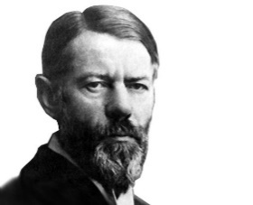
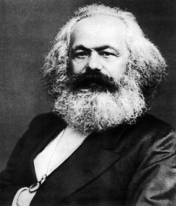
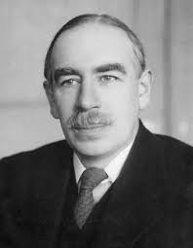
4. 1 Market economy: definition
Aim: study of wealth accumulation → Primary question: what are the modalities of wealth accumulation? (2.2)
Karl Marx
►The creation of social wealth essentially follows a CHREMATISTIC logic.
Max Weber
►individual and social wealth are different in nature (2.1)
►there is money
► there is private property
J. Maynard Keynes
Other characteristics that seem important:
► WAGED LABOUR
Mainstream economists
► FREE
Based on private property, no subordination by law and DECENTRALIZED
WAGED LABOUR, FREE, CHREMATISTIC ECONOMY

Slide 3

4.2 Economic theories in the light of the definition of market econoy
Waged labour | Free | Chrematistic | Monetary economy
x
x
x
x

Slide 4
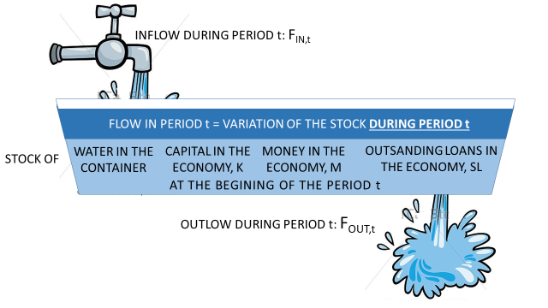
4.3 Accounting approaches / monetary analyis (individual and social wealth are different in nature
Mathematical representation of variations in discrete time
point in time t-1
Point in time t
Period t
S_{t-1}+ (F_{IN,t}-F_{OUT,t}) = S_{t}

Slide 5
4.3 Accounting approaches/ monetary analysis
Real analysis / value theories
Definitions: related to social rules that determine the variation of wealth (especially money)
Definitions are related to commodities
Household = Consumer…
Firm = Producer ….
 | Chrematistic |  | Non chrematistic
 | Can create money | Cannot create money | Can create money | Cannot create money
Do not make social rules (laws) | Commercial BANK | ENTREPRISE |  | HOUSEHOLD
Make social rules and enforce them |  |  | Central BANK | Government
Agents
Private agent
Public firm
State
STATE
Agent in private property
Public agent = agent in public property

Slide 6
4.3 Accounting approaches/ monetary analysis
Stock account
Stock account
Real asset
(VE_{t-1})
Individual
wealth
Real asset
(VE_{t})
Individual
wealth
Finanical
liability
(+VE_{t-1}+)
ΔEG_{t}
Finanical asset
ΔVE_{t}
Flow type accounts
Records changes in wealth resulting from
the activity of the agent in monetary terms
decreases increases
balance:
Finanical
liability
Finanical asset
Poin in time t-1
Point in time t
ΔEG_{t}
Stock type accounts
Records the variation in the form of wealth already acquired
Change in the stocks of real assets (Δ VE_{t})
Variation in individual wealth ΔEG_{t}
Change in the stocks of financial assets
Change in the stocks of financial liabilities
4.3.1 Business accounting

Slide 7
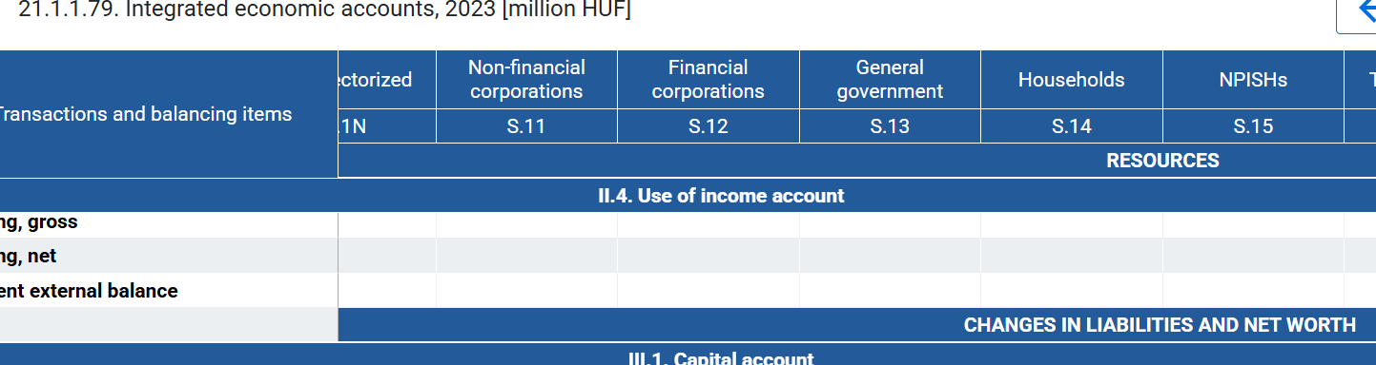
4.3.2 National accounting
Recording by the „income flow”
Account of 1 aggregated agent
Production account
Generation of income account
Allocation of primary income account
Secondary distribution of income account
Use of income account
Flow type accounts
Records changes in wealth resulting from
the activity of the agent in monetary terms
decreases increases
balance:
Stock type accounts
Records the variation in the form of wealth
already acquired in monetary terms
ΔEAssets ΔLiablities
Balance: ΔEG_{t}
Agent= sector (activity as main profile): Household, Financial corporations, Non-financial corporations, General governement, etc.

Slide 8
4.3.2. National accounting
Example: A firm sells for 100HUF to households a table, that costs 80HUF: 45HUF buys woodfrom another firm and pays 35HUF wage.
Income side recording
1HUF of expenditure is at the same time 1HUF of income: the double-entry bookkeeping is valid for two agents together.
1.Buying wood: Intermediate consumption CI 45HUF
2.Wage payment W 35HUF
3.Households purchase: Consumption C 100HUF
Firms
- Flow accounts +
Households
- Flow accounts +
1.45Ft CI
1.45Ft CI
3.100Ft C
3.100Ft C
NOTIONS DEFINED IN VALUE THEORY
2. 35Ft W
2. 35Ft W
CI: products totally used up in production during the period
C: satisfaction of need with goods
Notions: what do we have in accounting framework (monetary analysis)?
NO COMMODITY SPACE!!
Who pays to whom
Changes social wealth or not (change in real assets)
cost expenditure to execute a chrematistic (business) plan / non cost
We should define these notions differently…

Slide 9
4.3.2 National accounting: a mule
NOTIONS DEFINED IN VALUE THEORY
CI, C
Income side recording
Product side (use-ressource balance) recording
Society as a whole
branch a group of homogeneous production units which produce the same product from the other products of the nomenclature.
Flow type accounts
Records changes in wealth resulting from
the activity of the agent in monetary terms
decreases increases
TOTAL INCOME
= TOTAL PRODUCT
balance: ΔEG=S saving
P= CI+C+I
I: purchase of capital, capital …
P: outptu/production (market/non market)
CI
balance: GDP=C+I
C
GDP=P-CI=C+I
GDP: the value of the surplus (products) produced by the residents of a country at market prices during the year / total value added at market price
STOCK ACCOUNTS
Records the variation in the form of wealth
already acquired in monetary terms
ΔEAssets ΔLiabilities
balance: 0 (net lending/borrowing)
In total income there is no:
WAGE
INCOME from FINANCIAL OPERATIONS (ex. interest)
TAX
because…
ΔVE=I
S
I: … / expenditure in period t on which the chrematistic agent wants to realize the excess earning only in subsequent periods

Slide 10
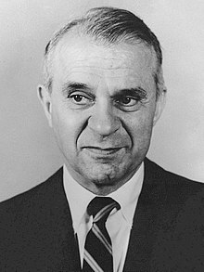
4.3.2.1. Economic theory independent application of the product side recording : the
LEONTIEF MODEL (Input – output model)
Income side recording
Product side (use-ressource balance) recording
1973 Nobel price
P= CI+C+I
 |  | 1.Branch Agriculture CI₁ | 2.Branch Industry CI₂ | Final use (C+I)
1. Product agriculture | P₁=p₁q₁ | p₁r₁₁q₁ | p₁r₁₂q₂ | p₁v₁=p₁(q₁-r₁₁q₁ -r₁₂q₂)
1.Product industry | P₂=p₂q₂ | p₂r₂₁q₁ | p₂r₂₂q₂ | p₂v₂=p₂(q₂-r₂₁q₁ -r₂₂q₂)
Value added | VA (h) | h₁q₁=(p₁-p₁r₁₁ -p₂r₂₁)q₁ | h₂q₂=(p₂-p₁r₁₂ -p₂r₂₂)q₂
 | P | P₁=p₁q₁ | P₂=p₂q₂
P₁ value of total product 1.
r₂₁production coefficient: the use in product 2. of the 1. branch
q₁ physical quantity of the 1. product
p₁ price of 1. product
R matrix of production coefficients
p price vector, q, v, h vectors
q =R*q+v
p =p*R+h
Practical questions:
If the output of a branch varies, what is the total change in output or imports it generates?
If the price of one product changes, how will this affect the price of other products?
effective rate of protection: If we impose tariffs on one product, how will that affect the competitiveness of other products?
Suppose production coefficients are FIX!

