Slide 1
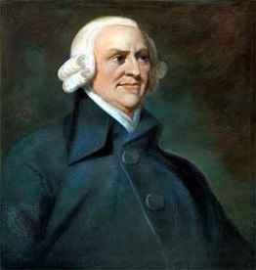
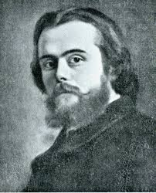

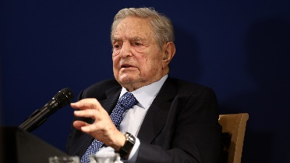
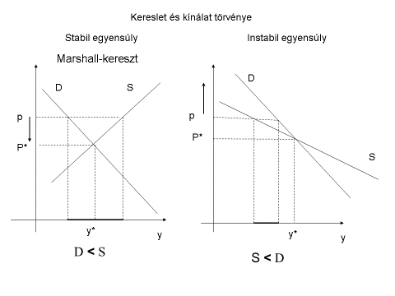
4.4.2 General Equilibirum Theory (orthodox theory)
all economic relationships are EXCHANGES of COMMODITIES
Essence of market economy: FREEDOM
Final driving force of economic decisions is exclusively OIKONOMIA C-(…)-C’
Economy can be described in terms of give (supply)-obtain (demand) (i.e.markets)
Adam Smith
Give in order to obtain
EQUILIBRIUM MAY EXIST in all market
but only if all product markets are in equilibirum, so is the labour market … (WALRAS law)!
Manifestation of exchange
Léon Walras
„…, the contention that free markets lead to the optimum allocation of resources loses its justification. The supposedly scientific theory ['s] … resemblance to Marxism, which also claimed scientific status for its tenets, is too close for comfort.” (George Soros 1997, The capitalist threat)
Law of demand and supply
Stable equilibrium Unstable equilibrium
PROBLEM: do we get where exactly?
PROBLEM: do we get there?
commodities
Marschallian cross
TÚLKERESLETI MÁTRIX |  | Jószágok
 |  | a | b | c
Szereplők | A | +1 | -1 | 0
 | B | 0 | +1 | -1
 | C | -1 | 0 | +1
 | Összesen | 0 | 0 | 0
Excess demand
matrix
Agents
total

Slide 2
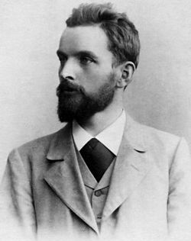
4.4.3 OIKONOMIC behavior’s systemic consequence
C-(M)-C’
value
═
S = D
equilibrium
What theories add to that:
We MAY get to an equilibirum state
GE: all product markets are in equilibirum, so is the labor market
KEYNES: all product markets are in equilibirum, but not necessarily the labor market (durable voluntary unemployment)
What does money analysis add to real analysis?
Product market equilibrium may exist = product market equilibrium system
State’s (economic policy’s) role)
Assure the conditions for well functioning markets, no need to intervene
GE: (because by faith the economy is in or tends to equilibrium)
KEYNES: if there is unemployment, increse demand (income, GDP) to obtain full employment
Silvio Gesell (liberal!): very different conclusion
Free land and free money reforms are needed!

Slide 3
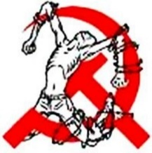
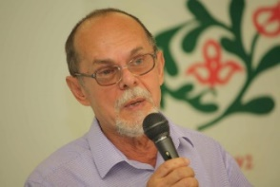
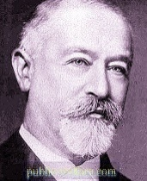
How does Silvio Gesell conclude that land and monetary reform is needed when he is a liberal and departs from the general equilibrium theory?
1916, Die Natürliche Wirtschaftsordung (The Natural Economic Order)
Logic of the GE: FREEDOM → well-functioning markets are efficient (1. Theorem of Welfare Economics) and does not redistribute wealth (there is exchange),
If well-functioning market does not hold (=market failure), that is not any more true
Non price taker economic agents – market force (monopoly, oligopoly, etc.)
Not only prices influence the decisions (externalities; public goods)
Information asymmetry
Optimization problem : prices are parameters (constants) and are the only variables that affect choices.
The liberal socio-economic system is
NOT FREE
No well-functioning market
If there are monopolies caused by social rules
There is redistribution of wealth
Ther is no need to quantify contributions and appropriations
There are two basic monopolies in the real market economy:
PRIVATE PROPERTY OF LAND – rent
Free land
abolish
FREE SOCIETY AND ECONOMY
ASYMMETRY OF MONEY AND COMMODITIES – interest
Free money
This is the desirable and
NATURAL ECONOMIC ORDER
(because see animals)
Marx won, Gesell’s theory was „covered”
This is not a coincidence
László Bogár
Jacob Schiff

Slide 4


4.4.4. CHREMATISTIC behavior’s systemic consequence: without economic theory
Growth imperative in monetary terms
M’-(C-C’)-M’’
< M’’
Wealth concentration (at least lending)
M<M’
3.2.2 Some historical facts (Medici, Fugger, Rotschild)
M-(C-C’)-M’
3.3.2 Evolution of monetary systems: economic analysis/ 2
For long (Aristotle, BIBLE) well-known
1 Timothy 6:10: For the love of money is a root of all kinds of evil
5 Mose 15: “At the end of every seven years you shall grant a release. ² And this is the manner of the release: every creditor shall release what he has lent to his neighbor; he shall not exact it of his neighbor, his brother, because the Lord’s release has been proclaimed. ³ Of a foreigner you may exact it; but whatever of yours is with your brother your hand shall release. ⁴ But there will be no poor among you (for the Lord will bless you in the land which the Lord your God gives you for an inheritance to possess), ⁵ if only you will obey the voice of the Lord your God, being careful to do all this commandment which I command you this day. ⁶ For the Lord your God will bless you, as he promised you, and you shall lend to many nations, but you shall not borrow; and you shall rule over many nations, but they shall not rule over you.
KHREMATISZTIKÉ
Merchant society
VERSUS
Sacral society
VERSUS
OIKONOMIA
Metthew 21:¹² And Jesus entered the temple of God^{[a]} and drove out all who sold and bought in the temple, and he overturned the tables of the money-changers and the seats of those who sold pigeons. ¹³ He said to them, “It is written, ‘My house shall be called a house of prayer’; but you make it a den of robbers.”

Slide 5
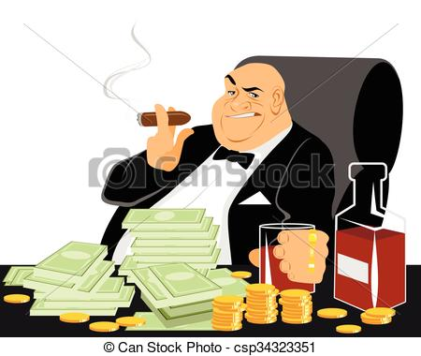
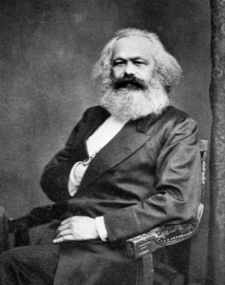
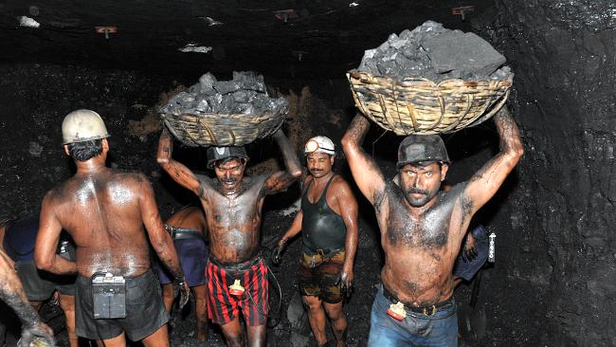

4.4.5 Karl Marx
capitalist
A priori starting point: there is exploitation in the liberal socio-economic system, just as there was in feudalism.
beause value is created by labour and the capitalist does not work (at least not as much as he gets)
worker
This proposition should be supported by economic theory. (Das Capital, A tőke (1867):
Systemic characteristics of capitalism (market economy):
1/ Redistribution of wealth: HOW exploitation is possible if the orthodox theory’s proposition that always equal values are exchanged is true?
Must measure how much one contributes to and appropriates from social wealth
Gesell!
The value of commodities = labour socially needed (to produce it).
2. LABOUT FORCE is like grain
3. The worker is forced to sell his labour because he cannot wait, and he cannot sell his labour directly (in the form of the product of his labour) because he has no means of production.
2/ growth and decreasing tendency of the profit rate
Capitalist mode of production
Capital is value over which the capitalist wants to realize value added again and again
Amount of capital is steadily increasing
In Lenin’s terms: imperialism
In modern terms: growth imperative
→ globalization and ”democraty” export
khrematistiké
using wage labor
Wage labour
decreasing tendency of the profit rate
$$\frac{quantity of LABOUR}{quantity of CAPITAL}$$
ratio has decreasing tendency

Slide 6
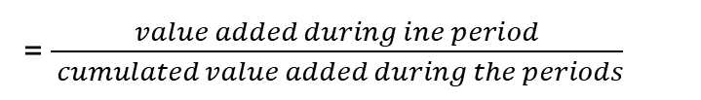
4.4.5 Karl Marx
decreasing tendency of the profit rate
$$\frac{quantity of LABOUR}{quantity of CAPITAL}$$
= $\frac{value added during ine period}{ cumulated value added during the periods}$
consant
ratio decreases
Not a coincidence that MARX „won”…
increasing exploitation is constrained solution, because
REVOLUTION
in developed capitalist regions
RUSSIA
MARXIAN SOLUTION: PRIVATE PROPERTY OF MEANS PRODUCTION TO BE ABOLISHED (tautology)
What is capital?
Jacob Schiff
CAPITAL: means of production (produced commodity that can be used several times in production) - orthodox theory
Then capital is not a distinctive characteristic of capitalism!
CAPITAL: „M-M', money which begets money, such is the description of Capital from the mouths of its first interpreters, the Mercantilists.” (Marx 1867, Capital, 4.Ch.)
CAPITAL: value over which the capitalist wants to realize value addded again and again; manifestation: money, commodity (including means of production), „M-C-M' is therefore in reality the general formula of capital as it appears prima facie within the sphere of circulation.”’, (Marx 1867, Capital, 4.Ch.)
CAPITAL: liabilities (wealth) used with chrematistic aim
In accounting the firm’s own wealth is called own capital.

