Slide 1
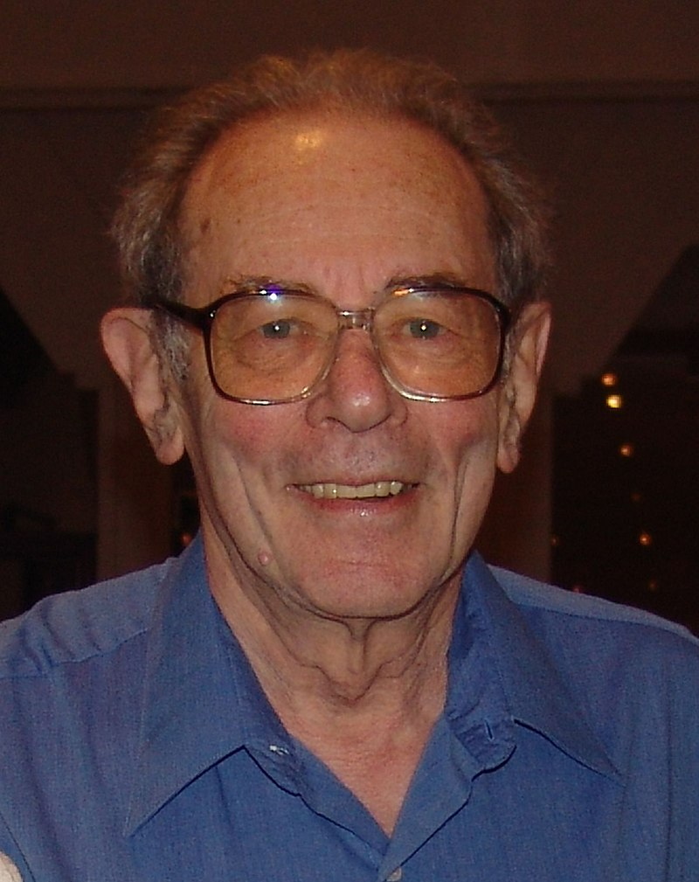
4.4.8. János Kornai’s propositin
PROPOSITION: Capitalism is a surplus economy / excess supply economic system.
Whether there is a crisis or not.
His argument: why compete when all products can be sold?
He has not developed a complete model.
KORNAI János
REFORMULATION
PROPOSITION: A chrematistic economy is not an equilibrium system but an excess supply system.
In the absence of a general crisis, price changes can bring markets into equilibrium. So what does the excess supply system means? How to interpret the excess supply?
If, in a given period, economic agents want to complete all their business (i.e. chrematistic) plans, then there will never be enough money in the period to pay the total planned value in monetary terms of full supply (production).
So all markets can be in equilibrium in the traditional sense in a given period, or in consecutive periods, but certainly NOT in all periods (mainstream: there is no full equilibrium / Kornai: we have to look at the dynamics of the economy)
Proof: 1. A chrematistic economy is subject to growth imperative in nominal terms. (Rosier-modell)
2. Growth imperative in nominal terms is the other face of the excess supply system.
An example (widget-problem/realization problem)
In a cashless market economy, households and banks are aggregated into macro-agents, the state is omitted. The bank always keeps its profits (!), firms always distribute all their profits to households. The interest rate is 10%, households always spend 80% of their money stocks. Firms produce widgets, the only cost is wages. There is 1 period between production and sale. We start from zero in the initial state.

Slide 2
A Bank L
A V1 L
A Household L
The first Firm V1 borrows $1000 and starts production
1.
Loan$1000
Money$ 1000
Widget $1000
Loan $1000
Money $1000
Ind. wealth $1000
End
of
periods
If nothing is done, the company will inevitably go bankrupt, because its income is only 0.8*$1000, but it has to pay back $1100 to the bank. This means that $300 is missing for a profit of zero.
2.
The second firm V2. does the same as V1 in the first period
Profit of V1 is 0,8*2000-1100=$500
E V2 F
Money $
900
Ind.wealth
$2000-$1600+$500
Loan1$000
Ind. wealth $100
Money $900
Widget
$1000
Loan $1000
Spends $1600 of $2000 on widgets and receives $500 dividend
3.
If nothing is done, V2 will go bankrupt, just as V1 would have gone bankrupt if V2 had not put money into the economy, because its income is only 0.8*$900, while its debt with interest is $1100. This means that there is now a shortfall of $380,000 for a profit of zero.
Nominal growth imperative (lack of nominal growth results in crisis, i.e. fix 1000$ spent into the economy) – impossible to realize all plans (product market excess supply) ($300 and $380 is missing) – (like Marx) decreasing tendency of the profit rate (500$ and 420$)

Slide 3



The above example illustrated in a stock-flow setting:
1.
2.
3.
4.
FM_{t=2}=1000$
FM_{t=3}=200$
220$ ≤ FM_{t=4}
FM_{t=1}=1000$
M_{t=1}=1000$
M_{t=1}=1000$
M_{t=2}=900$
M_{t=2}=900$
M_{t=3}=0$
Ponzi game
FM’_{t=2}=1100$
FM’_{t=3}=1100$
FM’_{t=4}=220$
Till t=4 ΣFM=2000
+200$ is to be spent
Till t=4 ΣFM’=2200 is to be taken out
Chrematistic(=business) plan in Aristotle-Marxian scheme : M-(C-C’)-M’, M’>M.
Proposition:
If M money is spent into the economy untill period t with chrematistic aim,
Thus, still wants to realize income, i.e. still wants to sell, i.e. always excess supply.
then it is impossible to withdraw M’>M until period t,
unless the missing (M’-M) is spent into the economy until period t.
But it is impossible to complete the chrematistic plans that start with the spending (M’-M) in period t; this can be done only in subsequent periods if additional money is spent into the economy…
Growth imperative in nominal terms

Slide 4
4.4.9 CHREMATISTIC (Capitalist) MODE OF PRODUCTION ON MICRO LEVEL
How does waged labour chrematistic production work in contrast to guild production?
AN EXAMPLE
1 product is produced in 2 phases with 2 machines with 1 individual’s 4-4 hours work.
Machine’s lifetime 24 hours each; one costs 100$
wage 100$
Product price 170$
Loan at 4% interest rate;
max. loan 200$
How much profit is realized in 6 days (total use of the machines) in the two cases?

Slide 5
1. Guild master
2 . Entrepreneur
2. LESSONS
What makes the entrepreneur more efficient or enables her to earn a higher return?
Advantage in productivity in physical terms?
NO, since same technology
Different prices (market power)?
NO, since same prices
THEN?
Entrepreneur’s money continuously works
1/ more efficient (i.e. more return) means more intensive capital use
Under which production technology does the capital of the guild master, who works a fixed 8-hour day, remain idle the longest?
If there are many work phases
2/ the increase of the number of work phases = increase of the division of labor enables higher capital intensive use
The essence of the division of labor lies not primarily in improving productivity in a physical sense (i.e., generating more physical output from a given physical input — the theory of comparative advantage), but rather in enabling a more intensive use of capital

Slide 6
As the division of labor intensifies, the physical productivity advantage of labor diminishes — meaning that even less productive workers can remain 'competitive’, in other words
More efficient technology enables higher wages
or lower product price
130,225
How much is it in this example?
139,77
2 . Entrepreneur
2 . Entrepreneur
and clearly the entrepreneur can drive the guild master out of the market (ex. at a price of 138, the guild master is already incurring losses)
Winner takes all
1. Guild master
2 . Entrepreneur

Slide 7
3/ The more efficient entrepreneur can drive the less efficient out of the market. market concentration.
Riddle: What do we call a competition where the aim is to force the other participants out? ☺
Why is the sole proprietor (guild master) unable to drive others out of the market, unlike the entrepreneur?
Help: How many hours a day can the guild master and the entrepreneur work?
4/ The essence of wage labor is that non scalable labor becomes scalable for the entrepreneur.
How to become more efficient relative to other entrepeneurs?
5/ innovation
Why is innovation of central importance in a market economy, given that even the guild master can earn extra profit with innovation?
Because of 4/ and 3/
Innovation: idea is not enough – realization requires capital – those who have money always profit, too →
6/ capital concentration

Slide 8
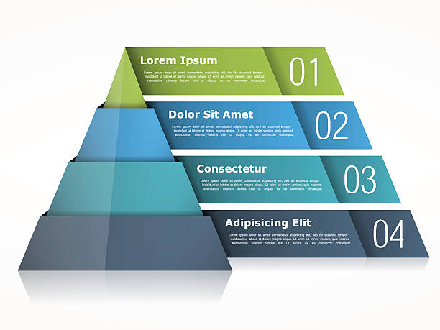
3. LESSONS ON MICRO LEVEL PROJECTED TO MACRO LEVEL
Can we do it? Do we make a mistake?
High- tech
product
1/ product – work phase: place in division of labor → income
In countries at the bottom of the capitalist production pyramid, incomes are lower.
product
Innovation requires money
product
Money power is central
product

Slide 9
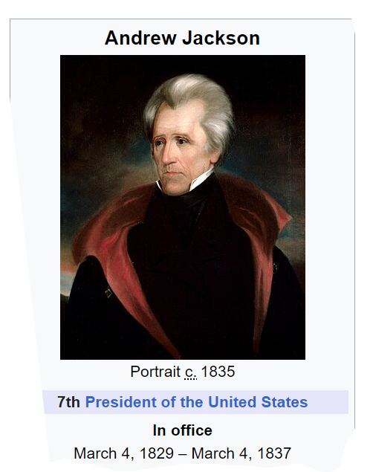
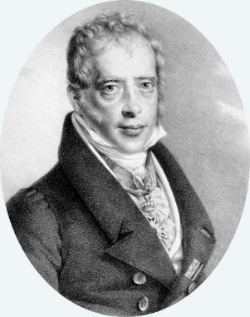
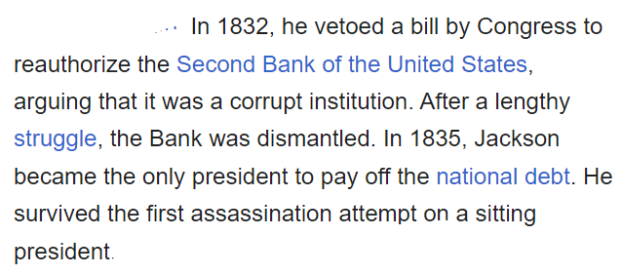
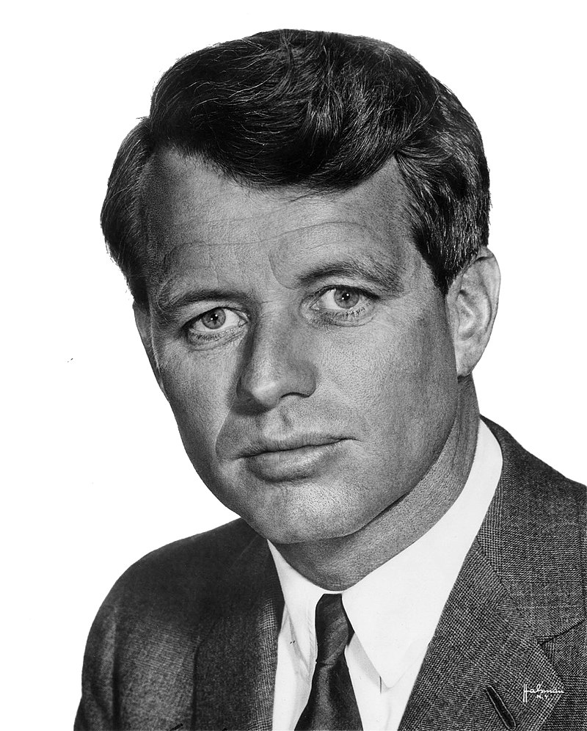
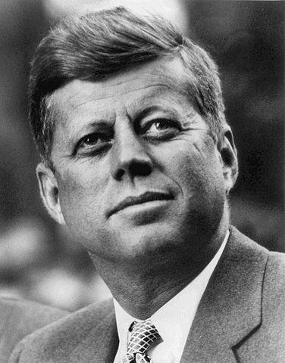
powers of the sate:
legislative, judiciary, executive powers +
money power
Mayer Amschel Rothschild
(1744-1812)
„Give me control of a nation’s money, and I care not who makes its laws!”
Robert Kennedy
(1925-1968)
John Fitzgerald Kennedy
(1917-1963)

Slide 10
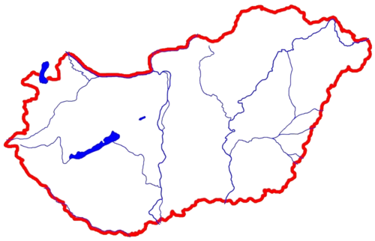
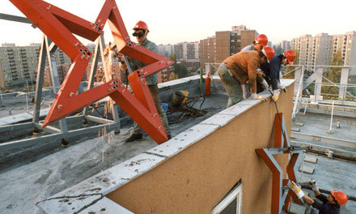


MONEY POWER
QUIZ
product
Source: Ábel I.-Szakadát L. (1997), A bankrendszer átalakulása Magyarországon 1987-1996 között, Közgazdasági Szemle, 44.évf.: :635-652.
product
product
1. When was the decision made to move to a two-tier banking system in Hungary?
1983!!
2. When did the transition to the two-tier banking system take place in Hungary?
1987
3. When were foreign private banks first allowed to operate in Hungary?
In 1987! 3 western private banks!!
product
1989

