Slide 1
M.TECH DISSERTATION PHASE-I · PROGRESS EVALUATION
Empirical Benchmarking of Neural Text-to-Speech
Architectures for Indic Languages
ə
Does explicit Devanagari grapheme-to-phoneme conversion still matter?
Kaustubh Pandey
2025PA17326
Supervisor: Dr. Shobha Bhatt, Assistant Professor
Department of Computer Science and Engineering
Netaji Subhas University of Technology, New Delhi
the vowel nobody writes
nəmək → nəmkiːn
Notes:
Open with the two words out loud: namak, namkeen. Say the question once, then move on. Do not read the title slide aloud.

Slide 2
ə
Abstract
2
Hindi deletes many of the unwritten vowels Devanagari implies, and keeps others. The spelling does not say which. This study measures whether a neural TTS model still needs an explicit grapheme-to-phoneme front end to get that right, or learns it from audio.
Three architectures from three generative families: FastSpeech 2, VITS, Matcha-TTS
Two input arms, phonemic and graphemic, under a provably identical training budget
A nested data ladder from 9 hours down to 10 minutes
Marathi as a same-script control: same script, no medial schwa deletion
This report covers the preparatory phase, which is complete. Nothing is trained yet.
Notes:
Thirty seconds. The last bullet is the one to say plainly rather than hide.

Slide 3
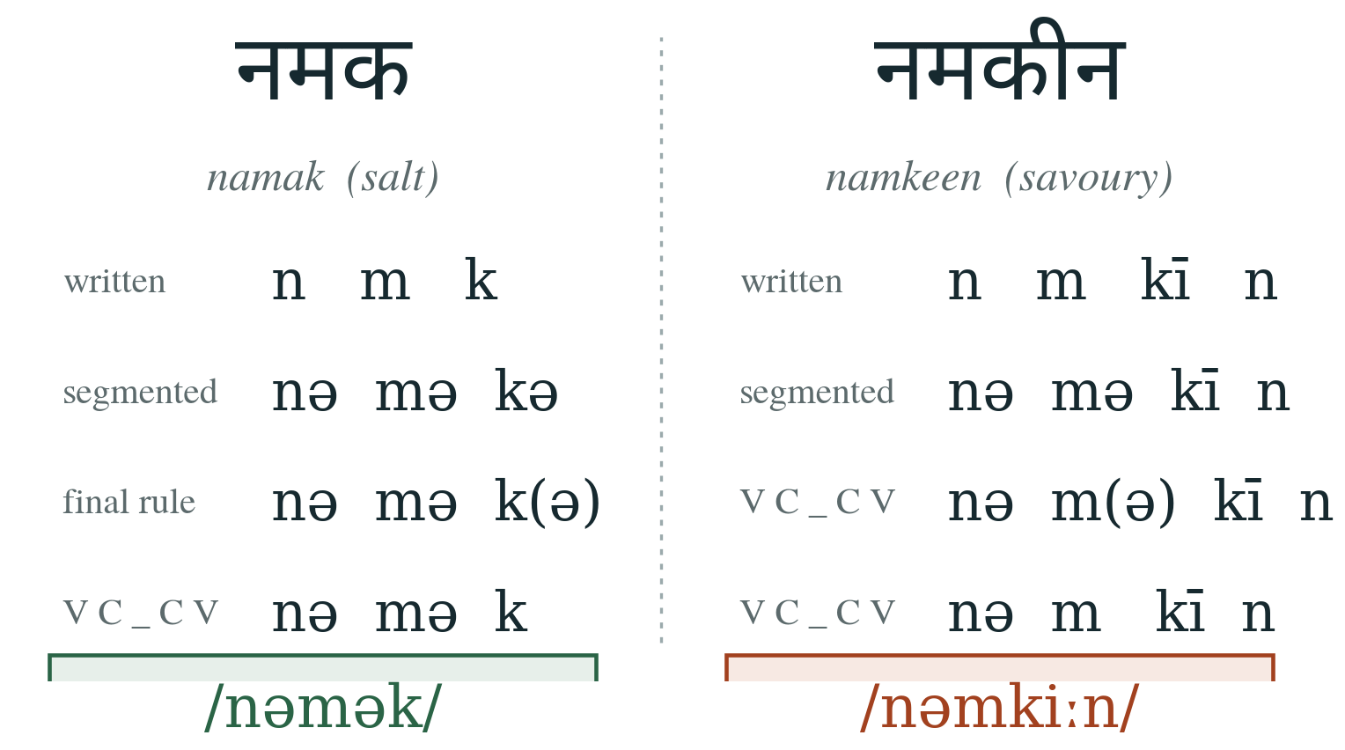
ə
Introduction and motivation
3
Two words, one problem
Devanagari is an abugida: every consonant carries an unwritten schwa
The rule since Narasimhan, Sproat and Kiraz (2004): delete a schwa in V C _ C V, right to left
Accurate, not perfect. Errors cluster at morpheme boundaries and in loanwords
2 बी G2P or not 2 बी?
The first three letters are identical. The pronunciation of the second one is not, and nothing in the spelling says so.
Purists build the full front end. Modernists feed raw Devanagari in and assume the model learns zero duration schwas by itself. Nobody has umpired the argument.
Marathi is written in the same script and shares almost all of Hindi's phone inventory, but does not apply the medial rule. That is what makes it a control rather than a second target language.
Notes:
Say namak and namkeen out loud. Then the pun, once, and move on quickly. If asked why the rule is not solved: the RULE is well studied; whether a neural model NEEDS it is not.

Slide 4
PROBLEM STATEMENT
Holding training budget, evaluation protocol and speaker fixed, does phonemic input from an explicit Devanagari G2P front end improve neural TTS quality in Hindi relative to raw grapheme input?
Does it depend on the architecture?
FastSpeech 2 · VITS · Matcha-TTS
Does it survive less data?
9 h → 5 h → 1 h → 30 min → 10 min
Is it schwa, or is it script?
Marathi control: same script, no medial rule
OBJECTIVES
O1
O2
O3
O4
Speaker-matched corpus,
frozen checksummed splits
G2P front end with schwa
deletion as a switchable stage
Train all three under one
provably identical budget
Ladder, Marathi control,
verified metrics, release
Notes:
Return to this slide whenever a question drifts. Every design decision exists to keep one of these three comparisons clean.

Slide 5
ə
Literature review: the architectures
5
One from each current generative family, so the result is not a quirk of one design
FastSpeech 2
~27M
VITS
~83M
Matcha-TTS
~18M
Non-autoregressive transformer
VAE + normalising flow + GAN
Optimal-transport flow matching
Generation
Generation
Generation
one parallel forward pass
text straight to waveform
a few ODE solver steps
Durations
Durations
Durations
predicted, needs a target
stochastic predictor
predicted, MAS aligned
Vocoder
Vocoder
Vocoder
separate HiFi-GAN
built in, none shared
separate HiFi-GAN
Weakness
Weakness
Weakness
averaged, flat prosody
largest, 16 kHz checkpoint
least validated on Indic
StyleTTS 2 reports higher naturalness than any of these. It is cut for compute, not for quality, and is named as future work.
Notes:
Likely question: is it fair to compare an 83M model with an 18M one? Answer: the budget held equal is the TRAINING budget, not the parameter count. Parameter count is part of what an architecture is, and real-time factor is reported for exactly that reason.

Slide 6
ə
Literature review: the gap
6
External forced alignment
What no existing work does
A separate GMM-HMM aligner marks phone boundaries. Accurate, and what the original FastSpeech 2 recipe assumed.
Narasimhan et al.
rule only, no TTS
Monotonic alignment search
Arora et al.
G2P accuracy only
Dynamic programming inside the model, improving as the model does. Used by VITS and Matcha-TTS.
AI4Bharat
single system
Internal unsupervised aligner
IndicVoices-R
corpus contribution
Soft attention learned jointly, then sharpened to a hard path. Used here for FastSpeech 2.
MMS
one model, 1,000+ languages
Why forced alignment was dropped
None isolates the front end, none uses a same-script control, and none reports how the effect changes with data quantity.
Forced alignment would give FastSpeech 2 supervision the other two never get, and MFA has a Hindi model but no Marathi one. Both asymmetries would sit inside the comparison.
Notes:
If asked 'has nobody really done this?': be precise. People have compared architectures and people have built Indic systems. Nobody has held everything constant and moved only the input representation.

Slide 7
ə
Methodology: one variable at a time
7
Two corpora
IndicTTS Hindi and Marathi, 48.6 h measured
Held constant
100,000 steps, 12,000 mel frames/batch, one LR schedule, fp16
One male speaker per language, matched on median F₀
One HiFi-GAN per language, shared
Same metrics, same 300-utterance test set
Standardise
mono, trimmed, −23 LUFS, 22.05 and 16 kHz
Freeze splits
salted SHA-256, nested ladder, 300-utt test
Two arms
phonemic and graphemic, one shared normaliser
Varied
Three models
Input representation: phonemes or graphemes
Architecture: FastSpeech 2, VITS, Matcha-TTS
Data quantity: five nested rungs
Language: Hindi, Marathi as control
FastSpeech 2, VITS, Matcha-TTS, one HiFi-GAN
Evaluate
MCD, log-F₀, WER vs floor, MOS, RTF
Notes:
The question to expect: how do you KNOW the budgets are identical? assert_budget_matched() runs every time the 17 config files are generated and refuses to write them if any budget field differs. It is an assertion, not a convention.

Slide 8
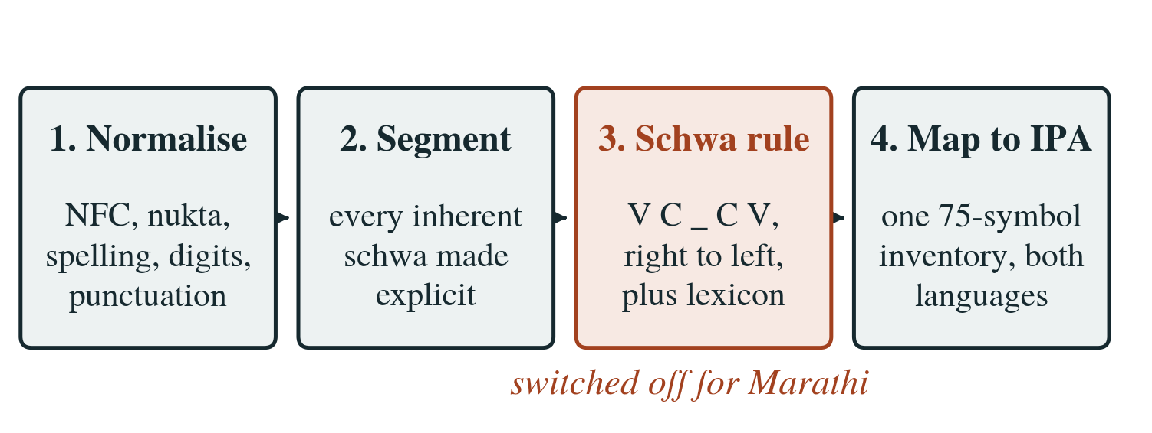
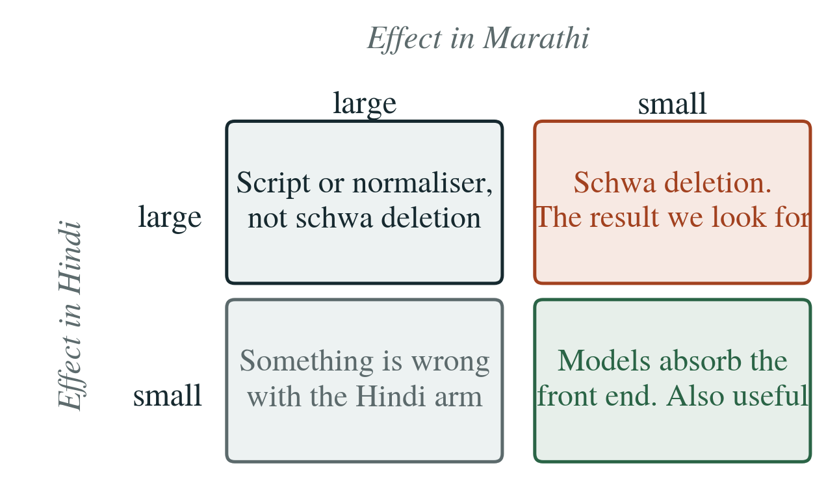
ə
Methodology: the front end and the control
8
Stage 3 is the entire control condition
Why Marathi is the control
Marathi runs identical code with medial deletion disabled. One boolean flag. There is no separate Marathi code path, so the control cannot be contaminated by an implementation difference between the two languages. The grapheme arm runs stages 1 and 4 only, so both arms share one normaliser and the ablation measures phonology rather than preprocessing.
Same script, same corpus collection, same resource level. It differs from Hindi in the phonological rule and in nothing else that matters, which is what a control has to do.
Splits are frozen by a salted SHA-256 of the utterance id, so a rebuild reproduces the test set byte for byte, and the ladder takes prefixes of one ordering.
Notes:
Expect: why Marathi and not Sanskrit? Sanskrit data is gated behind a request with unknown turnaround and was a single point of failure for half the study. Marathi differs in the RULE rather than in the resource level, which is what a control has to do. Dr. Bhatt approved it.

Slide 9
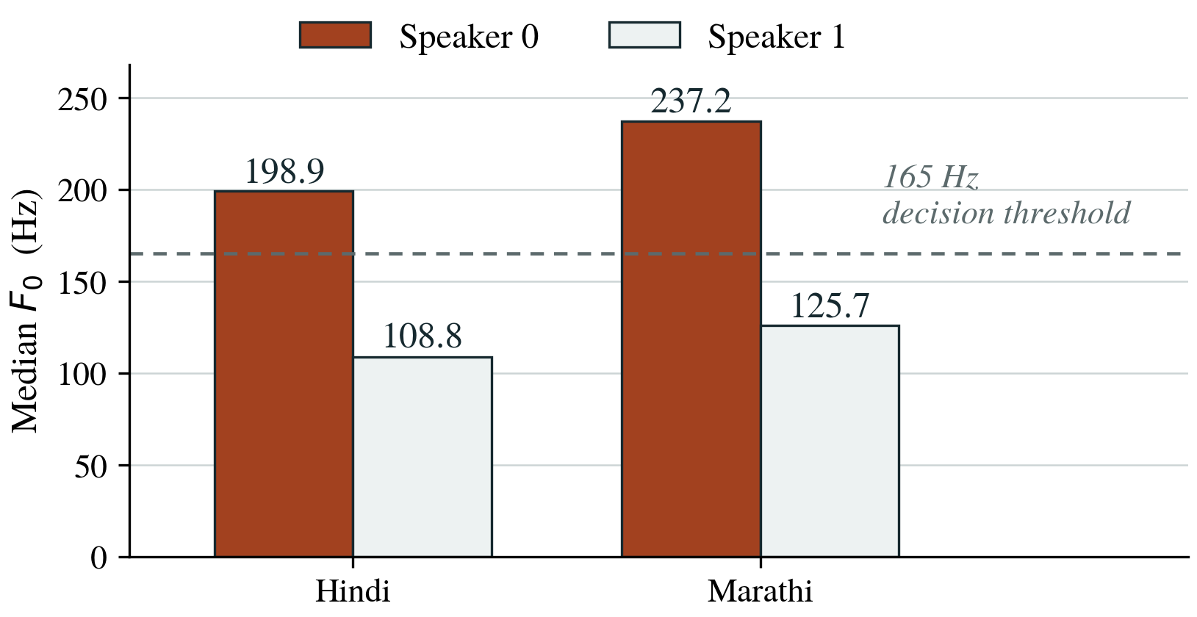
ə
Results: the apparatus, measured
9
Nothing is trained yet. Everything here is a property of the corpus, the front end or the metrics.
48.6 h
0
19%
78
profiled across both
corpora, 22,764 utts
unknown symbols over
870,547 phone tokens
error in the estimate
from a 50-row sample
tests passing, metrics
verified on paper
Speaker identity had to be recovered
The corpora label speakers 0 and 1 with no key, and the two arms must be matched. Median F₀ over 25 sampled utterances separates them cleanly and identically in both languages: 90 Hz apart in Hindi, 111 Hz in Marathi. Every gender label in the report rests on that measurement and is reported as an inference, not as something the dataset says.
Male speaker chosen in both: the two male voices sit 17 Hz apart across languages against 38 Hz for the female pair, so less acoustic difference is left that has nothing to do with schwa deletion.
Notes:
If challenged on the gender inference: 90 Hz and 111 Hz of separation is far wider than any threshold ambiguity, and the p10/p90 spread is recorded so a reader can check.

Slide 10
ə
Discussion: three defects, none of which announced itself
10
Correct
With a comma attached
A run was in the plan twice
input
नमक
नमक,
The ladder's 9 h rung was a second copy of the main run. Invisible because the run id sat inside the config hash, which makes two identical runs look distinct. 10 GPU-hours. 19 runs became 17.
word-final schwa
deletes
survives
its left neighbour
kept
deletes
output
/nəmək/
/nəmkə/
The sheet leaked its answers
Its worked examples were themselves items from the 49-word test set, handing every participant three answers. Found only because a reader asked about one. A check now refuses such a sheet at generation time.
Punctuation was rewriting words
A trailing comma means the word-final schwa is no longer final, so it survives, and its survival supplies the vowel that lets the schwa to its left delete. 16.5% of Hindi word tokens carry punctuation, and the damage fell on the phonemic arm alone.
All three were found by running over real data or by watching somebody use an instrument. The 78 unit tests caught none of them.
Notes:
Do not hide these. A progress review that lists only completed tasks says nothing about rigour. Volunteering a bug that would have corrupted the headline result is the strongest evidence that the apparatus is being checked rather than assumed.

Slide 11
ə
Conclusion and future work
11
Done
Immediate work
Corpora profiled, standardised, speaker-matched
Splits frozen, checksummed, byte-reproducible
G2P front end: zero unknown symbols on both corpora
MCD and log-F₀ verified against analytic answers
17 runs specified, budget enforced by assertion
Four training wrappers (FS2, VITS, Matcha, HiFi-GAN)
ASR-WER with its ground-truth floor, predicted MOS, RTF
Listening test infrastructure, piloted before recruiting
Elicitation sheets from 2–3 native speakers (blocked on people)
Kaggle GPU round trip, including checkpoint resume
Whichever way the result goes it is useful. If the architectures absorb schwa deletion, nobody building an Indic TTS system needs to write that front end again. If they do not, the field should stop defaulting to character level input for Indic languages.
Notes:
Expect: is one seed enough? Answer: no, and I say so. No difference smaller than measured seed variance is reported as a finding. Three seeds throughout is 368 GPU-hours against 136. That is the honest argument for institutional GPU access.

Slide 12
ə
References
12
[1] B. Narasimhan, R. Sproat, G. Kiraz. Schwa-deletion in Hindi text-to-speech synthesis. IJST, 2004.
[2] A. Arora, L. Gessler, N. Schneider. Supervised G2P conversion of orthographic schwas in Hindi and Punjabi. ACL, 2020.
[3] Y. Ren, C. Hu, X. Tan et al. FastSpeech 2: Fast and high-quality end-to-end text to speech. ICLR, 2021.
[4] J. Kim, J. Kong, J. Son. Conditional VAE with adversarial learning for end-to-end text-to-speech. ICML, 2021.
[5] S. Mehta, R. Tu, J. Beskow et al. Matcha-TTS: A fast TTS architecture with conditional flow matching. ICASSP, 2024.
[6] J. Kong, J. Kim, J. Bae. HiFi-GAN: GANs for efficient and high fidelity speech synthesis. NeurIPS, 2020.
[7] J. Kim, S. Kim, J. Kong, S. Yoon. Glow-TTS: A generative flow for TTS via monotonic alignment search. NeurIPS, 2020.
[8] R. Badlani, A. Łańcucki, K. J. Shih et al. One TTS alignment to rule them all. ICASSP, 2022.
[9] M. McAuliffe, M. Socolof, S. Mihuc et al. Montreal Forced Aligner. Interspeech, 2017.
[10] V. Pratap, A. Tjandra, B. Shi et al. Scaling speech technology to 1,000+ languages. JMLR, 2024.
[11] G. K. Kumar, P. S. V., P. Kumar et al. Towards building TTS systems for the next billion users. ICASSP, 2023.
[12] R. Kubichek. Mel-cepstral distance measure for objective speech quality assessment. IEEE PacRim, 1993.
Thank you
Questions welcome.
The report carries the full list of 30 references in IEEE style, with the derivations, the full experimental matrix and four appendices.
The report carries the full list of 30 references in IEEE style.
Notes:
Do not read these. Leave the slide up during questions.

