Slide 1
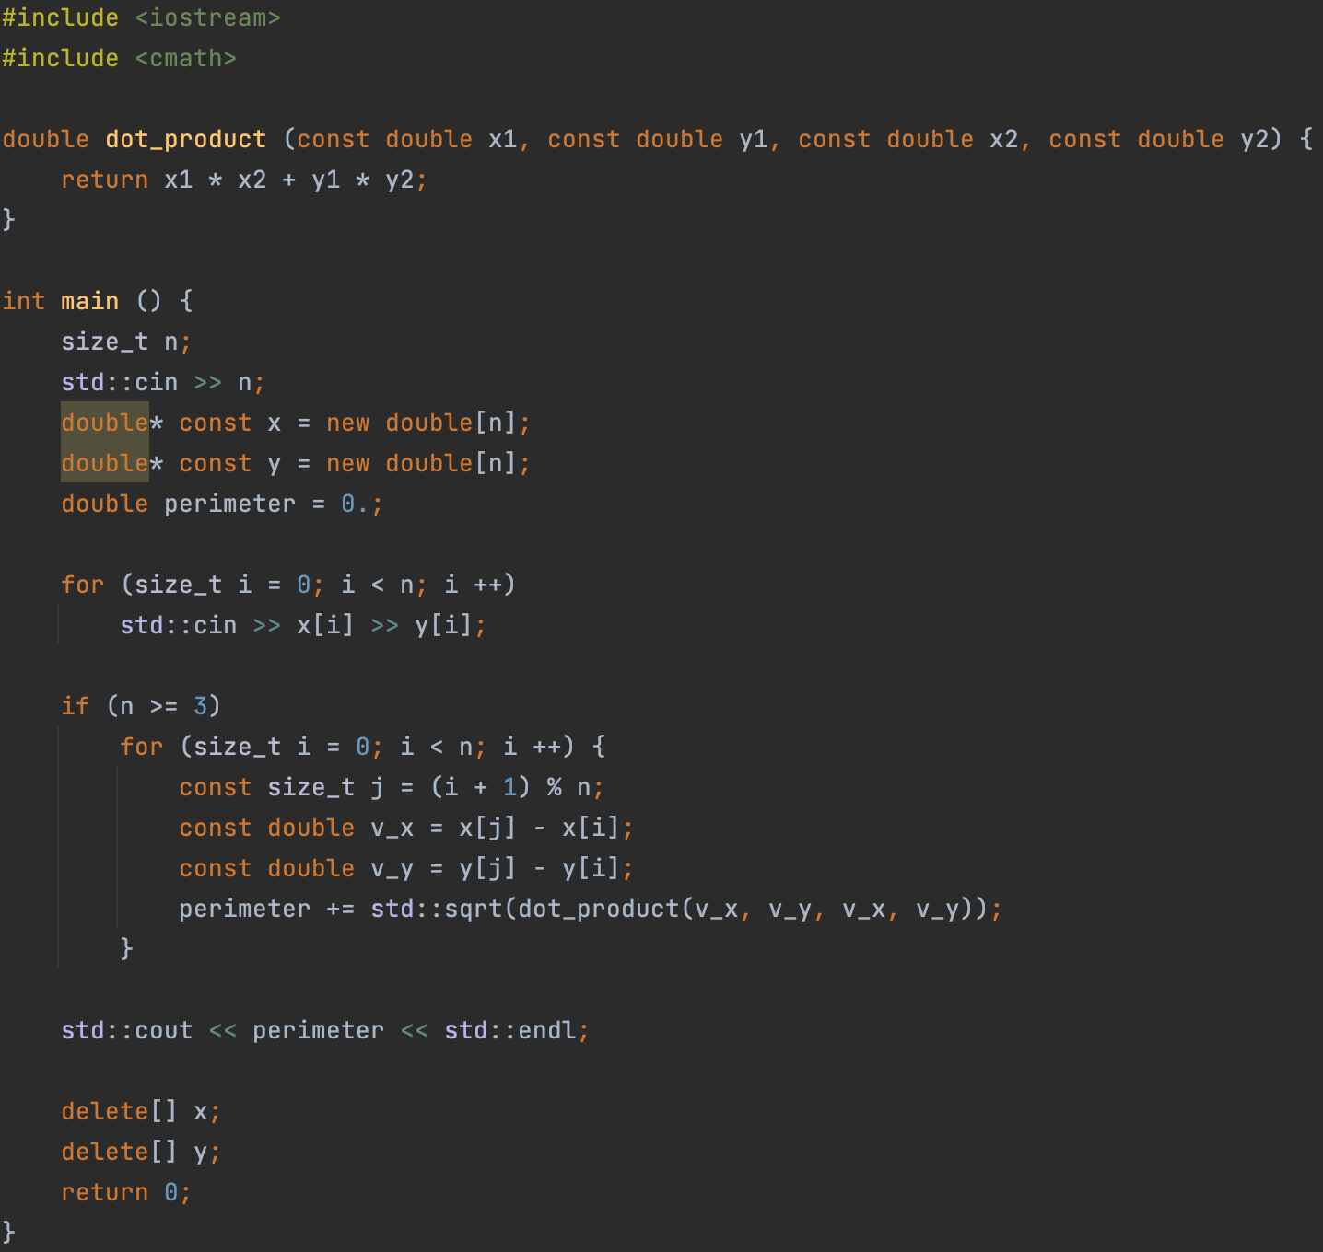
Problem
A sequence of 2D points is specified as a sequence of pairs (x, y).
It is necessary to find the perimeter of the polygon formed by a given set of points.
Points are given in order of counterclockwise traversal relative to the center of the polygon.

