Slide 1
Lecture 14
Templates
Konstantin Leladze
OOP in C++
DIHT MIPT 2021

Slide 2
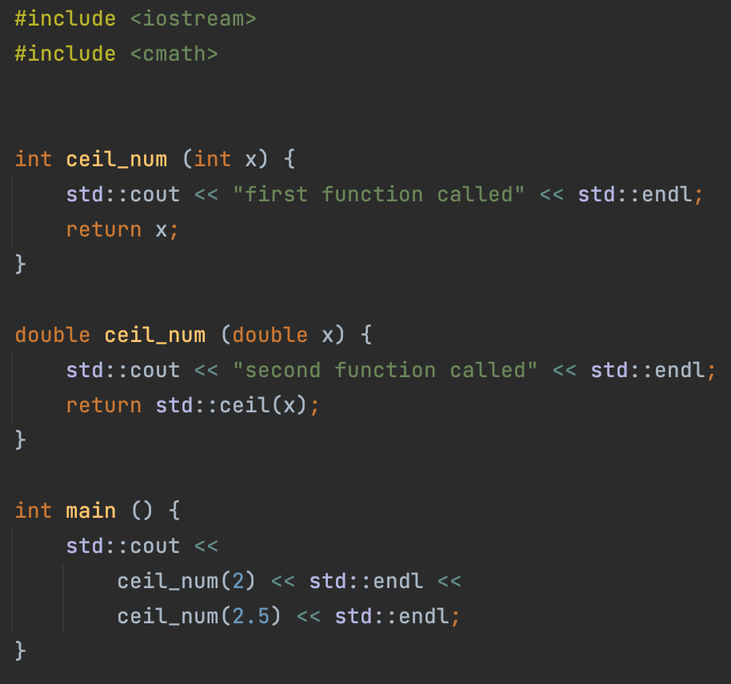
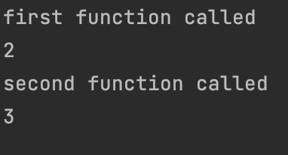
Function overloading
In C++ it is possible to define functions with the same names, but with different arguments and return types (this is not a compilation error!)
When a function call occurs, the most appropriate one is selected from all available overloads.
The question arises: what will happen in the case of the next expression: f('a')?

Slide 3
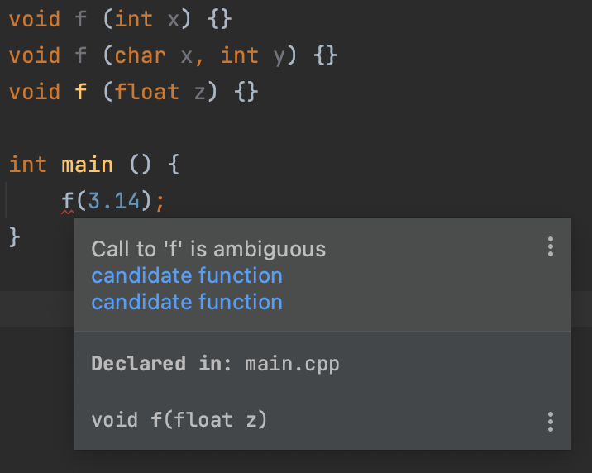
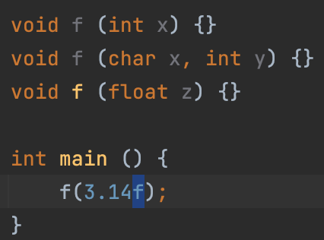
Function overloading: resolution rules
This is where the overload resolution rules come into play. The rules are a long and complex. They are a list of formal instructions for the compiler, so we will not analyze it exactly. Instead, I will give a general rule:
If the function has received exactly the types of arguments for which it is defined, then it is called.
Otherwise, there are various attempts to convert the original type to types defined in any overload versions.
Compilation errors occur only in two cases:
There was no suitable function at any of the stages
At some stage, several suitable functions were found
An example of an error and its fix is on the right side of the slide.

Slide 4
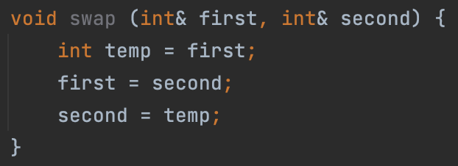
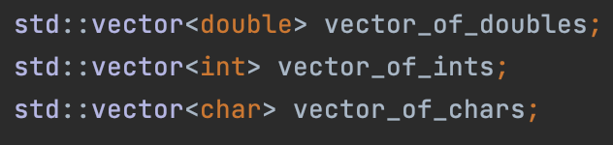
Templates: motivation
We would like to be able to write universal code for different types.
(Just like in the case of the std::vector<…>)

Slide 5
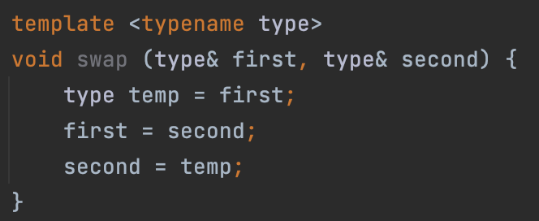
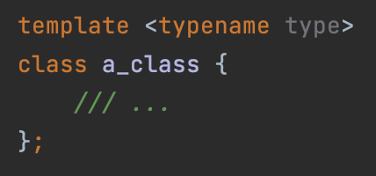
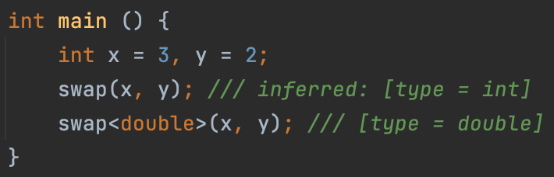
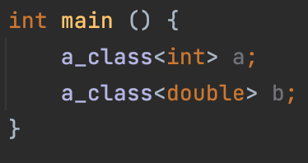
Templates: definition
In C++, functions, classes, and lambda expressions can be template.
Let’s look at template functions and classes:
The word type here defines the type of the variable for which this function will be called. For example, if the function is called with the template type = int, then wherever the word type occurs in the swap function, it will be replaced with int.
The template mechanism in C++ works entirely at compile-time, meaning that the template parameters are substituted at compile time.

Slide 6
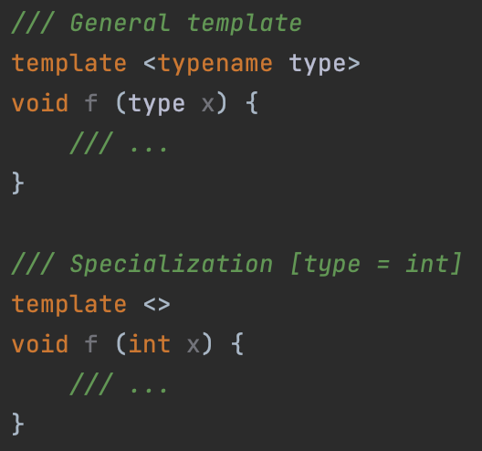
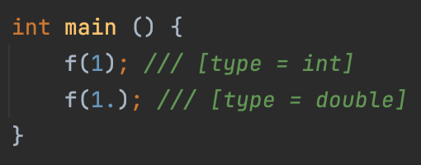
Templates: specialization
Similar to functions, templates can be specialized. Which means that you can create a version of a template function or class that will work for a specific type. Rule: the most highly specialized of suitable substitutions is chosen.

Slide 7
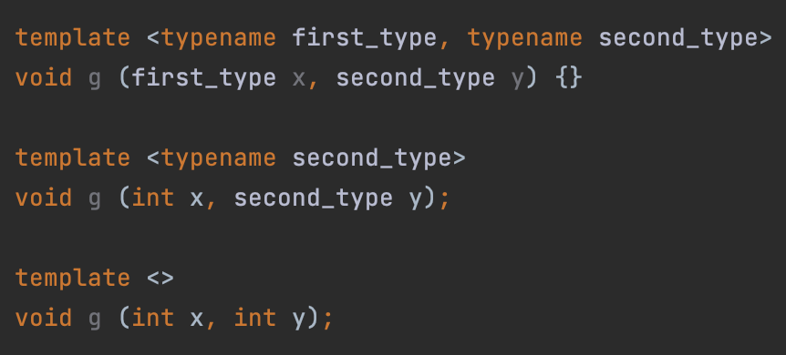
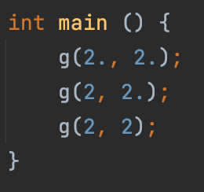
Templates: specialization
For example, this time there are two template arguments, and there is a so-called partial specialization (the second version of the g function).

Slide 8
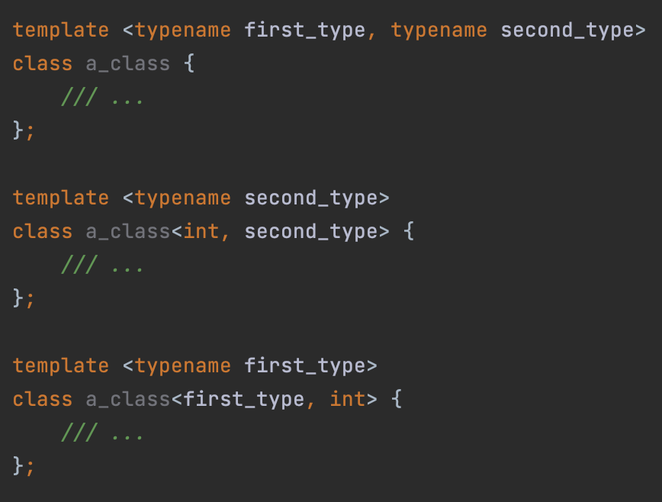
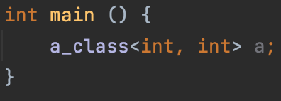
Templates: specialization
By analogy with function overloading, specialization must be unambiguous.
For example, here is the problem (it is not clear which specialization to call):

Slide 9
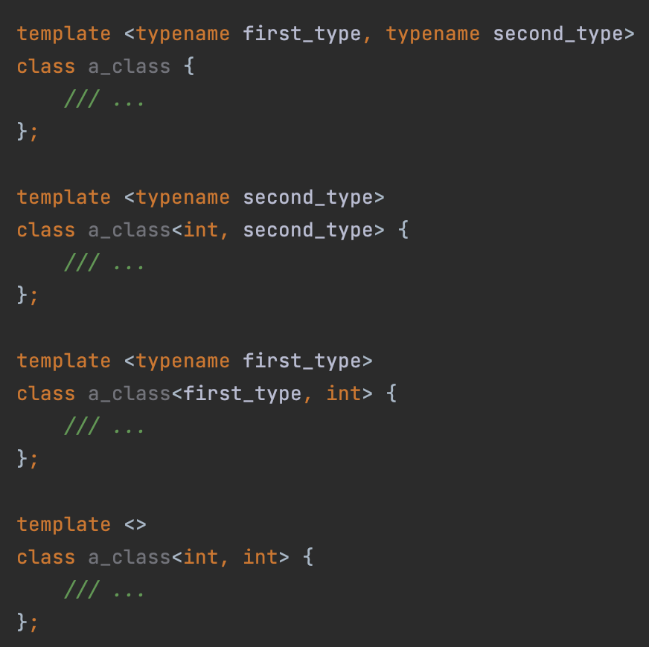
Templates: specialization
Now everything is fine: the latest version of the class is instantiated (a_class<int, int>)

Slide 10
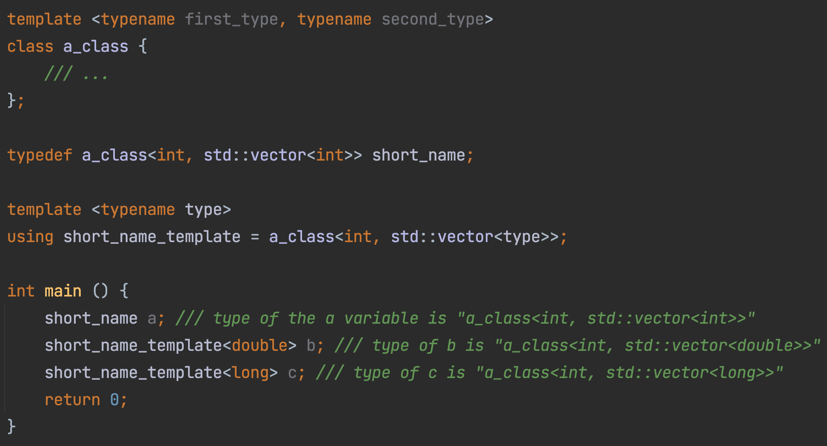
Typedef & using
C++ allows us to create our own shorthand for types. For example, if the name of some type is too long, we can create a new type that is semantically equivalent to the previous one. Moreover, we can parameterize the new type:

Slide 11
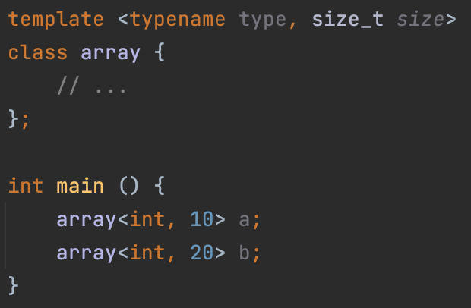
Non-type template parameters
You can put some value directly into the data type at compile time

Slide 12
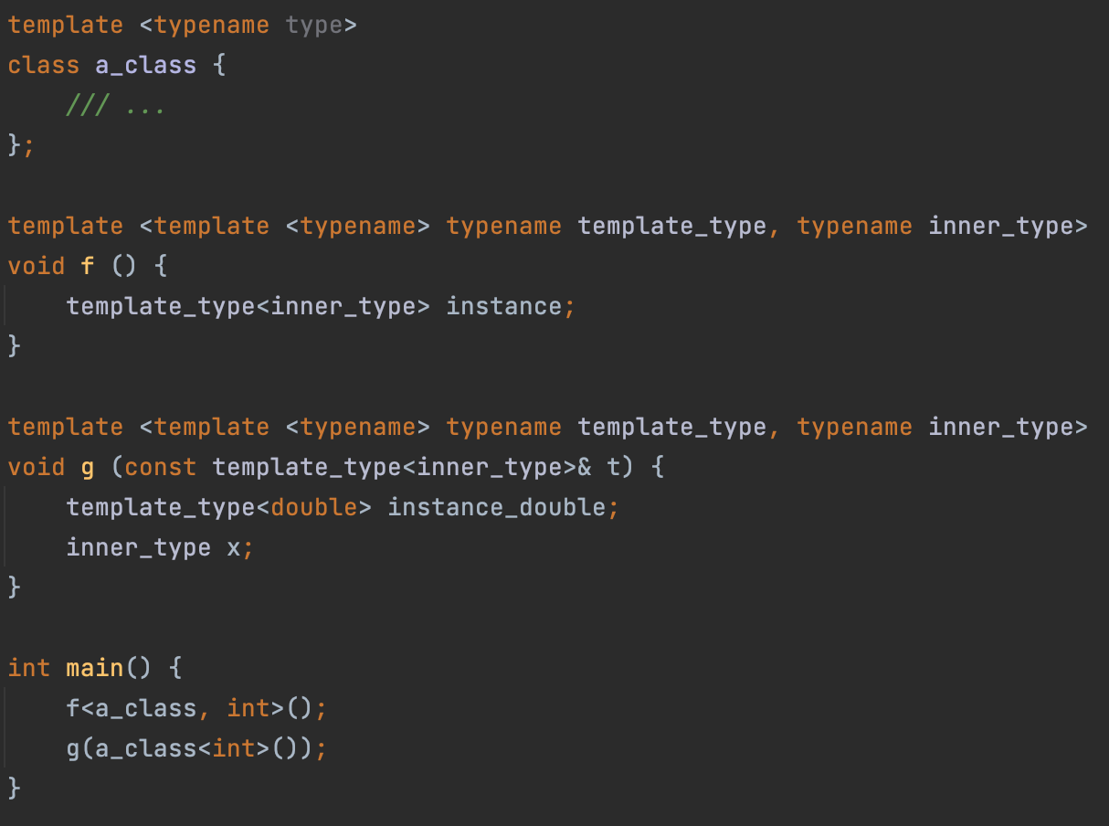
Template template parameters

Slide 13
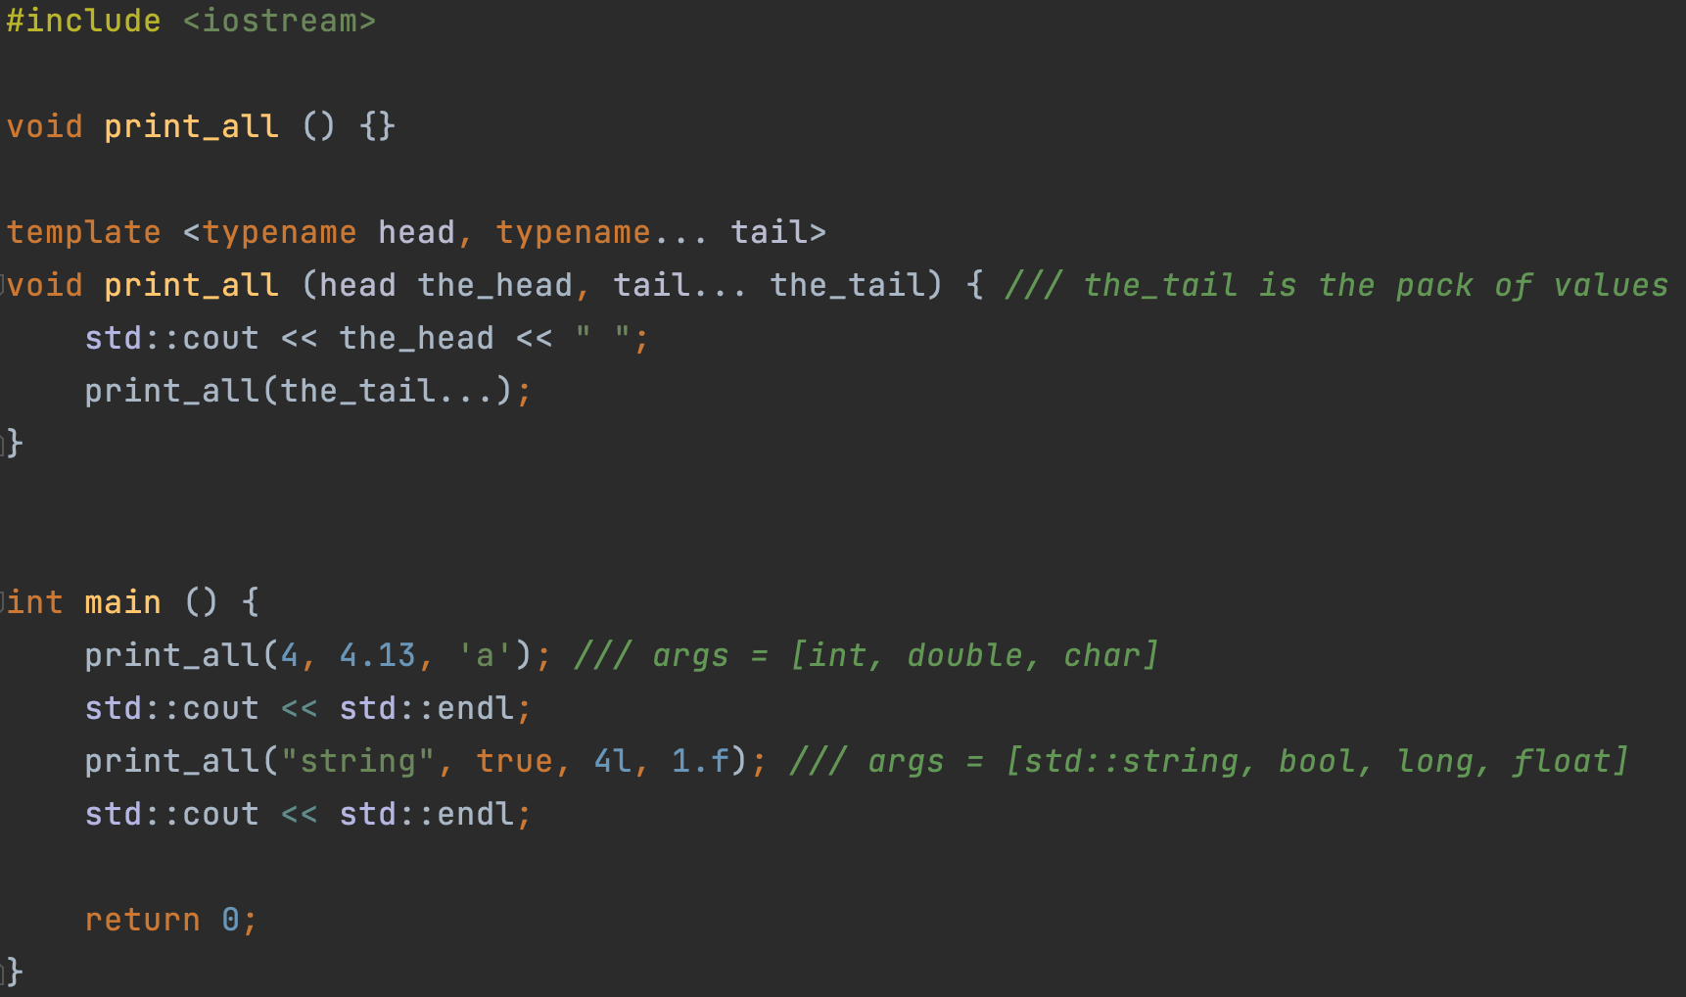

Variadic templates

Slide 14
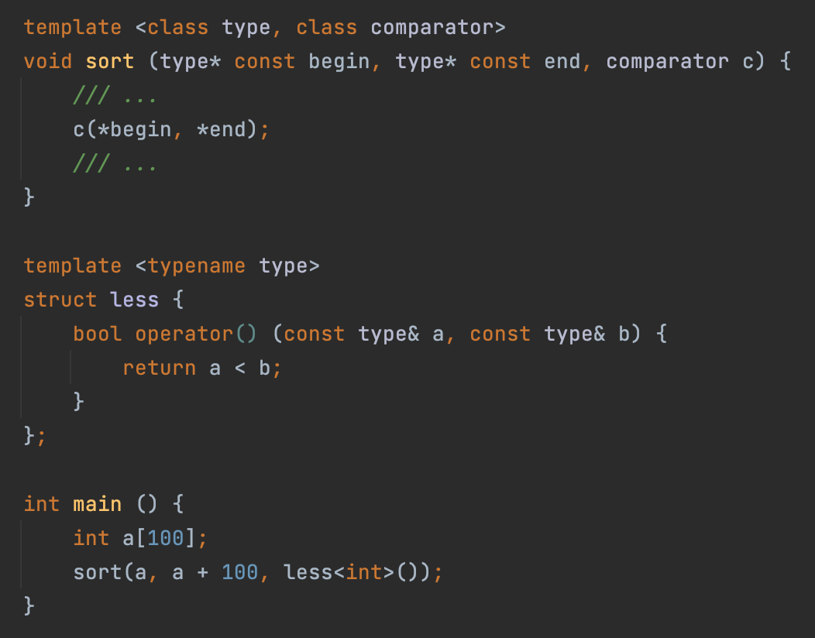
Functors

Slide 15
Lecture 14
Templates
Konstantin Leladze
OOP in C++
DIHT MIPT 2021

