Slide 1
Lecture 15
Inheritance, pt.1
Konstantin Leladze
OOP in C++
DIHT MIPT 2021

Slide 2
Three principles of OOP
OOP has three principles, they are listed below. These principles are present not only in C++, but in any object-oriented language. Below I have given a list of these principles and the mechanisms by which they are implemented in C ++.
Encapsulation: private and public access modifiers
Polymorphism:
static polymorphysm (compile-time): templates
dynamic polymorphysm (runtime): virtual functions & inheritance
Inheritance: inheritance
In green I colored what we have already managed to talk about, in red - what is yet to come.

Slide 3
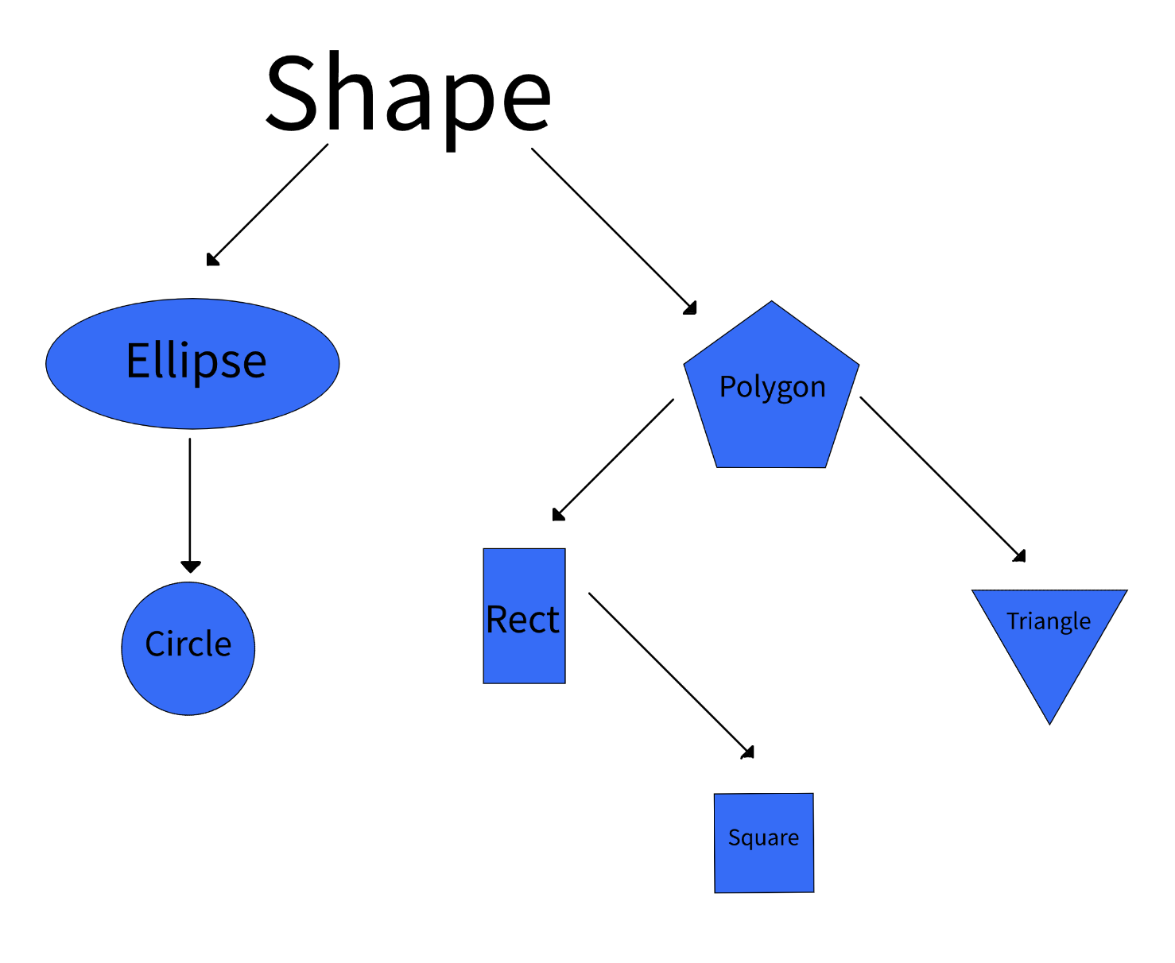
Inheritance, idea
Inheritance is one of the key features of Object-oriented programming in C++. It allows us to create a new class (derived class) from an existing class (base class).
The derived class inherits the features (members and methods) from the base class and can have additional features (members and methods) of its own.
In practice, very often you have to create object hierarchies in order to select their common properties, which allows you to reduce the amount of code.

Slide 4
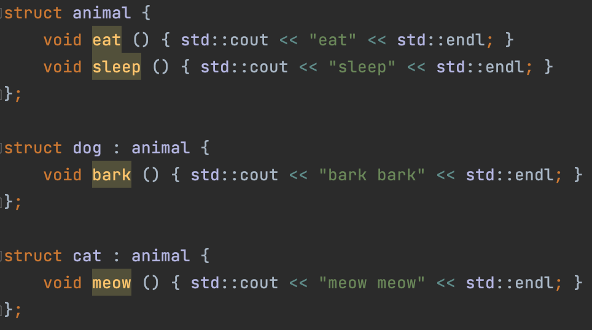
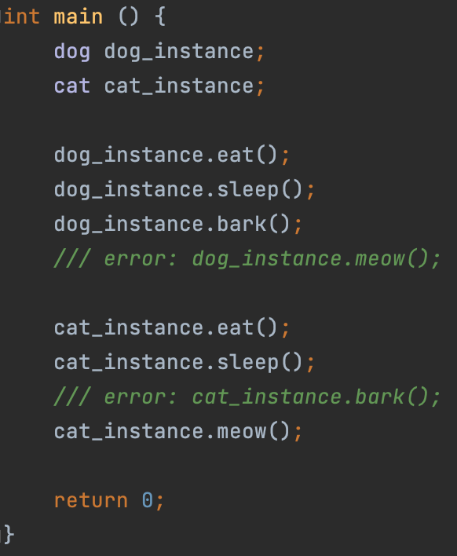
Inheritance, motivation
Both the cat and the dog can eat and sleep, but the dog has a unique option - to bark. Cat – to meow. The motivation for using inheritance in this case is obvious, we write less code due to the reuse of the eat and sleep methods.

Slide 5
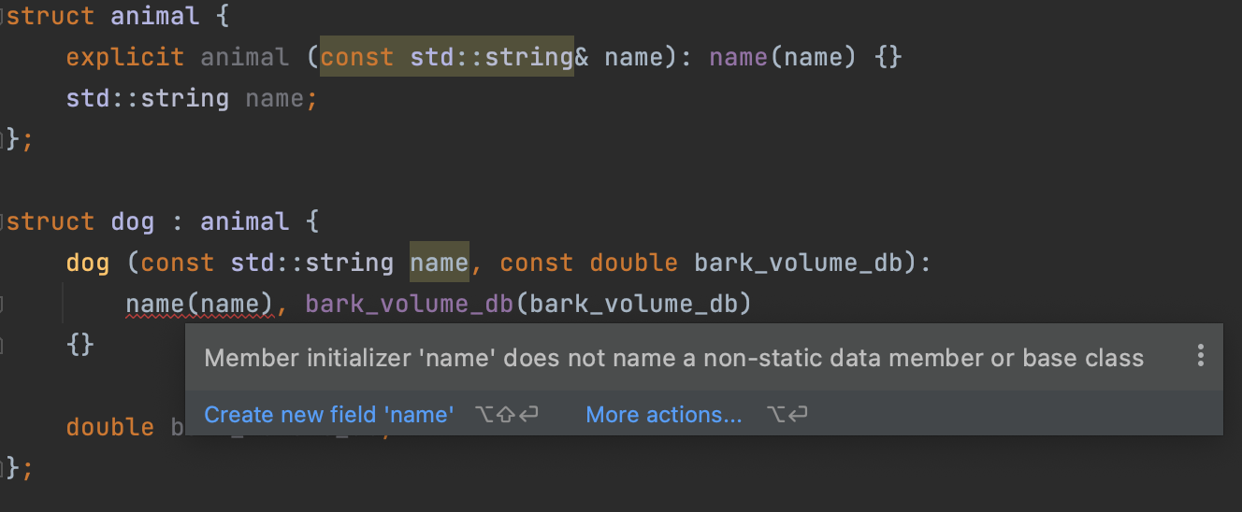
How to initialize base class
If we inherit from a class that accepts a value in the constructor, then we will need to somehow initialize the base class (class which we inherit the derived class from).

Slide 6
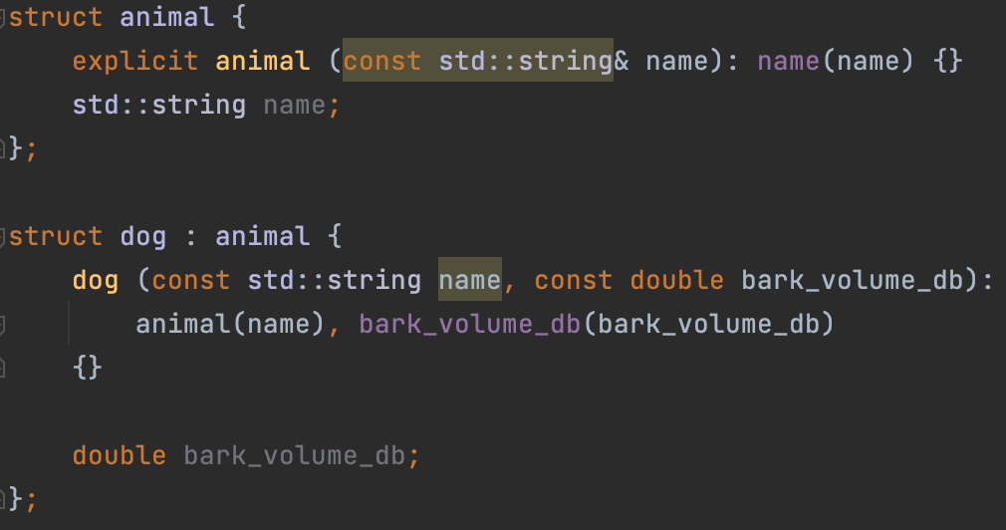
How to initialize base class: solution
Solution: let’s use delegate constructors in order to initialize the base.

Slide 7
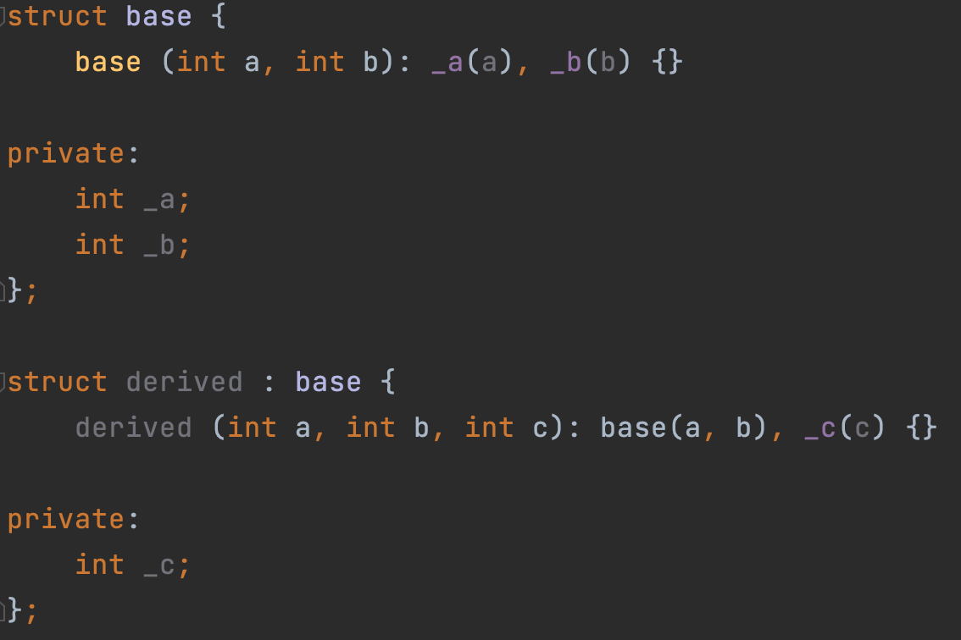
How to initialize base class: solution
Another example:

Slide 8
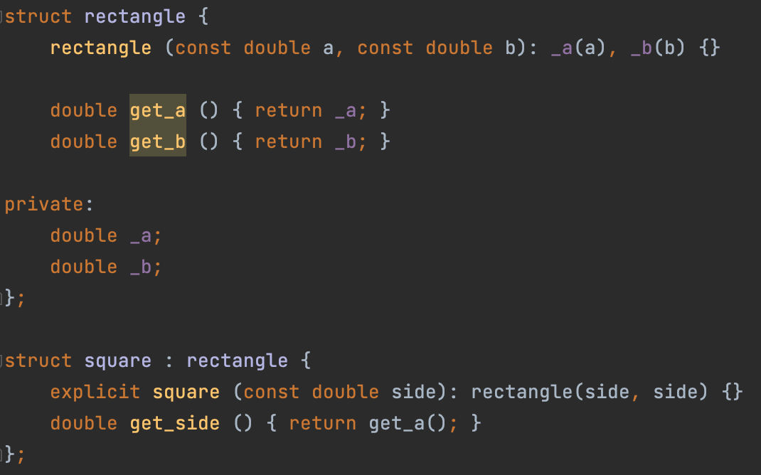
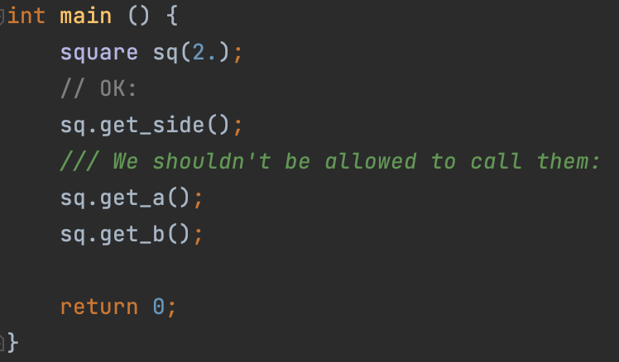
Inheritance modifiers, motivation

Slide 9
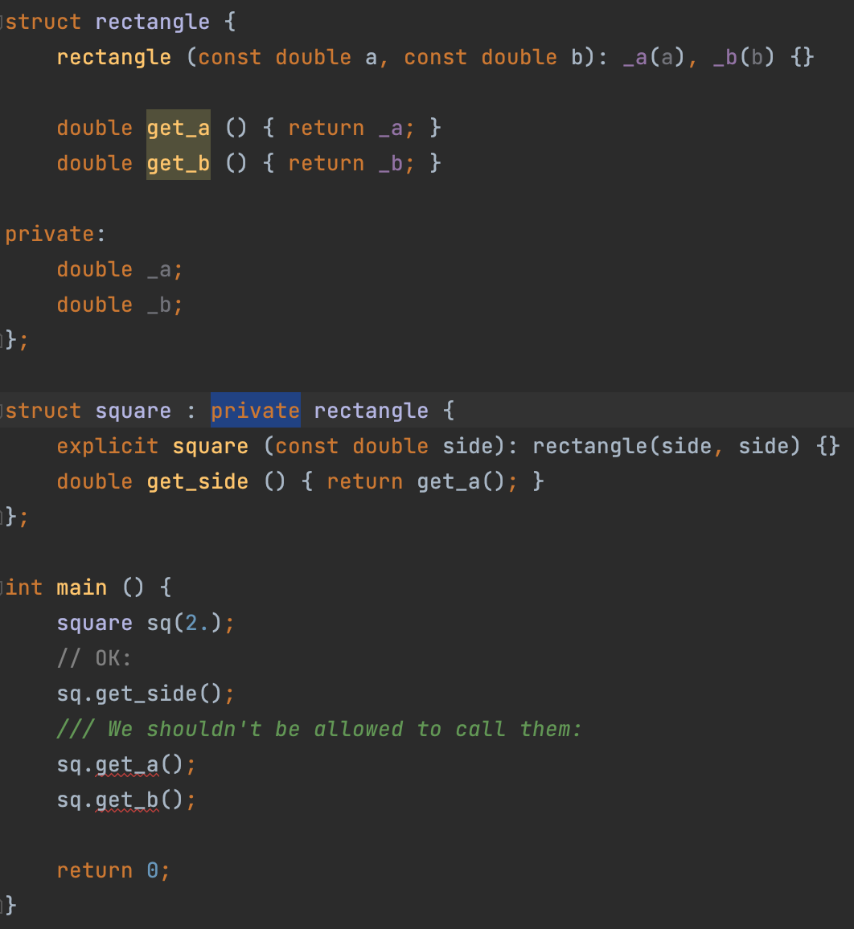
Inheritance modifiers, motivation
Private inheritance allows you to hide all inherited fields and methods from the user.
In addition to private inheritance, there are public and protected inheritance.
We'll talk about them a little later. Well, now let’s talk about the third access modifier in C++.

Slide 10
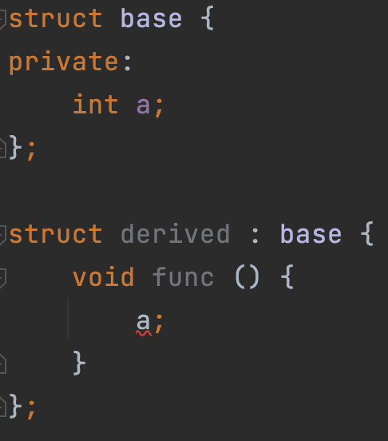
Protected keyword, motivation
Imagine the situation: we have a base class that has a private member that we want to use somewhere inside the heir. This is where the problem arises: private members and methods are not inherited under any circumstances. Thus, we can’t refer to it in the derived classes.
A simple solution would be to make the field public, but in this case the user could access this field from outside (and we want to prevent this!)
This is where the protected access modifier comes handy. The thing is that protected fields can be inherited, but are not available to the user.

Slide 11
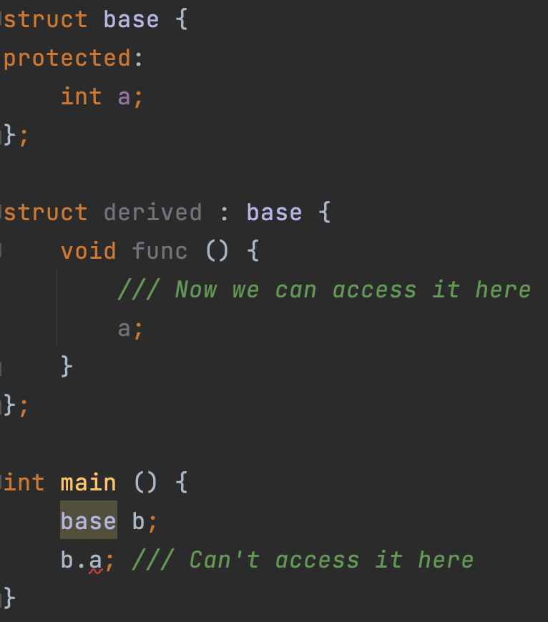
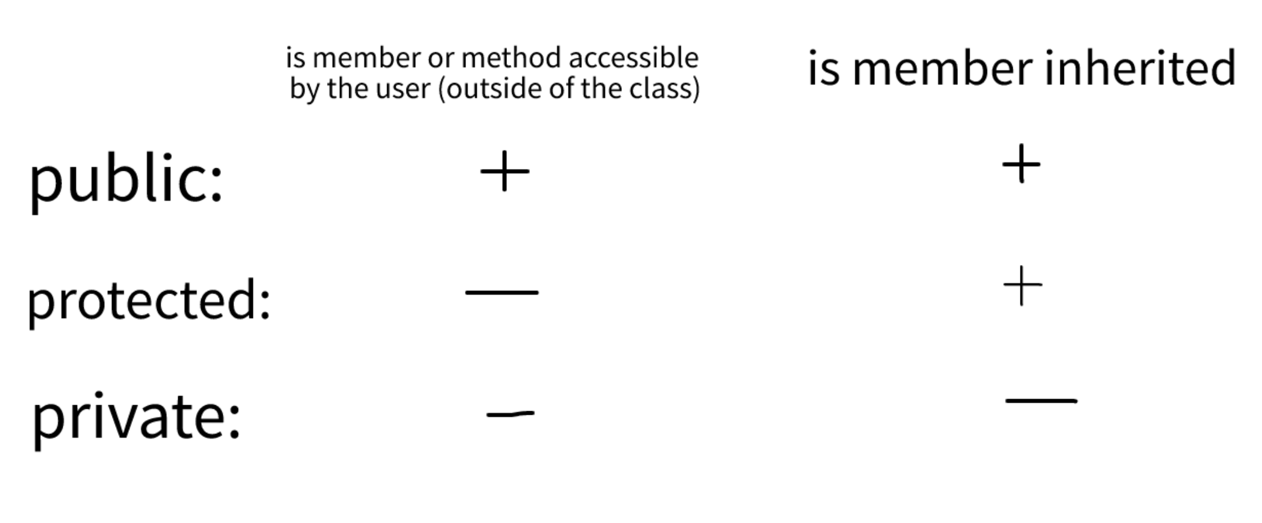
Protected keyword
Full solution:
Also, here I provide a table that shows the differences between the three access modifiers.
Now let's get back to inheritance modifiers.

Slide 12
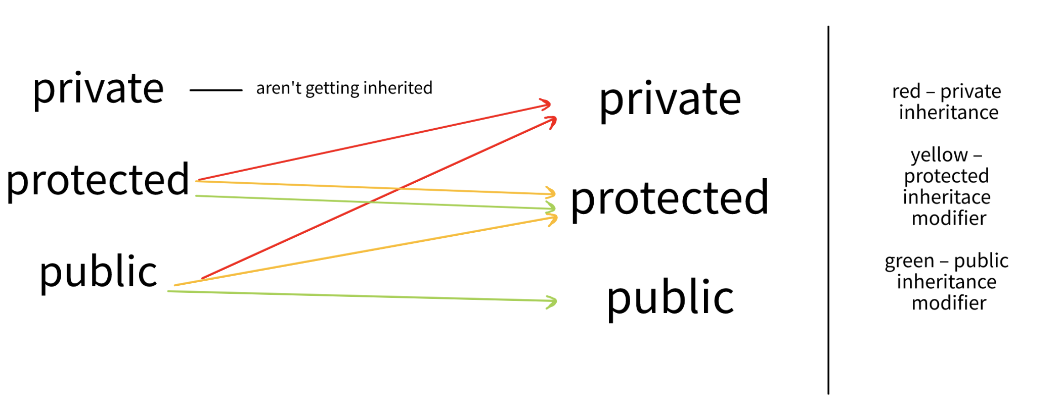
Inheritance modifiers
Inheritance modifiers allow you to change the access modifiers of fields and methods when inheriting (this explains the rectangle example, namely why adding a private access modifier solved our problem)
member access modifier before the inheritance (in the base class)
member access modifier after the inheritance (in the derived class)
Inheritance modifier:
If we do not specify any modifier, then by default for the class, inheritance will be private, and for struct - public.

Slide 13
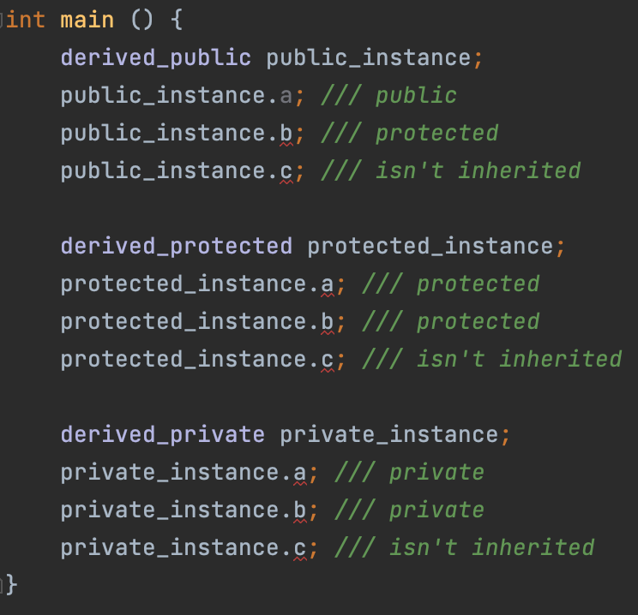
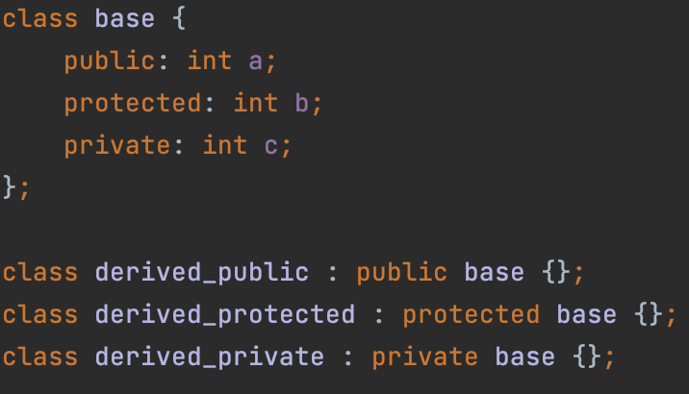
Inheritance modifiers, example
In this example, I have demonstrated all possible combinations of access modifiers and inheritance modifiers (previous table)

Slide 14
Lecture 15
Inheritance, pt.1
Konstantin Leladze
OOP in C++
DIHT MIPT 2021

