Slide 1
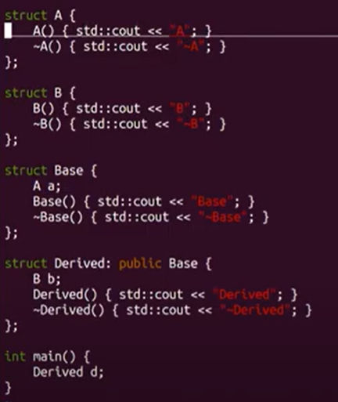
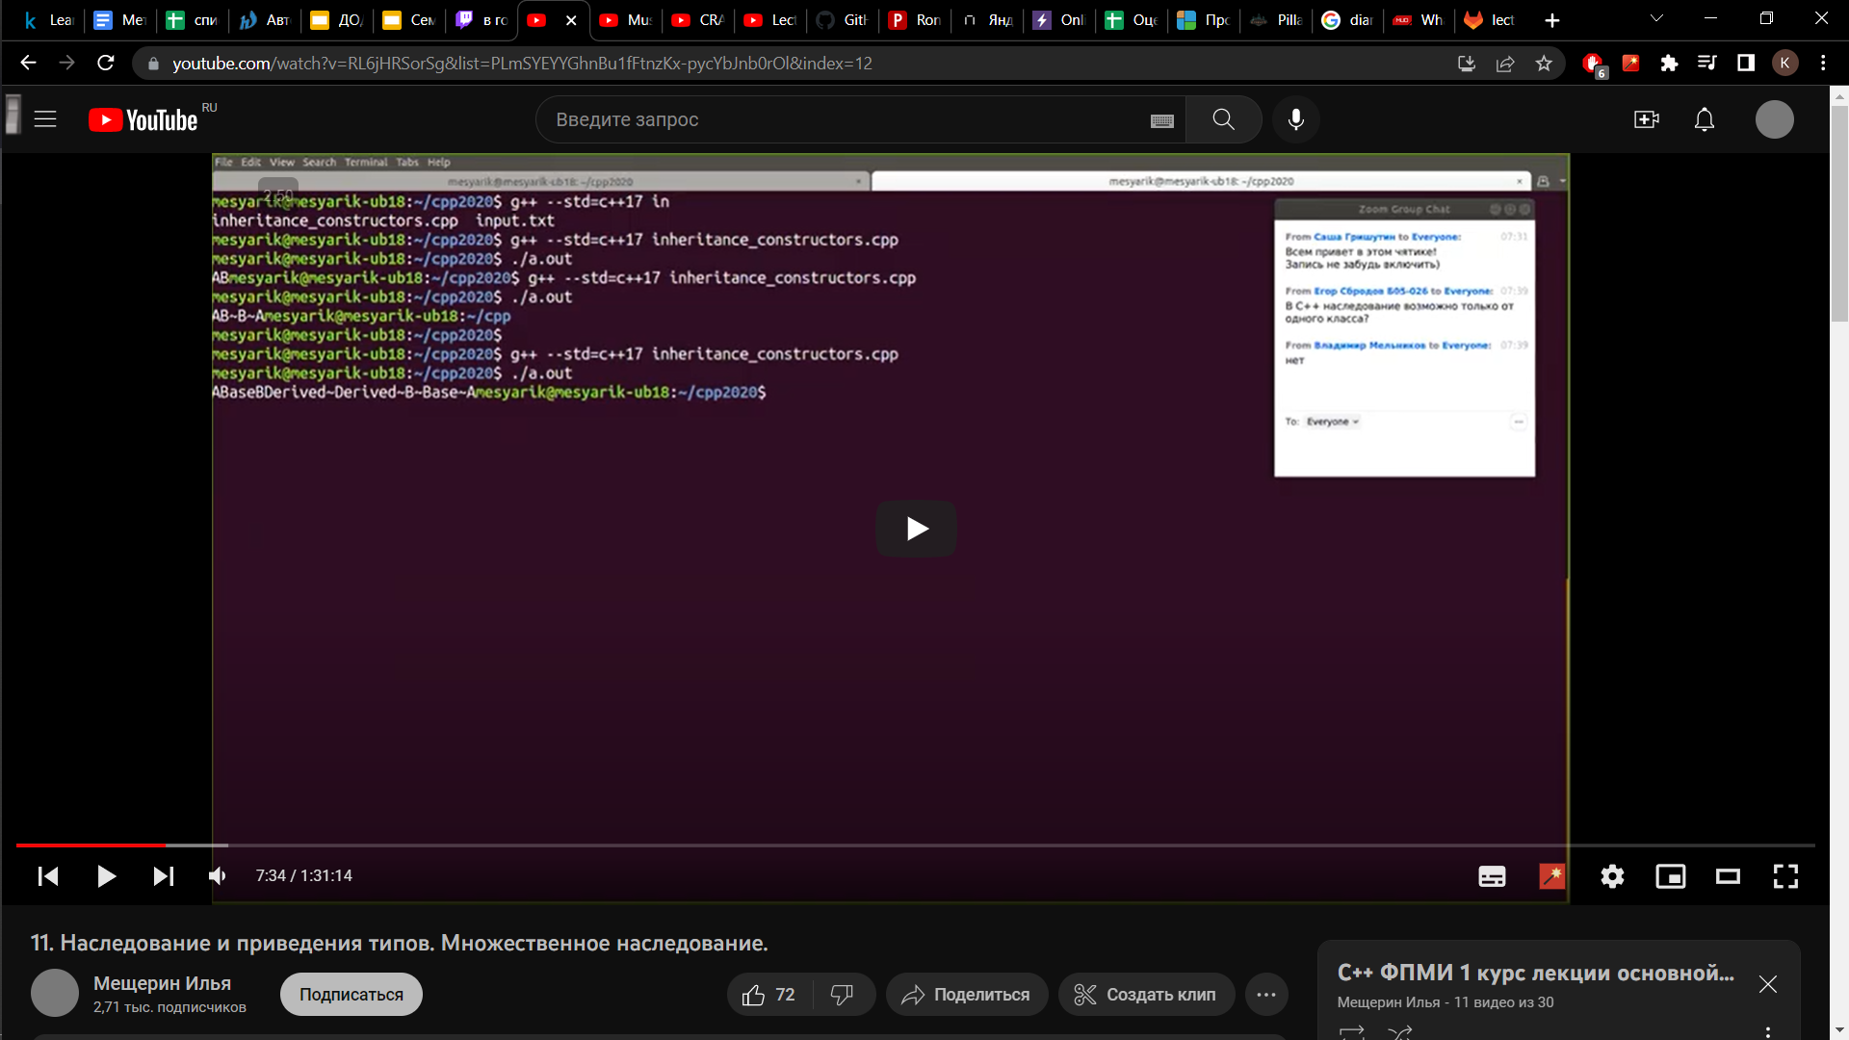
Exceptions
The objects are constructed and destructed in a strict order
Firstly the constructor of the most base class is called, then the constructors
of the classes that inherits from base and so on
Destructors called in reverse order: firstly the most derived class is destroyed
If we have to construct some fields in the class (A/B in the example), they are
constructed before calling the constructor of the class itself,
and vice versa with destruction
Example: we created Derived d object, then we should firstly create Base part of “d”,
and for that we should call A constructor before Base constructor
The program ends, “d” gets destroyed: from calling the Derived destructor to
calling the A destructor

Slide 2
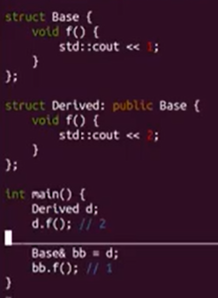
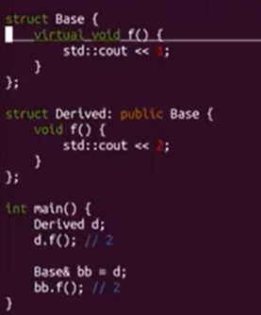
Meta functions
Problem: when we are trying to access Derived object using
reference of type Base, we get the output
such as “d” was of type Base
This can be solved using by calling functions virtual
Now all redefinitions of “f” will be virtual functions
Notice: virtual functions should have the same signature!
If we will define void f() const {} in Derived, it won’t be virtual!
There are also two keywords for functions in classes
void f() final – means that function can’t be redefined in descendants
void f() override -- means that function must redefine some function of the ancestors (you will get an error if not)

