Slide 1

AI System Overview
March 2012

Slide 2
AI System Basics – Navigation
Default Navigation System
  Triangulation
    2D terrain-based navigation
  Navigation Modifiers
    Waypoints
    Flight
    Volume etc.
Multi-layer Navigation System
Smart Object System
  Allows AIs to move in a special way

Slide 3
AI System Basics – Decision Making
Behavior Selection System
  Uses Behavior Selection Trees to select behaviors of AIs
Goal System
  Executes atomic and composite goals of AIs
Cover System
  Provides AIs with static and dynamic covers
Smart Object System (again)
  Allows AIs to interact with their environment
Interest System
  Allows AIs to perform intelligent actions when not alerted

Slide 4
AI System Basics – Tactical AI
Tactical Point System
  Allows AIs to ask intelligent questions about their environment (e.g. where to hide or attack)
Faction System
  Determines which AIs are hostile to which other AIs
Group Coordination System
  Uses Coordination Selection Trees to select group behaviors
Formation System
  Allows AIs to move in formations

Slide 5
AI System Basics – World Interfacing
Signals
  Trigger events and/or change behaviors
Perception System – 2 options:
  Perception Handler (legacy, usually per-game)
  Target Track System uses configurable ADSR envelopes to represent incoming stimuli
Communication System
  Allows AIs to play sound/voice/animation events

Slide 6
Environment (1/4) - CryAction
Game Object Model
  Entity, Movement Controller, Extensions
Actor & Vehicle System
  Health, camera, IK, weapons, animation etc.
Flow Graph
  Visual definition of game logic
AI Debug Renderer
  HUD, geometric primitives, text labels, graphs etc.

Slide 7
Environment (2/4) - Editor
AI Entities (AIs)
  Properties, Flow Graphs (FG Debugger available), scripts
Entity Archetypes
  Templates for properties of individual AIs
AI Shapes
  AI Territories, AI Paths, Forbidden Areas
Navigation
  Navigation Modifiers for where Triangulation is not used
Cover Surfaces
  CoverSurface anchors for where cover should be
Visual AI Debugger
  Recording AI signals, active behaviors, goals, stimuli etc.

Slide 8
Environment (3/4) – Lua & XML
Lua scripts
    Entity definitions (including entity Flow Graph nodes)
    AI behavior definitions
    Group behavior definitions
    Library or shared Lua code (game rules, basic entities)
    Blackboards to share information among groups or globally
  XML files
    Behavior/Coordination Selection Trees
    Goalpipes
    AI Communications
    Items (e.g. weapons)

Slide 9
Environment (4/4) – Entity System
Spatial queries: GetPhysicalEntitiesInBox
AIs and vehicles are entities of the Entity System
To spawn an entity, its Entity Class is required
  Defined either using .ent file in directory Game/Entities
  Or through a C++ call to RegisterFactory(…) in game code
Entity Pool can be used to limit the number of active AI actors (AIs) per each specified Entity Class

Slide 10
AI System Execution Context
AI update is called every frame
That said, AIs are “fully” updated only at ~10Hz
Some AI subsystems use independent time-slicing:
  Pathfinding
  Tactical Point System
  Dynamic waypoints update
  Smart Object System
  Interest System
  Dead bodies removal
Some services can be called synchronously from game code (e.g. Tactical Point System queries)

Slide 11
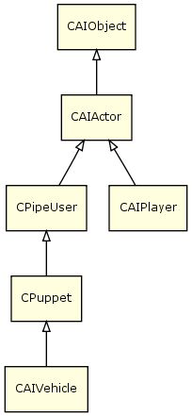
AI Objects Hierarchy
CAIObject: Basic properties (entity ID, position, direction, group ID, faction etc.)
CAIActor: Basic perception & navigation, behavior selection, coordination, blackboard, AI Territory awareness, AI Proxy (of CryAction)
CPipeUser: Goalpipes/goalops, smart objects, pathfinding/pathfollowing/obstacle avoidance, attention target, full-fledged perception
CAIPlayer: AI System’s representation of the actual (real) game player
CPuppet: Aiming, firing, stances, covers –
full-fledged AI agent
CAIVehicle: Vehicle-specific code

Slide 12
Navigation (1/3)
Default Navigation
  Triangulation on terrain
    Uses cylindrical objects (e.g. trees) and Forbidden Areas
  Human Waypoints
    Waypoints need to be placed manually
    Connections can be generated automatically
  Flight Navigation
    Information about navigable volumes for flying entities
  Volume Navigation
    More general volume navigation, e.g. for ocean

Slide 13
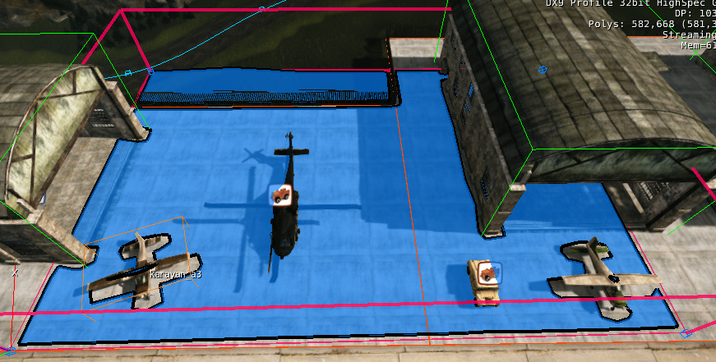
Navigation (2/3)
Multi-layer Navigation

Slide 14
Navigation (3/3)
In general
  A* search is time-sliced to use 0.5 ms per AI frame (configured in console variable “ai_PathfinderUpdateTime”)
  Pathfinding options: high priority, straight or partial path
  Human Waypoints update is a bit heavy but time-sliced
  Navigation graph is optimized but needs some memory
Navigation generation
  Navigation data is generated offline, in Editor
  Multi-layer Navigation allows the regeneration of navigation mesh as the designer modifies the map

Slide 15
Behavior Selection Tree – Overview
Effectively a state machine
  Defines conditions to changes Behaviors (“states”)
Behavior variables are used to choose behaviors
  They can be set in Lua or as a result of receiving a Signal
Uses tree decision system with condition checking
  Conditions are specified as strings but can be more complex than just checking a single variable
    E.g. "IsHurt and !InCover and HasTarget"
  If a condition fails traversal moves on to the next sibling
  If no leaf node is reached then no behavior switch is made
The code can be shared among a number of BSTs

Slide 16
Behavior Selection Tree - Example
<SelectionTrees>
<SelectionTree name="FogOfWar" type="BehaviorSelectionTree">
<Variables>
<Variable name="IsFar"/>
<Variable name="IsClose"/>
<Variable name="AwareOfPlayer"/>
</Variables>
<SignalVariables>
<Signal name="OnEnemySeen" variable="AwareOfPlayer" value="true"/>
<Signal name="OnNoTarget" variable="AwareOfPlayer" value="false”/>
<Signal name="OnLostSightOfTarget" variable="AwareOfPlayer" value="false"/>
</SignalVariables>
<Priority name="Root">
<Leaf name="FogOfWarSeekST" condition="IsFar"/>
<Leaf name="FogOfWarEscapeST" condition="IsClose"/>
<Leaf name="FogOfWarAttackST" condition="AwareOfPlayer"/>
<Leaf name="FogOfWarIdleST"/>
</Priority>
</SelectionTree>
</SelectionTrees>

Slide 17
Behavior Selection Tree – Definition
XML file which resides in Scripts/AI/SelectionTrees
Use tag <SelectionTree>
Multiple Behavior Selection Trees (BSTs) can be defined in the same file, if really necessary
<SelectionTrees>
<SelectionTree name="FogOfWar" type="BehaviorSelectionTree">
[…]
</SelectionTree>
</SelectionTrees>

Slide 18
Behavior Selection Tree – Tags
To define a BST, use tags <Leaf> and <Priority>
Leaf name should be the same as that of the corresponding behavior (or a Leaf Translation node)
Leaves are evaluated (as defined in attribute “condition”) in order. The behavior of the first leaf evaluated to true is selected.
<Priority name="Root">
<Leaf name="FogOfWarSeekST" condition="IsFar"/>
<Leaf name="FogOfWarEscapeST" condition="IsClose"/>
<Leaf name="FogOfWarAttackST" condition="AwareOfPlayer"/>
<Leaf name="FogOfWarIdleST"/>
</Priority>

Slide 19
Behavior Selection Trees – Variables
Variables can only be Boolean
<Variables>
<Variable name="IsFar"/>
<Variable name="IsClose"/>
<Variable name="AwareOfPlayer"/>
</Variables>

Slide 20
Behavior Selection Trees – Signals
AI signals can be used to change the values of specific BST variables
<SignalVariables>
<Signal name="OnEnemySeen" variable="AwareOfPlayer" value="true"/>
<Signal name="OnNoTarget" variable="AwareOfPlayer" value="false"/>
<Signal name="OnLostSightOfTarget" variable="AwareOfPlayer" value="false"/>
</SignalVariables>

Slide 21
Behavior
Can essentially be thought of as an FSM state
Written in Lua and contains a function table where each row defines the response to a Signal
Scripts must be in “Scripts/AI/Behaviors” (or below)
Each behavior script should contain a call to
  function CreateAIBehavior(name, parent, def)
defined in AIBehavior.lua in order to be added to the table of available behaviors.

Slide 22
Behavior – Example
Scripts/AI/Behaviors/NewAliens/AlienGrunt/AlienGruntAvoidImmediateThreat.lua:
local Behavior = CreateAIBehavior("AlienGruntAvoidImmediateThreat", "GruntBaseBehavior",
{
Alertness = 2,
Constructor = function(behavior, entity)
...
end,
Destructor = function(behavior, entity)
...
end,
AvoidThreat = function(behavior, entity)
...
end,
AvoidThreatCoverNotFound = function(behavior, entity)
...
end,
...
})

Slide 23
Goalpipes
Goalpipe is a predefined sequence of atomic goals (goalops) to be performed by an AI
In Lua it’s easier to create goalpipes on the fly, if necessary
In XML goalpipe definitions look a lot more intelligible
Example of an XML goalpipe:
<GoalPipe name="ApproachAndShootObject">
<Speed blocking="false" id="Run"/>
<FireCmd mode="Burst"/>
<LookAround blocking="false" lookAroundRange="360" scanRange="5" interval="60" breakOnLiveTarget="true"/>
<Timeout intervalMin="1.0" intervalMax="4.0"/>
</GoalPipe>

Slide 24
Goalops – Some Examples
Locate
  Locate an AI object/actor for further handling
LookAt
  Look at a specified AI object/actor
FireCmd
  Attack a specified AI object/actor in a specified manner
Signal
  Send a signal to a specified AI actor/group/neighborhood
Speed
Stance
Stick
  Approach/follow a specified AI object/actor
TacticalPos
  Find a spot that match certain criteria (to hide, attack etc.)

Slide 25
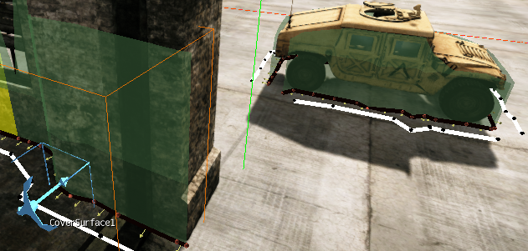
Cover Surfaces
Actual cover information is generated offline, in Editor

Slide 26
Interest System
If the player is able to secretly approach AIs, merely playing idle animations may not suffice to look cool
Interest System basically triggers predefined AI Actions, as soon as idle AIs of applicable AI classes find themselves near applicable (interesting) entities
Examples:
  AI attentively examines a dead body
  AI attentively examines an abandoned car
  AI “finds” a good spot and uses his binoculars to attentively examine the landscape

Slide 27
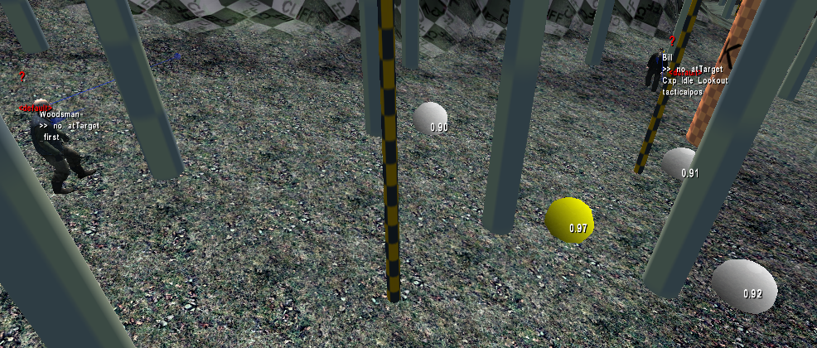
Tactical Point System (TPS)
Bill, on the right, finds a hidespot from a Woodsman

Slide 28
Tactical Point System – Overview
Tactical Point System
  Allows AIs to ask intelligent questions about their environment
  Is a structured query language over sets of points in the world
  Is used for finding hidespots or attack points or navigation waypoints
  Optimizes queries automatically and processes them in a time-sliced manner
Accessible through Lua, XML, C++

Slide 29
TPS Query Example
Find a cover from referencePoint
AI.RegisterTacticalPointQuery( {
Name = "Find_Cover",
{
Generation = { hidespots_from_referencePoint_around_puppet = 20.0 },
Conditions = { reachable = true,
coverSuperior = true,
},
Weights = { distance_from_referencePoint = -1.0,
distance_from_puppet = -1.0,
friendlyDistance = 1.0,
},
},

Slide 30
Faction System
Determines which AIs are hostile to which other AIs:
<Factions>
<Faction name="Players">
<Reaction faction="Grunts" reaction="hostile"/>
<Reaction faction="Civilians" reaction="friendly"/>
<Reaction faction="Assassins" reaction="hostile"/>
</Faction>
<Faction name="Civilians" default="neutral"/>
...
</Factions>
(Game/Scripts/AI/Factions.xml)

Slide 31
Group Behavior – Example (1/2)
<SelectionTrees>
<SelectionTree name="DefaultGroup" type="CoordinationSelectionTree">
<Variables>
<Variable name="AreaSearch" />
<Variable name="Sweep" />
<Variable name="InvestigateMemberDeath" />
</Variables>
<Priority name="Root">
<Leaf name="GroupAreaSearch" condition="AreaSearch" />
<Leaf name="GroupSweep" condition="Sweep" />
<Leaf name="GroupInvestigateMemberDeath" condition="InvestigateMemberDeath" />
<Leaf name="DEFAULT" />
</Priority>
</SelectionTree>
</SelectionTrees>

Slide 32
Group Behavior – Example (2/2)
local Behavior = CreateAIGroupBehavior("GroupAreaSearch", "DEFAULT",
{
Constructor = function(self, group)
...
end,
Destructor = function(self, group)
...
end,
OnGroupTargetNone = function(self, group)
...
OnGroupTargetSound = function(self, group)
...
OnGroupTargetMemory = function(self, group)
...
OnGroupTargetVisual = function(self, group)
...
end,
...
})

Slide 33
AI Territories & Waves
Control the number of active AIs at any time through simple Flow Graph logic
All AIs assigned to an AI Territory can be activated, deactivated, and spawned using a single FG node
Optionally, AI Waves are attached to AI Territories and allow independent AI activations
If AIs were marked to be Created Through Pool and assigned to an AI Wave, the AI Wave handles Entity Pool issues – e.g. loading/unloading – automatically

Slide 34
AI Debug Draw – (1/2)
ai_DebugDraw
  1: Basic info on AIs (selected by ai_DrawAgentStats)
  74: All the Navigation Graph (can be slow)
  79: Parts of the Navigation Graph around the player
ai_statsTarget Goon35
  Detailed info for specified AI (e.g. Goon35)
ai_DebugTargetTracksAgent Grunt1
  Perception information on AI Grunt1
ai_Recorder_Auto
  Record AI activity in Editor game mode for AI Debugger
ai_DebugTacticalPoints
  Debug TPS queries

Slide 35
AI Debug Draw – (2/2)
ai_DrawPath Grunt1
  Draw the path of a specific AI (can be “all”, for all AIs)
ai_DrawPathFollower
  Draw the actual path following
ai_DrawSmartObjects
  Display Smart Objects, their classes and attributes
ai_DebugDrawEnabledActors
  List currently enabled AIs

Slide 36
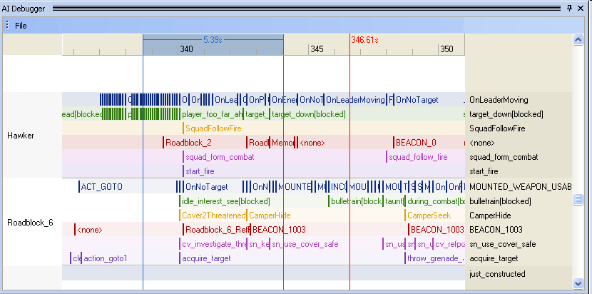
AI Debugger
AI Debugger can track a number of AI features: active behavior, active goalpipe, signal received, attention target, comments created with AI.RecComment etc.

Slide 37
Scriptbind Functions
Some AI functionality is available in Lua, for example
  AI.CreateGoalPipe
  AI.Signal
  AI.FindObjectOfType
  AI.GetAttentionTargetType – Visual, Memory, Sound, None
  AI.GetAttentionTargetAIType – Actor, Grenade, Car etc.
  AI.GetRefPointPosition
  AI.DistanceToGenericShape
  AI.SetBehaviorVariable (change behavior)
  AI.CanMelee
  AI.RecComment (make comment for Visual AI Debugger)
  …

Slide 38
Questions?

