Slide 1
Smart Factory
Cheyenne Hathaway, Kaylee Auguillard, Daniel Wright

Slide 2
Main System Components
AI Models
IIoT Devices including robots and sensors
CNC Machines that can perform automated tasks
Ethernet and WiFi
Edge Computing Devices
The Cloud

Slide 3

Flow of Data
First the sensors collect the data from the automated machines or robots
Next, the AI models process it locally and send it to the cloud
More in depth analysis is performed using a cloud based model
The resulting insights are sent to the operators dashboard so they can determine if everything is working as expected
Image generated by Copilot

Slide 4
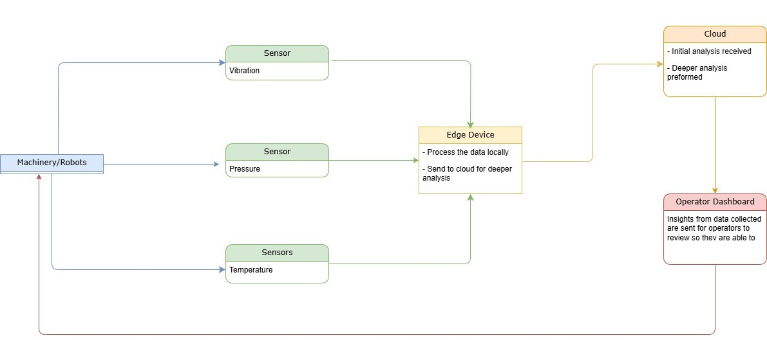
Here is a flow chart showing the data flow within the system:

Slide 5
Potential Security Risks:
Outdated firmware
Weak authentication methods
Malware
Network vulnerabilities
Data Vulnerabilities
AI model poisoning
Application vulnerabilities
Unsecured interfaces between applications and devices
Human factor
Insider threats

Slide 6
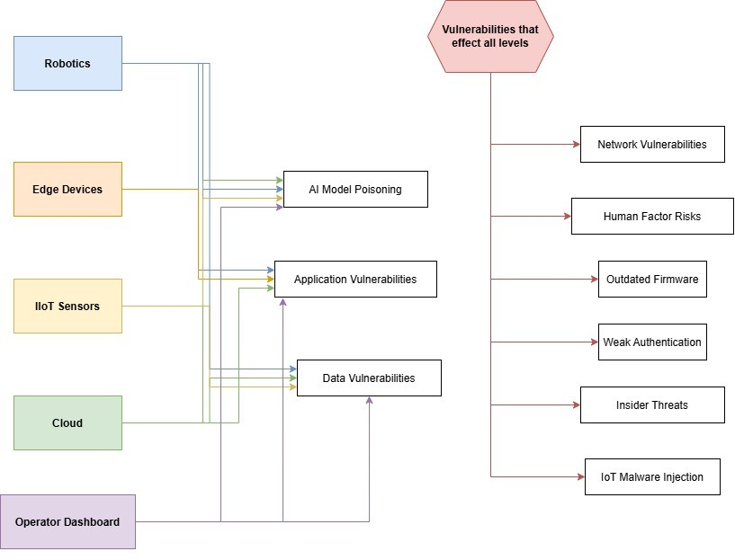
What part of the system do these threats effect?
Outside of the flowchart, privacy and confidentiality is at risk at each level, with each possible vulnerability
Image created in draw.io

Slide 7

Proposed Solutions:
Zero Trust/Least Privileged Access
Multi-Factor Authentication
End-to-End Encryption
Secure API Gateways
Zone Segmentation, Firewalls, Intrusion Detection
Secure Software Development and Regular Updates
Verification of Data Sources
Physical Security

Slide 8
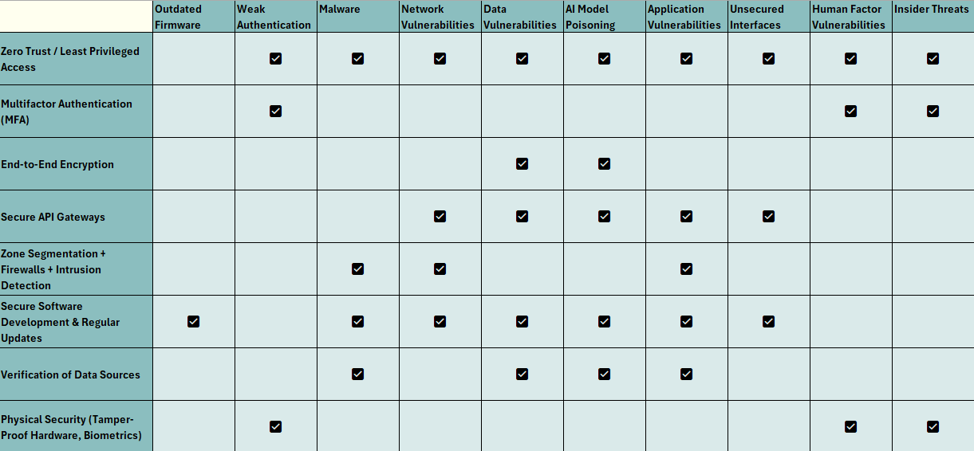
Which security measure addresses which issue?

Slide 9
Implementation
These are the steps following a complete security assessment to ensure there are no immediate threats that need to be addressed:
Authentication and Encryption Set Up- this will reduce unauthorized access attempts
Network Segmentation and Monitoring- limit lateral movement to prevent any possible threats from impacting the entire system. This will also notify the appropriate party of any suspicious activities
Secure Software Updates- this includes the development of a process to periodically retrain the AI models, and check any third party apps that are in use for pending updates. This ensures vulnerabilities are caught and addressed before they can be exploited.
Employee Training and Awareness- training on how to identify phishing attempts and the importance of password security to reduce malware introduced by user exploitation
Physical Security- tamper proof seals to prevent access, require code or key cards to access hardware

Slide 10
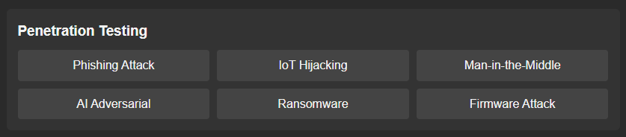
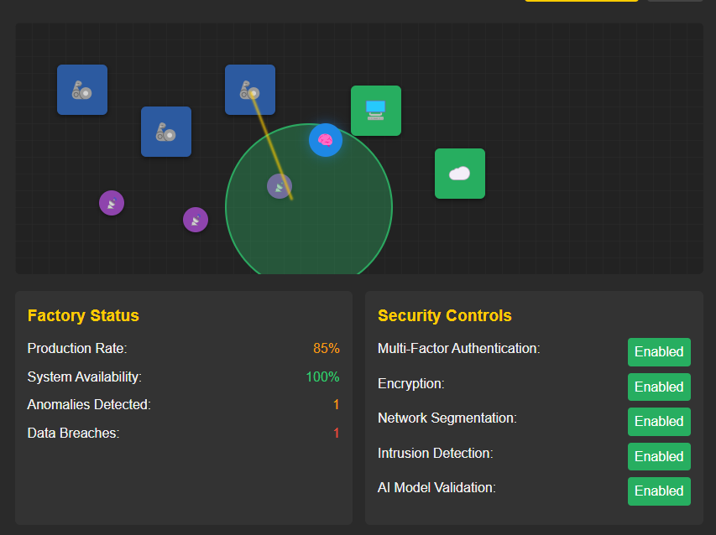

Testing New Security via Simulation
Possible simulated tests:
Simulation Dash:
Notification of attack and determination of success:
Source: https://hccai.ngrok.io/#simulation

Slide 11
Test
Why?
What happens if it fails?
1
Simulated Phishing Attacks
Determine effectiveness of employee training and identify areas for improvement
Employees who fall for the attack will be required to complete further training
2
IoT Hijacking
See if attackers can gain control over factory machinery or extract sensitive data
Immediate prioritization of updating firmware
3
Man in the Middle Attacks
Test network security by intercepting data transmissions to see if there is a lack of secure communication or weak encryption
An update to encryption policies as well as an update to system communications
4
AI Adversarial Attacks
Evaluate how well the models detect and mitigate threats
The model will need further training on trusted data, before being tested again
5
Ransomware Simulations
Determine how well the system can detect and recover from an attack, as well as incident response strategies
If the attack is successful, the system to detect anomalies will require an update, and policies around incident response will be re-evaluated

Slide 12
Sources
Microsoft. (n.d.). Security design principles. Microsoft Learn. Retrieved April 1, 2025, from https://learn.microsoft.com/en-us/azure/architecture/guide/security/security-start-here
StrongDM Team. (2024, March 18). Zero trust vs. the principle of least privilege: What's the difference? StrongDM. Retrieved April 1, 2025, from https://www.strongdm.com/what-is/zero-trust-vs-principle-of-least-privilege
Melecio, N. (n.d.). Enhancing cybersecurity for IoT and AI systems: A comprehensive overview. ScaleUp Lab Program. Retrieved April 1, 2025, from https://scaleuplab.gatech.edu/enhancing-cybersecurity-for-iot-and-ai-systems-a-comprehensive-overview/​
DataGuard. (n.d.). 10 key challenges and cybersecurity solutions for smart factories in manufacturing. Retrieved April 1, 2025, from https://data-guard365.com/manufacturing/10-key-challenges-and-cybersecurity-solutions-for-smart-factories-in-manufacturing/

