Slide 1
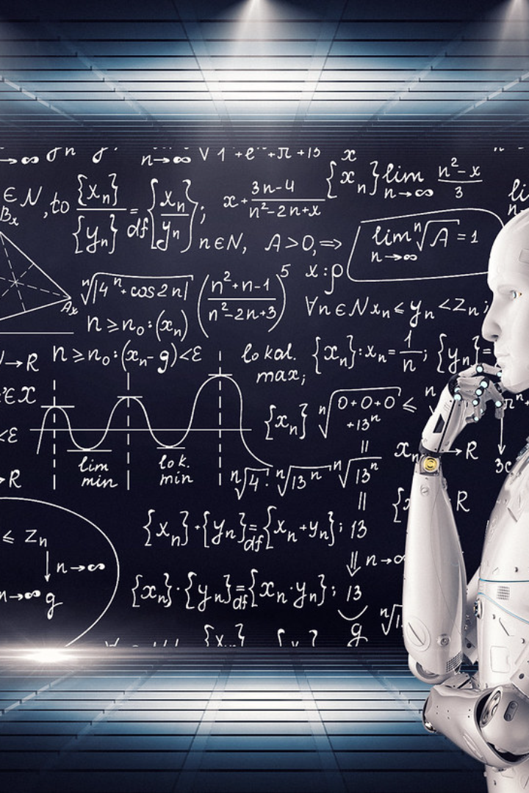
Final Project Machine Learning
Presented by Rayyan Bawazeer, Aseel Suhail, Khalid Nimri, and Mohammed Allagany.

Slide 2
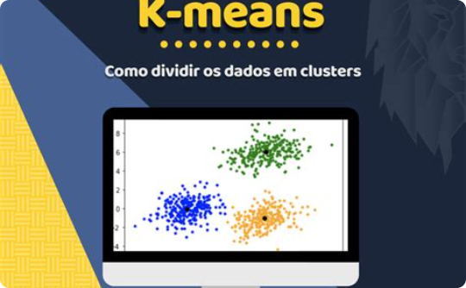
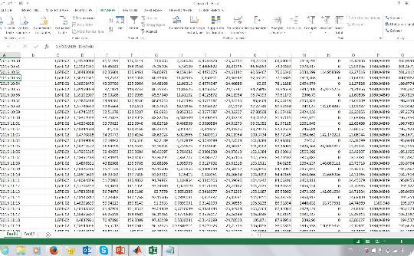

Project Overview
Implement K-Mean from scratch
Generate Datasets
Model's Accuracy

Slide 3

Key Achievements
1
Design
2
Implement
3
Demonstrate
a suitable machine learning solution for a given problem
a suitable machine learning algorithm for a given problem using python
comprehension of professional, ethical, and social responsibilities associated with artificial intelligence

Slide 4
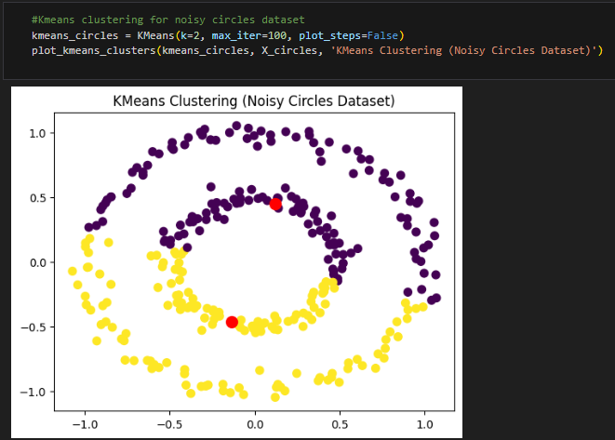
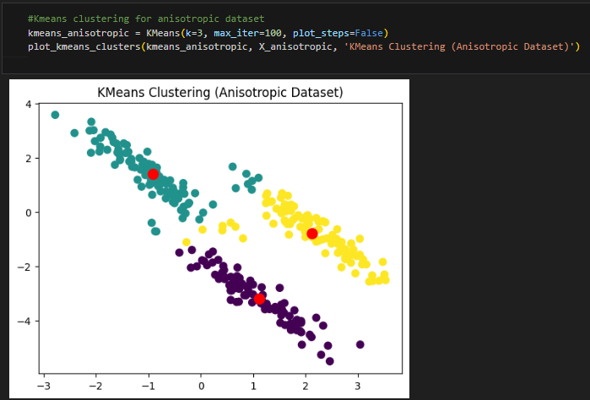
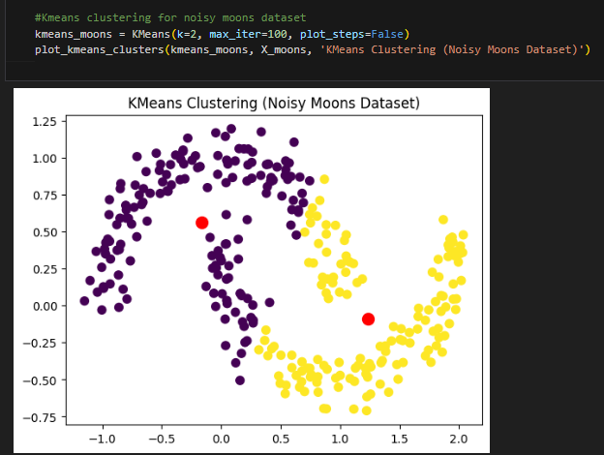
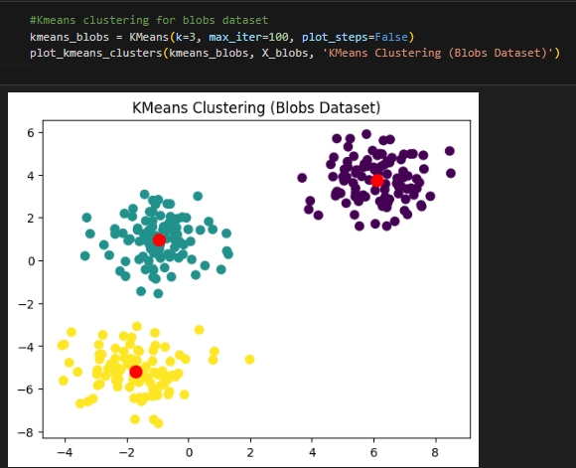
K-Means Clustering

Slide 5
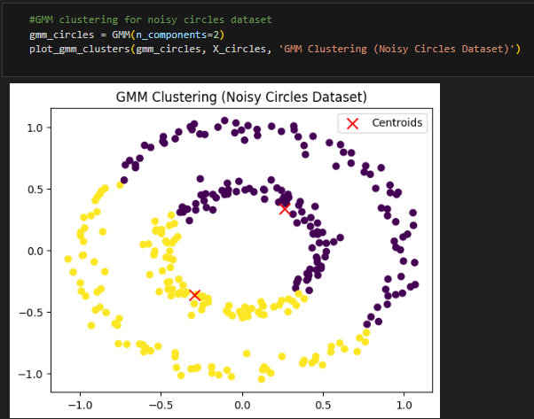
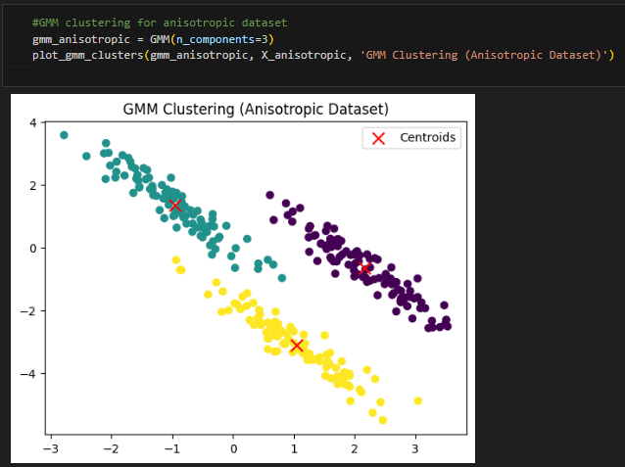
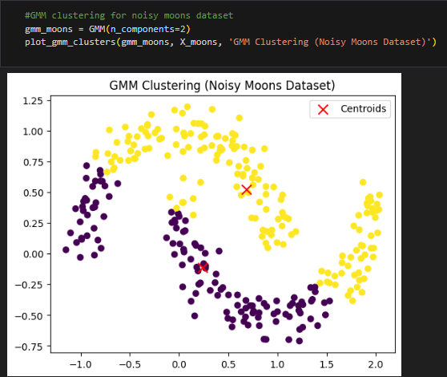
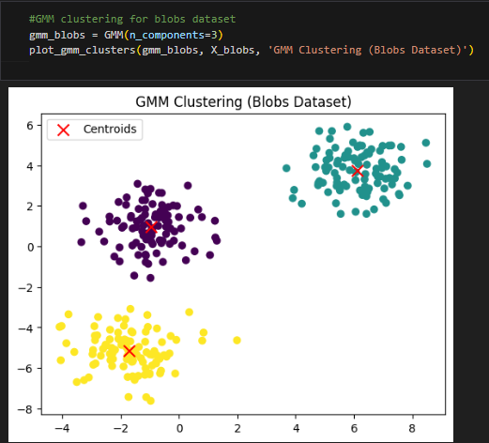
GMM Clustering

Slide 6
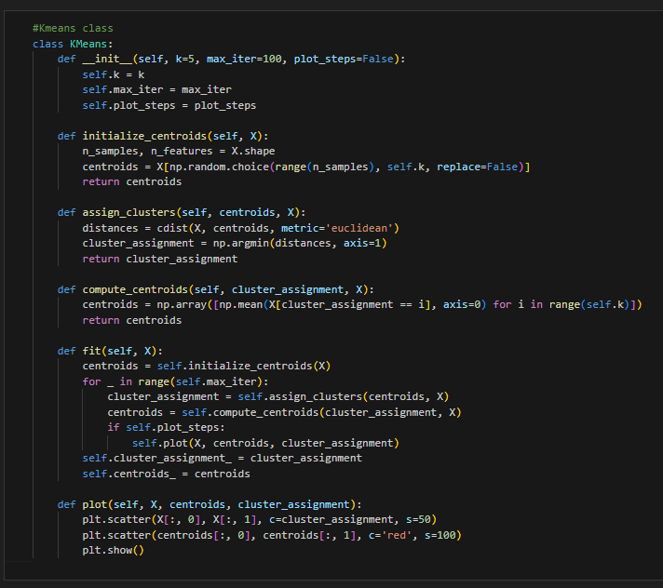
K-Means
K-Means is a centroid-based clustering algorithm that partitions data into K clusters by iteratively assigning points to the nearest cluster centroid and updating centroids.

Slide 7
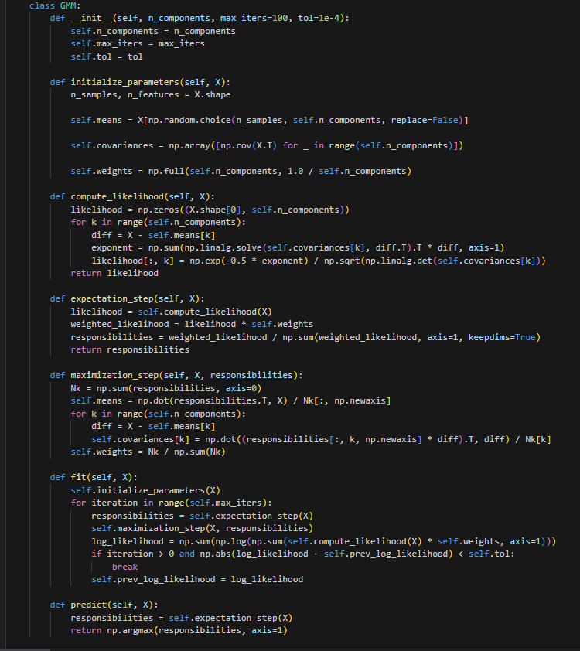
Gaussian Mixture Model (GMM)
Probabilistic clustering model using a combination of Gaussian distributions for flexible representation of data.

Slide 8
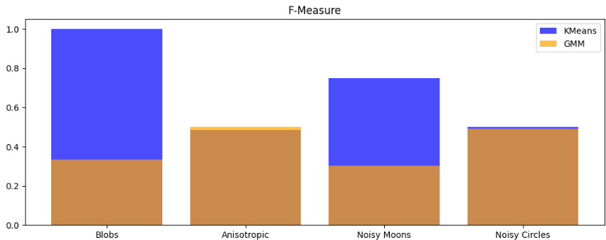
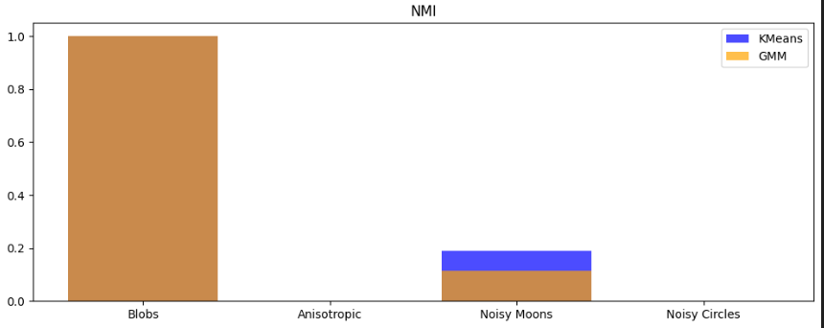
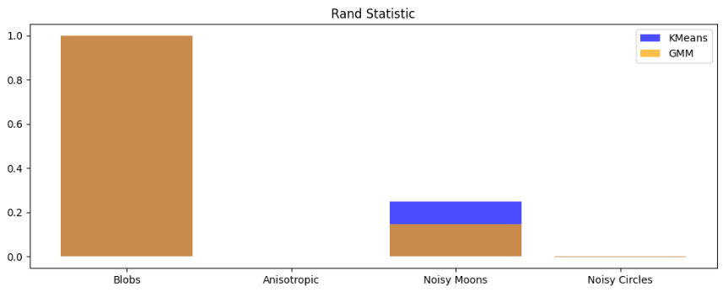
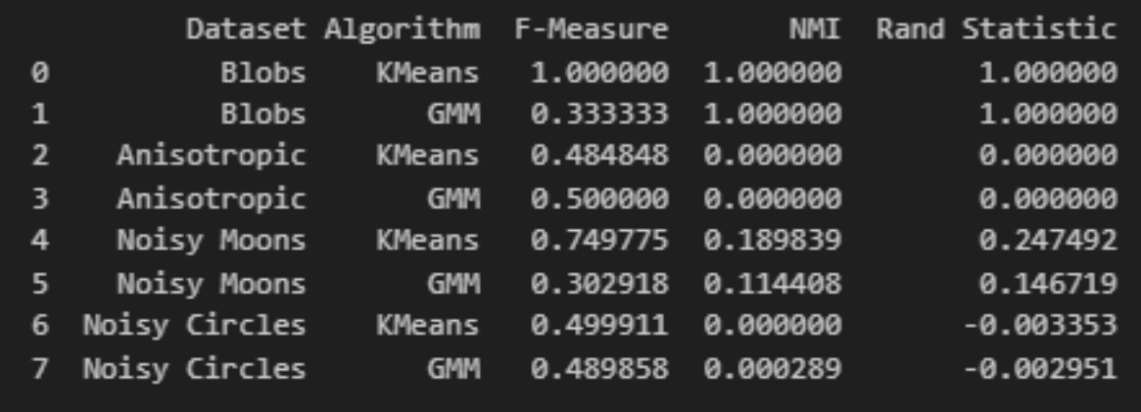
Model's Accuracy

