Slide 1
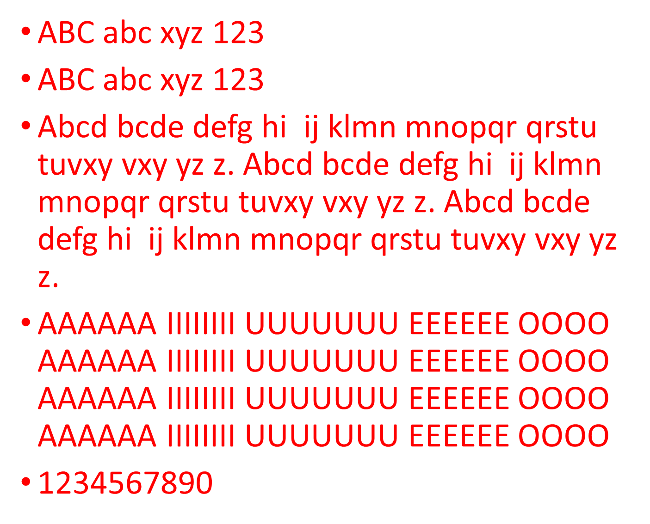
ABC abc xyz 123
ABC abc xyz 123
Abcd bcde defg hi ij klmn mnopqr qrstu tuvxy vxy yz z. Abcd bcde defg hi ij klmn mnopqr qrstu tuvxy vxy yz z. Abcd bcde defg hi ij klmn mnopqr qrstu tuvxy vxy yz z.
AAAAAA IIIIIIII UUUUUUU EEEEEE OOOO AAAAAA IIIIIIII UUUUUUU EEEEEE OOOO AAAAAA IIIIIIII UUUUUUU EEEEEE OOOO AAAAAA IIIIIIII UUUUUUU EEEEEE OOOO
1234567890

Slide 2
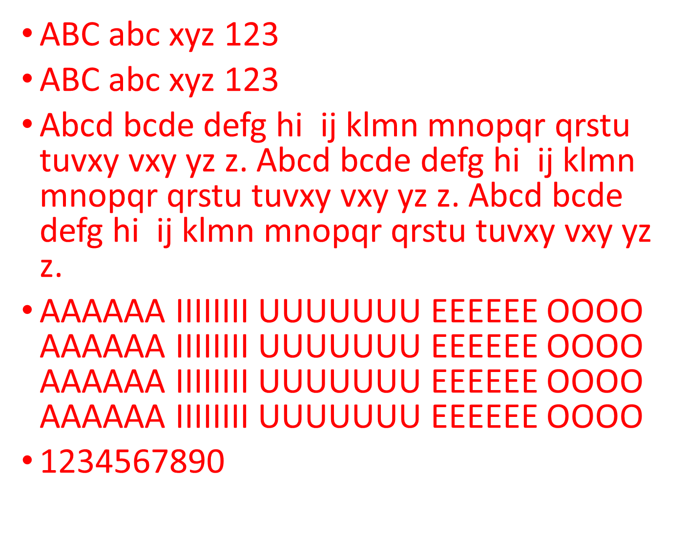
ABC abc xyz 123
ABC abc xyz 123
Abcd bcde defg hi ij klmn mnopqr qrstu tuvxy vxy yz z. Abcd bcde defg hi ij klmn mnopqr qrstu tuvxy vxy yz z. Abcd bcde defg hi ij klmn mnopqr qrstu tuvxy vxy yz z.
AAAAAA IIIIIIII UUUUUUU EEEEEE OOOO AAAAAA IIIIIIII UUUUUUU EEEEEE OOOO AAAAAA IIIIIIII UUUUUUU EEEEEE OOOO AAAAAA IIIIIIII UUUUUUU EEEEEE OOOO
1234567890

Slide 3
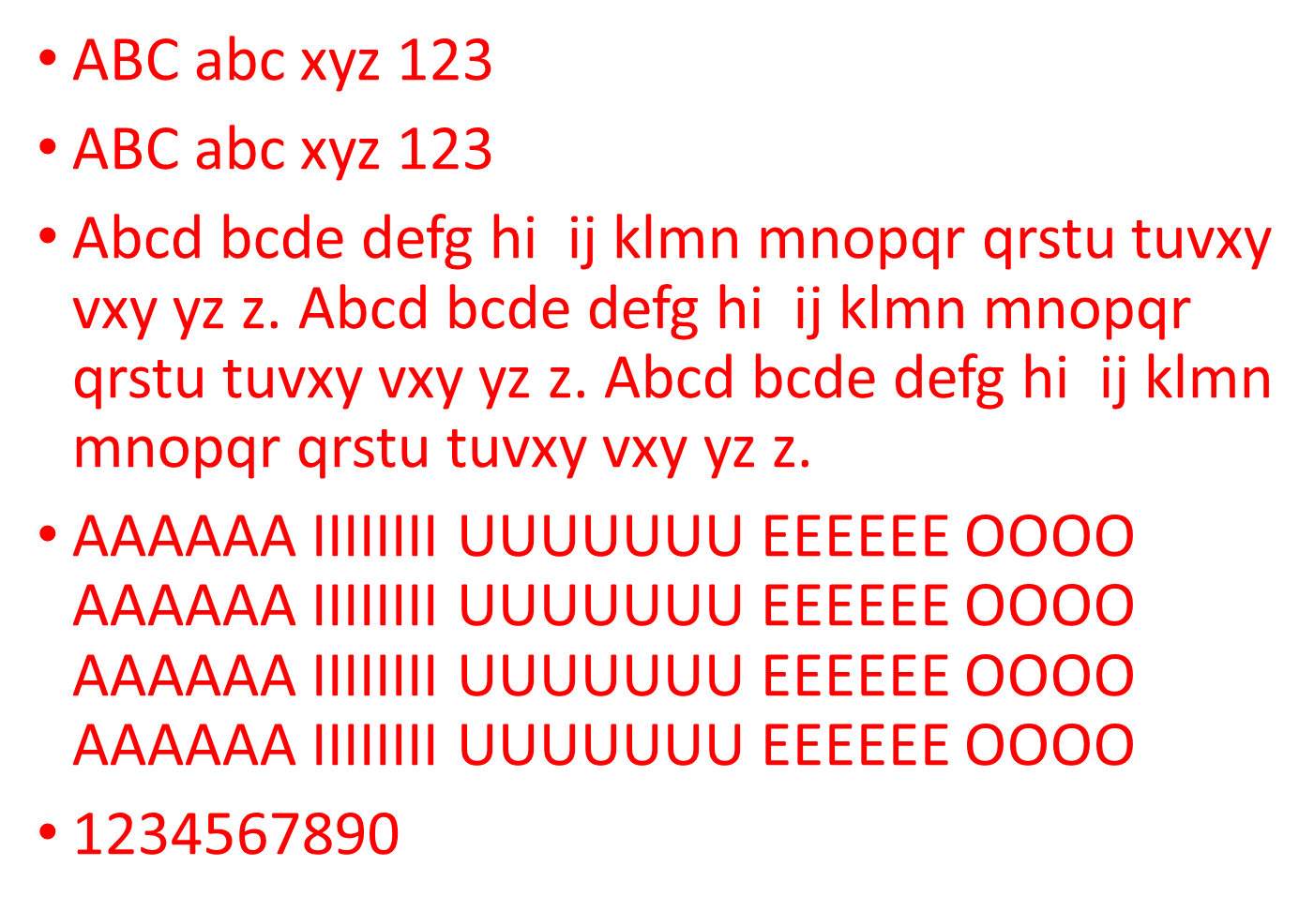
ABC abc xyz 123
ABC abc xyz 123
Abcd bcde defg hi ij klmn mnopqr qrstu tuvxy vxy yz z. Abcd bcde defg hi ij klmn mnopqr qrstu tuvxy vxy yz z. Abcd bcde defg hi ij klmn mnopqr qrstu tuvxy vxy yz z.
AAAAAA IIIIIIII UUUUUUU EEEEEE OOOO AAAAAA IIIIIIII UUUUUUU EEEEEE OOOO AAAAAA IIIIIIII UUUUUUU EEEEEE OOOO AAAAAA IIIIIIII UUUUUUU EEEEEE OOOO
1234567890

Slide 4
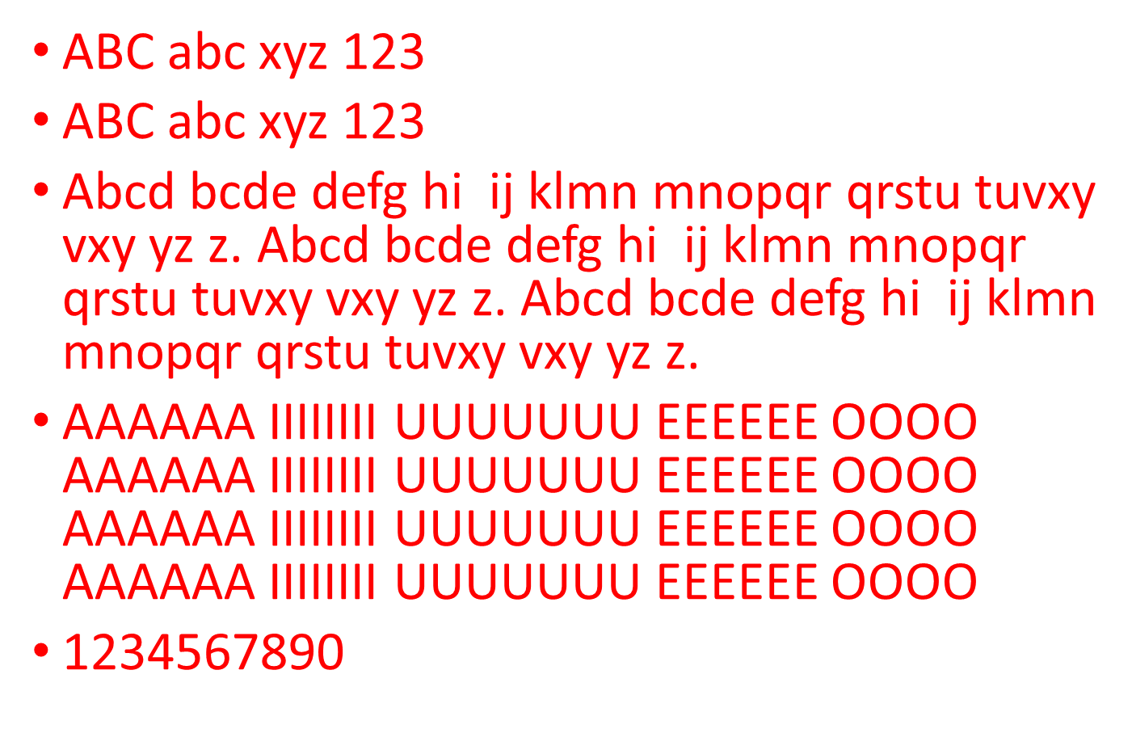
ABC abc xyz 123
ABC abc xyz 123
Abcd bcde defg hi ij klmn mnopqr qrstu tuvxy vxy yz z. Abcd bcde defg hi ij klmn mnopqr qrstu tuvxy vxy yz z. Abcd bcde defg hi ij klmn mnopqr qrstu tuvxy vxy yz z.
AAAAAA IIIIIIII UUUUUUU EEEEEE OOOO AAAAAA IIIIIIII UUUUUUU EEEEEE OOOO AAAAAA IIIIIIII UUUUUUU EEEEEE OOOO AAAAAA IIIIIIII UUUUUUU EEEEEE OOOO
1234567890

Slide 5
ABC abc xyz 123
ABC abc xyz 123
Abcd bcde defg hi ij klmn mnopqr qrstu tuvxy vxy yz z. Abcd bcde defg hi ij klmn mnopqr qrstu tuvxy vxy yz z. Abcd bcde defg hi ij klmn mnopqr qrstu tuvxy vxy yz z.
AAAAAA IIIIIIII UUUUUUU EEEEEE OOOO AAAAAA IIIIIIII UUUUUUU EEEEEE OOOO AAAAAA IIIIIIII UUUUUUU EEEEEE OOOO AAAAAA IIIIIIII UUUUUUU EEEEEE OOOO
1234567890

Slide 6
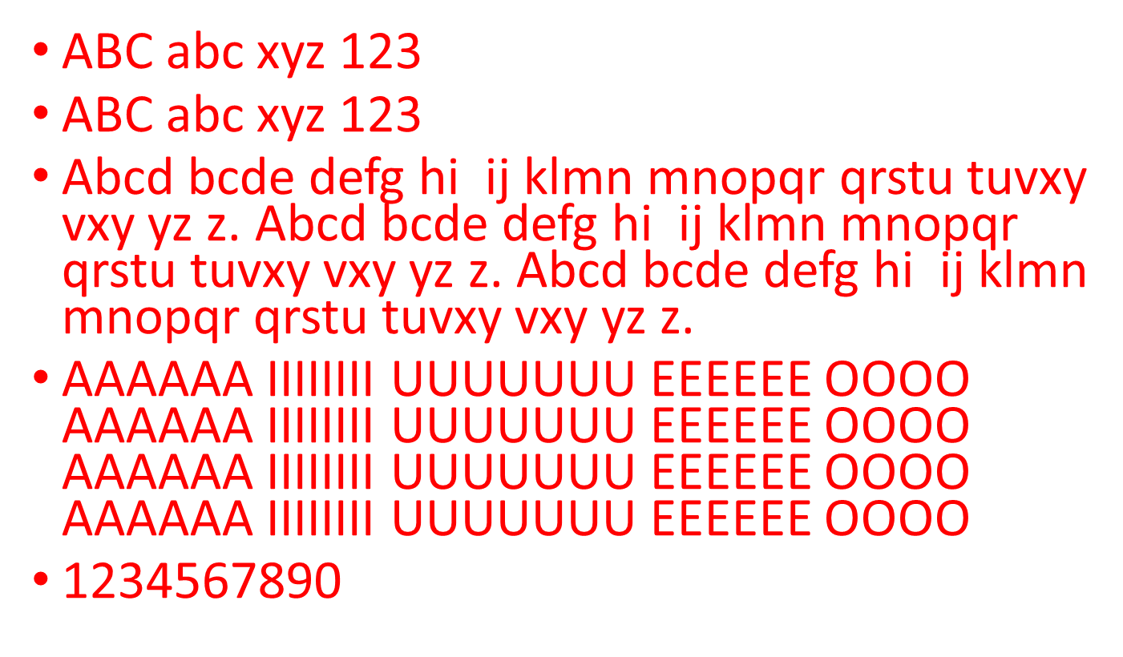
ABC abc xyz 123
ABC abc xyz 123
Abcd bcde defg hi ij klmn mnopqr qrstu tuvxy vxy yz z. Abcd bcde defg hi ij klmn mnopqr qrstu tuvxy vxy yz z. Abcd bcde defg hi ij klmn mnopqr qrstu tuvxy vxy yz z.
AAAAAA IIIIIIII UUUUUUU EEEEEE OOOO AAAAAA IIIIIIII UUUUUUU EEEEEE OOOO AAAAAA IIIIIIII UUUUUUU EEEEEE OOOO AAAAAA IIIIIIII UUUUUUU EEEEEE OOOO
1234567890

Slide 7
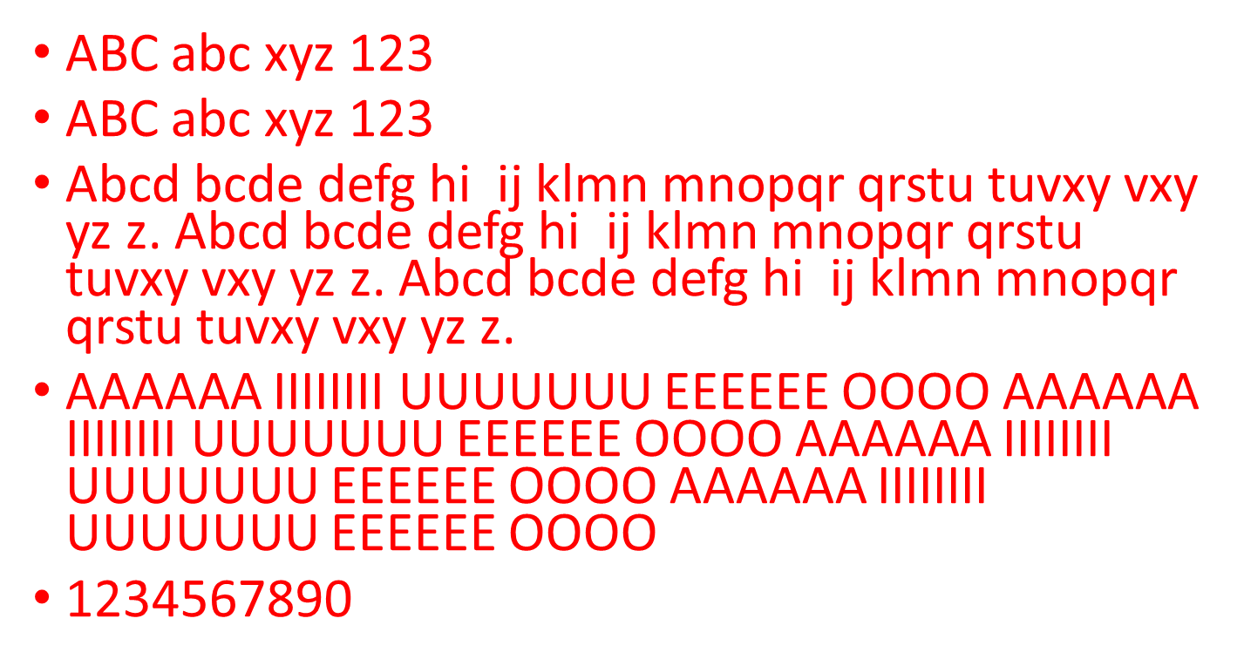
ABC abc xyz 123
ABC abc xyz 123
Abcd bcde defg hi ij klmn mnopqr qrstu tuvxy vxy yz z. Abcd bcde defg hi ij klmn mnopqr qrstu tuvxy vxy yz z. Abcd bcde defg hi ij klmn mnopqr qrstu tuvxy vxy yz z.
AAAAAA IIIIIIII UUUUUUU EEEEEE OOOO AAAAAA IIIIIIII UUUUUUU EEEEEE OOOO AAAAAA IIIIIIII UUUUUUU EEEEEE OOOO AAAAAA IIIIIIII UUUUUUU EEEEEE OOOO
1234567890

Slide 8
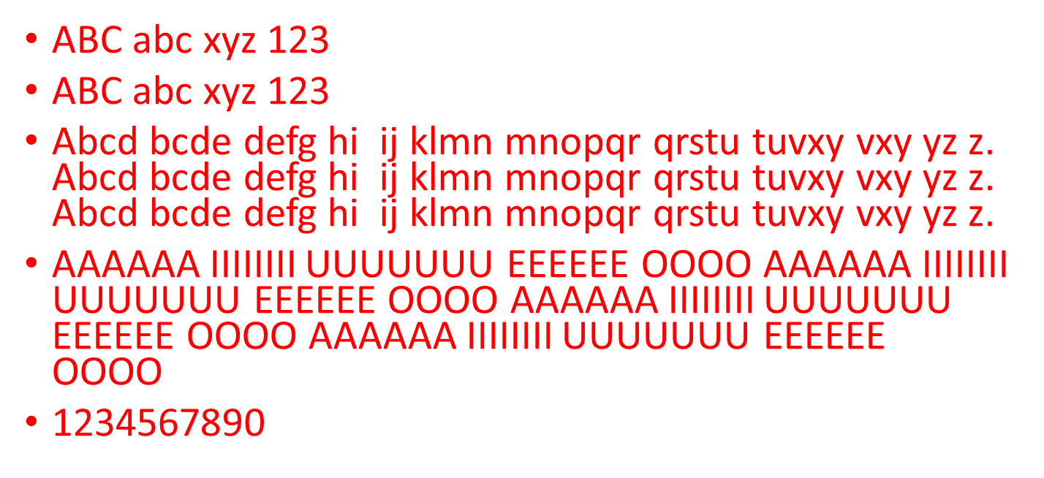
ABC abc xyz 123
ABC abc xyz 123
Abcd bcde defg hi ij klmn mnopqr qrstu tuvxy vxy yz z. Abcd bcde defg hi ij klmn mnopqr qrstu tuvxy vxy yz z. Abcd bcde defg hi ij klmn mnopqr qrstu tuvxy vxy yz z.
AAAAAA IIIIIIII UUUUUUU EEEEEE OOOO AAAAAA IIIIIIII UUUUUUU EEEEEE OOOO AAAAAA IIIIIIII UUUUUUU EEEEEE OOOO AAAAAA IIIIIIII UUUUUUU EEEEEE OOOO
1234567890

Slide 9
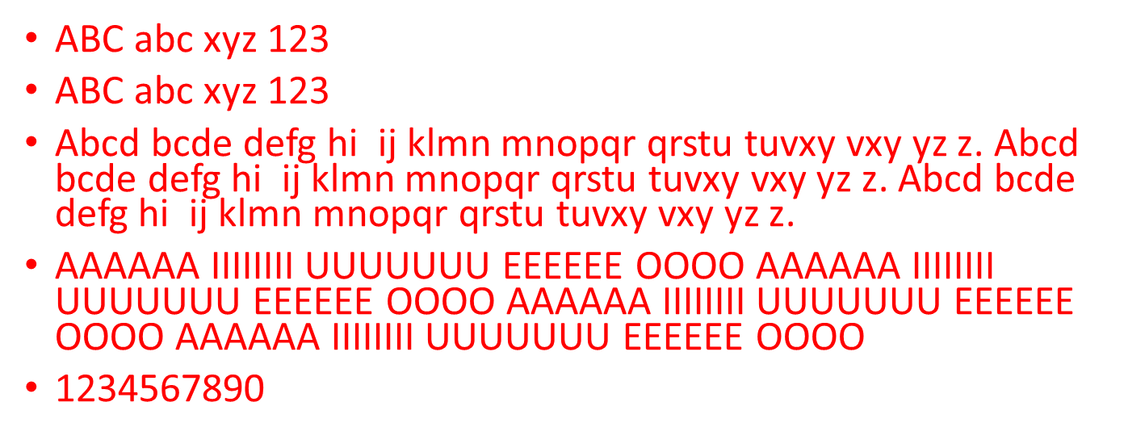
ABC abc xyz 123
ABC abc xyz 123
Abcd bcde defg hi ij klmn mnopqr qrstu tuvxy vxy yz z. Abcd bcde defg hi ij klmn mnopqr qrstu tuvxy vxy yz z. Abcd bcde defg hi ij klmn mnopqr qrstu tuvxy vxy yz z.
AAAAAA IIIIIIII UUUUUUU EEEEEE OOOO AAAAAA IIIIIIII UUUUUUU EEEEEE OOOO AAAAAA IIIIIIII UUUUUUU EEEEEE OOOO AAAAAA IIIIIIII UUUUUUU EEEEEE OOOO
1234567890

Slide 10
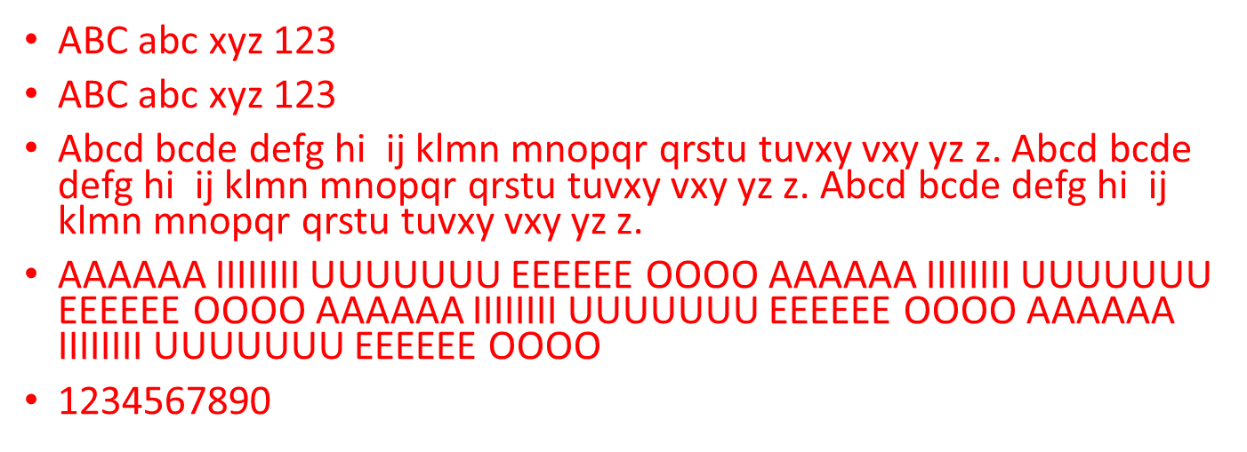
ABC abc xyz 123
ABC abc xyz 123
Abcd bcde defg hi ij klmn mnopqr qrstu tuvxy vxy yz z. Abcd bcde defg hi ij klmn mnopqr qrstu tuvxy vxy yz z. Abcd bcde defg hi ij klmn mnopqr qrstu tuvxy vxy yz z.
AAAAAA IIIIIIII UUUUUUU EEEEEE OOOO AAAAAA IIIIIIII UUUUUUU EEEEEE OOOO AAAAAA IIIIIIII UUUUUUU EEEEEE OOOO AAAAAA IIIIIIII UUUUUUU EEEEEE OOOO
1234567890

Slide 11
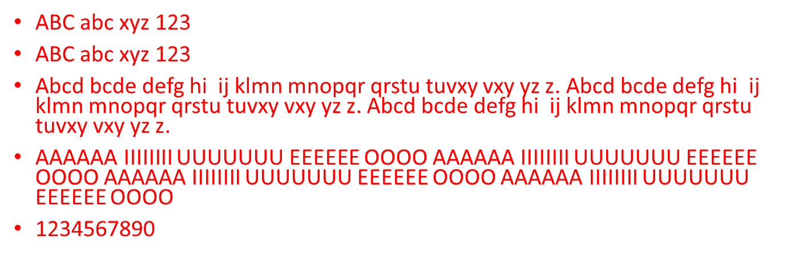
ABC abc xyz 123
ABC abc xyz 123
Abcd bcde defg hi ij klmn mnopqr qrstu tuvxy vxy yz z. Abcd bcde defg hi ij klmn mnopqr qrstu tuvxy vxy yz z. Abcd bcde defg hi ij klmn mnopqr qrstu tuvxy vxy yz z.
AAAAAA IIIIIIII UUUUUUU EEEEEE OOOO AAAAAA IIIIIIII UUUUUUU EEEEEE OOOO AAAAAA IIIIIIII UUUUUUU EEEEEE OOOO AAAAAA IIIIIIII UUUUUUU EEEEEE OOOO
1234567890

Slide 12
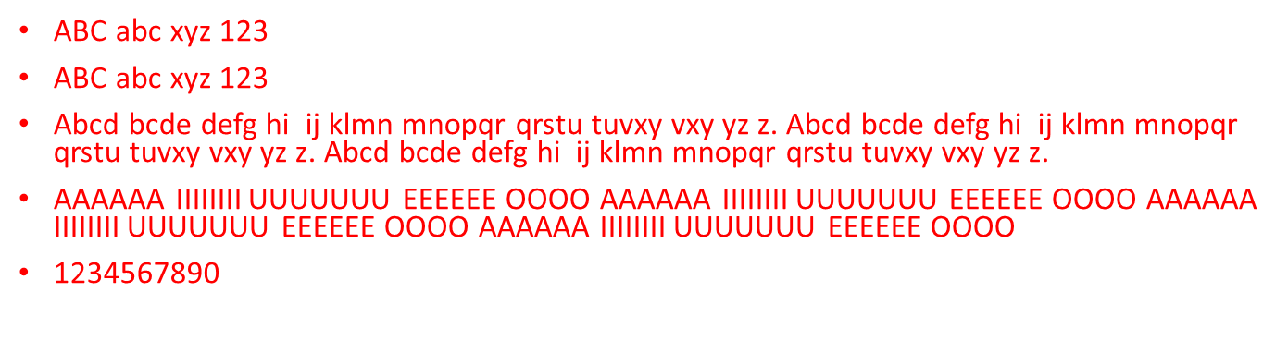
ABC abc xyz 123
ABC abc xyz 123
Abcd bcde defg hi ij klmn mnopqr qrstu tuvxy vxy yz z. Abcd bcde defg hi ij klmn mnopqr qrstu tuvxy vxy yz z. Abcd bcde defg hi ij klmn mnopqr qrstu tuvxy vxy yz z.
AAAAAA IIIIIIII UUUUUUU EEEEEE OOOO AAAAAA IIIIIIII UUUUUUU EEEEEE OOOO AAAAAA IIIIIIII UUUUUUU EEEEEE OOOO AAAAAA IIIIIIII UUUUUUU EEEEEE OOOO
1234567890

Slide 13
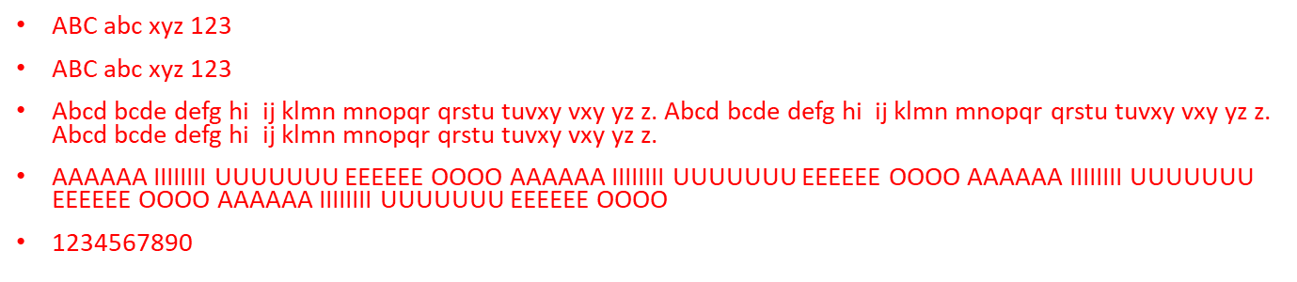
ABC abc xyz 123
ABC abc xyz 123
Abcd bcde defg hi ij klmn mnopqr qrstu tuvxy vxy yz z. Abcd bcde defg hi ij klmn mnopqr qrstu tuvxy vxy yz z. Abcd bcde defg hi ij klmn mnopqr qrstu tuvxy vxy yz z.
AAAAAA IIIIIIII UUUUUUU EEEEEE OOOO AAAAAA IIIIIIII UUUUUUU EEEEEE OOOO AAAAAA IIIIIIII UUUUUUU EEEEEE OOOO AAAAAA IIIIIIII UUUUUUU EEEEEE OOOO
1234567890

Slide 14
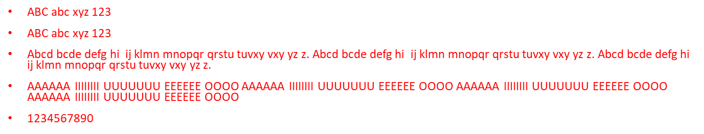
ABC abc xyz 123
ABC abc xyz 123
Abcd bcde defg hi ij klmn mnopqr qrstu tuvxy vxy yz z. Abcd bcde defg hi ij klmn mnopqr qrstu tuvxy vxy yz z. Abcd bcde defg hi ij klmn mnopqr qrstu tuvxy vxy yz z.
AAAAAA IIIIIIII UUUUUUU EEEEEE OOOO AAAAAA IIIIIIII UUUUUUU EEEEEE OOOO AAAAAA IIIIIIII UUUUUUU EEEEEE OOOO AAAAAA IIIIIIII UUUUUUU EEEEEE OOOO
1234567890

Slide 15
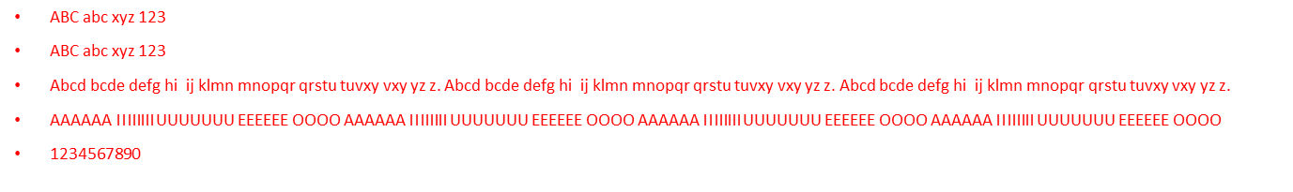
ABC abc xyz 123
ABC abc xyz 123
Abcd bcde defg hi ij klmn mnopqr qrstu tuvxy vxy yz z. Abcd bcde defg hi ij klmn mnopqr qrstu tuvxy vxy yz z. Abcd bcde defg hi ij klmn mnopqr qrstu tuvxy vxy yz z.
AAAAAA IIIIIIII UUUUUUU EEEEEE OOOO AAAAAA IIIIIIII UUUUUUU EEEEEE OOOO AAAAAA IIIIIIII UUUUUUU EEEEEE OOOO AAAAAA IIIIIIII UUUUUUU EEEEEE OOOO
1234567890

Slide 16
ABC abc xyz 123
ABC abc xyz 123
Abcd bcde defg hi ij klmn mnopqr qrstu tuvxy vxy yz z. Abcd bcde defg hi ij klmn mnopqr qrstu tuvxy vxy yz z. Abcd bcde defg hi ij klmn mnopqr qrstu tuvxy vxy yz z.
AAAAAA IIIIIIII UUUUUUU EEEEEE OOOO AAAAAA IIIIIIII UUUUUUU EEEEEE OOOO AAAAAA IIIIIIII UUUUUUU EEEEEE OOOO AAAAAA IIIIIIII UUUUUUU EEEEEE OOOO
1234567890

