Slide 1
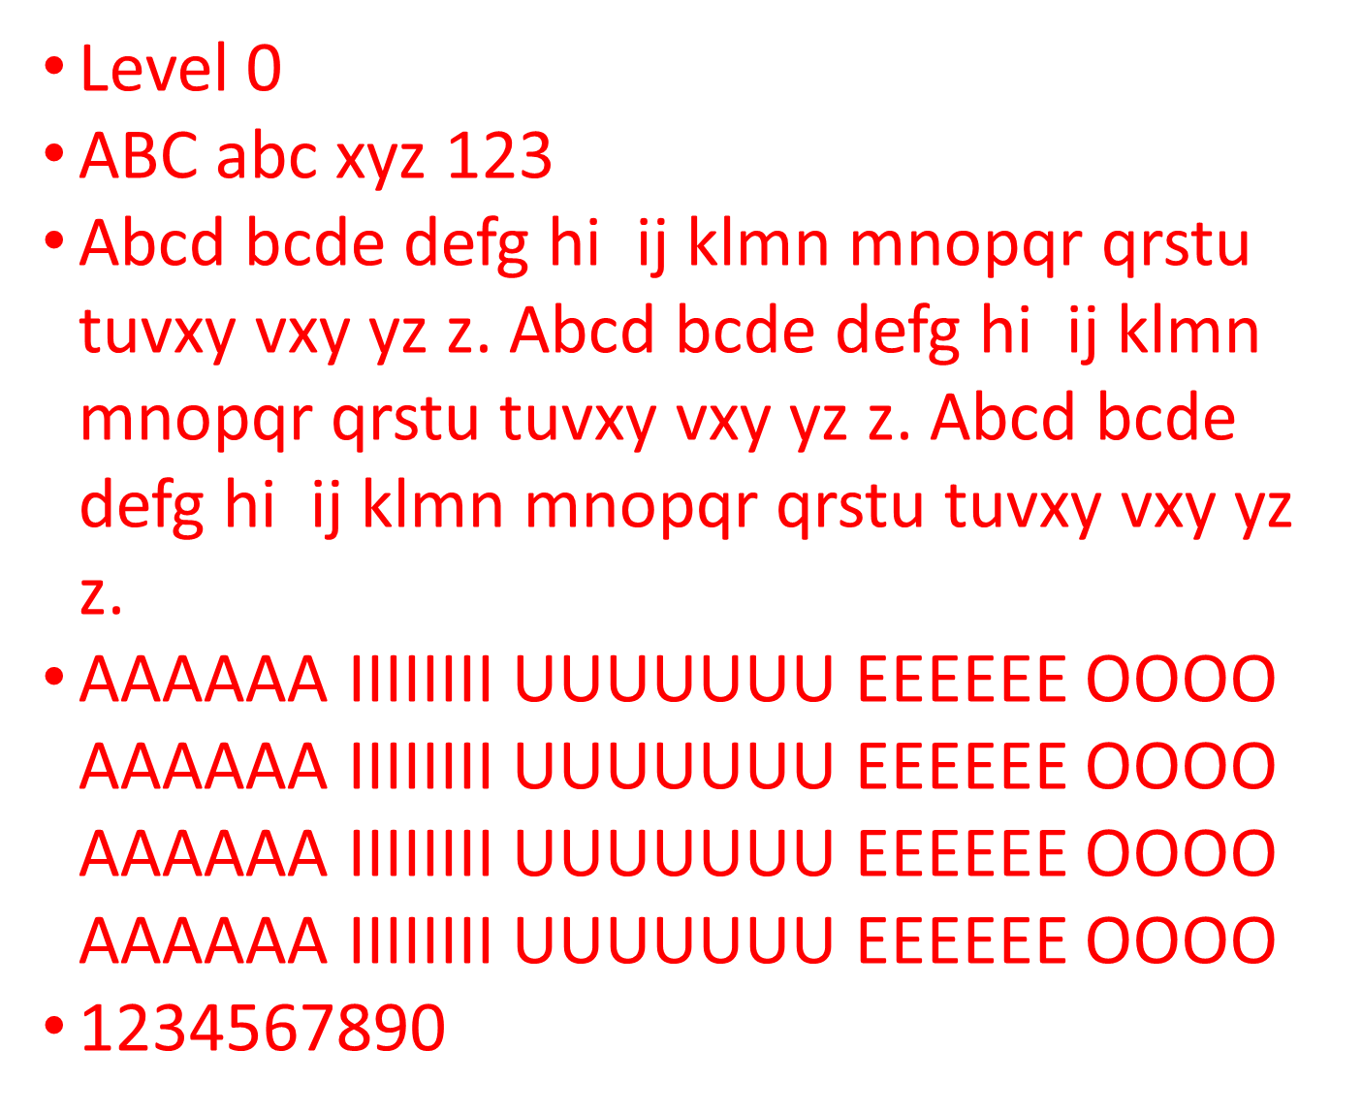
Level 0
ABC abc xyz 123
Abcd bcde defg hi ij klmn mnopqr qrstu tuvxy vxy yz z. Abcd bcde defg hi ij klmn mnopqr qrstu tuvxy vxy yz z. Abcd bcde defg hi ij klmn mnopqr qrstu tuvxy vxy yz z.
AAAAAA IIIIIIII UUUUUUU EEEEEE OOOO AAAAAA IIIIIIII UUUUUUU EEEEEE OOOO AAAAAA IIIIIIII UUUUUUU EEEEEE OOOO AAAAAA IIIIIIII UUUUUUU EEEEEE OOOO
1234567890

Slide 2
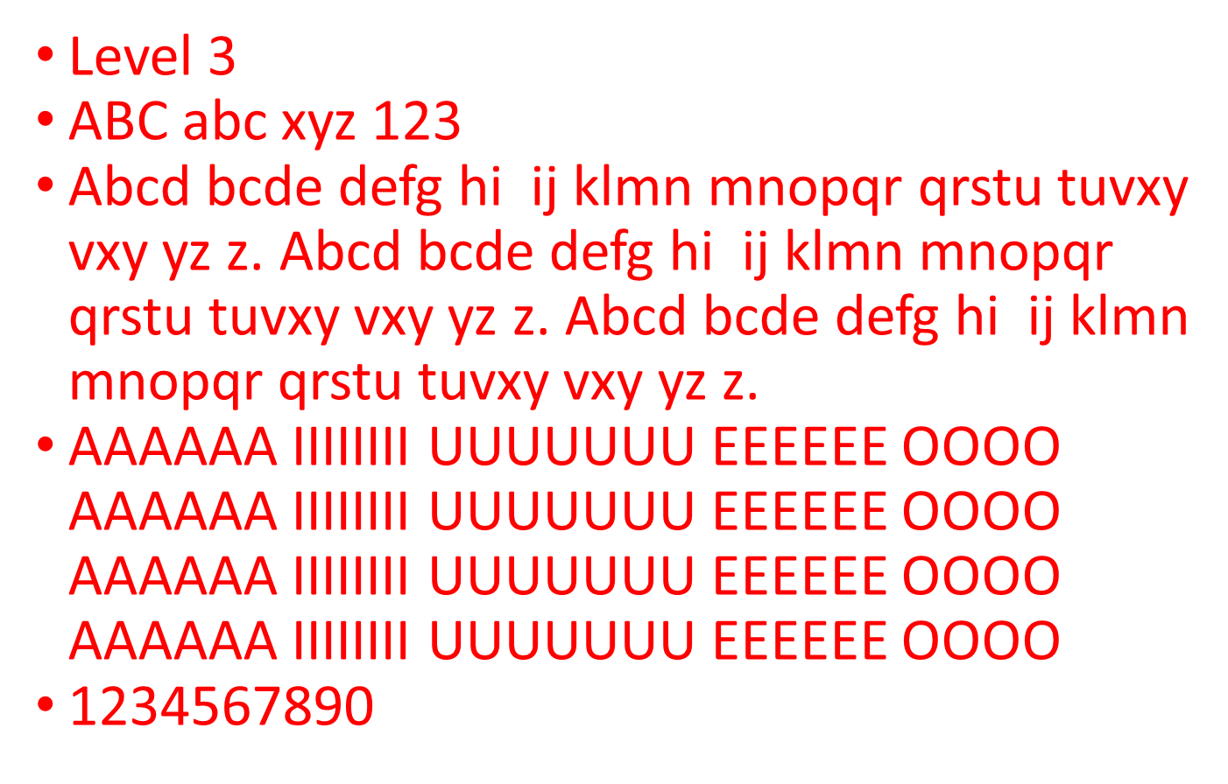
Level 3
ABC abc xyz 123
Abcd bcde defg hi ij klmn mnopqr qrstu tuvxy vxy yz z. Abcd bcde defg hi ij klmn mnopqr qrstu tuvxy vxy yz z. Abcd bcde defg hi ij klmn mnopqr qrstu tuvxy vxy yz z.
AAAAAA IIIIIIII UUUUUUU EEEEEE OOOO AAAAAA IIIIIIII UUUUUUU EEEEEE OOOO AAAAAA IIIIIIII UUUUUUU EEEEEE OOOO AAAAAA IIIIIIII UUUUUUU EEEEEE OOOO
1234567890

Slide 3
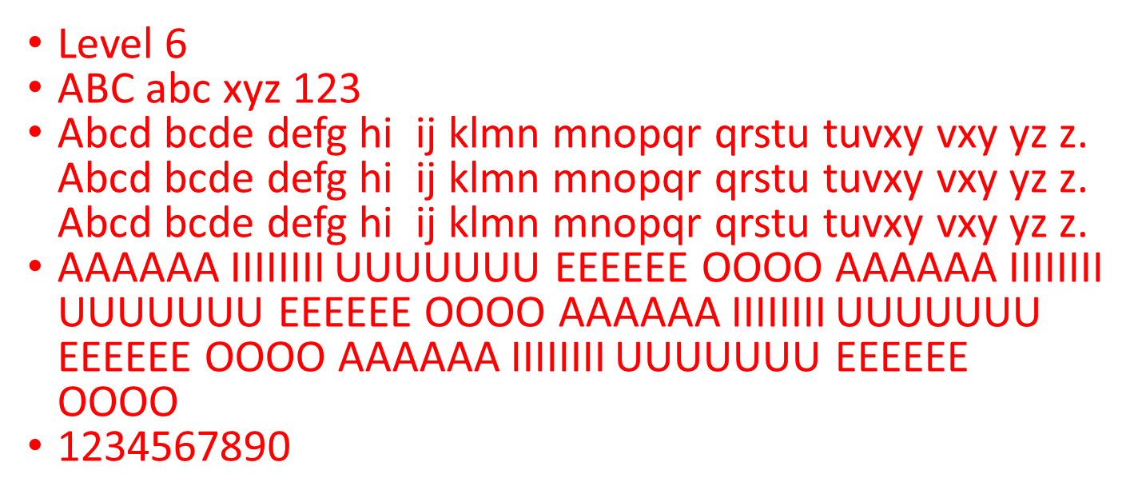
Level 6
ABC abc xyz 123
Abcd bcde defg hi ij klmn mnopqr qrstu tuvxy vxy yz z. Abcd bcde defg hi ij klmn mnopqr qrstu tuvxy vxy yz z. Abcd bcde defg hi ij klmn mnopqr qrstu tuvxy vxy yz z.
AAAAAA IIIIIIII UUUUUUU EEEEEE OOOO AAAAAA IIIIIIII UUUUUUU EEEEEE OOOO AAAAAA IIIIIIII UUUUUUU EEEEEE OOOO AAAAAA IIIIIIII UUUUUUU EEEEEE OOOO
1234567890

Slide 4
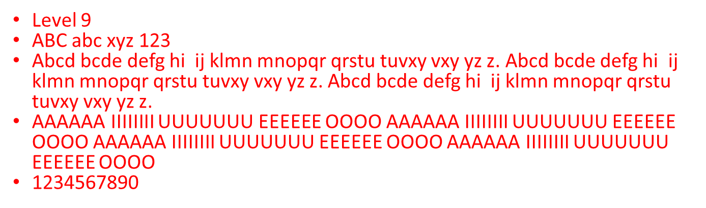
Level 9
ABC abc xyz 123
Abcd bcde defg hi ij klmn mnopqr qrstu tuvxy vxy yz z. Abcd bcde defg hi ij klmn mnopqr qrstu tuvxy vxy yz z. Abcd bcde defg hi ij klmn mnopqr qrstu tuvxy vxy yz z.
AAAAAA IIIIIIII UUUUUUU EEEEEE OOOO AAAAAA IIIIIIII UUUUUUU EEEEEE OOOO AAAAAA IIIIIIII UUUUUUU EEEEEE OOOO AAAAAA IIIIIIII UUUUUUU EEEEEE OOOO
1234567890

Slide 5
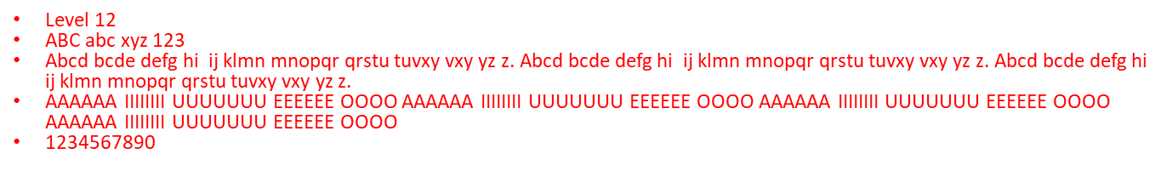
Level 12
ABC abc xyz 123
Abcd bcde defg hi ij klmn mnopqr qrstu tuvxy vxy yz z. Abcd bcde defg hi ij klmn mnopqr qrstu tuvxy vxy yz z. Abcd bcde defg hi ij klmn mnopqr qrstu tuvxy vxy yz z.
AAAAAA IIIIIIII UUUUUUU EEEEEE OOOO AAAAAA IIIIIIII UUUUUUU EEEEEE OOOO AAAAAA IIIIIIII UUUUUUU EEEEEE OOOO AAAAAA IIIIIIII UUUUUUU EEEEEE OOOO
1234567890

Slide 6
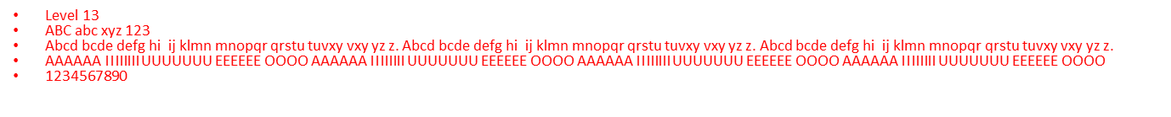
Level 13
ABC abc xyz 123
Abcd bcde defg hi ij klmn mnopqr qrstu tuvxy vxy yz z. Abcd bcde defg hi ij klmn mnopqr qrstu tuvxy vxy yz z. Abcd bcde defg hi ij klmn mnopqr qrstu tuvxy vxy yz z.
AAAAAA IIIIIIII UUUUUUU EEEEEE OOOO AAAAAA IIIIIIII UUUUUUU EEEEEE OOOO AAAAAA IIIIIIII UUUUUUU EEEEEE OOOO AAAAAA IIIIIIII UUUUUUU EEEEEE OOOO
1234567890

