Slide 1
JATSPack and JATSPAN, a packaging format specification and a web site
(mostly) for schema customizations.
Chris Maloney
August 4, 2011

Slide 2
Note
JATSPack and JATSPAN are not part of the NLM/NISO JATS.
JATSPack is a proposed specification that is completely independent of the tag suite.
JATSPAN is a non-commercial web site with no affiliation with NLM or NISO.

Slide 3
Extensibility, Customizability, and Interchange
Several different perspectives
Eliot Kimber:
It's all about interchange
The goal should be "blind" interchange: “By blind interchange I mean interchange that requires the least amount of pre-interchange negotiation and knowledge exchange between interchange partners.”
JATSPack is about lowering the barrier to interchange, but not quite down to the level of "blind" (depending on how you define “least”).

Slide 4
Extensibility, Customizability, and Interchange
Wendell Piez:
The problem with schema extensibility: “Extensions to a tag set, even as they successfully address new requirements, raise interoperability issues with systems that do not know about them.”
“... we have a devil's choice: fork or bloat.”
But, maybe schema extensions can be made more manageable

Slide 5
Expressiveness vs. Interoperability
Yes, there’s a tradeoff
But maybe not zero-sum
Maybe we can push both forward together

Slide 6
Extensions and customizations happen
When a publisher needs a feature, they will find a way to get it in.
Standards bodies are sometimes, maybe, a little bit too slow.
Leading to extending the "wrong" way:
Documents that ostensibly are the same "type", but that are not interchangeable, because of different special vocabularies or tagging styles.
Leading to interchange problems.

Slide 7
Schema languages are designed for this
Provide the proper ways to extend and customize
DTD, W3C Schema, Relax NG, Schematron, and NVDL exist for a reason
XML = "Extensible Markup Language“
Escape hatches are necessary,
But, there are advantages to using core schema technologies.

Slide 8
Users should customize
They know their requirements better than others.
The environment is evolving too fast.
(Can’t emphasize this enough)
Crowdsourcing might be a solution
But, crowdsourcing needs an infrastructure.

Slide 9
Interoperability problems
These are real
Maybe, these are part of the cause:
Lack of a standard way to communicate customizations
Dearth of simple, step-by-step tutorials and examples on doing customizations right.

Slide 10
Motivation for JATSPack
Facilitate systems that can use many different schema types easily
Ease the installation of the complete set of all JATS schemas.
Ease reuse and interchange of schema customizations.
Ease reuse and interchange of libraries that go along with customizations,
These should, in turn, allow for easier interchange of document instances

Slide 11
Inspirations
oXygen "frameworks“
TEI's ODD

Slide 12
Requirements
JATSPacks should be usable on existing systems without any special infrastructure
Avoid the "chicken/egg" problem to adoption
Backwards compatibility with core JATS
Don’t reinvent the wheel
Reuse/extend some existing packaging specification

Slide 13
What is JATS?
Journal Article Tag Suite
Old name: NLM Journal Archiving and Interchange Tag Suite
Recent NISO standard for trial use

Slide 14
What is JATS?
Primarily for publishing journal articles.
Used for other things too (books, archiving).
Many “flavors” and versions.
Mostly used as DTDs,
Also distributed as W3C schema and Relax NG.

Slide 15
JATSPack
A packaging format specification based on Florent Georges' EXPath packaging
A way to package schema customizations and extensions
And more:
XProc, XQuery, XSLT, and XPath code libraries
OASIS catalog files
Documentation and other resources
Some metadata

Slide 16
Extension of EXPath Packaging (EXPath-pkg)
JATSPack is will be forwards-compatible
Right now there are some incompatibilities.
Every JATSPack is an EXPath package
Zip file with a .xar extension
Every package has a abbreviated name (abbrev)
(one-part, two-part, or hierarchical?)
Contains a top-level package descriptor.
Any JATSPack-enabled system should be able to use EXPath packages from CXAN.
EXPath-pkg is already supported by several tools

Slide 17
JATSPack is also a Zip file
Forwards-compatible extension of a simple Zip file
Can be used without any special infrastructure
Simply by unpacking the Zip file to the right place,
And adding a "nextCatalog" entry in your master catalog file
(Note: this introduced an incompatibility with EXPath packaging. I require that the on-disk repository layout be the same as the in-zip directory layout; that is, that the install process does no moving of files around after they are unzipped.)

Slide 18
JATSPack packaging of related resources
DTDs, W3C Schemas, Relax NG, Schematron, NVDL
OASIS catalog files
XQuery, XSLT to provide function modules
XProc to bind them all
Documentation
Examples
Self-tests

Slide 19
JATSPack directory structure
[root] abbrev-1/ abbrev-2/ version/ README.txt (optional) expath-pkg.xml catalog.xml dtd/ rng/ rnc/ xsd/ xslt/ xquery/ xproc/ doc/ samples/ resources/ test/

Slide 20
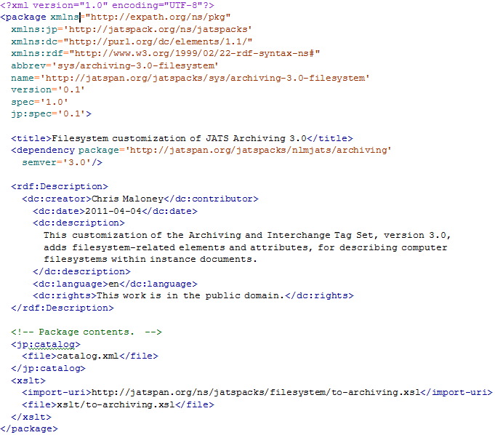
JATSPack package descriptor

Slide 21
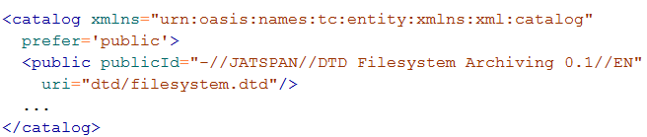
JATSPack OASIS catalog file

Slide 22
JATSPAN
JATSPack archive network
Analogous to CPAN or CXAN
A web site jatspan.org
Allows authors to share and reuse JATSPacks
Allows other users to discover relevant JATSPacks

Slide 23
jatspan
A client program
Not necessary to use JATSPacks
Manages local repositories
At a specified directory on the local filesystem
Contains a master OASIS catalog file
Automates installation of JATSPacks
Resolves dependencies, and downloads and installs prerequisite packs
Here's how you use it to install the TaxPub JATSPack:
jatspan install taxpub-schema

Slide 24
Use Cases / Examples

Slide 25
Use Case - A publisher evaluates JATS for the first time
JATS has many flavors and versions (currently 34 permutations)
Downloadable from the NLM archive_dtd and JATS FTP sites
Can seem overwhelming and complicated
Many publishers still use older versions for their published articles
Each flavor / version is distributed as separate, flattened Zip file
includes the bundled version of all of the files for that particular set
Installation of each requires manually tweaking the OASIS catalog file
Difficult/tedious to configure a system that can use all/any of them simultaneously

Slide 26
Example: Core JATS Bundle
Each of the 34 flavors and versions has been refactored as a JATSPack
Core modules factored out into "core" JATSPack
Each pack has an OASIS catalog file that references only the modules in that pack
All of these can be downloaded and installed as a single bundle.
Bundle has a single top-level OASIS catalog file
Currently just the DTDs (not W3C schema or Relax NG)
Also includes sample XML instance documents

Slide 27
Changes to the core JATS
Might be controversial (I don't know)
Mostly necessitated by changing the directory structure and moving files around
Changed relative URIs that cross-reference between the modules
Cleaned up some discrepancies in old versions
Didn't change any top-level public identifiers
My bundle is 100% compatible
(I’m 99% sure of this)

Slide 28
Use Case - A publisher develops a new JATS customization
There is an ongoing sea change in the nature of journal articles
Articles are no longer limited to the (print media) figures, tables, and equations.
The lines between traditional definitions of media types, such as journal articles, books, wikis, blog posts, data-only articles, presentations, etc., are continually getting blurred
Open-science movement
Scientists are sharing their data more often.
Grass roots efforts to bypass traditional publishing models
This trend is moving/evolving very fast
We cannot anticipate what will be the needs of the users

Slide 29
Supplemental materials
Supplemental material (data) moving into main content
“Pseudo-supplemental”: essential material, but doesn't "fit” into the journal article. (Sasha Schwarzman)
Also called "integral content".
E.g., Cell doesn't embed movies because they don't fit into PDFs.
Sasha quoted E. Marcus: “... over time the concept of supplemental material will gradually give way to a more modern concept of a hierarchical or layered presentation in which a reader can define which level of detail best fits their interests and needs.”
We need to be facilitating this transformation

Slide 30
JATS Customizations
JATS was designed in modular, extensible way, but the barrier to customizing is still high
Alternatives to customizing:
Suggest a change to the standard, and wait
Create a local customization, and forego interchangeability
Pseudo-customization

Slide 31
Pseudo-customization
Strategies
Put the data into a separate file and link to it.
CDATA section (à la RSS)
"Escape hatches" with custom vocabulary
Processing Instructions
These are all ways of getting around the DTD (schema)
So validation has to use a different mechanisms
This is the tail wagging the dog: the DTD (schema) should work for us, not the other way around.

Slide 32
JATS and supplemental data
JATS has "escape hatches" for different kinds of data objects, and links to external objects.
But it would often make more sense to include it natively.
Bottom line: extensions and customizations will happen. It would be nice to have an infrastructure for communicating and managing them.

Slide 33
Example - TaxPub
Customization of JATS
Allows inclusion of Taxonomic treatments into journal articles
As described by Terry Catapano at last year's JATS-Con
Used in ZooKeys, published by PenSoft.
Articles are simultaneously released to the Species-ID wiki

Slide 34
TaxPub JATSPack
Named “taxpub-schema”
Directory structure:
taxpub/
schema/
0.1/
dtd/
doc/
samples/

Slide 35
Converting TaxPub into a JATSPack
Fixed relative system identifiers
Fixed doctype declarations, for example:
From: <!DOCTYPE article SYSTEM "../tax-treatment-NS0.dtd">
To: <!DOCTYPE book PUBLIC
"-//TaxonX//DTD Taxonomic Treatment Publishing DTD v0 20100105//EN"
"../dtd/tax-treatment-NS0.dtd">
Created an OASIS catalog file
Zip the results into a .xar file.
Upload to JATSPAN

Slide 36
TaxPub to JATSPack: advantages
The advantages are not dramatic
Lower the activation energy for others to discover and install
Increase visibility
Could allow for inclusion of (for example) XSLT libraries, self tests, documentation, in a consistent way
Easier for some other developer to extend TaxPub

Slide 37
Use Case - Publisher or archive adds support for new document type
Currently there is no standard way of packaging the information relevant to a document type.
Installation is not especially hard, but does require some expertise and coordination of resources

Slide 38
Use Case - Publisher or archive adds support for new document type
With JATSPack but not jatspan:
Just download the Zip file, unzip it, and update your catalog file
With jatspan:
jatspan install
This automatically resolves dependencies.

Slide 39
Use Case - JATS-related libraries
These are not schema extensions; just code libraries.
Right now, there is no standard way to deploy a library
Advantages here are the same as for EXPath packaging
In fact they could be deployed as EXPath packages.

Slide 40
Example - Journal Publishing 3.0 Preview Stylesheets as a JATSPack
By Wendell Piez, presented at JATS-Con last year
Repackaged as a JATSPack
Adapted to use Xproc
Not a major improvement, but, again, incrementally lowers the activation energy to find/install/use/extend these.
Especially extend
Other authors could write new JATSPacks that depend on these,
Installing those, dependency would be automatically resolved.

Slide 41
Example, JATS-to-EPub transformation
By Laura Kelly, presented at JATS-Con last year
Depends on the preview stylesheets mentioned above
This could be deployed without the preview stylesheets, and that dependency would be resolved by jatspan

Slide 42
Customizations and compatibility

Slide 43
JATSPack supports any schema language
Schematron is the best language to use for validation –
-- Eliot Kimber
Relax NG is very expressive and easy to use
NVDL looks cool
The documentation is the final word (Eliot again)
JATSPack can (should) include this documentation

Slide 44
Forwards compatibility - review
Means that newer documents (version 2) can be used by existing/old processing systems (version 1).
E.g. "must ignore" pattern of extensibility of HTML
HTML renderers must ignore any tags that they don't understand
This is a forwards-compatibility extension substitution rule
This allows future designers to customize the HTML schema, adding elements and attributes, while being able to predict how document instances in the new schema will be processed by old systems.

Slide 45
Forwards compatibility – we can do better than HTML
TaxPub, for example, adds new elements and attributes
The package could include XSLTs that transform those into "standard JATS“
More powerful extension forward-compatibility substitution rules.
Gets close to useful, blind interchange

Slide 46
How JATSPack and JATSPAN help Interchange
By lowering the activation energy (just a little) at several rate-limiting steps in the reaction:
Easier to customize
... correctly and robustly
Easier to package
Easier to share
Easier to discover
Easier to install

Slide 47
Closing remarks

Slide 48
Format is not JATS specific
This format could be used to package customizations of any other XML standard.
I hope to merge my extensions back into EXPath-pkg
Could use CXAN

Slide 49
Future work
Current work (not as far along as I'd hoped).
Adding other existing resources (Relax NG and docs) to core bundle.
Finish up the examples described in the paper.
Get the JATS core bundle to be packaged with oXygen XML editor as JATS “framework”.
This is an idea/suggestion. Don’t know if it would be acceptable, but I think it’s a good fit.

Slide 50
Future work – forwards compatible extension mechanism
I think JATSPack is an important first step, but more work is needed to realize this goal.
A lot of prior work on this topic.
Eliot seems to have some ideas.

Slide 51
Future work - JATSPAN
Throw examples and how-tos on the JATSPAN site
JATSPacks should be usable directly off of JATSPAN, without installing to a local machine
Should be able to browse package documentation on JATSPAN, w/o downloading
JATSPAN could provide document instance tools, such as a validator, style checker, and document previewer.
Not just for DTDs but for any of the schema languages in the JATSPack.
"Roma for JATS"

Slide 52
Help!
Suggestions / criticisms welcome
Jatspan-users mailing list
https://lists.sourceforge.net/lists/listinfo/jatspan-users
jatspan-users@lists.sourceforge.net (No need to subscribe. Just send “+1” to this address. It will help!)
Help with development
Help with ideas

Slide 53
Links
Sourceforge site
Latest version of Balisage paper
Sourceforge project
JATSPAN (Coming soon!)
Interesting article on ZooKeys / TaxPub / Species-ID

Slide 54

Candy

