Slide 1

Data Repair center
https://github.com/Kloudtek/data-repair-center

Slide 2

The problem
Asynchronous guaranteed delivery messaging is widely used in server application in order to guarantee data integrity. This is typically done using message queue systems like ActiveMQ, RabbitMQ, weblogic JMS, etc. or through batch processing systems.

Slide 3
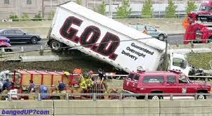
The problem
However reliance on guaranteed delivery often forgets the fact that sometimes things go wrong in a way that cannot be solved automatically by the system.

Slide 4

The problem
Unfortunately the most widely used “solution” for this problem has been to ignore it.

Slide 5
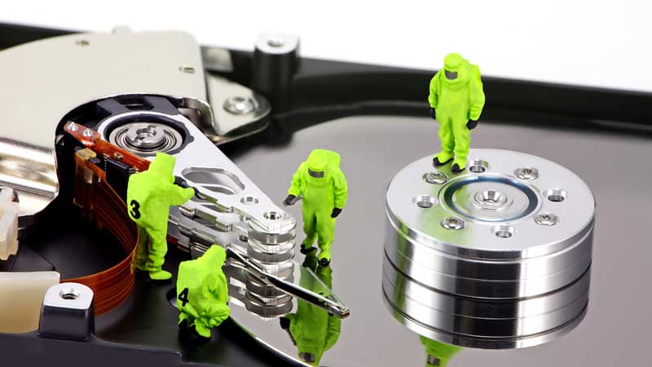
The solution
The Data Repair Center allows to collect data which is invalid or which has been sent to a dead letter queue after too many failed delivery attempts, for manual review by a human being which will be able to take appropriate action

Slide 6
Functional Requirements
Must be able receive data from Dead Letter Queues or from other systems
Must be able process data to extract information useful for analysis
Must provide a web user interface for human review and analysis of data
Must allow data to be edited
Must allow data to be deleted
Must allow data to be resubmitted

Slide 7
Non-Functional Requirements
Easily customized
Easy to integrate
Designed for maintainability

Slide 8
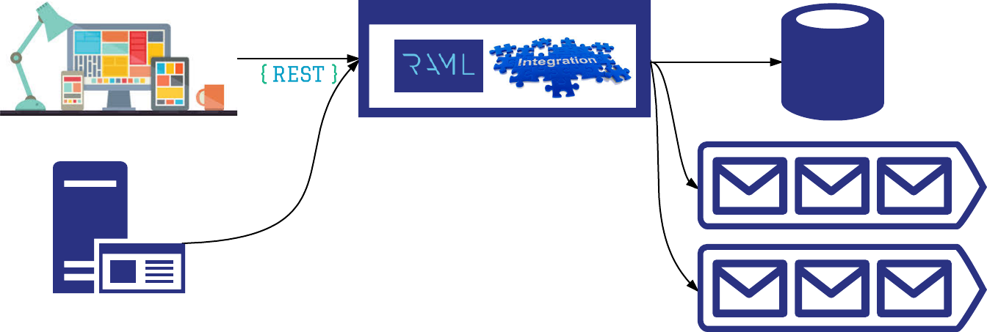
Architecture Overview

Slide 9
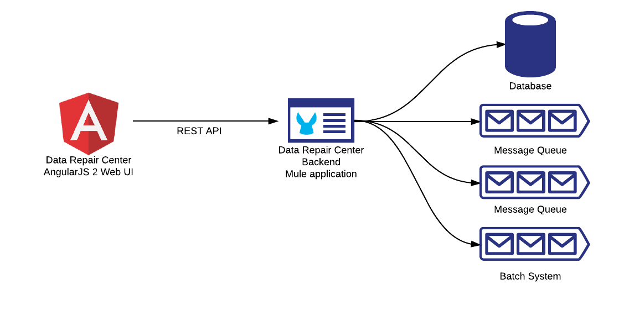
Architecture Implementation
- AngularJS 2 frontend can be packaged and provided from the mule application.
- Modular architecture allow UI to be integrated and/or customized
Mule allow to easily customize DRC to specific needs.

Slide 10
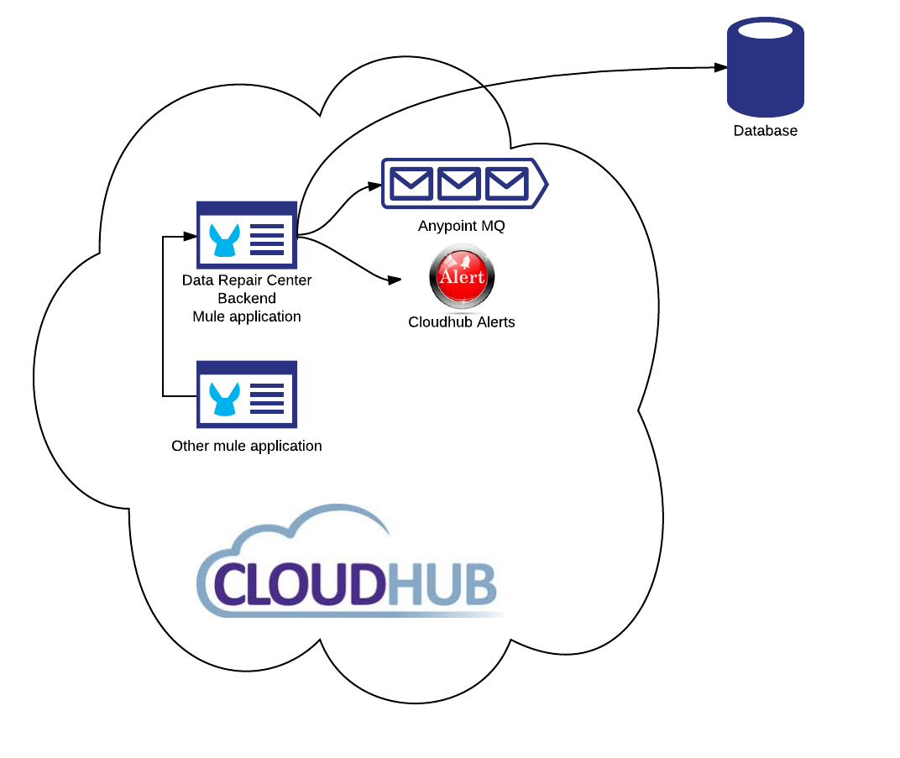
Cloudhub deployment scenario
Cloudhub doesn’t provide data store so one must provided externally

Slide 11
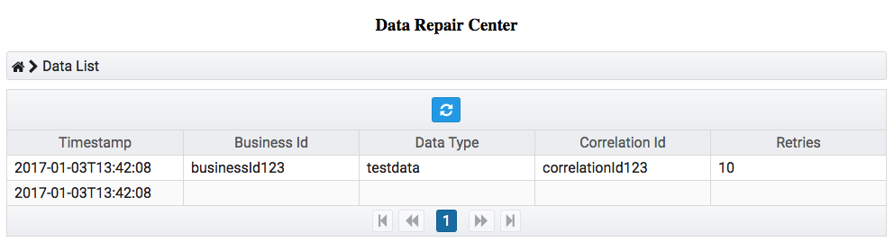
User Interface: Browse Data

Slide 12
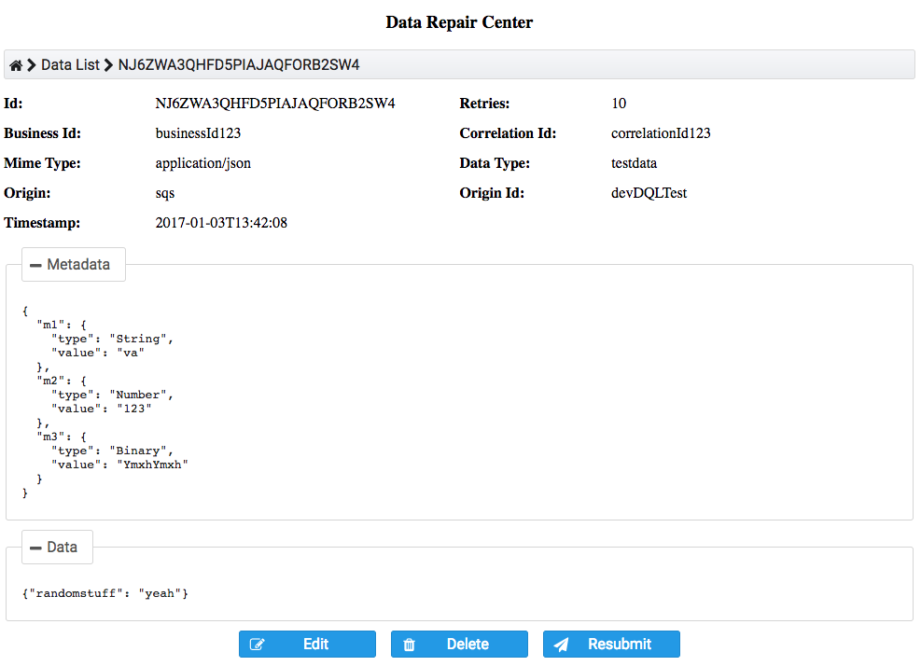
User Interface: View Data

Slide 13
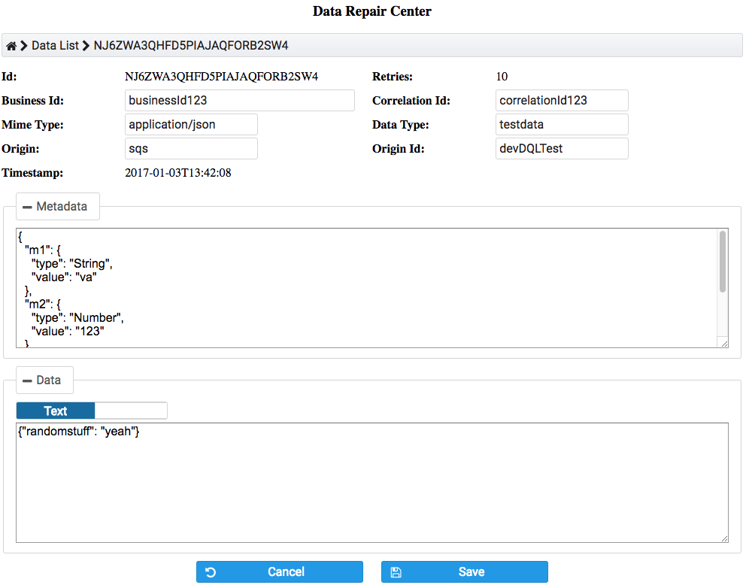
User Interface: Edit Data

Slide 14



Distribution
DRC Backend library available on maven central.
Example mule application is downloadable from github
AngularJS 2.0 web UI components will be available through NPM in addition to maven.
We’re also planning to provide DRC as a connector through the mulesoft anypoint exchange

Slide 15
Licensing
Open Source application licensed under the Apache 2.0 License

Slide 16
Thank you !
https://github.com/Kloudtek/data-repair-center

