Slide 1

Data Repair center
https://github.com/Kloudtek/data-repair-center

Slide 2

The problem
Asynchronous communication is widely used to guarantee data integrity (through message queue and batch systems)

Slide 3
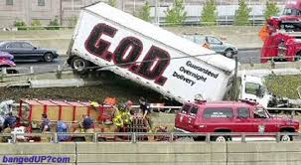
The problem
However reliance on guaranteed delivery often forgets the fact that sometimes things go wrong in a way that cannot be solved automatically by the system.

Slide 4

The problem
Unfortunately the most widely used “solution” for this problem has been to ignore it.

Slide 5
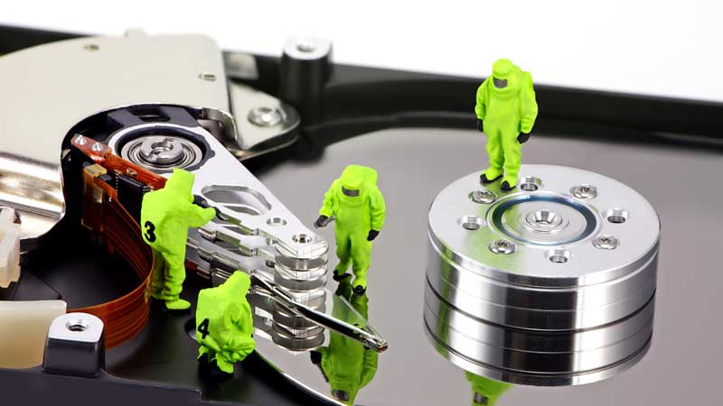
The solution
The data repair repair will collect data that couldn’t be successfully processed after too many attempts, and take appropriate actions

Slide 6
Functional Requirements
Receive data from Dead Letter Queues or from other systems
Process data to extract information useful for analysis
Provide a user interface for human review and analysis of data
Allow data to be edited
Allow data to be deleted
Allow data to be resubmitted

Slide 7
Non-Functional Requirements
Must be able to integrate with a wide variety of queue and batch technologies
Since data is closely tied to the system’s business logic, it must be very easy to customize the DRC and add relevant analysis logic and/or data-specific user interfaces
Must be designed for maintainability

Slide 8
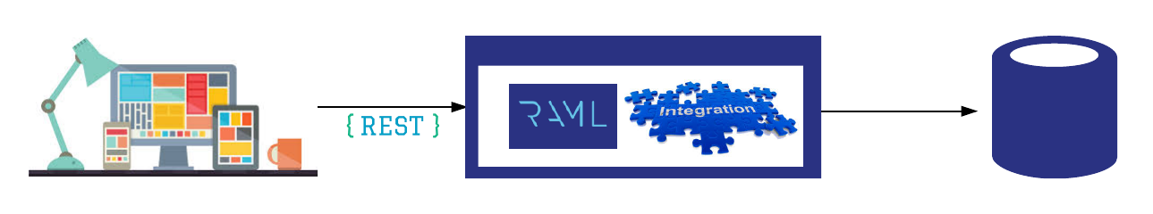
Solution overview

Slide 9
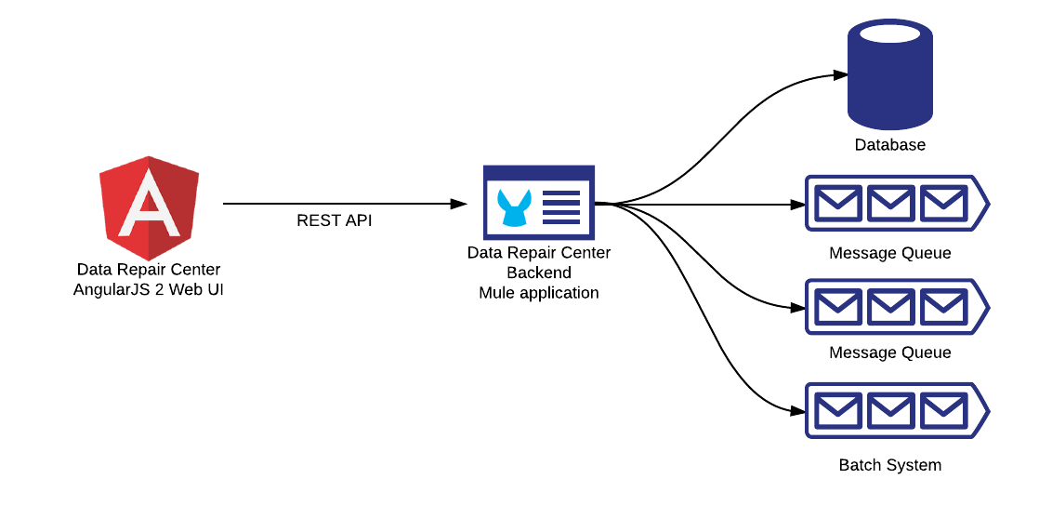
Solution Implementation Overview
- AngularJS 2 frontend can be packaged and provided from the mule application.
- Modular architecture allow UI to be integrated and/or customized
Mule allow to easily customize DRC to specific needs.

Slide 10
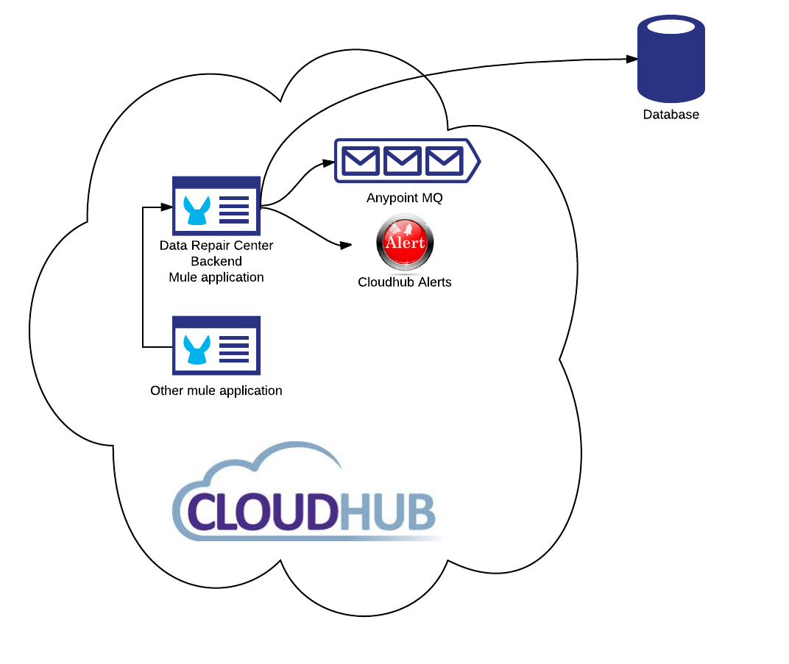
Cloudhub deployment scenario
Cloudhub doesn’t provide data store so one must provided externally

Slide 11
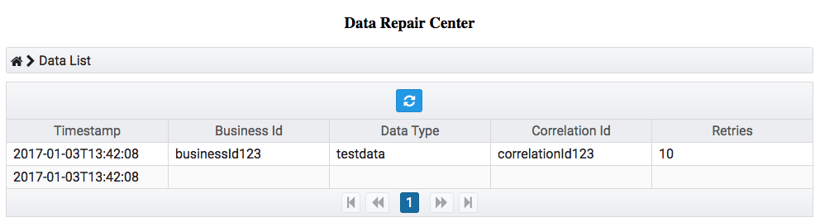
User Interface: Browse Data

Slide 12
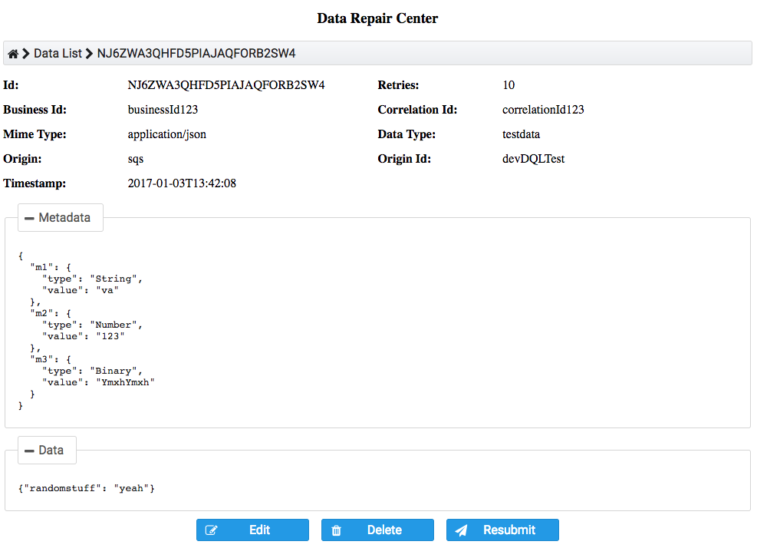
User Interface: View Data

Slide 13
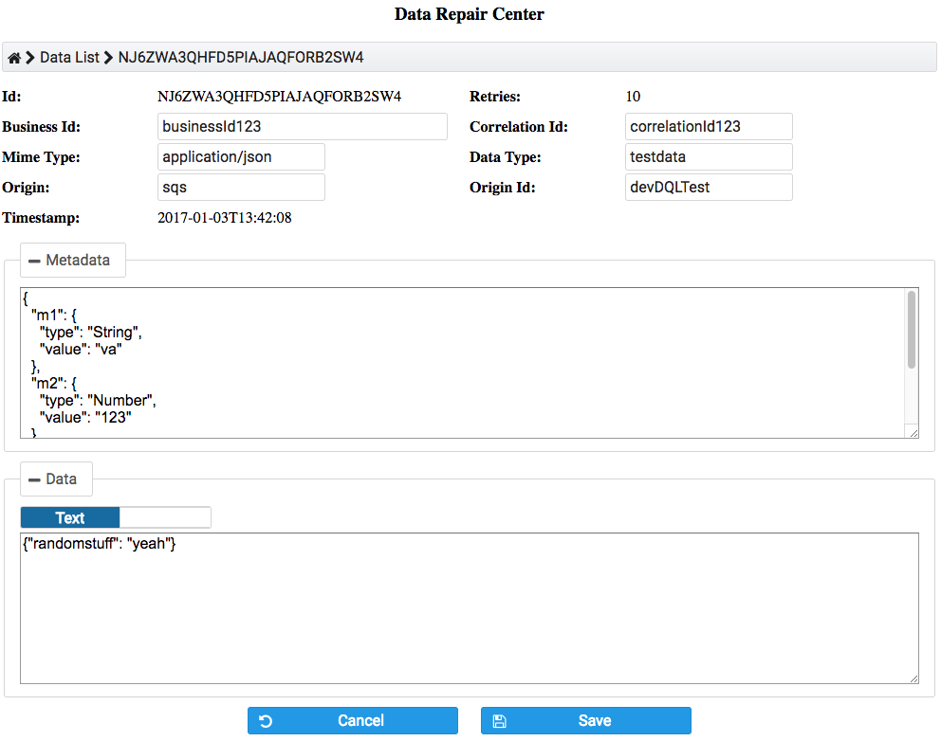
User Interface: Edit Data

