Slide 1
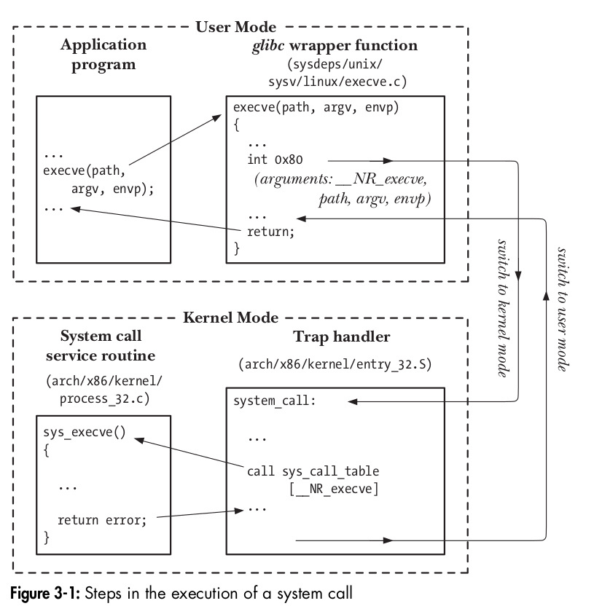
Group 3
01
SysCall Wrappers
CS3500 course project
We will work on the development and deployment of wrapper functions for several UNIX system calls to handle side effects and common errors encountered.

Slide 2
Group 3
02
What are SysCalls?
A syscall (system call) is a mechanism that allows a user-space program to request services from the kernel. It serves as an interface between a running process and the operating system, enabling programs to perform privileged operations, such as interacting with hardware, accessing files, or allocating memory, which would otherwise be restricted.
The kernel maintains a table (often called the system call table) that maps syscall numbers to their corresponding kernel function addresses. The syscall handler uses this table to dispatch the request to the appropriate function.
Application Binary Interface: The ABI defines how syscalls are made, including calling conventions and how results are returned. It provides a consistent interface for programs regardless of implementation details.

Slide 3
Group 3
03
What are Wrappers?
Syscall wrappers are user-space library functions that provide a convenient and portable interface for making system calls. They essentially "wrap" the low-level details of invoking a system call, including setting up registers and handling the transition from user mode to kernel mode.
The function prepares the arguments according to the system's calling convention and performs the syscall using a dedicated instruction.
If the syscall returns an error (by convention, negative values indicate errors), the wrapper translates this into a return value of -1 and sets the global errno variable accordingly. If successful, the syscall's return value is passed back to the calling program.

Slide 4
Group 3
04
How a system call is created in Linux
Download and extract linux kernel code, currently working on Arch linux
Create <name>.c file , and create a Makefile to compile it
Edit the system call table file in arch/x86/entry/syscalls/ directory ( syscall_64.tbl )
Add system call to syscalls.h in /include/linux
Can compile the kernel after this.
We are using QEMU to test our compiled kernel. (Filesystem : busybox)

Slide 5
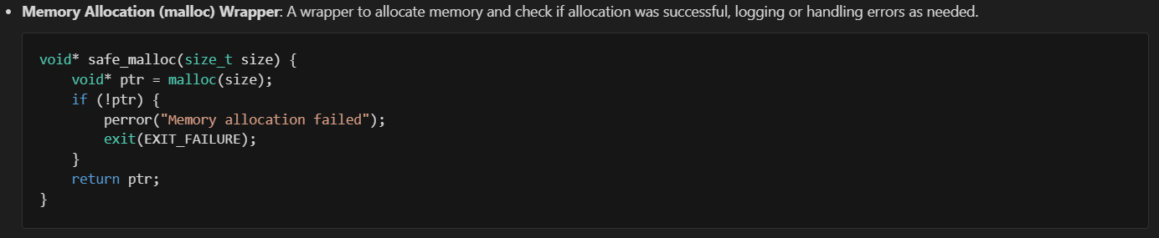
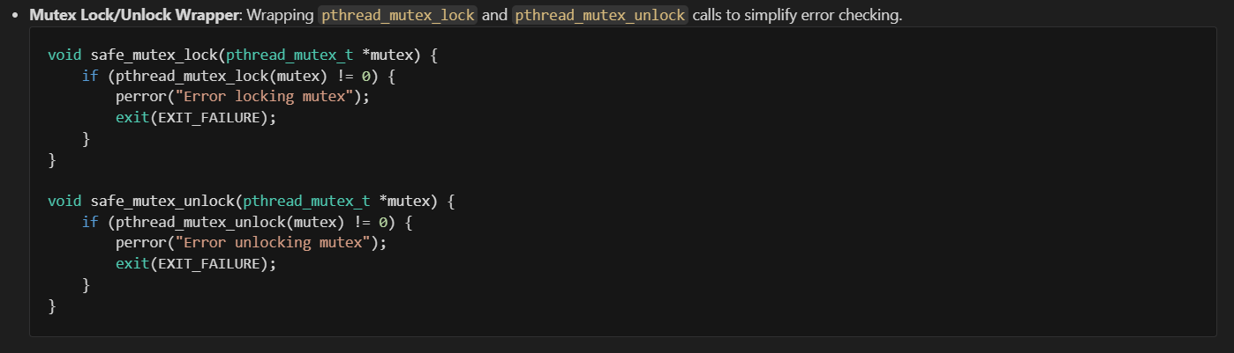
Group 3
Examples of Wrappers
05

Slide 6
Group 3
05
Benefits of using wrappers
Portability: Directly making syscalls is platform-specific, as different architectures may use different instructions, calling conventions, or syscall numbers. Wrappers provide a consistent interface across various platforms by hiding these low-level details.
Error Handling: Syscall wrappers typically handle errors in a standardized way. For example, in the POSIX standard, if a syscall fails, it returns -1, and the global variable errno is set to indicate the specific error. Wrappers encapsulate this behavior.
Convenience: Syscall wrappers provide a higher-level interface by handling parameter passing and any additional work that may be needed before making the syscall. For instance, the open wrapper may internally convert a file path to a format suitable for the kernel.

Slide 7
Group 3
03
Project Stages
Stage 1
Researching what sys calls to implement based on use case scenarios and time constraints to implement
Deciding the OS distribution which is most streamlined to work with. Team members getting familiar with the OS architecture and compiling.
Stage 2
Learning and implementing basic wrappers with proper logging and error messages surrounding file I/O and creation, memory management.
This will give team member solid foundation about implementing system calls and the operating system specifics.

Slide 8
Group 3
04
Project Stages
Stage 3
Creating wrappers for process creation, memory management, networking and synchronization especially ones which may help in logging, error handling etc.
Stage 4
Custom tracer for system calls similar to strace.
Create a wrapper for systematic analysis for pointer assignments
Create a Testing env.
Create a wrapper for file write and read with encryption using RSA and other advanced algorithms.

Slide 9
Team Members
Dev Mehta (CS22B007)
Kritang Kothari (CS22B012)
Aditya Jain (CS22B065)
Aditya Srivastav (CS22B066)
Raadhes Ch. (CS22B069)
Daksh Sehra (CS22B071)
Harshvardhan Daga (CS22B075)
Rohan Bagati (CS22B082)
Shreyanshu Gurjar (CS22B084)
Yashvardhan Toshniwal (CS22B088)
Mith Jain (CS22B097)

