Slide 1
Industrial Releases of Toxic Substances in Canada
Group 33 Project Pitch Presentation Hilary Zou | Kevin You | Yifan Zhi | Yingke He | Ziheng Zhong

Slide 2
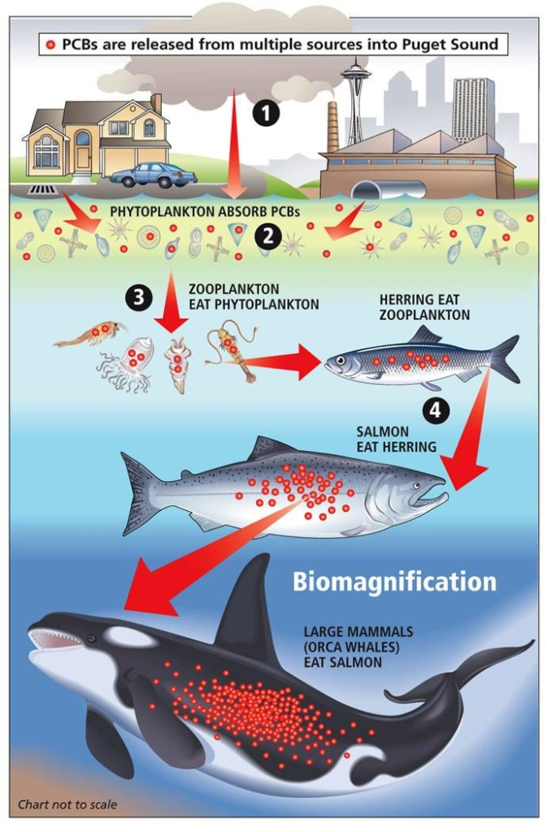
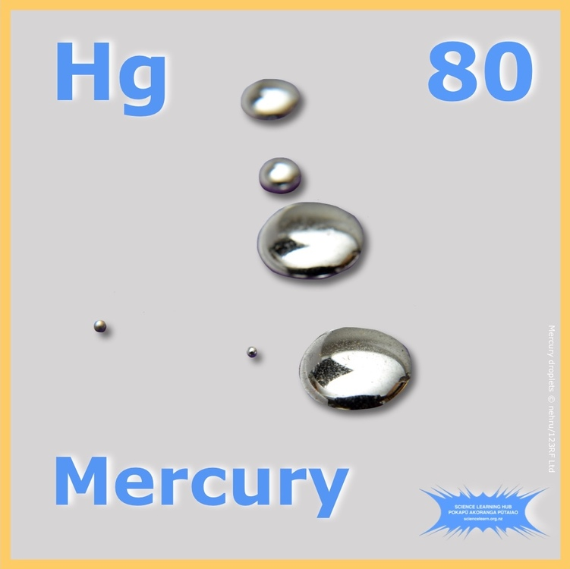
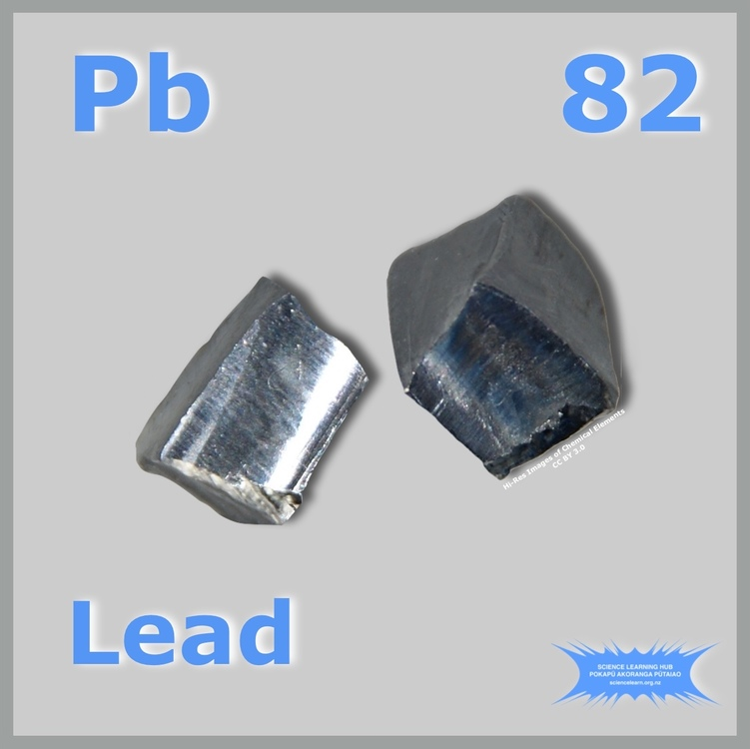
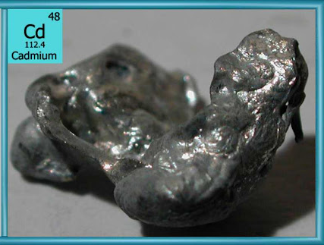
Topic and Social Good
Pollutants pose serious risks to human health
Mercury can cause neurological damage, particularly in children.
Negative impact on wildlife
Pollutants accumulate in fish and other organisms.
Ecosystems are disrupted by pollutant build-up.
Preventing pollutant release protects
Public health.
Community well-being.

Slide 3
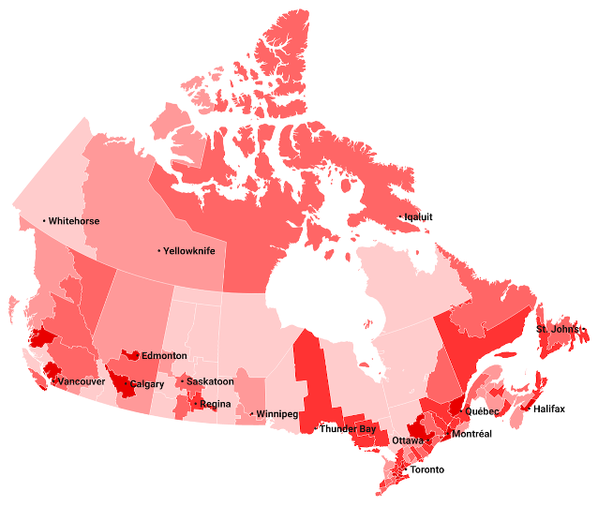
Topic and Social Good
Research goal
Provide data-driven insights for social change.
Identify high-risk areas.
Evaluate pollution trends.
Objectives
Promote stronger environmental regulations.
Inspire sustainable practices across Canada.
Aim
Benefit all Canadians through improved public
health and environmental quality.

Slide 4


Intended Audience & Key Questions
Target audience
Policymakers and environmental scientists in government
Purpose
Provide visualizations to make informed pollution control decisions
Key questions addressed
Which regions in Canada have the highest levels of toxic water contamination?
How has industrial pollution changed over time, especially in response to regulations?
Which sectors are the largest contributors to water pollution?

Slide 5
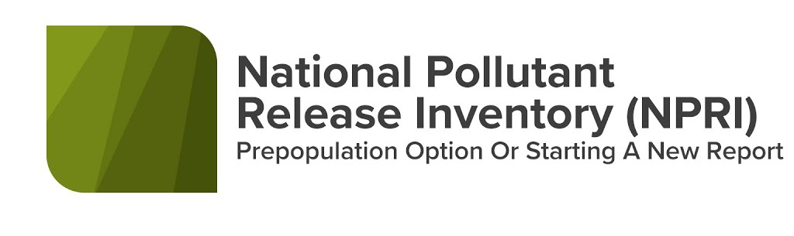


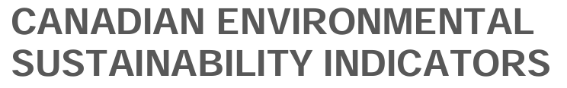
Data Sources
Primary datasets
National Pollutant Release Inventory (NPRI)
Canadian Environmental Sustainability Indicators (CESI)
Track pollutant releases across industries and geographic regions.
Urban insights dataset
ChemTrac data from Toronto Open Data.

Slide 6
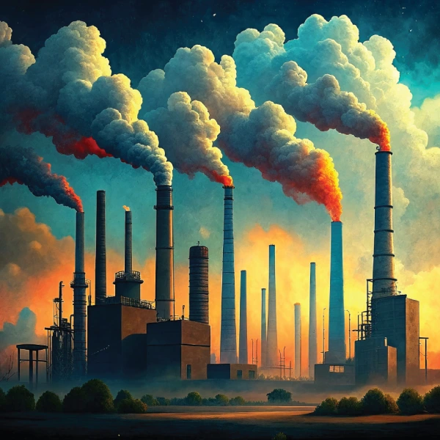
Data Sources
Additional data source
Bio-monitoring data.
Assesses human exposure to pollutants.
Links emissions to health risks in affected communities.
Multi-dimensional data approach:
Provides a comprehensive view of industrial pollution across Canada.

Slide 7
Thank you for your attention We look forward to your feedback!

