Slide 1


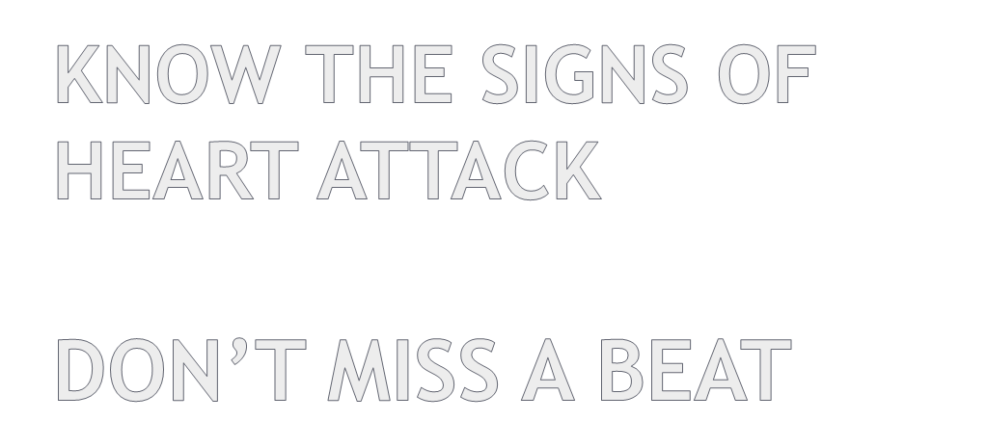


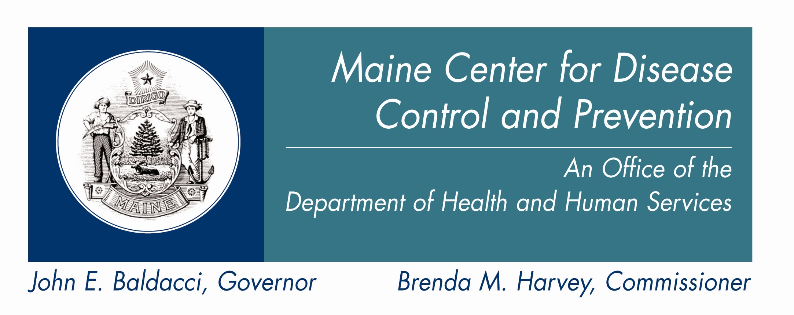
Welcome
Cardiovascular Health Program
Notes:
Introduce yourself and your organization or affiliation
I am happy to be here with you today, to share some very important information, that could someday save your life, or the life of someone that you care about. “In a Heartbeat” is a state-wide effort to help Maine residents learn the signs of heart attack, and what to do if you or someone near you experiences any of these signs. We’ll also talk a bit about what you can do to help prevent a heart attack.
*Note to trainers: Please feel free to add your own logo to this slide, so that your audience understands that this is a local initiative, and stress that you are a resource for information, materials, services, etc. as appropriate.
Please do not however, remove the ‘In a Heartbeat’ and/or Healthy Maine Partnership/Maine Cardiovascular Health logos from the slide – thank you!

Slide 2

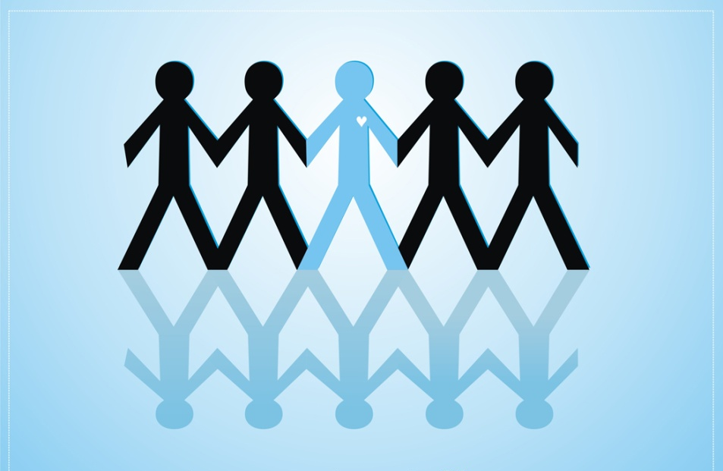
Do you know a friend or relative who has had a heart attack, or have you ever had a heart attack yourself?
Notes:
INTRODUCTION:
To get started, let’s see what the group’s experience with heart attack is.
Do you know a friend or relative who has had a heart attack, or have you ever had one yourself? (by show of hands.)
In this training program, you’ll learn to recognize the signs and symptoms of heart attack so that you can call 9-1-1 and increase the chance of survival and recovery for a person having one.

Slide 3

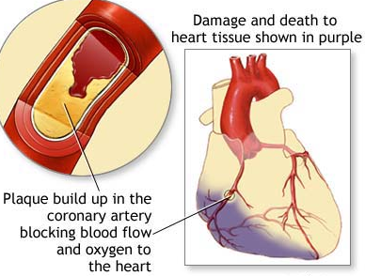
Heart disease develops over time as fatty build-up, or plaques, which can narrow the path of blood flow to the heart
Plaque breaks, causing a blood clot
Blood flow is blocked by the clot, causing a heart attack
If blockage continues, heart muscle dies
Time = Muscle
Notes:
So what causes a heart attack, and what does it look like?
Coronary arteries bring blood with oxygen and nutrients to the heart.
Heart disease, which can lead to a heart attack, develops over time as fatty build-up, or plaques. This build up narrows the coronary arteries, restricting blood flow to the heart. Sometimes a plaque ruptures releasing a blood clot.
During a heart attack, blood flow through one of the coronary arteries becomes mostly or completely blocked, usually by a clot.
If a blockage continues, heart muscle dies, reducing the heart’s ability to pump blood through the body.
That is what a heart attack looks like on the inside. Now let’s talk about what we see from the outside, and what we need to do.

Slide 4


Chest pain or discomfort
Pain or discomfort in the jaw, neck or back
Feeling weak, lightheaded, faint or sweaty
Pain or discomfort in the arms or shoulders
Shortness of breath
911
Notes:
These are the warning signs we need to look for. Any ONE of these warning signs is reason to call for help.
Chest pain or discomfort
Pain or discomfort in the jaw, neck or back
Feeling weak, lightheaded, faint or sweaty
Pain or discomfort in the arms or shoulders
Shortness of breath
Don’t wait! At the first sign of a heart attack, call 911. Time lost, is muscle lost.
It’s also important to point out that heart attack symptoms vary widely from person to person, and many times, they do NOT look like what happens in the movies.
Heart attacks often begin with vague symptoms that slowly intensify.
Pain or discomfort can be relatively mild.
Symptoms may come and go.
*Note to presenters: This is not an exhaustive list of symptoms. In an effort to keep the amount of information from being overwhelming to audiences, we have used the most common symptoms here. However, participants can be encouraged to learn more by talking with their doctor, or by researching websites such as the American Heart Association, National Heart Lung and Blood, or a local hospital website.

Slide 5

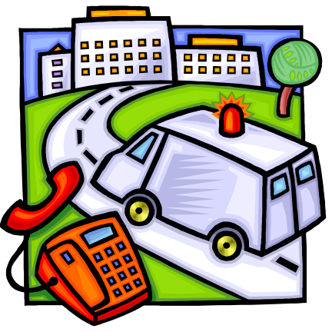
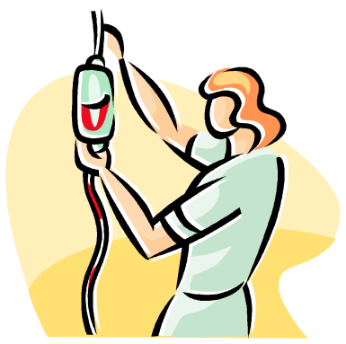

Patient delay is the biggest cause of not getting care fast
Do not wait more than a few minutes —5 at the most— to call 9-1-1
Notes:
Patient delay is unfortunately too common, and often means that heart attack victims do not receive care in time to be most beneficial for survival and quality of life.
Many patients do not receive certain beneficial drugs and treatments, because the window for treatment has been missed due to delay in calling 911. Emergency medical service providers want to hear from you before it is too late. It is much better to be safe than sorry.

Slide 6

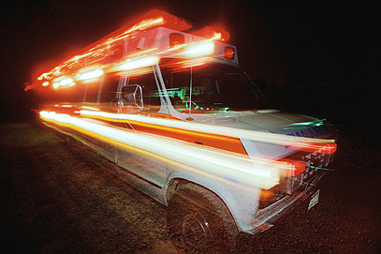
Emergency providers can monitor the condition and begin treatment on the way to the hospital
They can communicate with Emergency doctors
Person having a heart attack will be seen more quickly
Emergency Room can prepare for arrival
Time = Muscle
Notes:
GO IN AN AMBULANCE
A person having a heart attack arriving in an ambulance will be seen more quickly than a person checking into the ER by other means.
Emergency Medical Technicians (EMTs) can assess the patient’s condition and communicate with ER doctors while they are on the way. Alerted hospital staff can have equipment ready to begin tests immediately upon the patient’s arrival.
EMTs can monitor the patient’s condition and begin some tests and treatments in the ambulance, while driving to the hospital.
So don’t call your doctor’s office and wait for a call back, and don’t drive the person to the hospital yourself.
Going in an ambulance saves valuable time, and time saved is heart muscle saved.

Slide 7

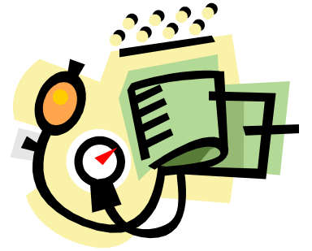
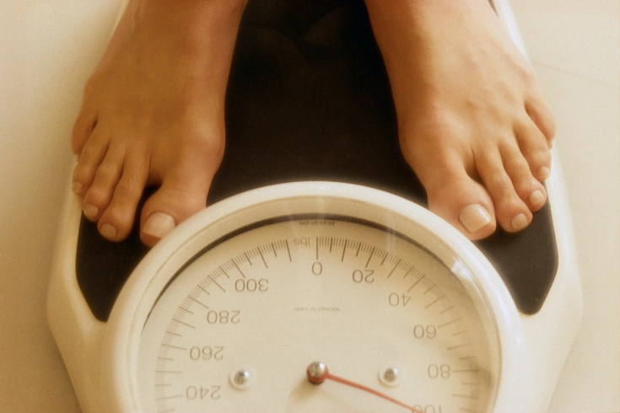
Smoking
Diabetes
High blood cholesterol
High blood pressure
Overweight/obesity
Physical inactivity
Notes:
There are a number of conditions and behaviors that can lead to heart attack. There are some heart attack risk factors that we cannot control, like getting older, gender, race and ethnicity, as well as having a personal or family history of heart disease. These things can mean that we are at higher risk, and although we cannot change them, we should definitely talk to our healthcare providers about them.
The good news is, that there are many risk factors that we CAN change or control:
CONTROLLABLE RISK FACTORS:
Controlling or eliminating these risk factors will dramatically reduce the odds of having a heart attack.
Smoking: Quitting smoking will help prevent heart attack, stroke, and some respiratory problems!
Diabetes: Control diabetes with proper diet, exercise and by monitoring glucose levels and taking medication.
High Cholesterol: Healthy eating, physical activity and medication can help lower cholesterol and reduce the risk of heart attack.
High Blood Pressure: Blood pressure should be checked annually. If blood pressure is ever high, have it checked more frequently and make sure to take medication as directed, to lower your risk of heart attack.
Overweight/Obesity: Being more than twenty pounds overweight can increase your odds of heart disease and heart attack.

Slide 8



Reduce intake of fatty foods and eat more fruits and vegetables
Walk 30 minutes a day
  Exercise reduces the risk of stroke, heart disease and other conditions
  Healthy Maine Walks: www.healthymainewalks.org
If you smoke or chew tobacco, stop!
  Maine Tobacco HelpLine: 1-800-207-1230
Notes:
LIFESTYLE CHANGES:
Obesity, diabetes, high cholesterol, and high blood pressure can be controlled through lifestyle changes.
Many Americans eat foods that are high in saturated fat and sugar, or that are highly processed. Reduce your intake of fatty foods, eat whole grains versus processed grains, and try to get 5 or more servings of fruits and vegetables each day.
There are many ways you can become physically active. An easy way to exercise is to walk. Just walking 30 minutes a day can make a huge difference. If it’s easier, you can even break it up into three 10 minute walks.
Regular physical activity can improve heart and lung condition, reduce risk of stroke, heart disease and depression, reduce weight, enhance your mood, and help you sleep better.
Check out the Healthy Maine Walks website for free indoor and outdoor walking routes near you.
Finally, quitting tobacco use is one of the best things that you can do for your heart, as well as your overall health. Call the Maine Tobacco HelpLine or your community tobacco cessation resource for help in kicking the tobacco habit.

Slide 9
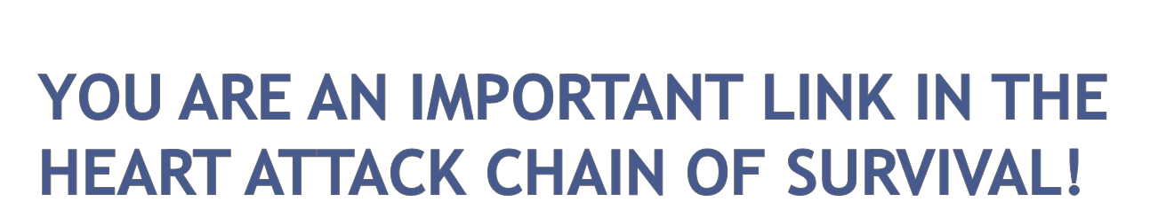
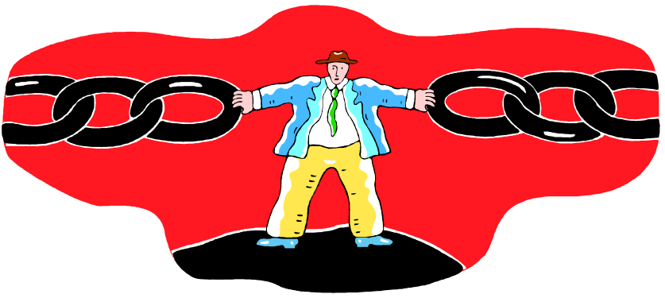
Know the signs and call 911 for heart attack
Know your risk factors and how to lower them
Take a community CPR/AED* class
Share your knowledge!!
THANK YOU!
*Cardiopulmonary Resuscitation/
Automated External Defibrillator
Notes:
‘In a Heartbeat’ is a state-wide effort to improve heart attack care for Maine residents. You are playing an important role in improving survival and decreasing disability associated with heart attack in Maine! Thank You!
DISCUSSION AND ACTIVITY IDEAS:
Can you remember what the signs and symptoms are, and what you should do?
Allow participants to list symptoms aloud, and discuss any questions they may have as time allows.
If you don’t have the answer for a specific question, encourage participants to follow up with their healthcare provider, or offer to follow up with them after you have checked in with a physician, nurse or other appropriate healthcare professional.
**Presenters: Be sure to distribute “In a Heartbeat” resources, including handouts and magnets.
If you have any questions, please contact the Maine CDC’s Cardiovascular Health Program at: 207-622-7566 x226 or dlouder@mcd.org

Slide 10

Local Contact:
email:
website:
phone:
Maine CDC Cardiovascular Health Program
www.healthymainepartnerships.org/mcvhp
Maine Quality Forum, “In a Heartbeat”
www.mainequalityforum.gov/inaheartbeat.html
Notes:
Add your contact information here, and urge participants to contact you, the Maine Quality Forum or the Maine CDC Cardiovascular Health Program with any questions, or for further information.

