Slide 1
Software Engineering
Prepared by: Neha Tripathi

Slide 2
Agile project management-Scrum
https://www.youtube.com/watch?v=xVi3lgyD080
A particular strength of extreme programming is the development of automated tests before a program feature is created. All tests must successfully execute when an increment is integrated into a system.
The principal responsibility of software project managers is to manage the project so that the software is delivered on time and within the planned budget for the project.
The standard approach to project management is plan-driven. Managers draw up a plan for the project showing what should be delivered, when it should be delivered and who will work on the development of the project deliverables.
Agile project management requires a different approach, which is adapted to incremental development and the particular strengths of agile methods.
The Scrum method is an agile method that provides a project management framework. It is centred round a set of sprints, which are fixed time periods when a system increment is developed.

Slide 3
Scrum: Phases
The Scrum approach is a general agile method but its focus is on managing iterative development rather than specific agile practices.
There are three phases in Scrum.
The initial phase is an outline planning phase where you establish the general objectives for the project and design the software architecture.
This is followed by a series of sprint cycles, where each cycle develops an increment of the system.
The project closure phase wraps up the project, completes required documentation such as system help frames and user manuals and assesses the lessons learned from the project.

Slide 4
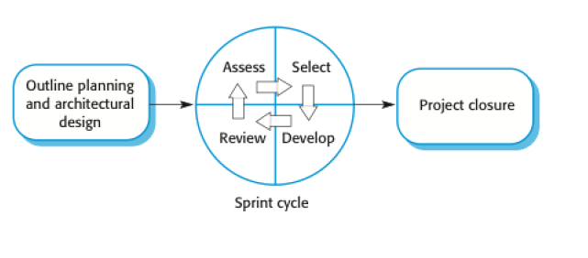
The Scrum process

Slide 5
The Sprint cycle
Sprints are fixed length, normally 2–4 weeks. They correspond to the development of a release of the system in XP.
The starting point for planning is the product backlog, which is the list of work to be done on the project.
The selection phase involves all of the project team who work with the customer to select the features and functionality to be developed during the sprint.
Once these are agreed, the team organize themselves to develop the software. During this stage the team is isolated from the customer and the organization, with all communications channelled through the so-called ‘Scrum master’.
The role of the Scrum master is to protect the development team from external distractions.
At the end of the sprint, the work done is reviewed and presented to stakeholders. The next sprint cycle then begins.

Slide 6
Teamwork in Scrum
The ‘Scrum master’ is a facilitator who arranges daily meetings, tracks the backlog of work to be done, records decisions, measures progress against the backlog and communicates with customers and management outside of the team.
The whole team attends short daily meetings(“Stand-up meeting”) where all team members share information, describe their progress since the last meeting, problems that have arisen and what is planned for the following day.
This means that everyone on the team knows what is going on and, if problems arise, can re-plan short-term work to cope with them.

Slide 7
Scrum benefits
The product is broken down into a set of manageable and understandable chunks.
Unstable requirements do not hold up progress.
The whole team have visibility of everything and consequently team communication is improved.
Customers see on-time delivery of increments and gain feedback on how the product works.
Trust between customers and developers is established and a positive culture is created in which everyone expects the project to succeed.

Slide 8
Thank You!

