Slide 1

FitMind AI – AI Based Fitness Application
Submitted in the partial fulfillment for the award of the degree of
BACHELOR OF ENGINEERING
IN
AIT-CSE
Submitted by:
Manikanta Chari [21BCS9709]
KiranReddy I [21BCS9707]
Vishal D [21BCS9684]
Hemanth P [21BCS9684]
Under the supervision of: Priyanka Kaushik Mam

Slide 2
Outline of the Presentation
Title
Introduction to Project
Problem Formulation
Objectives of the work
Methodology used
Implementation and Planning
Preliminary Design
Analysis of Features
Results and Outputs
Conclusion
Future Scope
References

Slide 3

Title:
FitMind Ai
AI Based Fitness Application

Slide 4
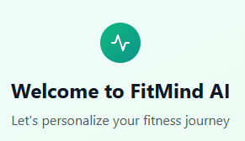
Introduction
FitMind AI simplifies fitness planning with personalized recommendations.
Focuses on health goals, consistency, and daily motivation.
Bridges traditional workout routines with modern digital experiences.
Designed for beginners to experts, making fitness easier and more enjoyable.
Offers clear daily workout suggestions based on user preferences and progress.
Promotes a balanced approach to fitness by including strength, cardio, and flexibility exercises.

Slide 5
Problem formulation
People find it hard to plan their fitness journey properly.
Most fitness advice is the same for everyone and doesn't suit individual needs.
Many users lose interest because workouts are not matched to their goals.
FitMind AI helps by giving simple, personalized workout plans for everyone.

Slide 6
Objectives
⁠ ⁠To create an easy-to-use fitness planning platform for all users.
⁠To provide daily workout and health recommendations based on personal details.
⁠To track fitness progress with simple dashboards and easy-to-read charts.
⁠To offer a variety of exercises, including cardio, strength, and flexibility routines.
⁠To help users stay motivated with clear goals and consistency tracking.
To make fitness accessible for beginners and supportive for experienced users.

Slide 7
METHODOLOGY
USER LOGIN / SIGN UP
User Login/Signup
↓
↓
↓
↓
↓
↓
↓
Collect User Details (Age, Gender, Goals, Fitness Level)
Analyse User Inputs
Generate Personalized Fitness Plan
Display Daily/Weekly Workout Routine
Track Progress and Update Dashboard
Provide Daily Motivation and Tips
User Feedback and Plan Adjustment

Slide 8
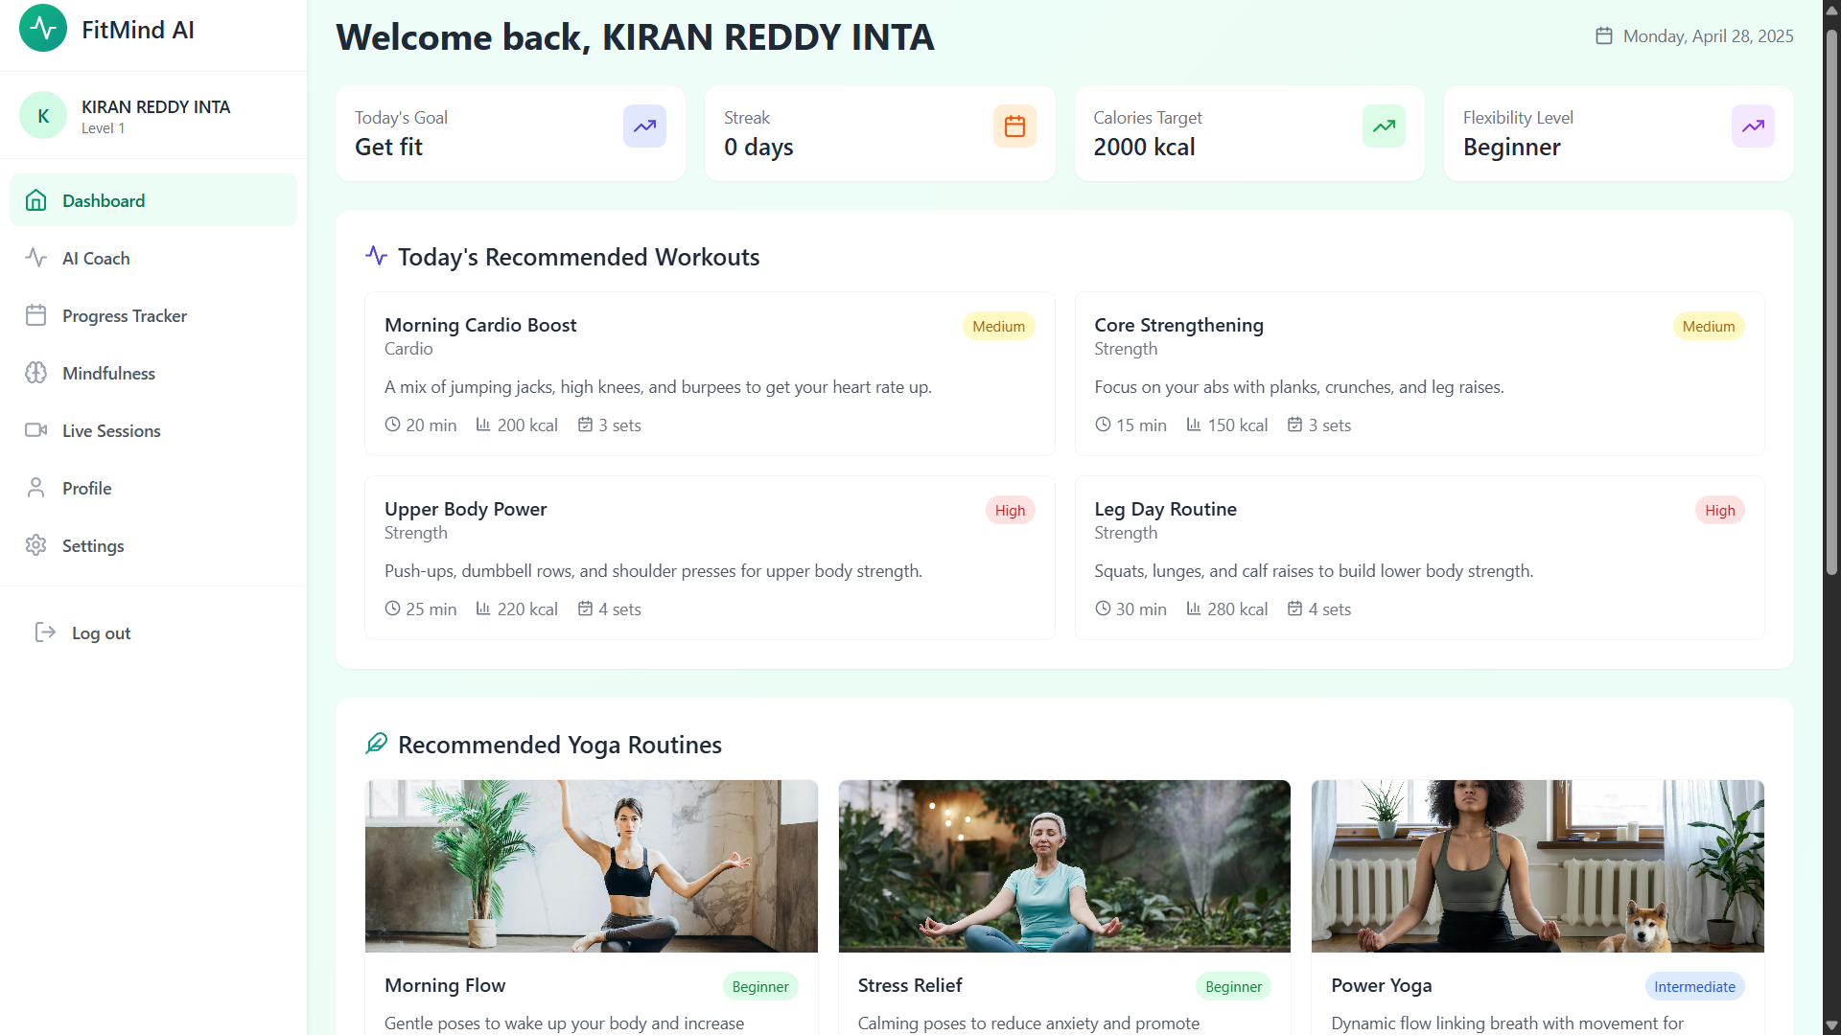

Slide 9
Implementation and planning
⁠Design a user-friendly and attractive web interface.
⁠Develop modules for user login, profile creation, and data input.
⁠Implement personalized fitness plan generation logic.
⁠Set up a backend server and database to store user data securely.
⁠Integrate progress tracking and daily motivation features.
⁠Conduct testing, gather feedback, and make improvements.

Slide 10
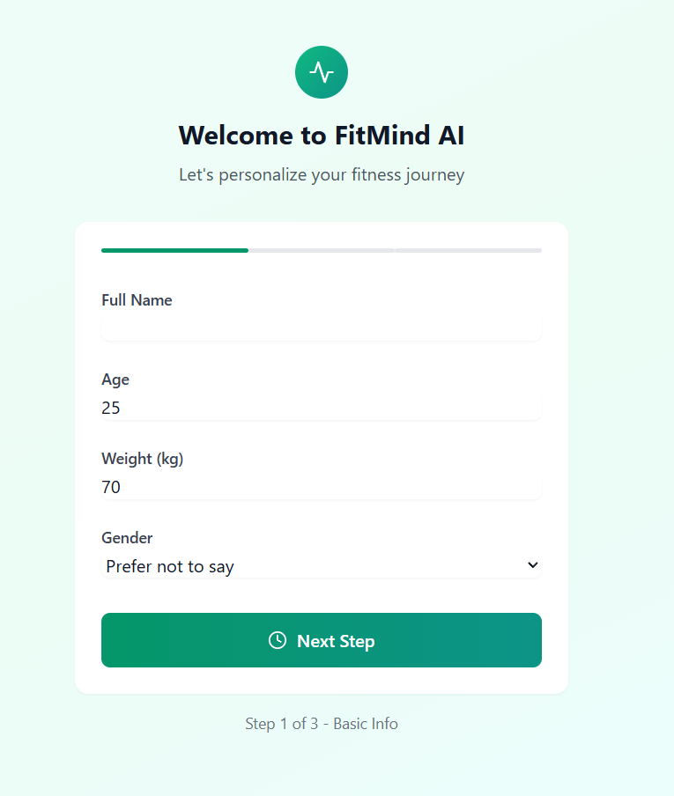
Preliminary Design
Simple, clean, and motivating user interface.
Easy navigation between fitness plans, progress tracking, and daily tips.
⁠Personalized dashboard showing user's fitness journey.
⁠Mobile-friendly and desktop-optimized responsive layout.

Slide 11

Analysis of Features
⁠Personalized AI-driven workout recommendations.
⁠Mood tracking integrated with fitness activities.
⁠Real-time progress tracking with visual analytics.
⁠Voice-assisted coaching and motivational prompts.

Slide 12
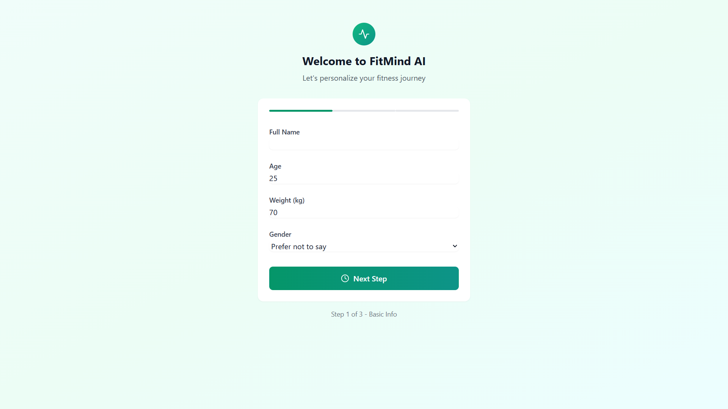
Results and outputs

Slide 13
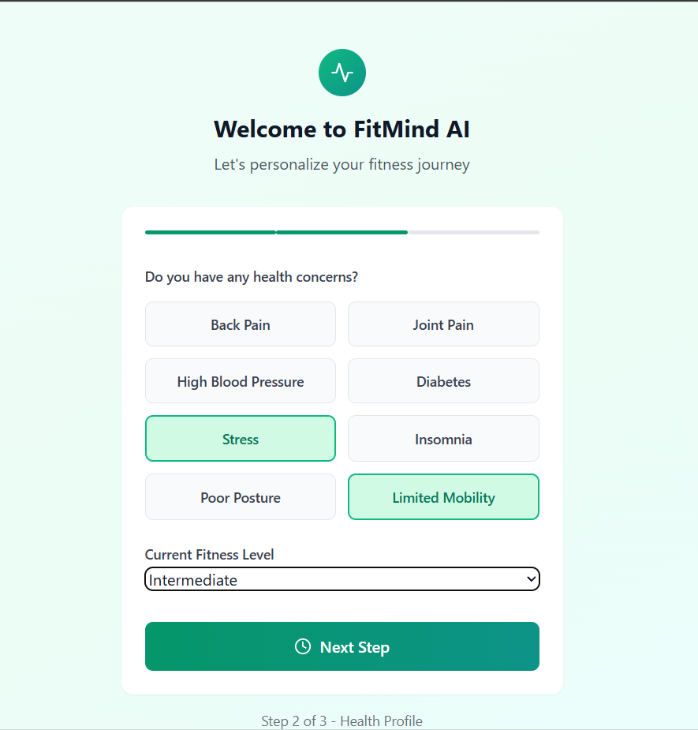
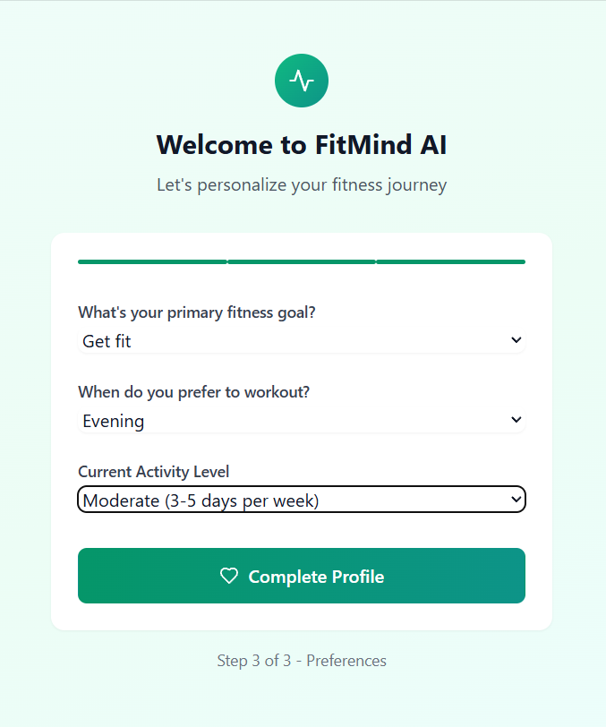

Slide 14
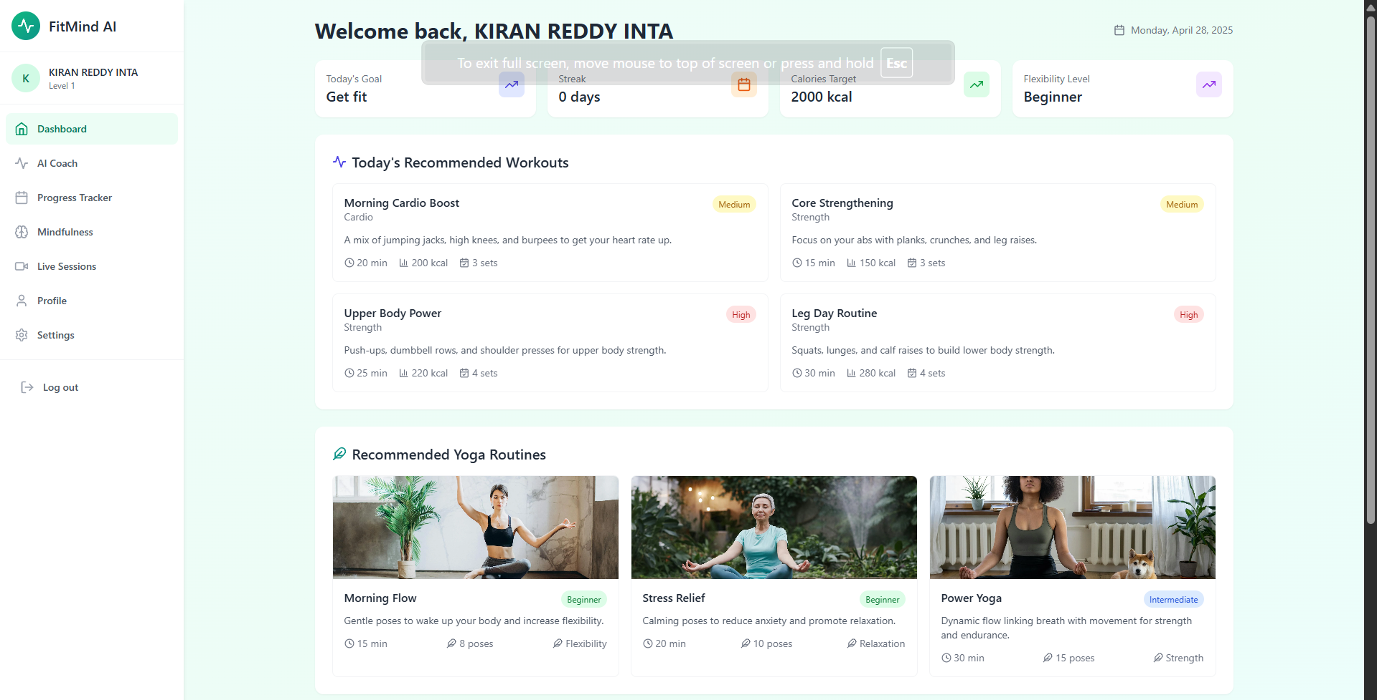

Slide 15
Conclusion
FitMind AI revolutionizes personalized fitness and mental wellness.
⁠Smart integration of AI enhances user engagement and motivation.
⁠Blends fitness tracking, mood analysis, and real-time coaching seamlessly.
⁠Poised to become a trusted companion for healthier, balanced lifestyles.

Slide 16

Future Scope
⁠Introduce personalized AI-driven workout and therapy plans.
⁠Enable group challenges and community-driven motivation features.
⁠Incorporate advanced mental health analytics and early warning systems.
⁠Expand integration with wearable devices and health platforms (Fitbit, Apple Health, etc.).

Slide 17
References:
[1] Smith, J. (2022). Personalized exercise programs and their effects on fitness outcomes. Journal of Health and Fitness Research
[2] Johnson, A. (2023). Exploring the role of AI in modern fitness applications. International Journal of Artificial Intelligence in Healthcare.
[3] Lee, B. (2021). Development of age-specific exercise recommendation systems. Proceedings of ACM HealthTech.
[4] Gupta, R. (2022). Leveraging yoga and technology for emotional well-being. Yoga Science and Research Journal.
[5] Patel, S. (2020). Utilization of machine learning models in healthcare recommendation engines. Procedia Computer Science
[6] Kumar, S. (2021). Predictive analysis techniques in healthcare-focused fitness systems. Journal of Medical Informatics.

Slide 18



