Slide 1

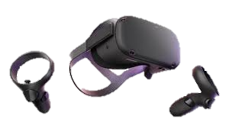
Home Content About
Virtual Reality
What is the purpose of this webpage?
The purpose of this web page is to Inform you
About what virtual reality is and why it should be
The technology of the future.
What Is Virtual Reality?
Virtual reality is a way that your able to connect
To the internet in almost a 3D way using googles.

Slide 2
Home Content About
Virtual Reality
This page contains to links to content that explains more in depth what VR is and why it is something that should
Be used in the future more!
Link To Inforgraphic
Link to video AD
Link to podcast
Link To Social Media post

Slide 3
Home Content About
Virtual Reality
Our mission
Our mission is provide information about VR and why and how it
Should be used in the future. We want educate on the VR because it gets a bad rep of just being for gaming but
That’s not the case and we hope to educate on it’s use and hopeful prove it’s usefulness in the future.
Sources
https://hqsoftwarelab.com/blog/virtual-reality-trends/
https://www.demandsage.com/virtual-reality-statistics/
Tools Used In Deliverables
Word
Adobe premiere
Soundcloud
Photoshop

