Slide 1
Deeper Look into Titanic Survivors
Kory Kinnear, Guy Nkiassi, Carson PRim

Slide 2

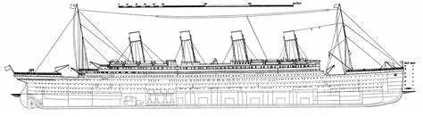



Background

Slide 3
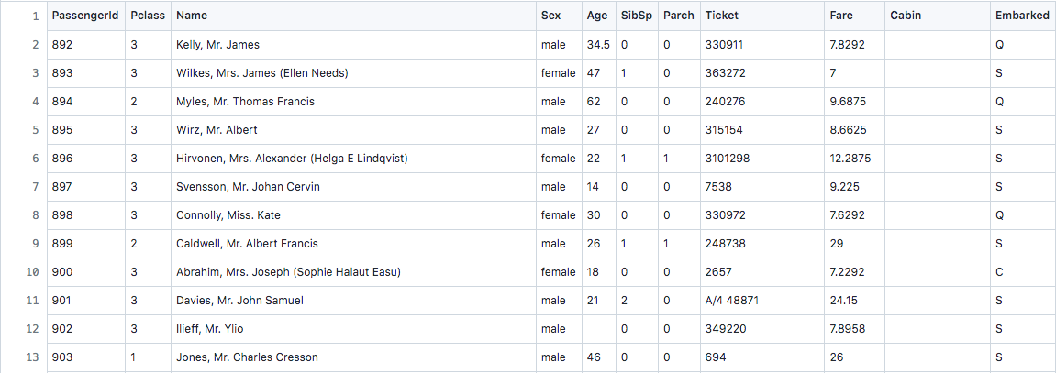
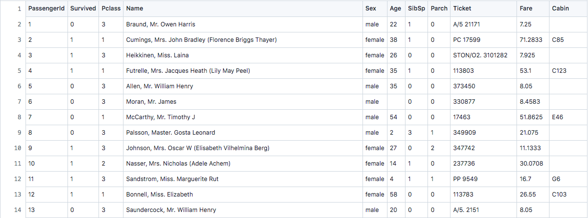
Dataset Overview
Test
Train

Slide 4
Goals
Manipulate the data to eliminate unneeded information
Find out via certain statistical manipulations how various groups of passengers fared
Represent that information in clear, descriptive models and charts
Use all the information provided to try and predict via a model whether or not each given passenger survived

Slide 5

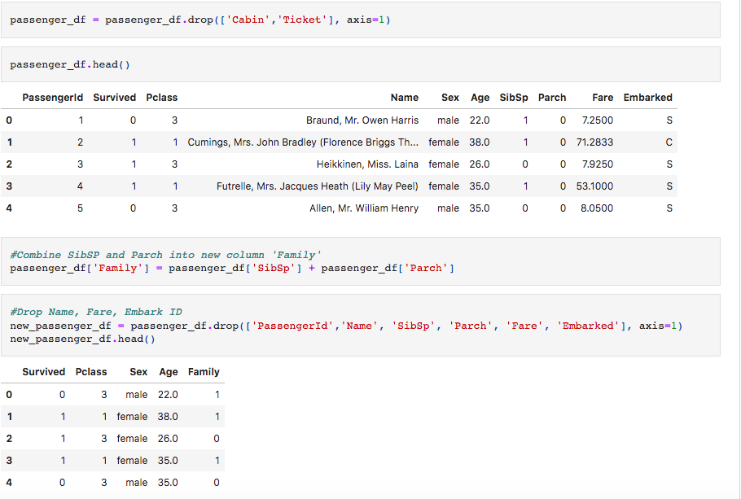
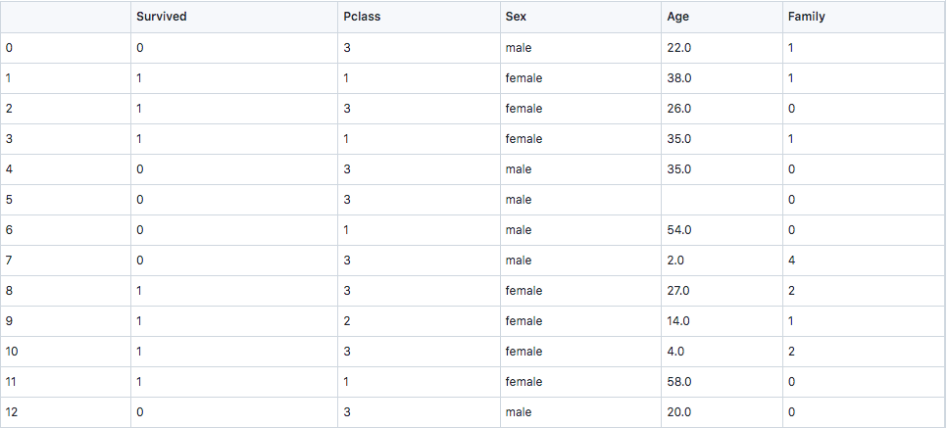
Data Manipulation

Slide 6
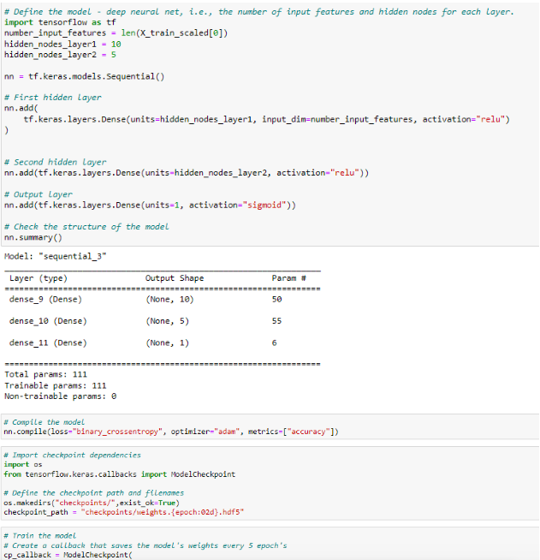
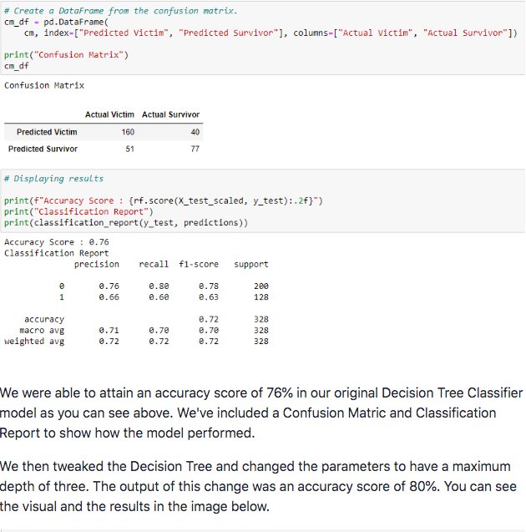
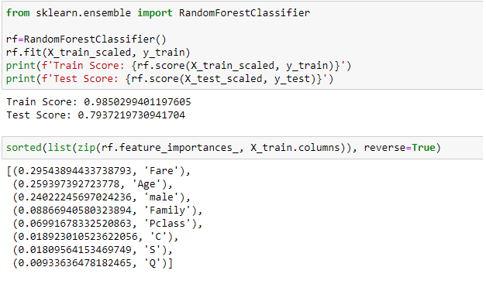
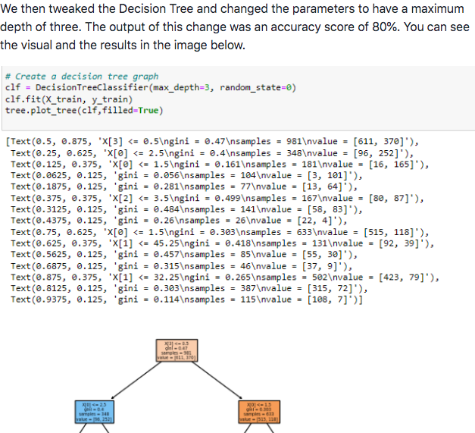
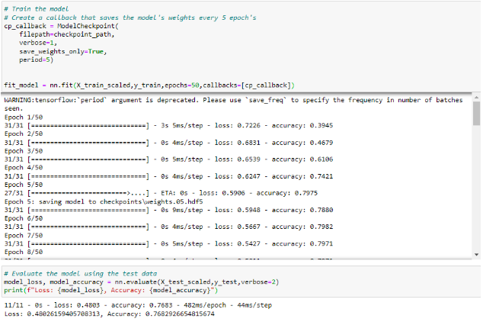
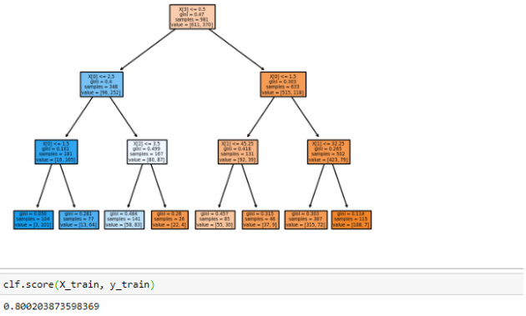
Models
Random Forest
Neural Network
Decision Tree

Slide 7
Visualizations

Slide 8
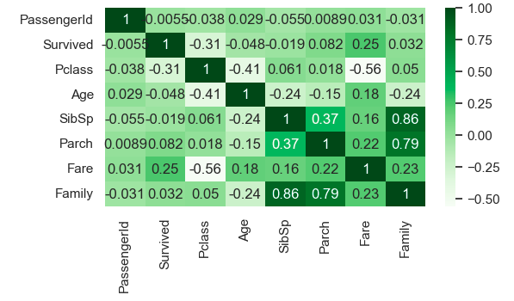

Slide 9
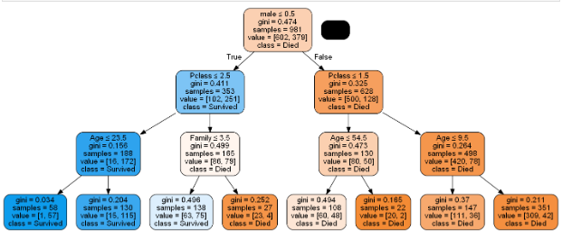

Slide 10
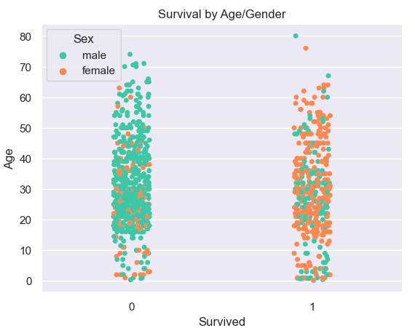

Slide 11
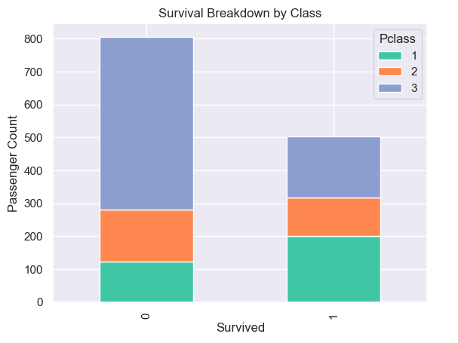

Slide 12
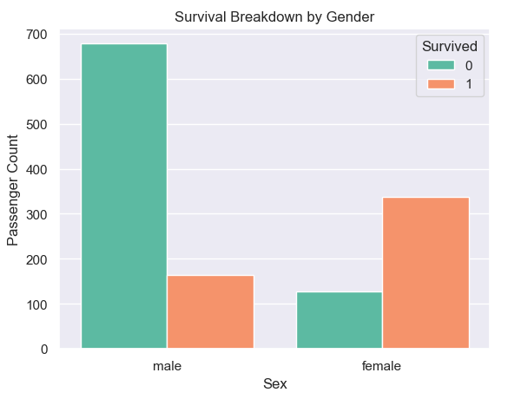

Slide 13
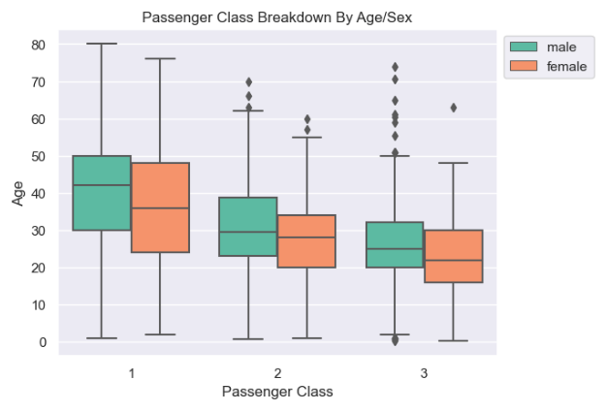

Slide 14
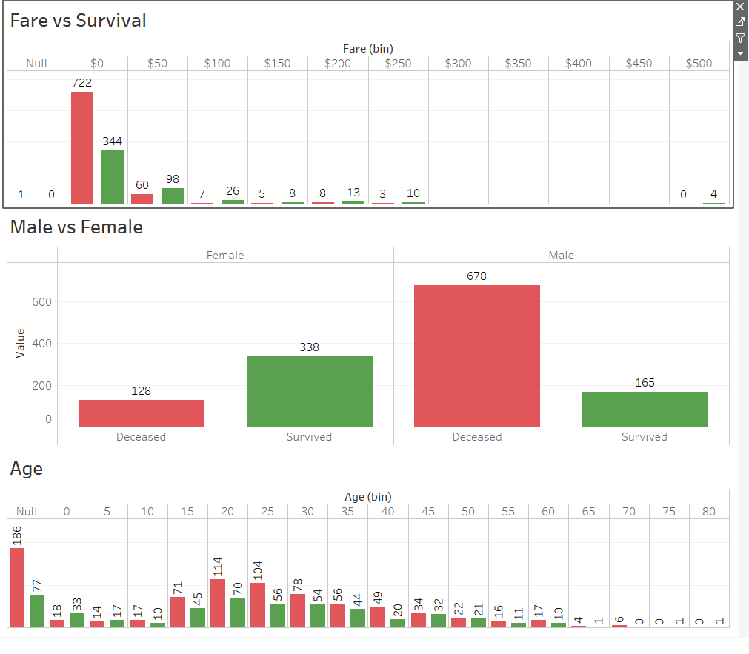
Tableau
https://public.tableau.com/app/profile/guy6801/viz/TitanicProject_16762110932600/TitanicProjectDashboard?publish=yes

Slide 15
Conclusions
Models could predict with good accuracy whether or not a passenger would survive

