Slide 1
Deeper Look into Titanic Survivors
X, Y, and Z

Slide 2

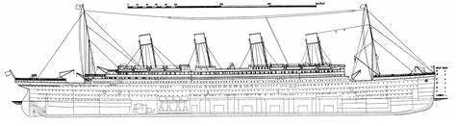



Background

Slide 3
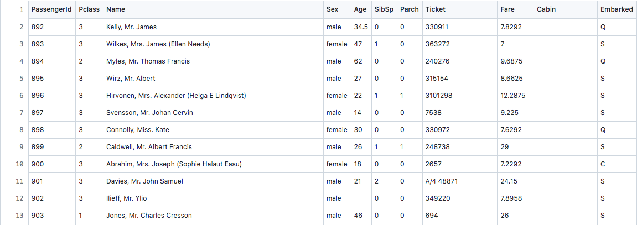
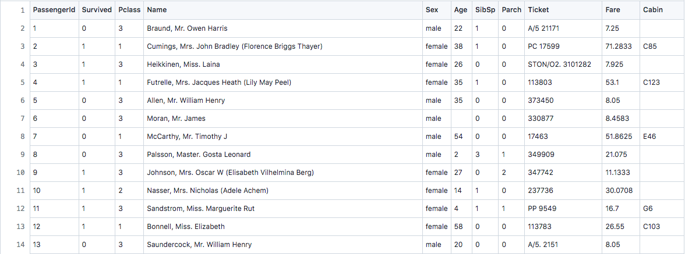
Dataset Overview
Test
Train

Slide 4
Goals
Manipulate the data to eliminate unneeded information
Find out via certain statistical manipulations how various groups of passengers fared
Represent that information in clear, descriptive models and charts

Slide 5

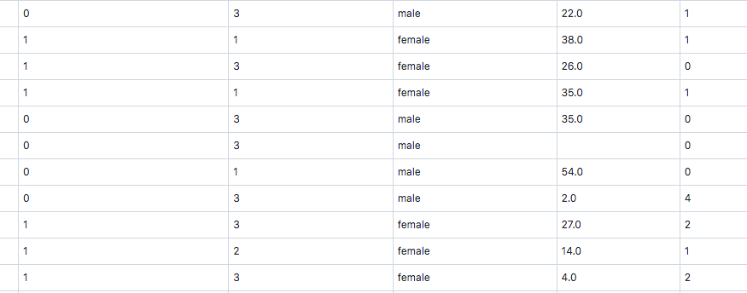
Data Manipulation

Slide 6
Models

Slide 7
Tableau

Slide 8
Results

Slide 9
Conclusions

