Slide 1
Deeper Look into Titanic Survivors
X, Y, and Z

Slide 2

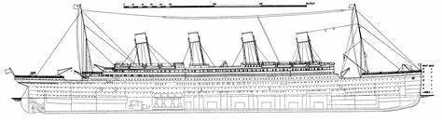



Background

Slide 3
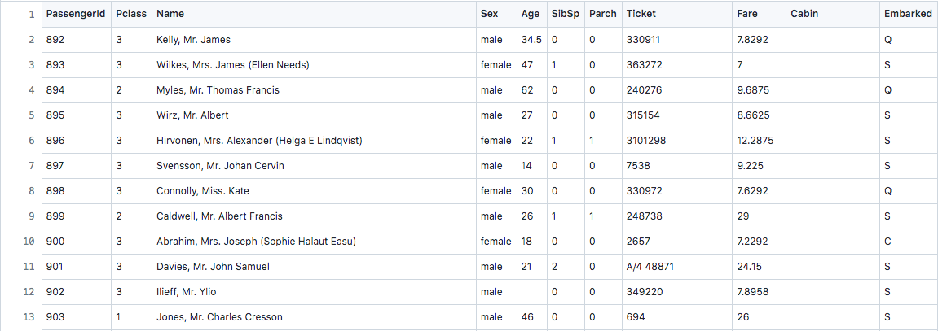
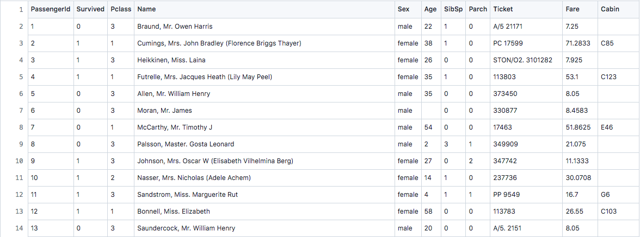
Dataset Overview
Test
Train

Slide 4
Goals
Manipulate the data to eliminate unneeded information
Find out via certain statistical manipulations how various groups of passengers fared
Represent that information in clear, descriptive models and charts

Slide 5

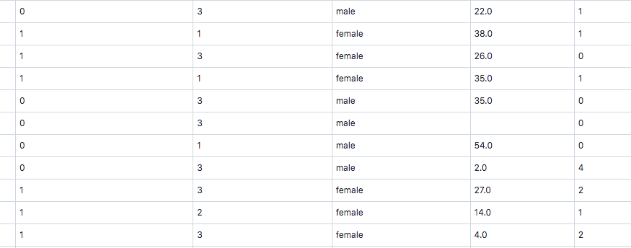
Data Manipulation

Slide 6
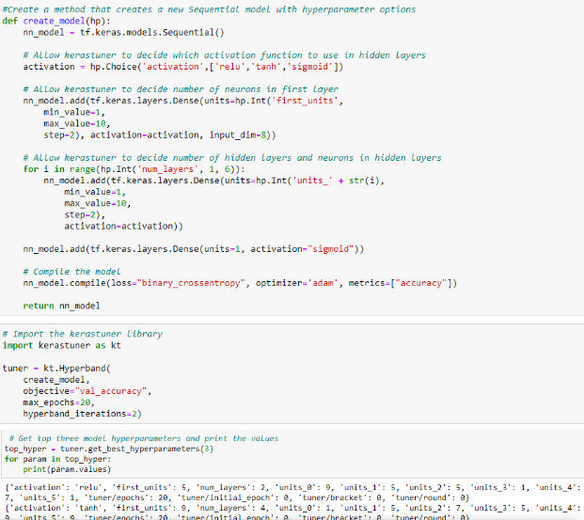
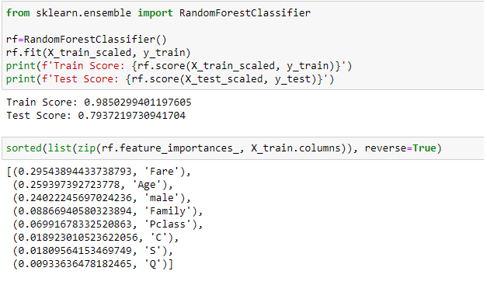
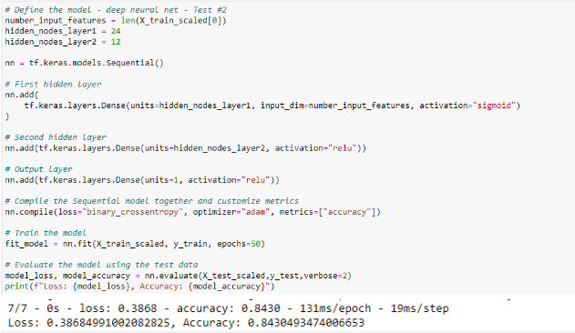
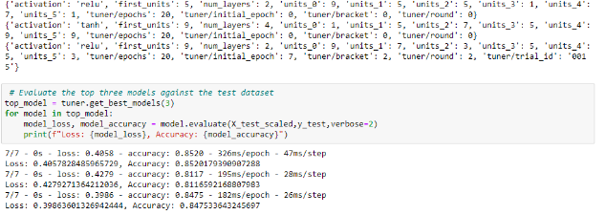
Models

Slide 7
Tableau

Slide 8
Results

Slide 9
Conclusions
We were able to make models that fairly accurately predicted whether or not a passenger would survive
Given all the data minus survival information, we could predict close to 80+% of the passengers

