Slide 1
Deeper Look into Titanic Survivors
X, Y, and Z

Slide 2

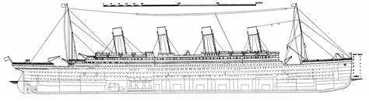



Background

Slide 3
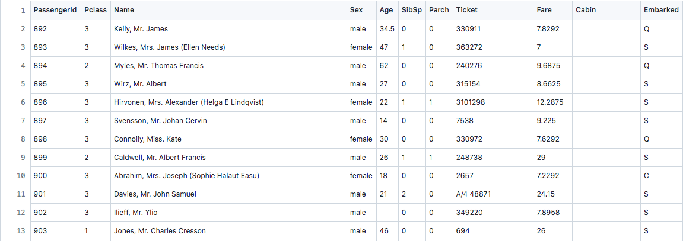
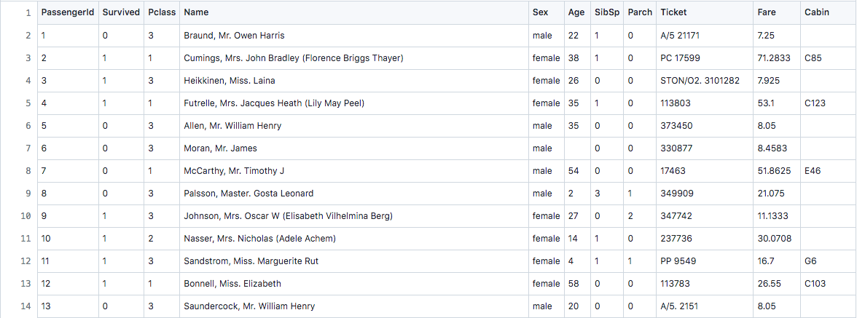
Dataset Overview
Test
Train

Slide 4
Goals
Manipulate the data to eliminate unneeded information
Find out via certain statistical manipulations how various groups of passengers fared
Represent that information in clear, descriptive models and charts
Use all the information provided to try and predict via a model whether or not each given passenger survived

Slide 5

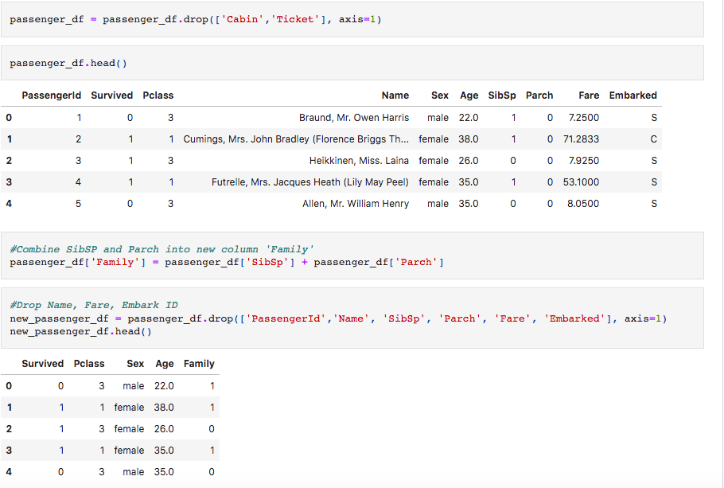
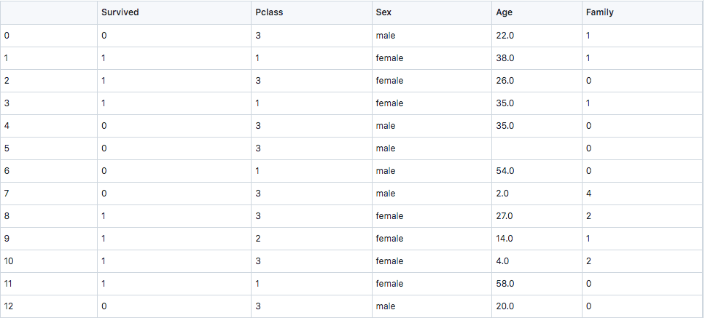
Data Manipulation

Slide 6
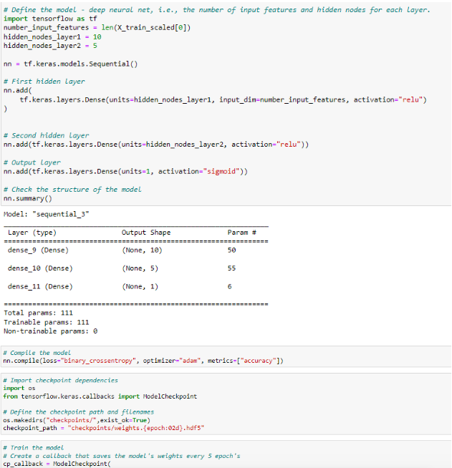
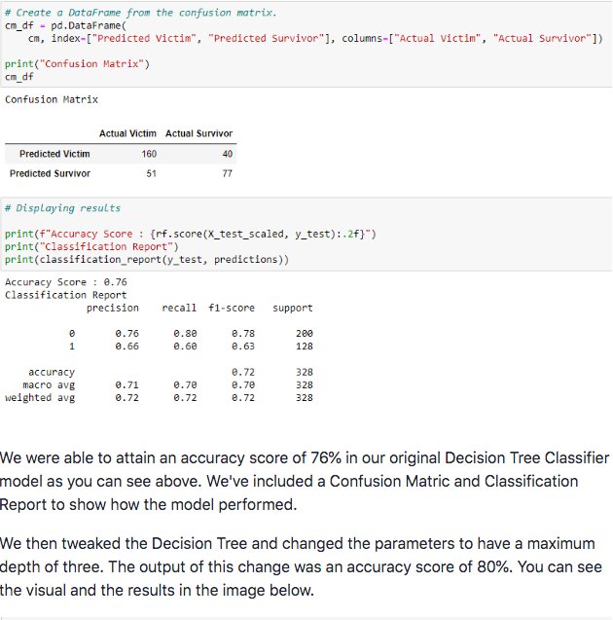
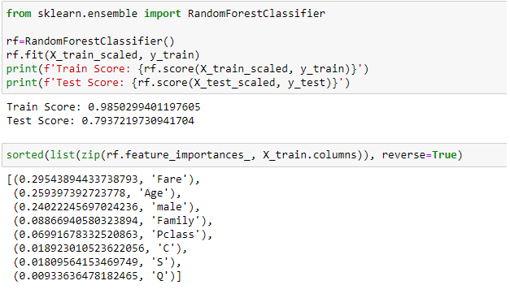
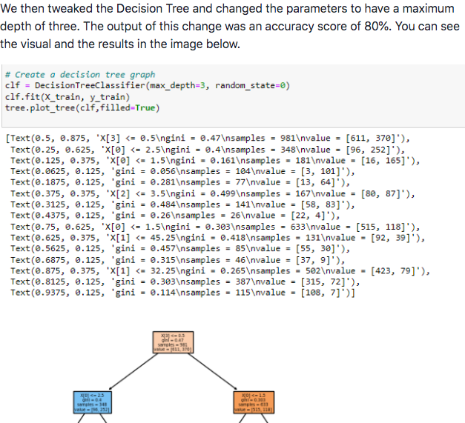
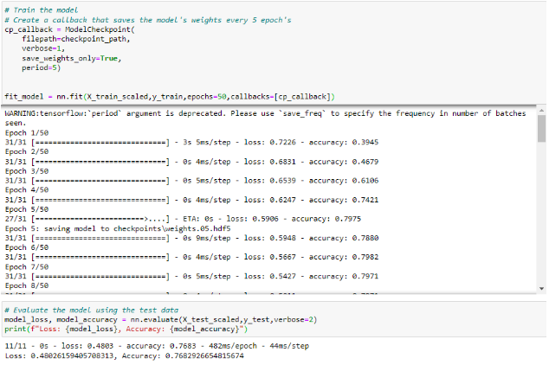
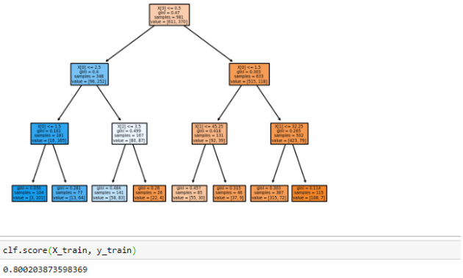
Models
Random Forest
Neural Network
Decision Tree

Slide 7
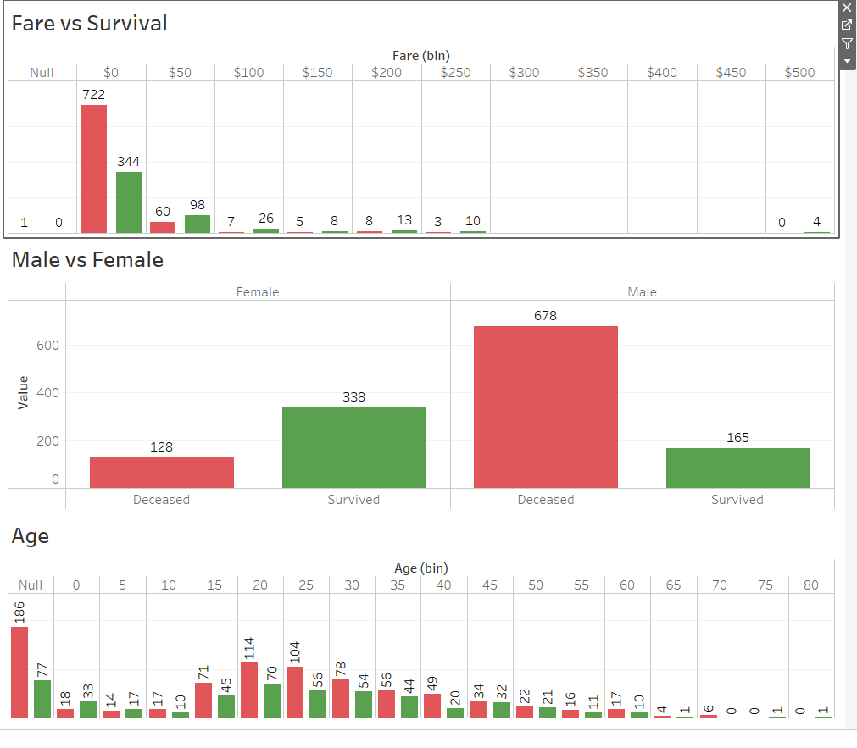
Tableau
Tableau Analysis Link

Slide 8
Results

Slide 9
Conclusions
We were able to make models that fairly accurately predicted whether or not a passenger would survive
Given all the data minus survival information, we could predict close to 80+% of the passengers

