Slide 1
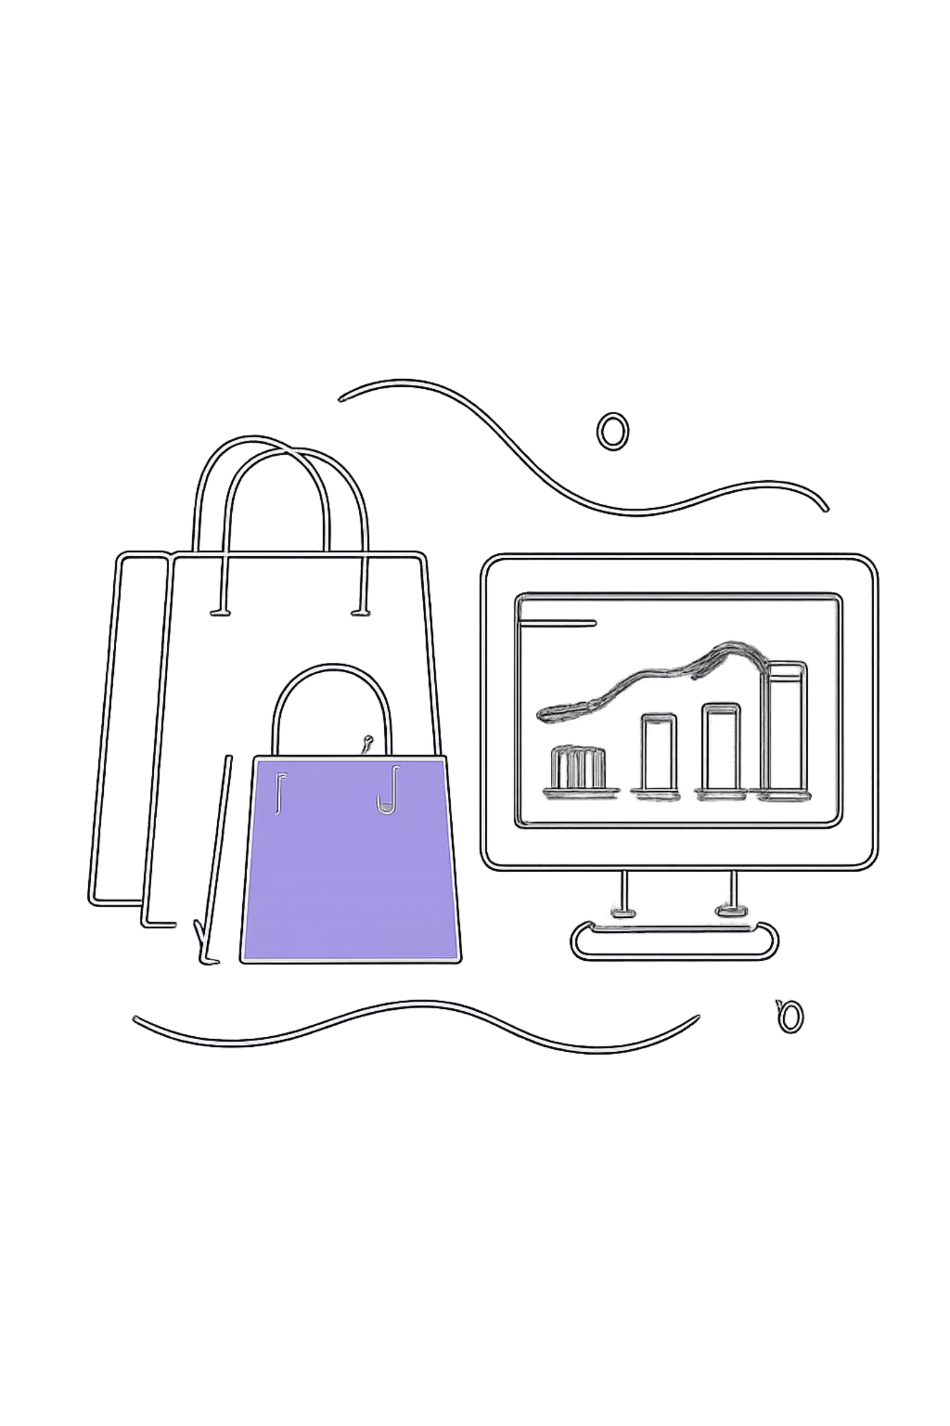
Customer Shopping Behavior Analysis
Uncovering insights from 3,900 transactions across product categories, customer segments, and subscription behavior.

Slide 2
Dataset at a Glance
3,900
18
Purchases
Features
37
$59.76
Missing Values
Avg. Purchase
Review Rating column
Features span demographics, purchase details, shopping behavior, and subscription status.

Slide 3

Data Preparation in Python
Clean
Imputed missing Review Ratings using median by category
Standardize
Renamed columns to snake_case; dropped redundant promo_code_used
Engineer
Created age_group bins and purchase_frequency_days
Load
Connected to PostgreSQL for SQL analysis

Slide 4
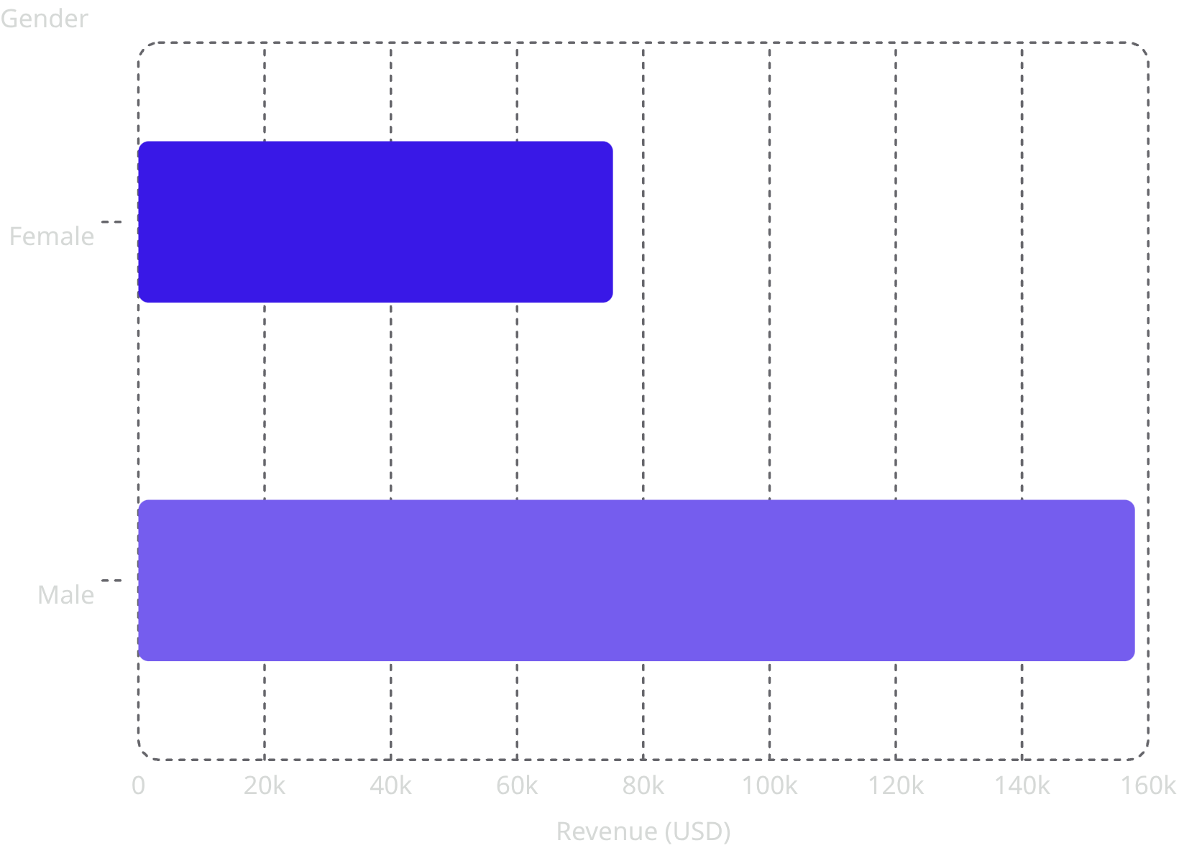
Revenue by Gender
Male customers drive 2x more revenue
Male: $157,890 vs. Female: $75,191
Male shoppers also represent 68% of the customer base (2,652 of 3,900).

Slide 5
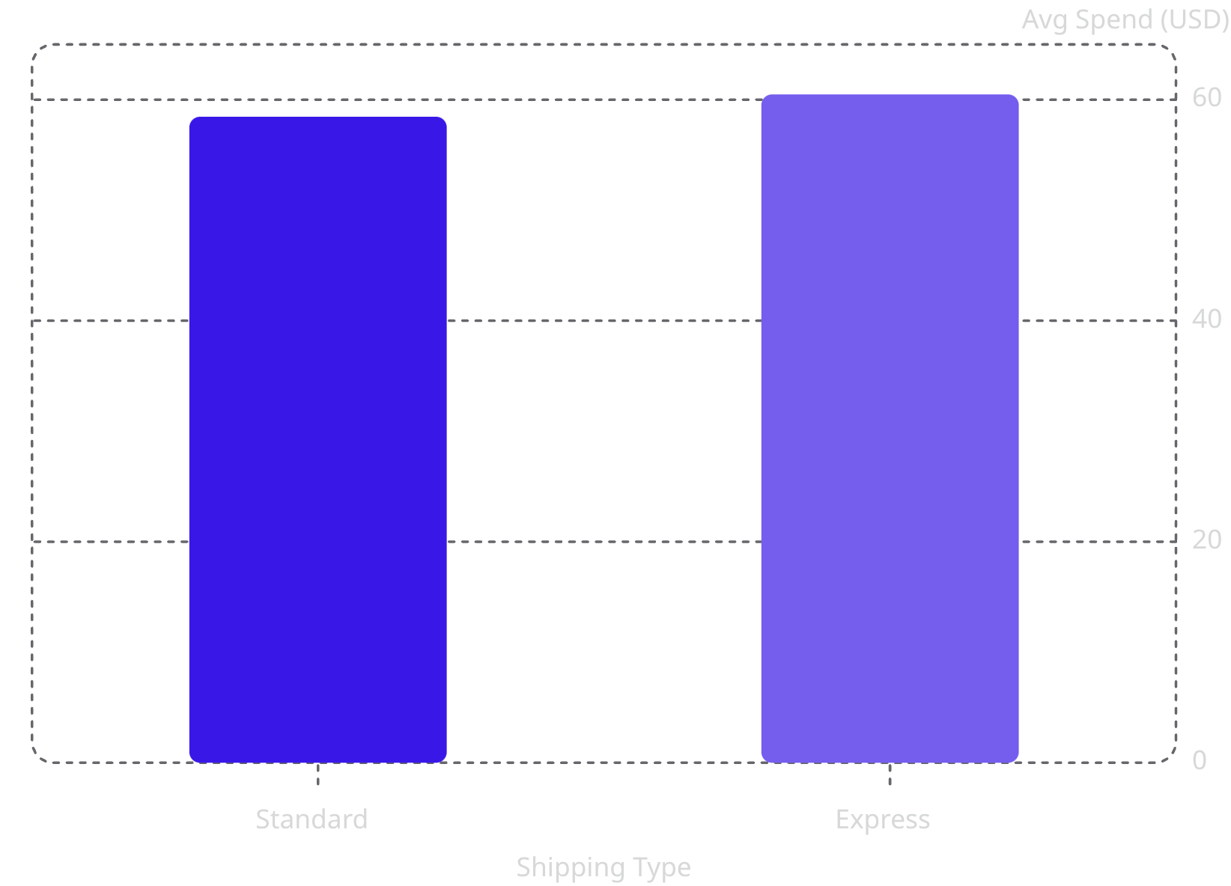
Key Product & Shipping Insights
Top 5 Products by Rating
Shipping Type — Avg. Spend
Product
Avg Rating
Gloves
3.86
Sandals
3.84
Boots
3.82
Hat
3.80
Skirt
3.78
Express shipping customers spend slightly more on average.

Slide 6
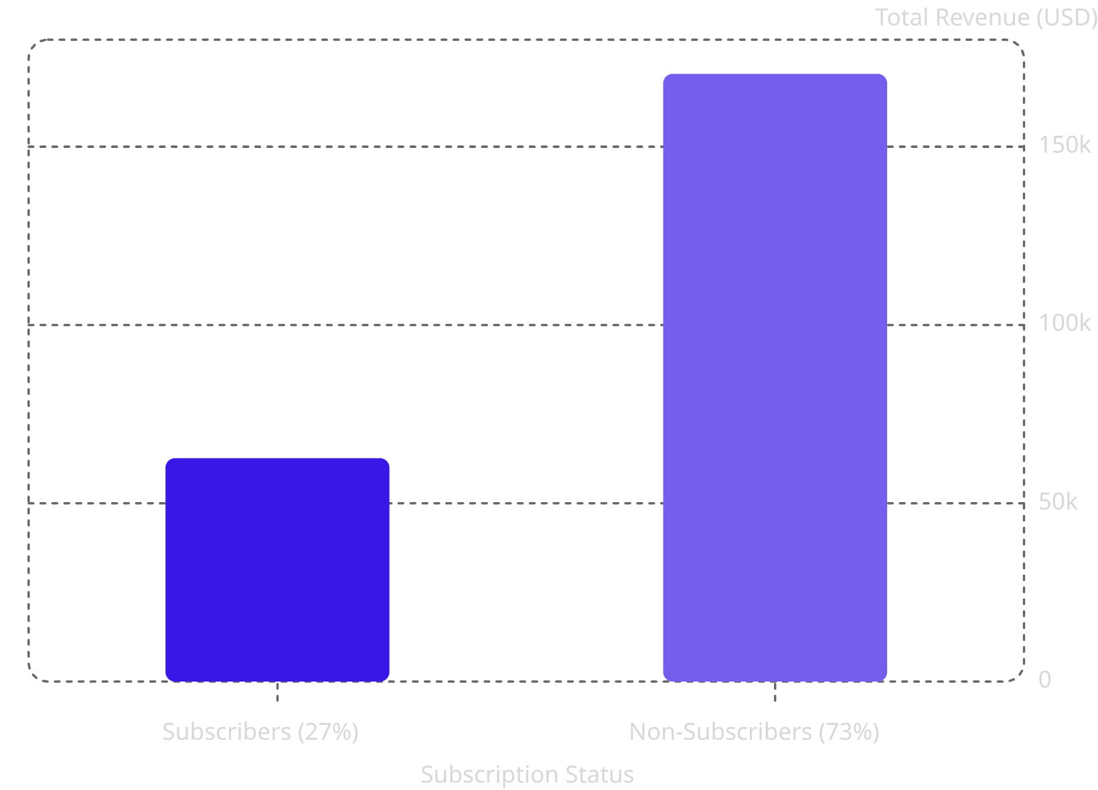
Subscribers vs. Non-Subscribers
Non-subscribers dominate revenue
73% of customers are non-subscribers, generating $170,436 in total revenue.
Average spend is nearly identical: $59.49 (subscribers) vs. $59.87 (non-subscribers).

Slide 7
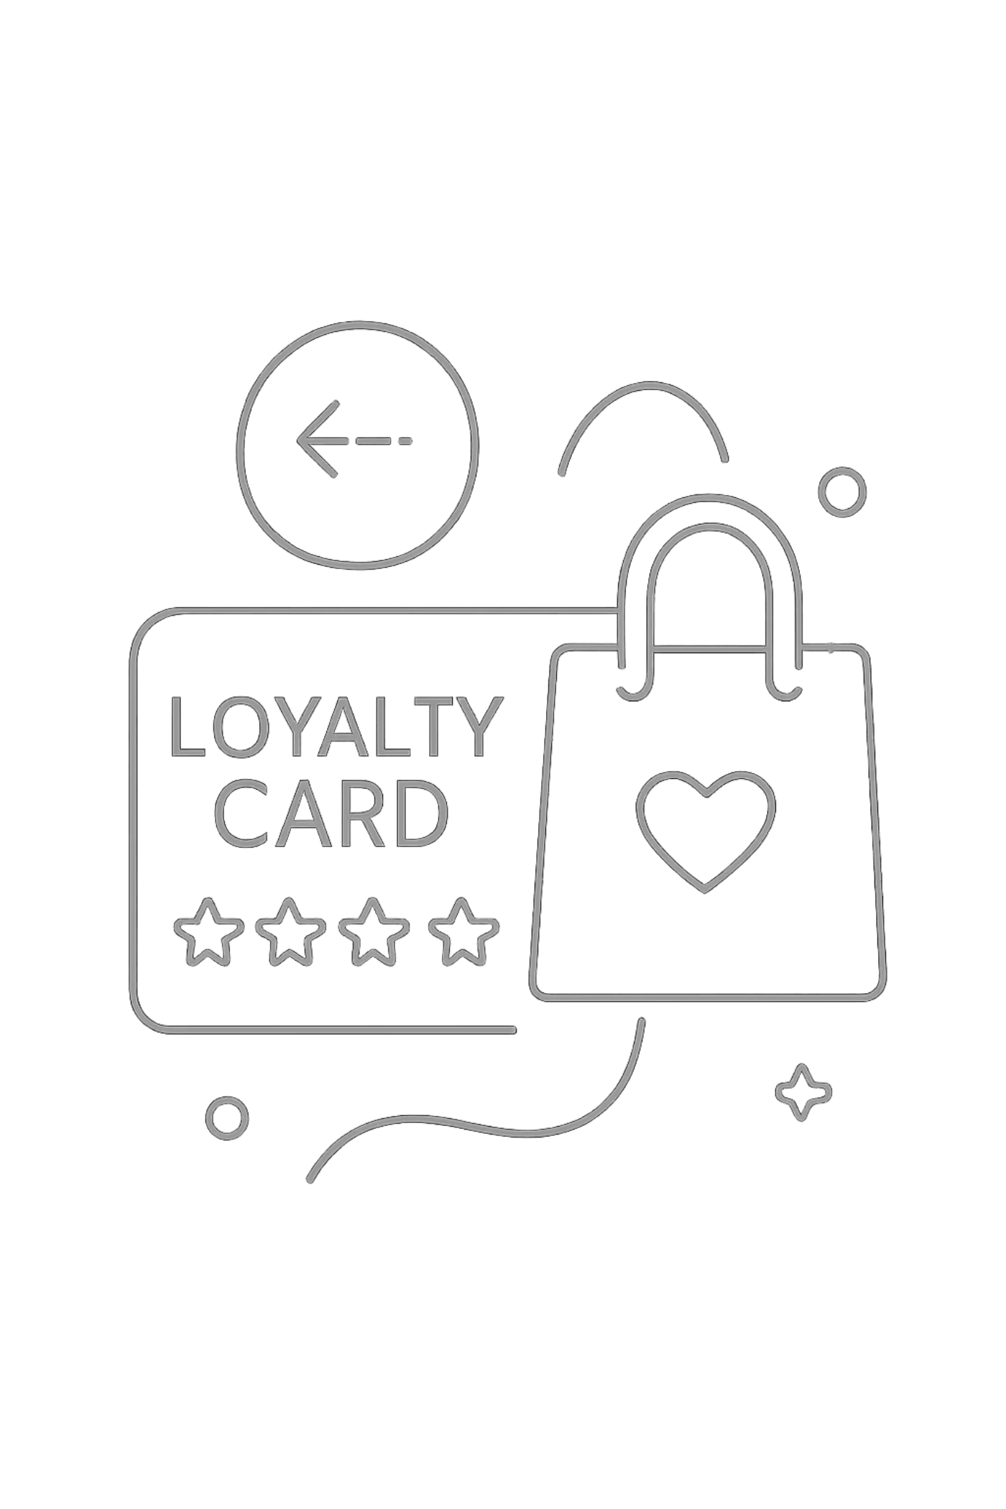
Customer Segmentation
🆕 New
🔄 Returning
83 customers
701 customers
⭐ Loyal
3,116 customers
Of loyal customers, 958 have subscriptions vs. 2,518 without — repeat buyers are not automatically subscribing.

Slide 8
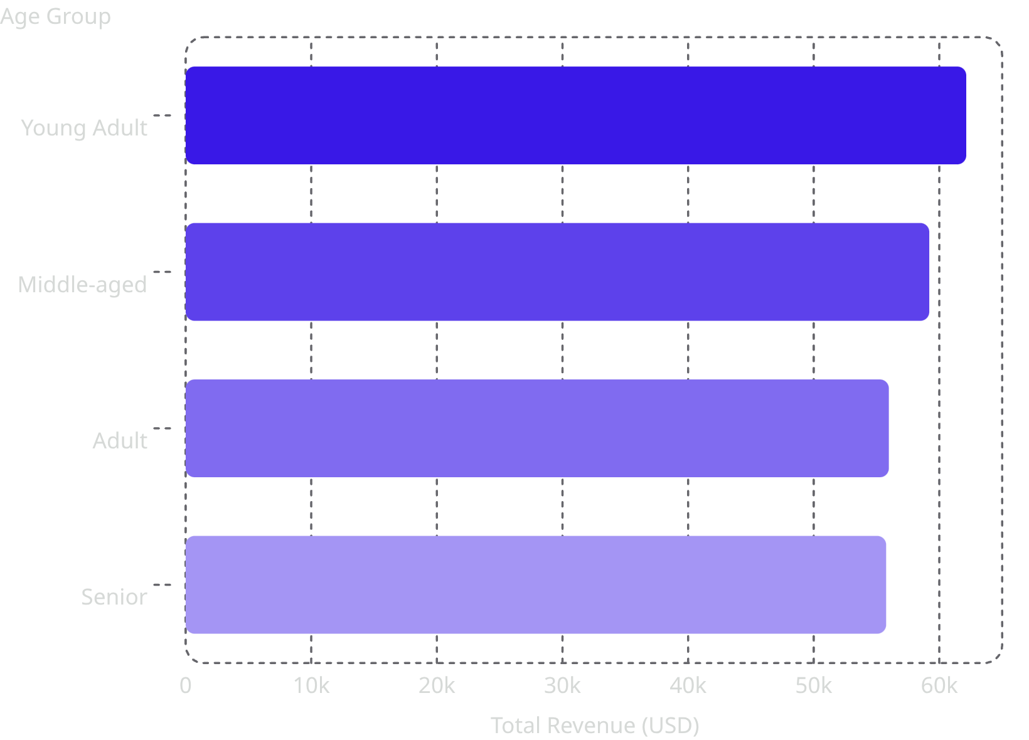
Revenue by Age Group
Young Adults lead revenue
Young Adults contribute the most at $62,143, with revenue declining slightly across older groups.

Slide 9
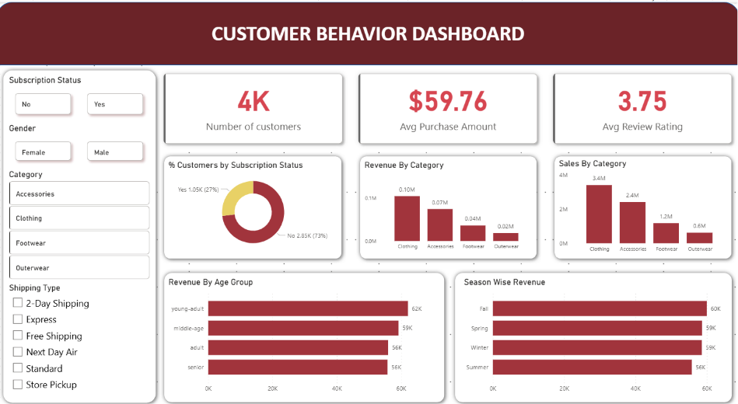
Power BI Dashboard
Interactive Visualizations
Revenue & sales by category
Revenue & sales by age group
Subscription status breakdown
Filters: gender, category, shipping type

Slide 10
Business Recommendations
Boost Subscriptions
Loyalty Programs
Review Discount Policy
Promote exclusive subscriber benefits
Reward repeat buyers to grow Loyal segment
Balance sales boosts with margin control
Targeted Marketing
Product Positioning
Focus on high-revenue age groups & express-shipping users
Highlight top-rated and best-selling products

