Slide 1
College Logo
University Logo
POTATO, APPLE, AND GRAPE LEAF DISEASE DETECTION USING DEEP LEARNING
(Project id: 1234567)
by
Member name (Roll No. 0123456) Member name (Roll No. 0123456) Member name (Roll No. 0123456)
Under the Supervision of
Mr. John Doe
Assistant Professor
DEPARTMENT OF COMPUTER SCIENCE AND ENGINEERING COLLEGE NAME

Slide 2
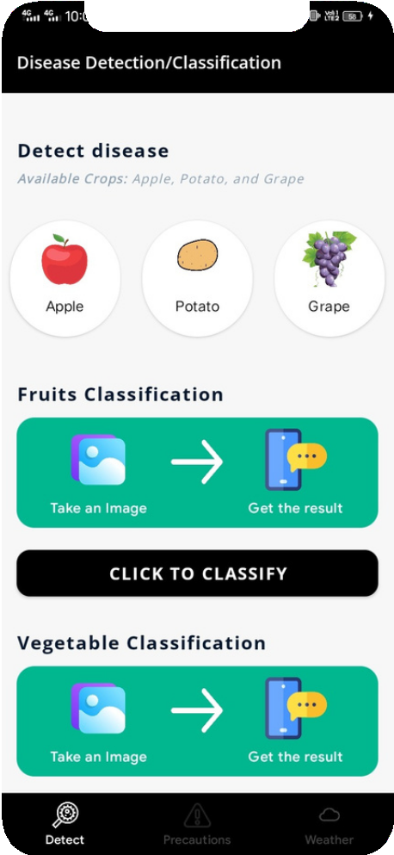
Introduction
The project is based on finding the different diseases of plants like Apples, Grapes, and Potatoes using Deep Learning (CNN) and implementation in Android.
Classification of Fruits and Vegetables

Slide 3
Tools and Technologies Used
Java (in Android), Python (in ML)
Android Studio
Jupyter

Slide 4
Techniques Used
CNN (Convolutional Neural Network)
Material Design Layouts for Android
Interconnection using Tensorflow (basically a TensorFlow lite model, that is used in the android application to run the machine learning model)

Slide 5
More about our project
The android application is developed for the purpose to provides the users with an easy way to interact with the app to detect what is going on in their plant leaf.
This app basically helps farmers to protect their crops. This app comes with a handy camera integrated to allow the farmer to click an image of the affected crop that he wishes to diagnose.
This image is processed in the backend using a machine learning model (tflite model) to classify the leaf disease (make sure we take the image of the affected leaf, otherwise it will give a hazardous result). Further, it gives information about the steps that need to follow on how to improve the plant health.

Slide 6
Cause
Earlier the farmers detect crop diseases with their naked eye which makes them take tough or sometimes wrong decisions on which fertilizer to use. It requires detailed knowledge of the types of diseases and a lot of experience needed to make sure of the actual disease detection.
Sometimes some of the diseases look almost similar to farmers often leaving them into confusion state.

Slide 7
Goal of the project
We have collected and continue to collect thousands of images of diseased and healthy crops in form of a dataset for our project.
The goal of our project is to help farmers, not only farmers others to detect the right disease from the plant and help them to grow a healthy plant.

Slide 8
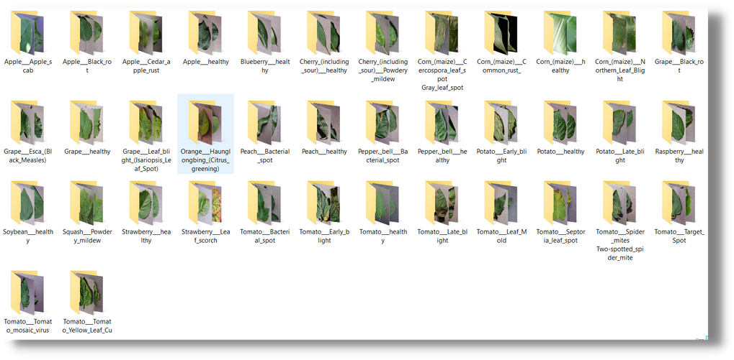
Dataset
Resource - The PlantVillage Disease Classification dataset (we take only potato, grape and apple dataset)
The dataset used in our project includes different plants' healthy and diseased classes.
The total images in the dataset are 10,000

Slide 9
Flowchart
Click the image
Load the image
Get into Deep Learning
Deep Learning operations
file locator loads the image from phone to app
Process
Result
Get the disease percentage
using TF functions
Get the precaution
Match the spots
using customized model

Slide 10
- DEEP LEARNING -

Slide 11
Understanding Representation
Input Layer: It is used to pass the input data (Image, text, or any suitable data for Learning)
Hidden Layer: These are the layers in between the input and output layers. These layers are responsible for learning the mapping between input and output.
Output Layer: This layer is responsible for giving us the output of the Deep Learning model.

Slide 12
Data Augmentation
It is one kind of imbalanced dataset.
It may lead the applied machine model to overfitting or underfitting.
To overcome this issue, we have increased the size of
the healthy images by data augmentation, like
Step 1: Tale a loop i=1 to 5 and do Step 1.1: Rotation range=15
Step 1.2: Width shift = 0.2
Step 1.3: Height shift = 0.2
Step 1.4: Zoom range = 0.2
Step 1.5: Horizontal_flip = True Step 1.6: Fill_mode = 'nearest', Step1.7: Data_format='channels_last')
Step 2: End

Slide 13
Image Pre-processing
Read all the images Resize the images
Remove the noise from the images Segmentation
Morphology or smoothing edges of the images

Slide 14
Image Segmentation
If we are having an image we can build a straightforward object classifier model and predict that there is a wanted object in the given image.
But there is a problem, we don't know where image localization comes into the picture. It helps us to identify the location of a single object in the given image.

Slide 15
CNN (Convolutional Neural
Network)
CNN is one of the main categories to do image recognition, image classifications, object detection, recognition of faces, etc.
CNN image classifications take an input image, process it, and classify it under certain categories. Computers see an input as an array of pixels and it depends on the image resolution. Based on the image resolution, it will see H*W*D (H = height, W = width, D = dimension).

Slide 16
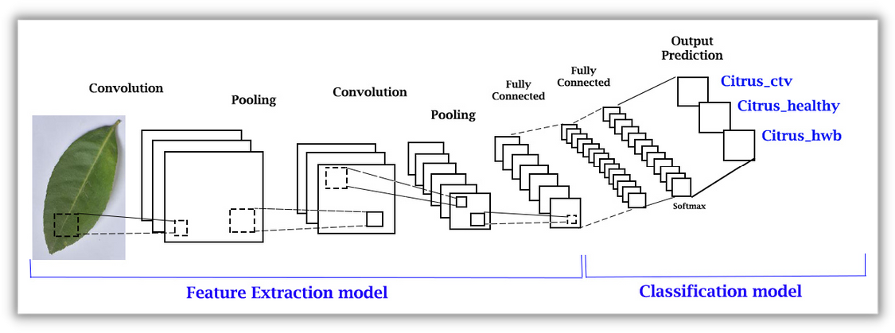
Layers in CNN
Technically, deep learning CNN models to train and test, each input image will pass it through a series of convolution layers with filters, Pooling, Fully Connected layer (FC), and apply Softmax function to classify an object with probabilistic values between 0 and 1.
Here we took one example of a citrus plant

Slide 17
Input Layer
The input layer in CNN should contain image data. Image data is represented by a three-dimensional matrix.
You need to reshape it into a single column. Suppose, you have an image of dimension 28*28 = 784, you need to convert it into 784*1 before feeding it into input, if you have "n" training examples then the dimension of input will be (784, n).

Slide 18
Convo Layer
The convo layer is sometimes called the feature extractor layer because features of the image are get extracted within this layer.
First of all, a part of an image is connected to the convo layer to perform the convolution operation. The result of the operation is a single integer of the output volume. We will repeat the same process again and again until we go through the whole image. The output will be the input for the next layer.

Slide 19
Pooling Layer
the pooling layer is used to reduce the spatial volume of the input image after convolution. It is used between two convolution layers.
If we apply FC after the convo layer without applying polling or max pooling, then it will be computationally expensive and we don't want it. So, max pooling is the only way to reduce the size of the input image.

Slide 20
Fully Connected (FC) Layer
The FC layer involves weights, biases, and neurons.
RELU activation function is used here to make all negative value zero and positives remains constant.
It is used to classify the images between different categories by training.

Slide 21
Softmax/Logistic Layer
The Softmax or Logistic layer is the last layer of CNN. It resides at the end of the FC layer. Logistic is used for binary classification and softmax is for multi-classification. It returns the probability distribution from the range 0 to 1.

Slide 22
Implementation Phase
Load and process the images
Train the image classifier on the dataset
Convert the model to the Tensorflow Lite model
Use the TensorFlow Lite model in Android to predict the diseases from the leaf.

Slide 23
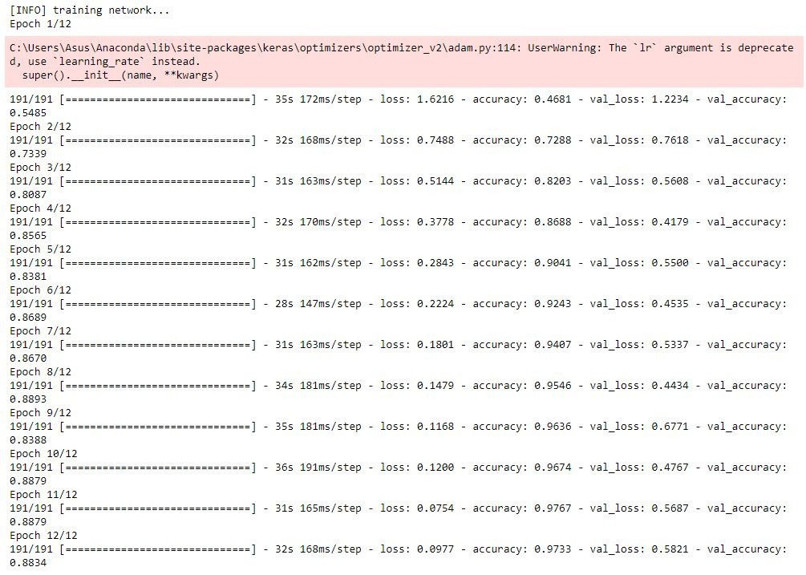
Result of the training and testing
For disease detection

Slide 24
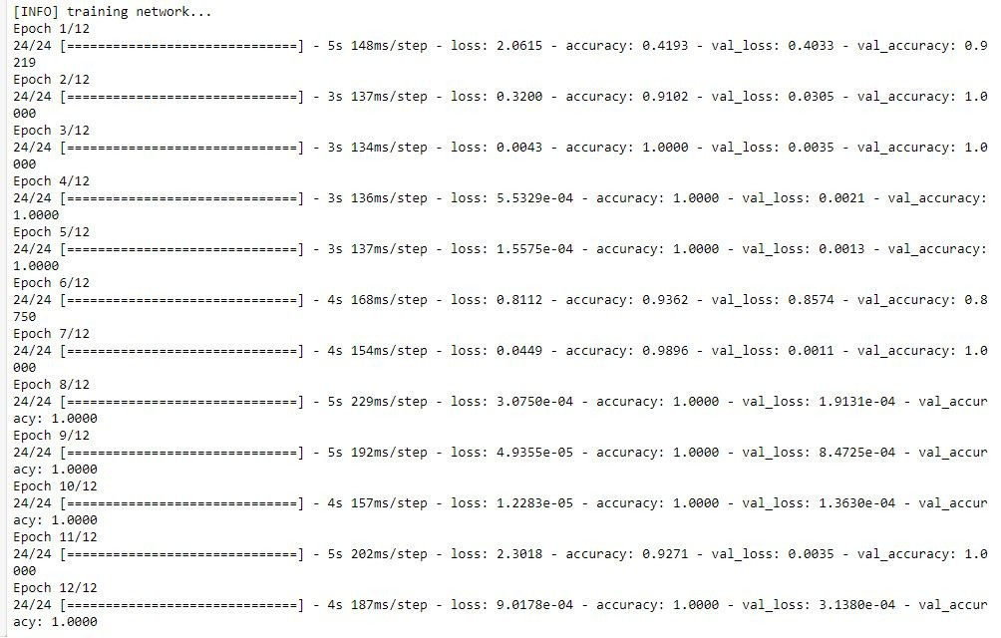
For Classification

Slide 25
- ANDROID -

Slide 26
Android Dependencies
TensorFlow Lite Navigation View Material Design

Slide 27
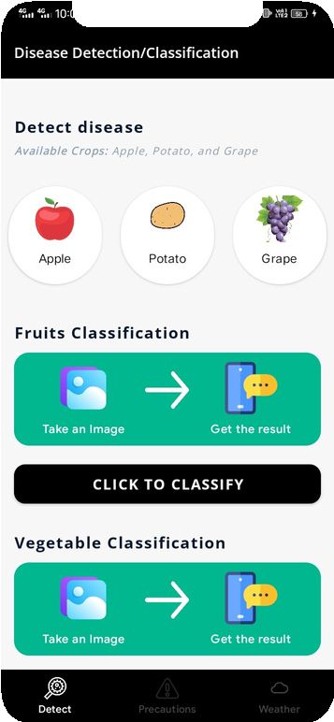
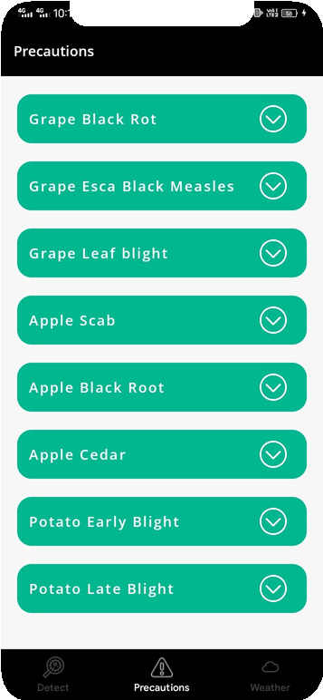
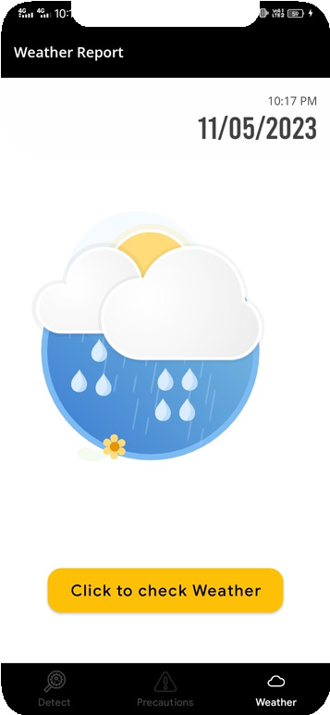
Application Screens
Three Tabs: Detect/Classification, Precation,and Weather Report

Slide 28
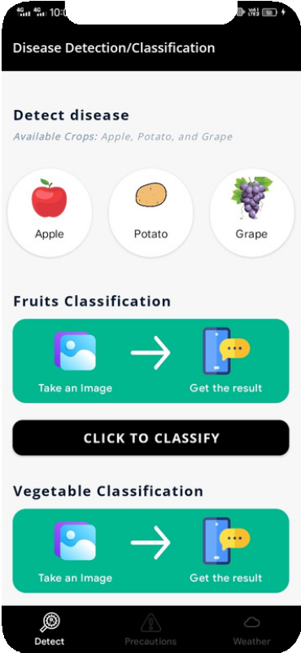
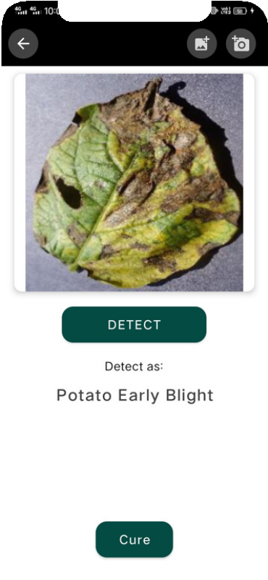
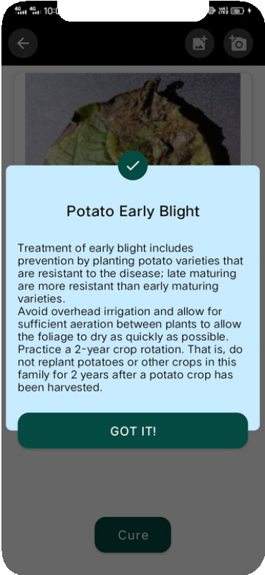
Detection Example for Potato: Select image from Gallery or capture using camera and detect the disease and get cure for it.

Slide 29
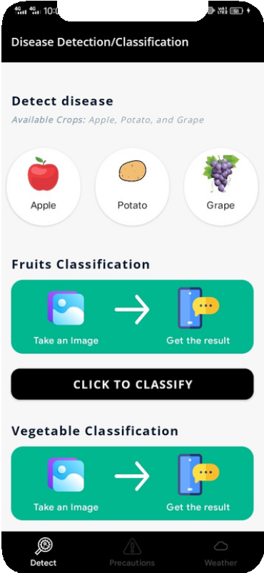
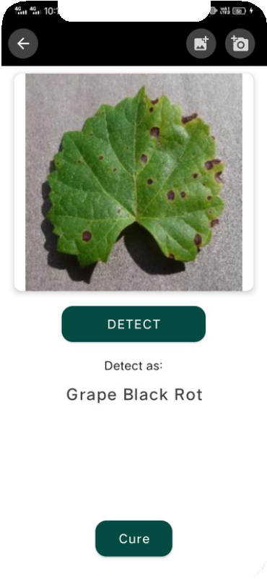
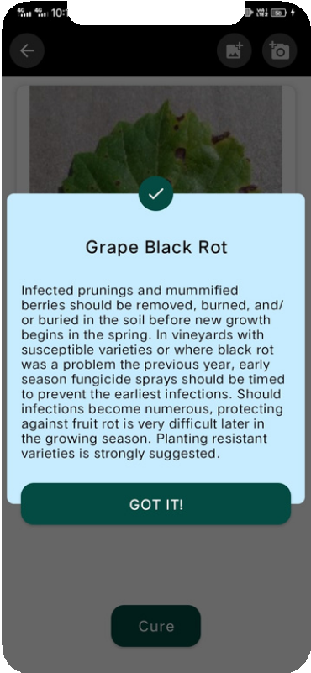
Another example of Grape

Slide 30
Limitation
We have listed the common remedies but we can't predict the remedies for the specific diseases for that we have to develop a recommendation system to predict them correctly.

Slide 31
Future Work
Improved the model so that it can predict the hazard images.
Also, we can add a pests detection model to detect the pests and give users some advice related to the pests.
Improve the UI/UX of the app.

Slide 32
Reference
J. Amara, B. Bouaziz, and A. Algergawy, “A deep learning-based approach for banana leaf diseases classification,” Datenbanksysteme für Business, Technologie und Web (BTW 2017)-Workshopband, 2017.
B. A. Ashqar and S. S. Abu-Naser, “Image-Based Tomato Leaves Diseases Detection Using Deep Learning,” 2019.
Y. Kawasaki, H. Uga, S. Kagiwada, and H. Iyatomi, “Basic study of automated diagnosis of viral plant diseases using convolutional neural networks,” in International Symposium on Visual Computing, 2015, pp. 638–645.
V. Singh and A. K. Misra, “Detection of plant leaf diseases using image segmentation and soft computing techniques,” Information processing in Agriculture, vol. 4, no. 1, pp. 41–49, 2017.
P. B. Padol and A. A. Yadav, “SVM classifier based grape leaf disease detection,” in 2016 Conference on Advances in Signal Processing (CASP), Jun. 2016, pp. 175–179, doi: 10.1109/CASP.2016.7746160.
S. P. Mohanty, D. P. Hughes, and M. Salathé, “Using deep learning for image-based plant disease detection,” Frontiers in plant science, vol. 7, p. 1419, 2016.
G. Wang, Y. Sun, and J. Wang, “Automatic image-based plant disease severity estimation using deep learning,” Computational intelligence and neuroscience, vol. 2017, 2017.
https://www.kaggle.com/emmarex/plantdisease

Slide 33
- Thank You -

