Slide 1


THE EVOLUTION OF COMPUTER AND ITS IMPACT ON SOCIETY
NAME: PRABIN GURUNG
COURSE: BBA
PAPER NAME: MIC
SEC: B
CODE : MIC101
UNIVERSITY ROLL NO- 32341924039
SUBJECT TEACHER: POOJA GHOSH

Slide 2
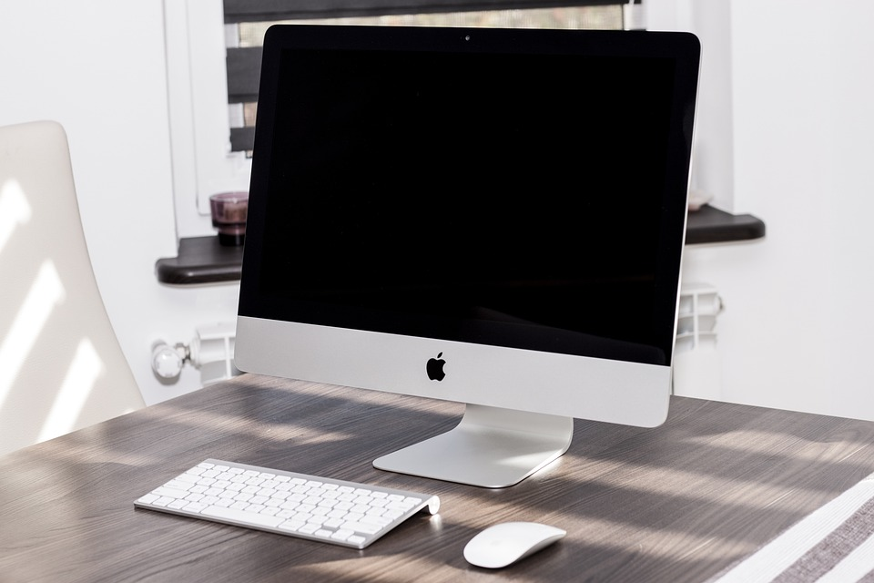

Join us on a journey through the evolution of computer generations! From the colossal machines of the past to the sleek and compact devices of today, we'll delve into how these transformations have shaped technology!

Slide 3
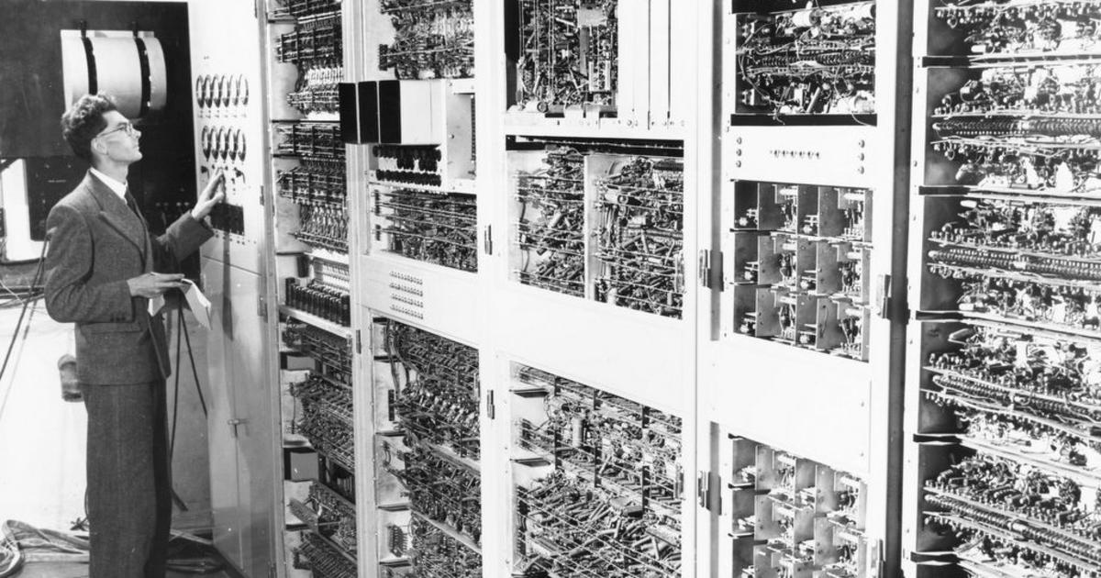
The earliest computers (1940–1956) were enormous machines that filled entire rooms and consumed a lot of power. Despite their massive size, they laid the groundwork for modern computing. Imagine programming on a machine that took up your entire living room!
IMPACT ON SOCIETY
Early Automation: Early computers like the ENIAC and UNIVAC were used for specific applications such as calculating artillery firing tables and performing census data analysis.
Industrialization of Knowledge: This generation marked the beginning of computer-assisted problem solving in fields like engineering, cryptography, and military applications.

Slide 4

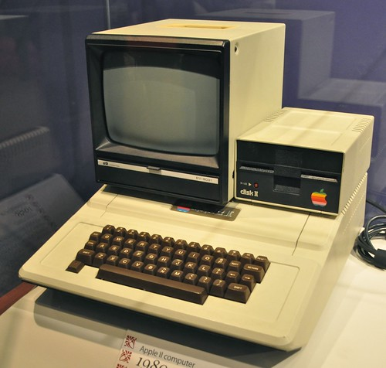
IMPACT ON SOCIETY
Business Efficiency: Businesses began to adopt computers for tasks like accounting, payroll, and inventory management, making operations more efficient.
Greater Access: While still expensive, computers were more accessible to larger organizations, making IT and data processing more integral to business and government.
With the arrival of transistors in the second generation (1956-1963), computers became smaller, faster, and more efficient. This era marked the beginning of affordable computing. Suddenly, computers were not just for governments and universities but could enter the business world!

Slide 5
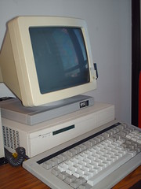
Third Generation: Integrated Circuits
The third generation of computers (1964–1971) introduced integrated circuits, which packed more power into smaller spaces. This innovation made computers more affordable and accessible, allowing people to own a computer and unlocking new opportunities for creativity and productivity!
IMPACT ON SOCIETY
Personal Computing Era Begins: The affordability and reduced size of computers paved the way for the emergence of minicomputers and eventually personal computers (PCs).
Information Revolution: The rise of computer networks and databases allowed for quicker access to information and streamlined decision-making in both government and business.

Slide 6
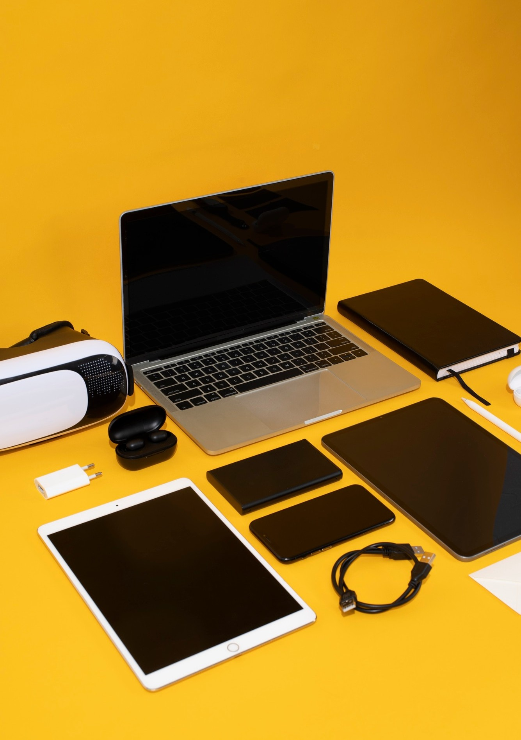
The fourth generation of computers (1971–present) revolutionized computing, making it accessible in our daily lives. From smartphones to laptops, we now carry powerful technology everywhere. It’s incredible to see how far we’ve come!"
IMPACT ON SOCIETY
Widespread Access to Personal Computing: The development of personal computers like the Apple II, IBM PC, and Macintosh made computers accessible to individuals and small businesses..
Globalization: The proliferation of personal computers and networking technologies helped create a global economy where information could flow freely, fostering international collaboration, trade, and outsourcing.

Slide 7
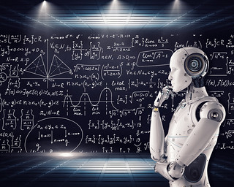
FIFTH GENERATION: ARTIFICIAL INTELLIGENCE
Fifth Generation Computing refers to a mix of ambitious AI and computing goals from historical projects, as well as speculative ideas for future computing systems. It could be interpreted in multiple ways depending on the context, but the overarching theme is the advancement of technology beyond traditional computational models.
IMPACT ON SOCIETY
Quantum Computing: While still in early stages, quantum computing promises to revolutionize fields such as cryptography, material science, and artificial intelligence by solving problems that are currently intractable for classical computers. This could lead to breakthroughs in medicine, energy storage, and climate modeling.
Connected World (IoT): The proliferation of IoT devices (smartphones, smart home devices, wearables) is making the physical world more interconnected, allowing for data-driven decisions in real time. This has created new forms of convenience but also raised concerns about privacy and security.

Slide 8
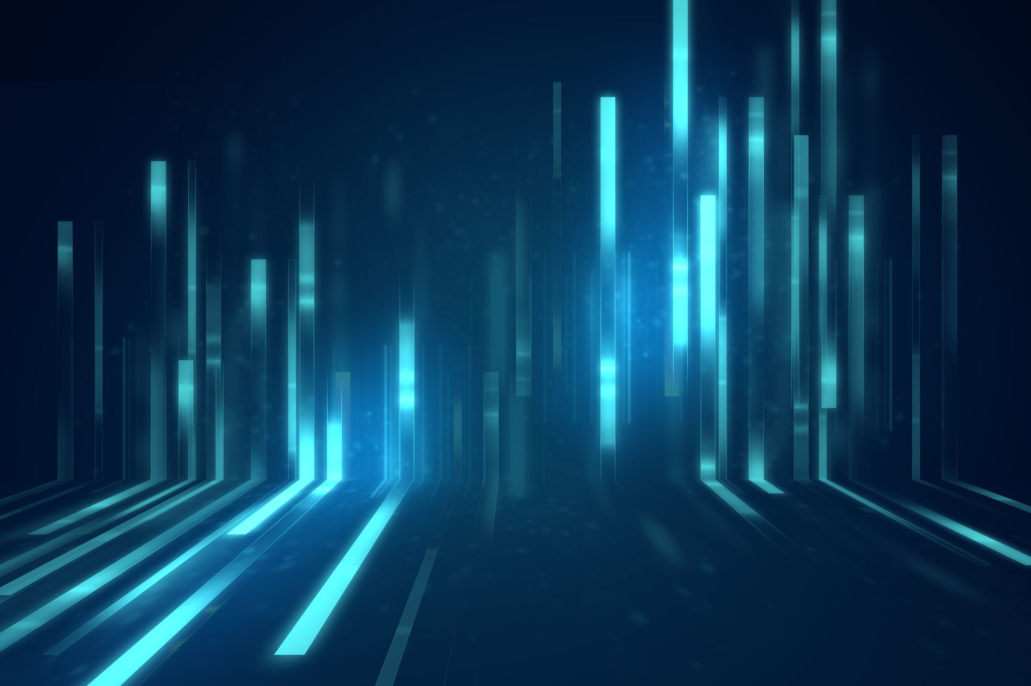
THANK YOU!

