Slide 1



E-Commerce Website for Personalized Book Shopping
Submitted By
Rupal Mandal (33671023004)
Department - MCA
Semester – 4th Semester
Year of Submission - 2025
Under the guidance of
Professor Dr. Tumpa Banerjee

Slide 2
Project Overview
This eCommerce website enhances the book-shopping experience by allowing users to personalize books before purchase. Operating in multiple countries, it offers books in English (US/UK), German, and French.
Key features include:
Customizable book characters (name, gender, appearance)
Personal photo upload & dedication message
Filtering system for easy book discovery
Multiple format options (hardcover, softcover, color variants)
The platform ensures secure transactions via Stripe and PhonePe and integrates Shopify for eCommerce management. AWS S3 handles image storage, and JSON files structure customization data. This system streamlines the book-buying process, making it engaging, interactive and user-friendly.

Slide 3





Technologies Used In The Project
Next.js
TypeScript
Tailwind CSS
PostgreSQL
Vercel

Slide 4
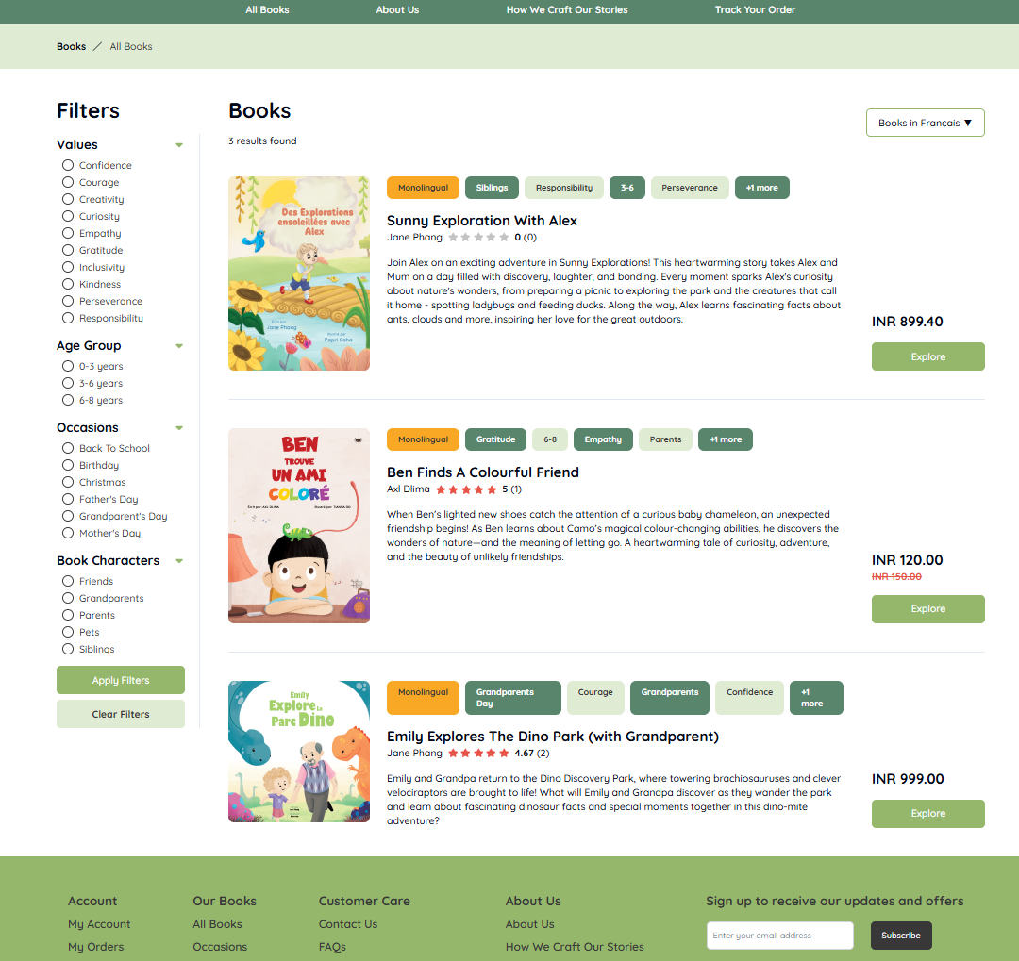
Website Interface & Features
Book Filtering System: Users can refine their search using filters based on values, age group, occasions, and book characters.
Book Listings with Details: Each book displays a cover image, title, author, rating, price, and a brief description.
Personalization: Users can explore book personalization features and adding them to the cart for purchase.
Order Tracking: The "Track Your Order" section allows users to check their order status (Confirmed/Pending).
User-Friendly Checkout: Clear pricing, discounts, and an "Explore" button make the shopping process smooth.

Slide 5
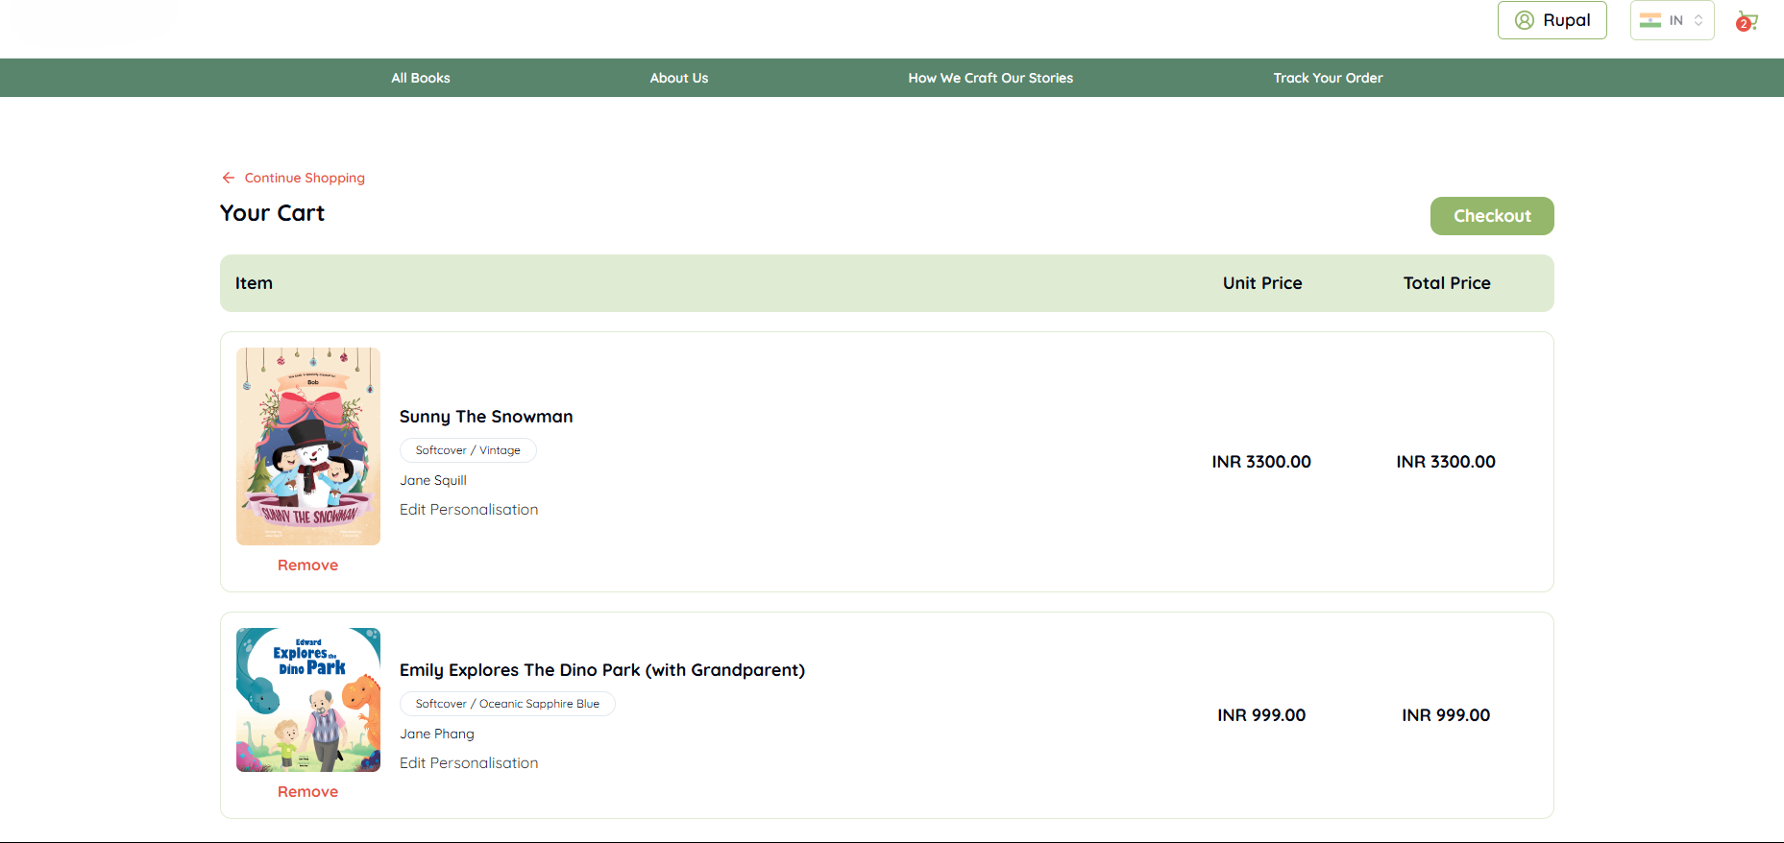
Website Features (Cont.)
Price Details: Shows the unit price and total price for easy cost breakdown.
Edit Personalization: We can personalize the book again within 12 hours and before the order is confirmed, once confirmed, personalization is locked.
Seamless Checkout: The “Checkout” button initiates the payment process, while “Continue Shopping” lets us add more books.

Slide 6
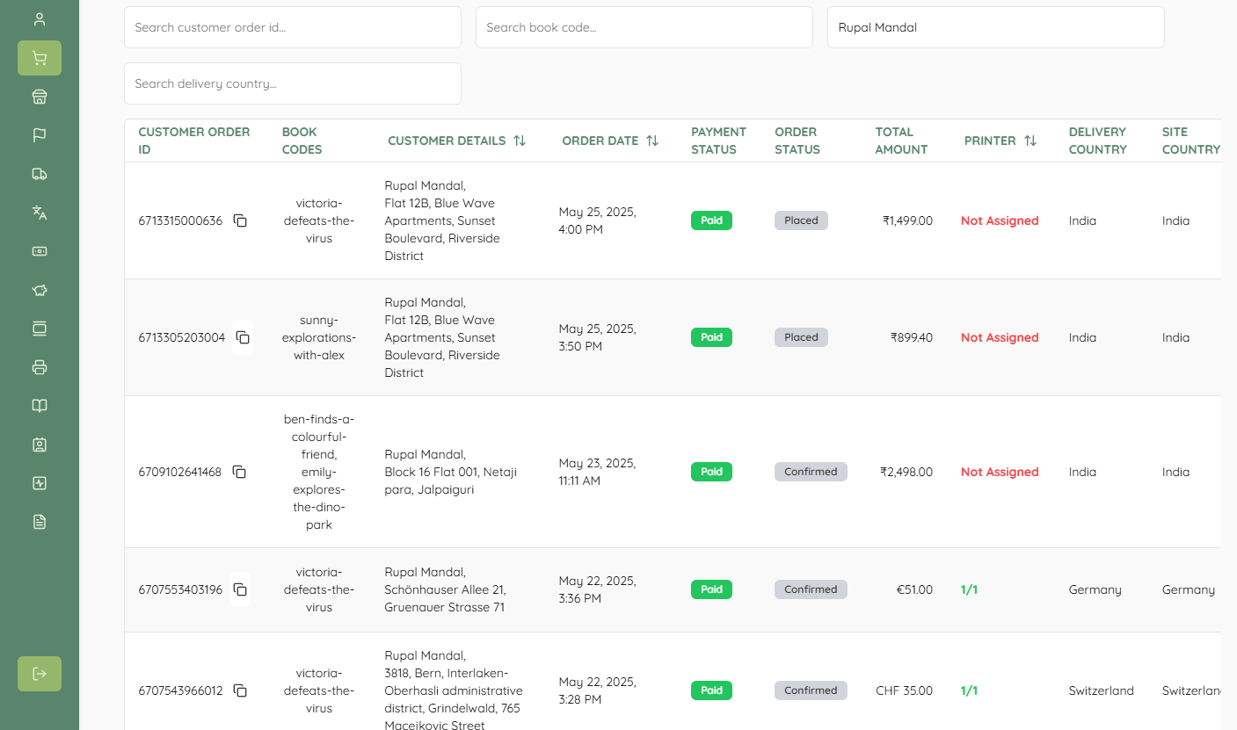
Admin Panel User Interface

Slide 7
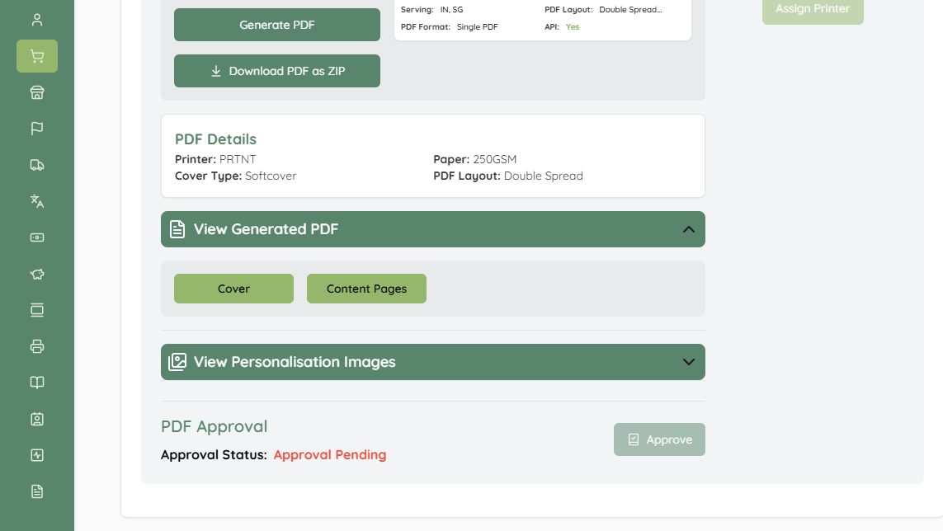
Admin Panel Overview
Instantly generate single or bulk book PDFs (cover and content pages) for printing.
Search & Filter Orders Easily: Find orders quickly using filters like Customer Order ID, Book Code, Customer Name, and Delivery Country.
View Order Details: Click on any order to access full details including personalized book cover, customer info, payment status, and delivery address.
Generate PDFs for Printing: Instantly generate single or bulk book PDFs of cover and content pages for printing.
Assign Orders to Printers: Send orders to the assigned printer by generating and sharing a JSON file with a single click.
Approve Final Personalization: Review personalization images and generated PDFs, then approve for printing when everything looks perfect.

Slide 8
Future Scope
Collecting user feedback
Implement those and improve site functionality and visuals
Content:

Slide 9
Thank You

