Slide 1
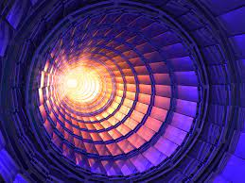
Twenty-GeV RAcetrack Synchrotron for Hadrons
TRASH
Group: Tirsi, Anny, Marc-Hervé, Bernd, Artem

Slide 2
TRASH Requirements
Start from the lattice of Exercise 4 and design a symmetric insertion with a low-β section in a dispersion free region. The β should be small at least in one plane and should have a waist at an “interaction point”. Choose the low-β (usually called β*) at your own discretion. Think and develop different options β*_{y} = β*_{x} (round beams) or β*_{y} ≠ β*_{x} (flat beams). Evaluate the effect of the low-β insertion on the chromaticity and rematch it to zero.

Slide 3
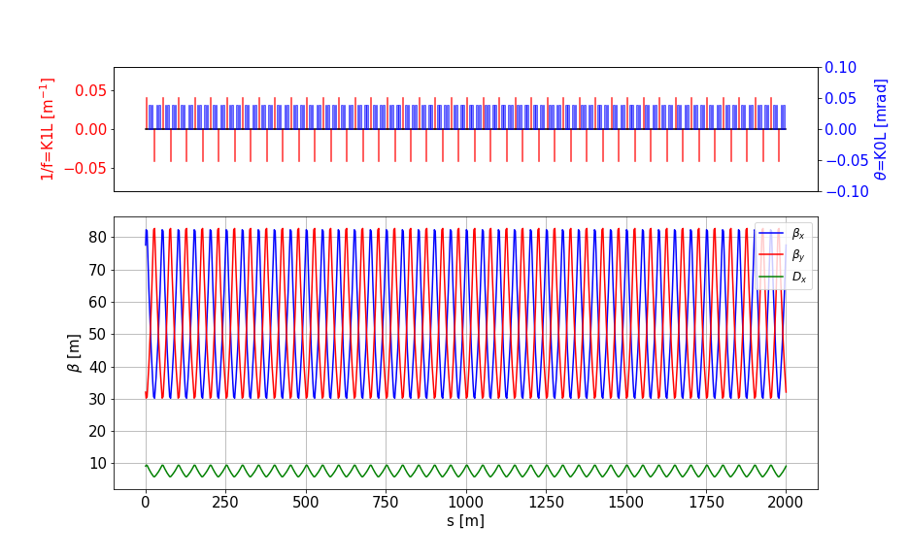
Initial Lattice
Circumference = 2000 m
Cells number = 40
Quad length = 3 m
Dipole length = 5 m
Simple matching – to adjust to 60 deg phase advance per cell

Slide 4
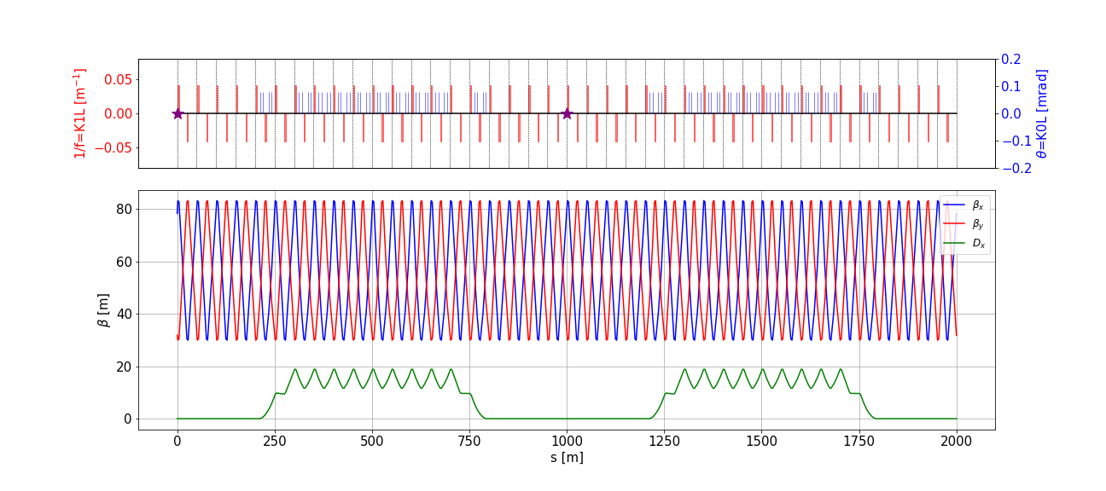
Adding Straight Sections
2 Straight sections added – Interaction Points
Both sections have dispersion suppressors
Parameters in the Interaction Points:
β_{x} = 83.3 m; β_{y} = 30.0 m
α_{x} = -1.7; α_{y} = 0.6
D_{x} = 0.0 m; D_{y} = 0.0 m

Slide 5
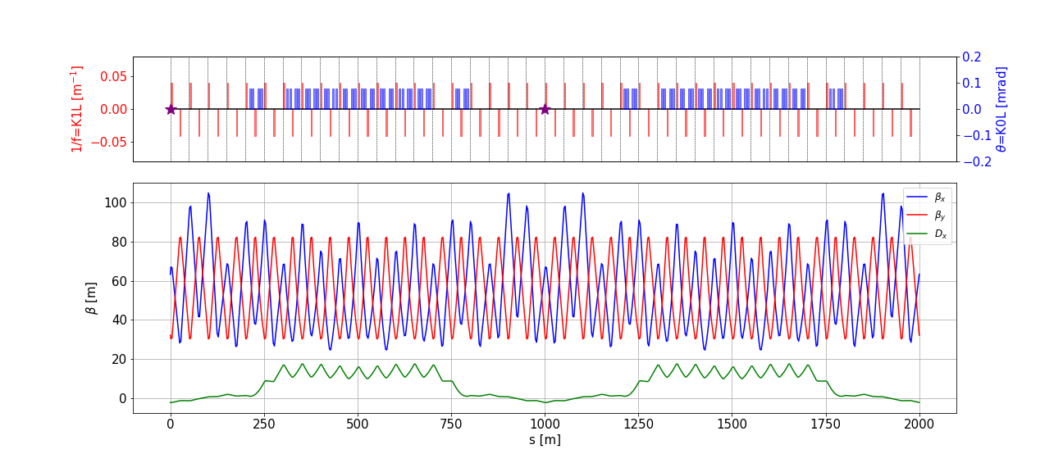
Switching to Thick BM
Parameters in the Interaction Points:
β_{x} = 67.0 m; β_{y} = 30.3 m; α_{x} = -1.3; α_{y} = 0.6
D_{x} = -2.1 m; D_{y} = 0.0 m; ξ_{x} = -6.7; ξ_{y} = -7.0

Slide 6
Straight section designing
The straight section is designed as a separate transfer line and later will be inserted into our machine lattice
To do that we need to fulfil 2 requirements. The optics has to match:
our beam requirements at the Interaction Point
the optics of the machine lattice
We have the straight section consisting of 8 cells. We will divide it into two (left and right with 4 cells each) and design them separately.
Matching quads
Matching quads
Matching quads
Triplet
IP
Dispersion Suppression
Arc
Second part of the
Straight line

Slide 7
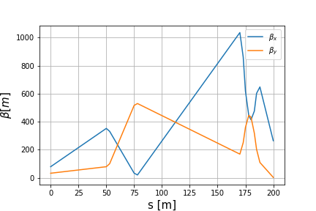
Straight section designing
After defining such lattice and setting its beta and alpha at its beginning equal to the ones of our machine at the start of the straight line we get…

Slide 8
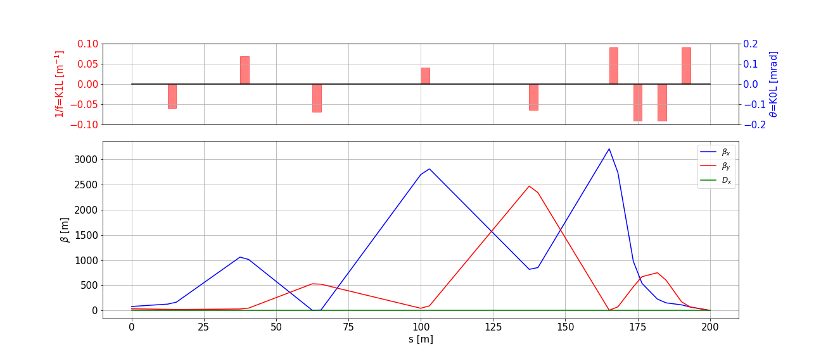
Left one
After the playing with the configuration of the line settings and matching it to the machine optics and the IP beam requirements we have following

Slide 9
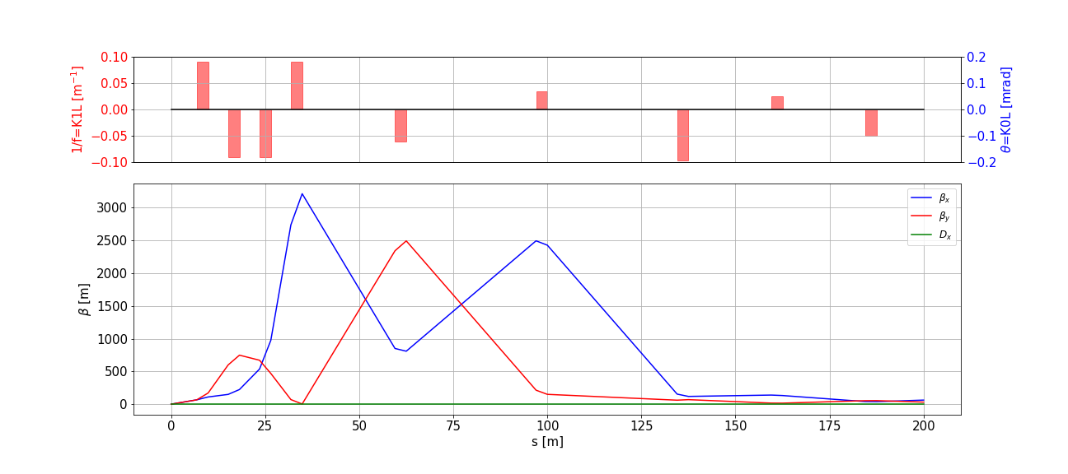
Right one
After the same procedure for the right one (apparently) we’ve got the section too

Slide 10
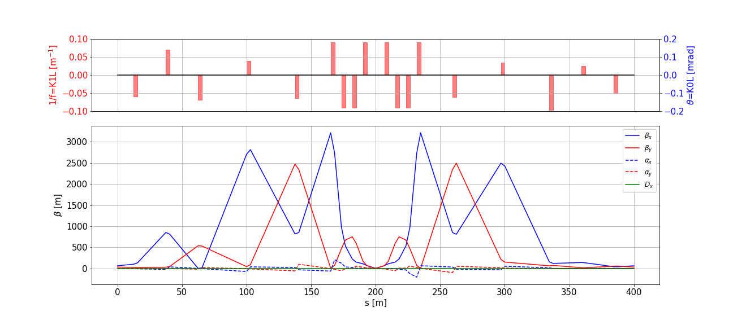
Both together
The next step is to connect those

Slide 11
And here we go…
Due to the SARS-CoV-2 (or f****** COVID19 in other words) strong restrictions all the necessary and fruitful meetings moved to online (tragic itself), but also brings us to the next point…
Apparently the network in the area, where most of us (EXPERTS) are, was not designed for online meetings with more than 1 person participating. (For 1 participant it works perfectly!)
So due to the previous point the whole project has been slowed down and as a consequence the expectations are probably slightly higher compared to the results…
But good news are – it is always like that!!! Whatever!

Slide 12
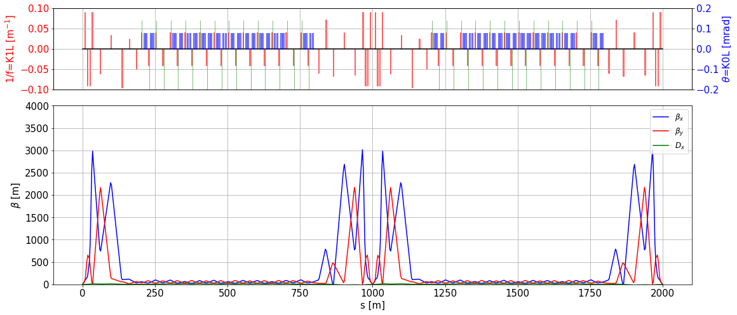
All together. The final perfect machine!
Parameters in the Interaction Points:
β_{x} = 0.8 m; β_{y} = 0.8 m; α_{x} = -0.18; α_{y} = 0.02
D_{x} = -0.15 m; D_{y} = 0.0 m; ξ_{x} = ξ_{y} = 0

Slide 13
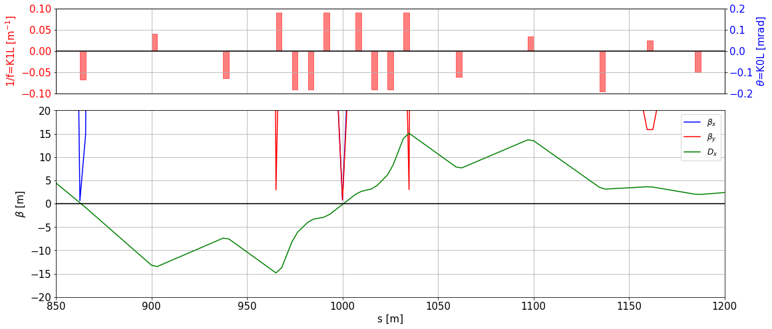
Closer look at the Beauty!
14 m for an Insertion Device/-s

Slide 14
Conclusions
Parameters in the Interaction Points
Initial:
β_{x} = 67.0 m; β_{y} = 30.3 m
α_{x} = -1.3; α_{y} = 0.6
D_{x} = -2.1 m; D_{y} = 0.0 m
ξ_{x} = -6.8; ξ_{y} = -7.0
Optimized:
β_{x} = 0.8 m; β_{y} = 0.8 m
α_{x} = -0.18; α_{y} = 0.02
D_{x} = -0.15 m; D_{y} = 0.0 m
ξ_{x} = ξ_{y} = 0
Conceptual Design Report can be found here!

