Slide 1



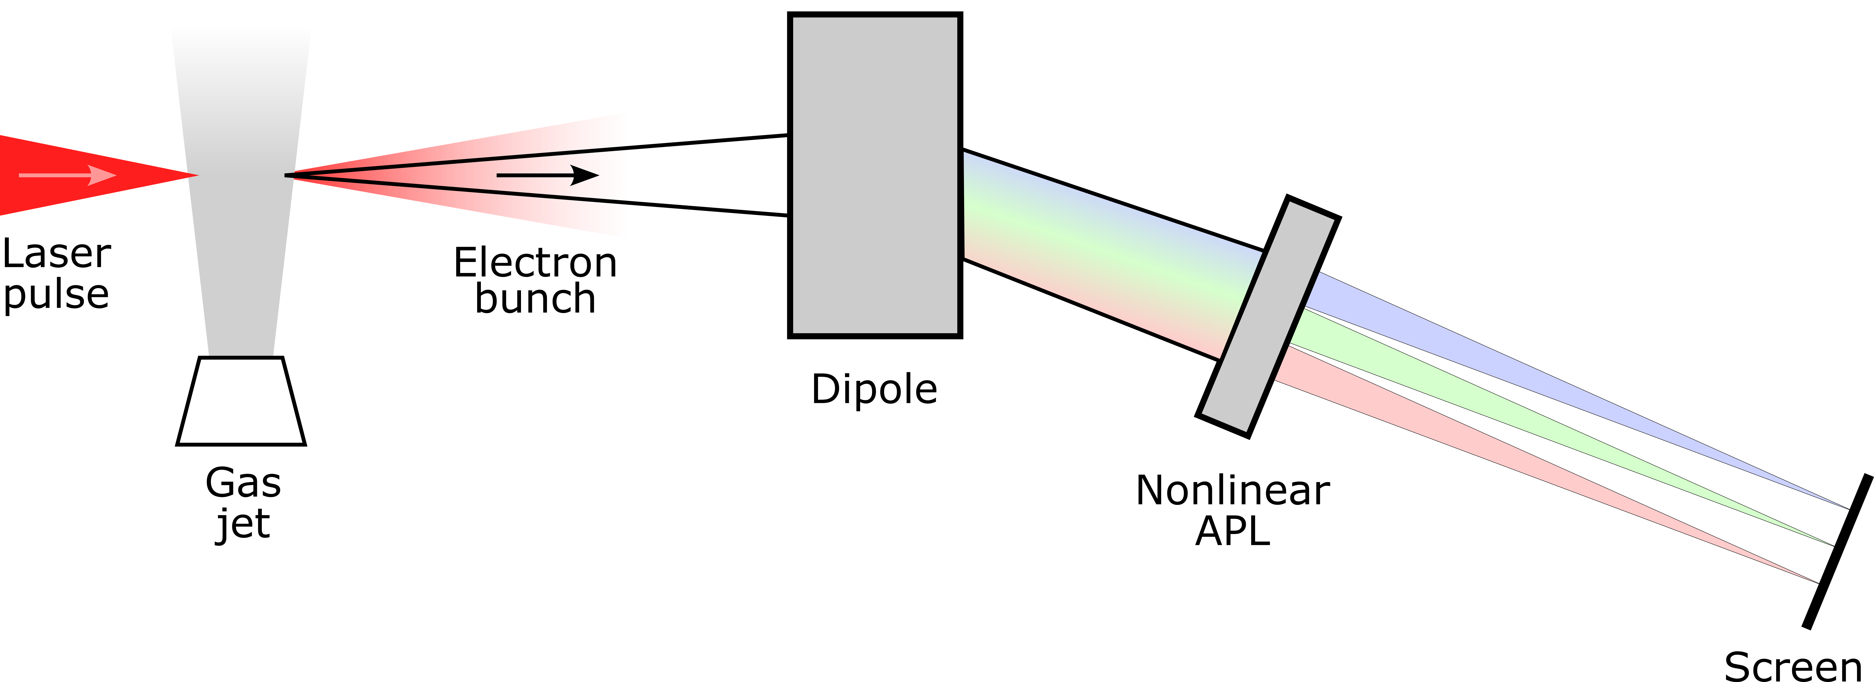

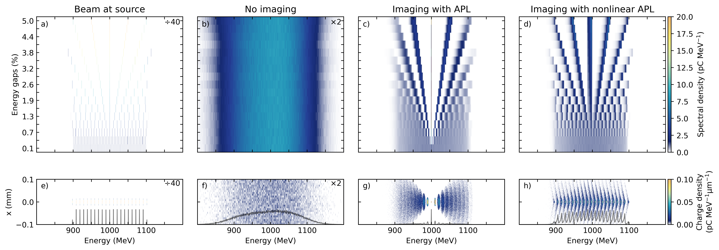
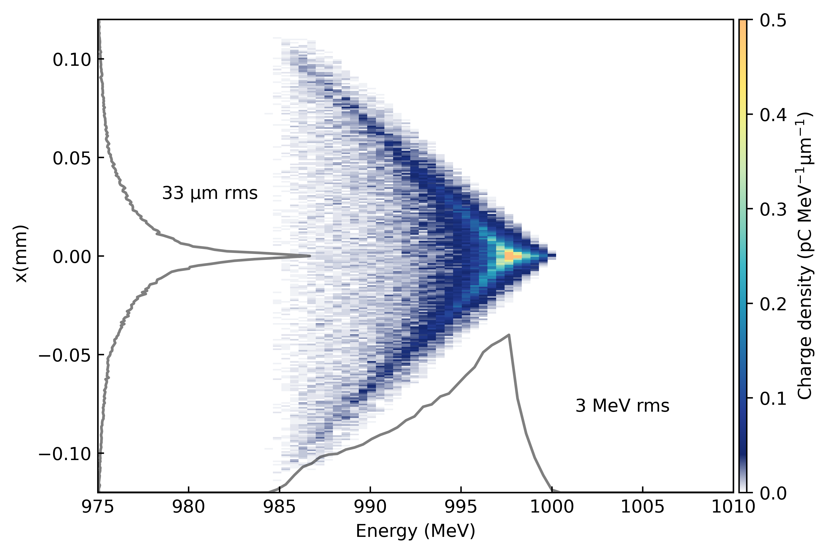


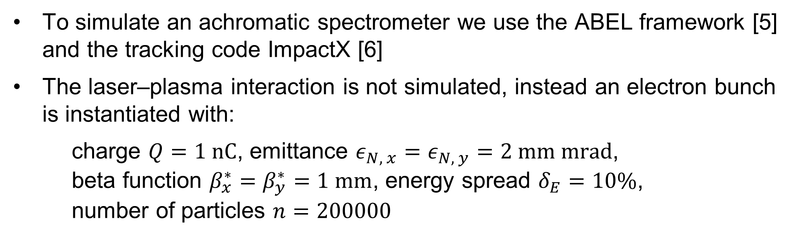
Development of an achromatic spectrometer for a laser-wakefield-accelerator experiment
F. Peña*¹, E. Adli, P. Drobniak, D. Kalvik, K. N. Sjobak, C. A. Lindstrøm
Department of Physics, University of Oslo, Oslo, Norway
¹also at Ludwig Maximilian University of Munich, Munich, Germany
1. Introduction
2. Motivation and goal
Plasma accelerators can sustain accelerating gradients of up to 100 GV/m, promising to reduce the footprint of future accelerator facilities
High-energy applications will require multiple plasma-accelerator stages
The beam optics between such stages are challenging due to chromatic effects [1]
The SPARTA project [2] aims to solve this problem with a nonlinear active plasma lens [3] currently under development
Goal: Demonstrate the effectiveness of the nonlinear plasma lens for staging
Can be done with a simpler setup that faces the same challenges
In combination with a magnetic dipole, it can provide point-to-point imaging for the full energy spectrum, i.e., an achromatically imaging spectrometer
Great diagnostic for plasma-accelerator experiments, which usually:
→ have bunches with an energy spread of up to 10% and a divergence of 5 mrad
→ need multi-shot scans to accurately measure the energy spectra [4], which is only possible with an often inexistent high energy stability
3. Experimental setup and simulation details
To simulate an achromatic spectrometer we use the ABEL framework [5] and the tracking code ImpactX [6]
The laser–plasma interaction is not simulated, instead an electron bunch is instantiated with:
charge $Q=1 nC$, emittance $ε_{N, x}=ε_{N, y}=2 mm mrad$, beta function $β_{x}^{∗}=β_{y}^{∗}=1 mm$, energy spread $δ_{E}=10\%$, number of particles $n=200000$
Higher energy
Lower energy
4. Comparison of novel optics with established imaging
Finer spectrum features
1%
No features visible Larger apparent energy spread
Features near imaged energy, blurred otherwise
Features throughout the spectrum
The electron energy is arranged to discrete values
The energy gaps are scanned
Divergence dominated
Suitable for single-shot emittance, multi-shot spectrum measurement
Suitable for single-shot, high-resolution, broad-band spectrum measurement
5. Point spread function
6. Conclusion and Outlook
Zoomed-in image of beamlet
Characteristic shape induced by achromatic imaging system
With these simulation parameters, the resolution limit is 0.3% rms
→ sufficient for single-stage plasma accelerators
In principle, measurements can be de-convolved with the point spread function to reach higher resolution
Simulations show that the nonlinear plasma lens can be used to achromatically image bunches across a ±10% energy spectrum
Resolution could be sufficient for plasma-accelerator experiments
Planned to start measurement in late 2026 at the Centre for Advanced Laser Application in Germany
These results pave the way towards achromatic staging for plasma accelerators
* felipe.pena@fys.uio.no.de
Contribution ID: TUPM096
16th International Particle Accelerator Conference, Taipei, Taiwan, 1–6 June 2025
References:
[1] C. A. Lindstrøm, “Staging of Plasma-Wakefield Accelerators”, Phys. Rev. Accel. Beams 24, 014801 (2021). [2] European Commission, “Staging of plasma accelerators for realizing timely applications” (2023). [3] P. Drobniak et al., “Development of a Nonlinear Plasma Lens for Achromatic Beam Transport”, NIM-A 1072 (2025): 170223. [4] F. Peña, et al., “Energy Depletion and Re-Acceleration of Driver Electrons in a Plasma-Wakefield Accelerator”, Phys. Rev. Res. 6, 043090 (2024). [5] J. B. Chen et al., “ABEL: The adaptable beginning-to-end linac simulation framework”, (in these proceedings). [6] A. Huebl et al., “Next Generation Computational Tools for the Modeling and Design of Particle Accelerators at Exascale”, in Proc. NAPAC’22, Albuquerque, NM, USA, Aug. 2022, pp. 302-306.
The project is funded by the European Research Council (project SPARTA, ERC Grant Agreement No. 101116161). We acknowledge Sigma2 - the National Infrastructure for High- Performance Computing and Data Storage in Norway for awarding this project access to the LUMI supercomputer, owned by the EuroHPC Joint Undertaking, hosted by CSC (Finland) and the LUMI consortium.

