Slide 1
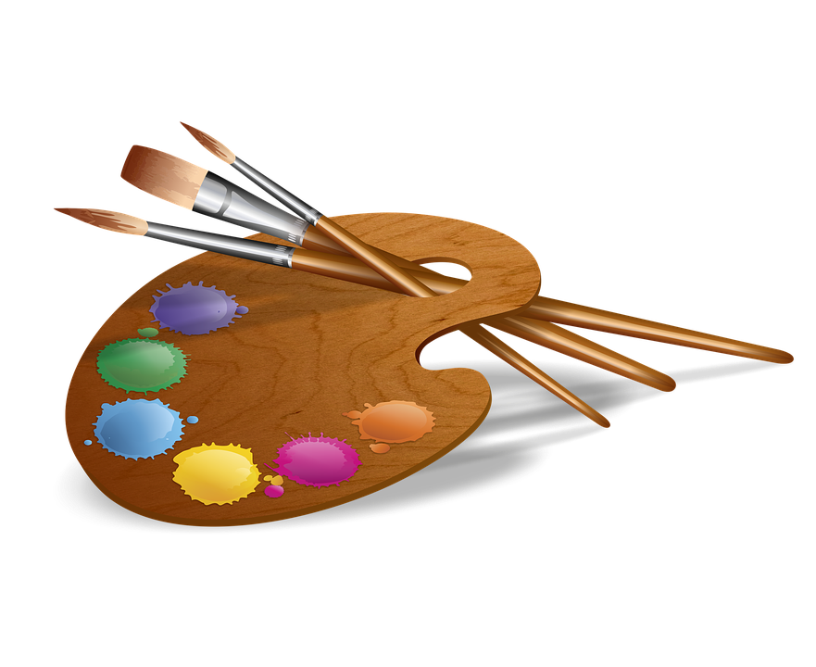

Creative Arts Award
Awarded To
{name}
For
{awardFor}
Lilly Rushe, Riley McLaughlin
Week {week} 2022

