Slide 1
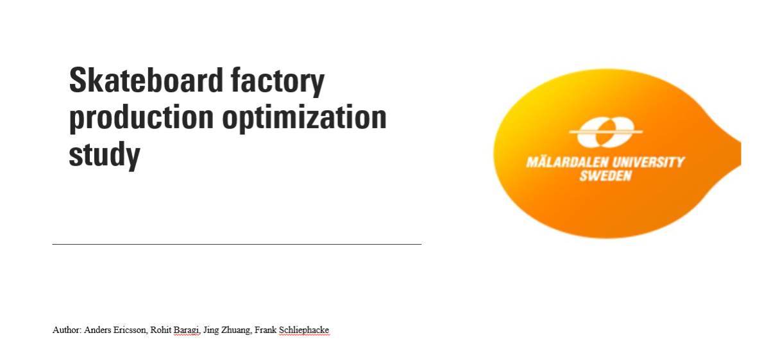
Group - 3
PPU - 432

Slide 2
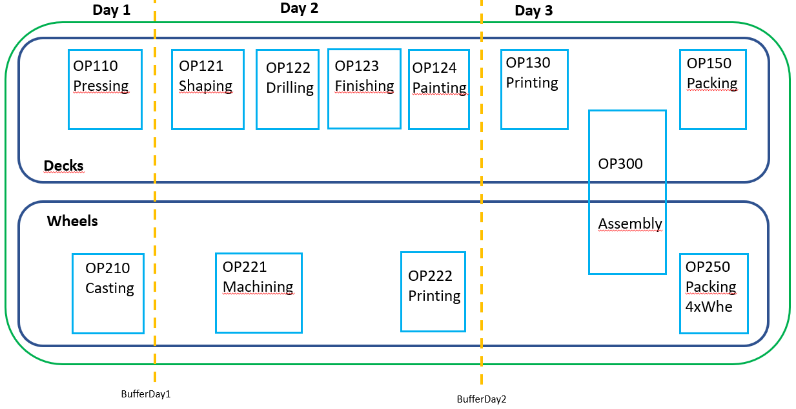
Conceptual Model
MODEL INPUTS
Batch processing
Flow
Case data
Worktime shifts, 8hr / day
Expected demand / month
Resources for operations
Cycle- / process times for stations
Scrap Rate
MODEL OUTPUTS
Plant capacity
Plant layout
Push or Pull strategy
Bottlenecks
Equipment utilisation
OEE-levels
Inventory level
Max throughput – min changes
Quality levels
MODEL CONTENT
Made to stock (MTS)
Equipment failure
Quality Checks
MODEL ASSUMPTIONS
Each month, 20 days
Raw Material is available
The personnel is healthy and not absent
Staff assigned to stations are manual
Otherwise stations are automated
Finished products are sent end of month
MODEL SIMPLIFICATIONS
Probability distrubutions are derived from yearly demand.
Trucks are always availble, not included
Deliverables: 1 screen view, visual appealingExcel spreadsheet of the data.
Provide a possible layout for the new factory

Slide 3
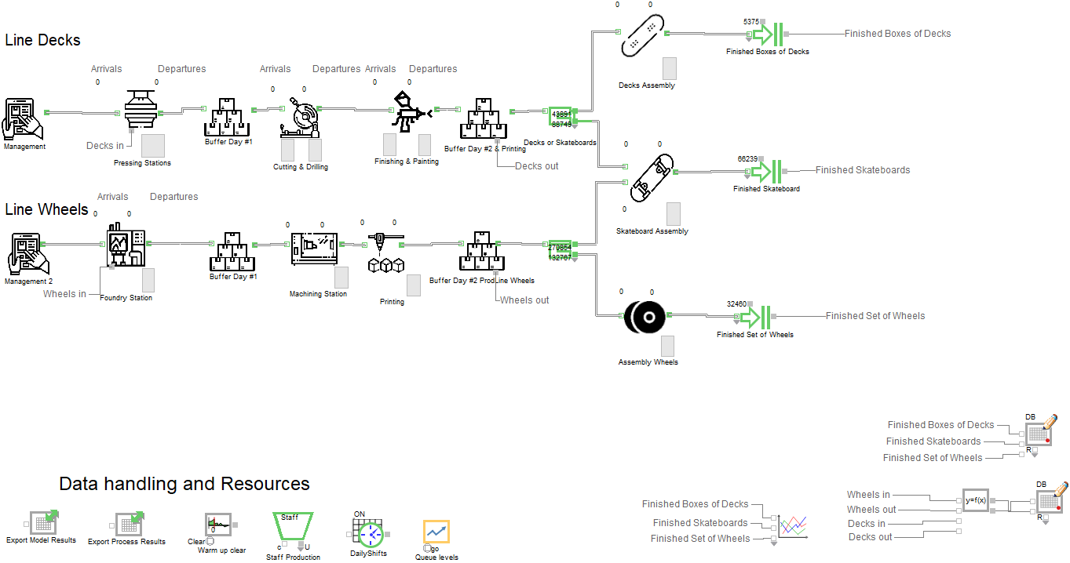
Group 3- Skateboard Factory Model
6 Presses
3 Workers
2 Workers
Production scheduled to yearly demand.
2 Workers
2 Furnaces
2 Lathes
1 Printer
1 Packing Machine

Slide 4
Push vs Pull

Slide 5
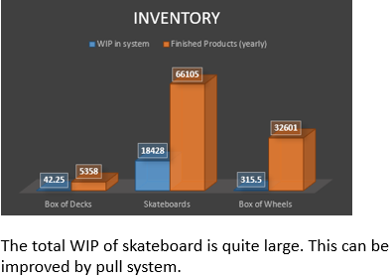
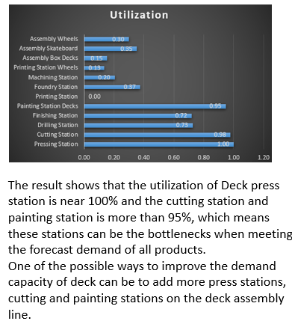
Analysis
Inventory
Utilization of machines

Slide 6
Take-away’s
Factory design aspects
Meeting the demand and higher level of inventory - Push
Almost reaching demand and having low inventory - Pull
Both are plausable
Quality must be improved – total less than 5% capacity scraped
Investments in new machines, optimzed worker operations
Use Statistical process control (SPC)
Further investigation needed
Should analyse cost vs expected profit per Product (Decks, Skateboard, Wheels)
Product mix; Boxed decks, Skateboards, Boxed Wheels => optimized profit

Slide 7


Slide 8
Group3 – Backup – Profit & cost analysis
Skateboard factory |  | Skateboard | Decks | Wheels 4x |  | Skateboard | Decks | Wheels 4x
Assummed sales prices |  | Sweden | Sweden | Sweden |  | Sweden | Sweden | Sweden
Average Sales Price (Pricerunner) | SEK | 800 | 1000 | 600 |  | 800 | 1000 | 600
Tax | % | 25% | 25% | 25% |  | 25% | 25% | 25%
Reseller | % | 10% | 10% | 10% |  | 10% | 10% | 10%
FactorySalesPrice | SEK | 540 | 675 | 405 |  | 540 | 675 | 405
Profit | % | 8% | 8% | 8% |  | 8% | 8% | 8%
SelfCost | SEK | 296.8 | 621 | 372.6 |  | 296.8 | 621 | 372.6
Manufacturing Cost per product | SEK | 296.8 | 621 | 93.15 |  | 296.8 | 621 | 93.15
Raw material | % | 25% | 25% | 25% |  | 25% | 25% | 25%
Controllable selfcosts | SEK | 222.6 | 465.8 | 69.9 |  | 222.6 | 465.8 | 69.9
Demand monthly |  | 5280 | 3520 | 31680 |  | 0 | 8800 | 31680
Total Selfcost per month |  | 1175328 | 1639440 | 2213244 |  | 0 | 4098600 | 2213244
Workers |  | 4 | 6 | 1 |  | 0 | 6 | 1
WorkerSalery | SEK | 25000 | 25000 | 25000 |  | 25000 | 25000 | 25000
HumanResourceCost | SEK | 175500 | 263250 | 43875 |  | 0 | 263250 | 43875
Machine_cost | SEK | 5000 | 300000 | 600000 |  | 5000 | 300000 | 600000
Facility | SEK | 200000 | 200000 | 200000 |  | 200000 | 200000 | 200000
TotalCosts | SEK | 380500 | 763250 | 843875 |  |  | 763250 | 843875
PROFIT | SEK | 794828 | 876190 | 1369369 |  |  | 3335350 | 1369369
TotalProfit monthly |  |  |  | 3040387 |  |  |  | 4704719

Slide 9
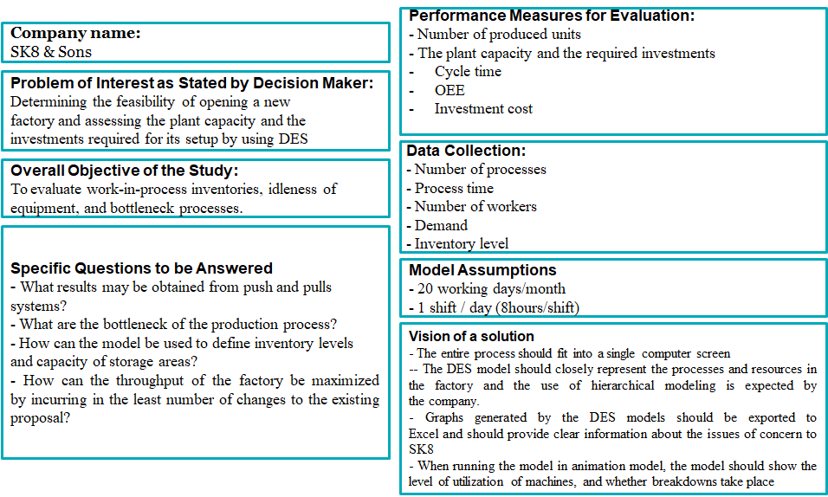

Slide 10
Group3 – Proposed layout
Decks
OP110 Pressing
OP123 Finishing
OP124 Painting
OP150
Packing
OP130
Printing
Storagearea 1
OP121 Shaping
OP122 Drilling
Storagearea 3
packed items for delivery
Drying storagearea
Storagearea 2
Transport lane
Wheels
Skateboards
Storagearea 4
OP300 Assembly
Storagearea 5 - Warehouse
packed wheels for delivery
OP350 Packning Skateboards
Storagearea 6 - Warehouse
packed items for delivery
OP210 Casting foundry
OP221 Machining
OP222 Printing
OP250 Packing
4xWheels
Frsc

Slide 11
Group3 – effort & findings (Key take aways)
Systematic approach following academic approach
Conceptual model identifying inputs, unknowns and assumptions.
Modelvalidation against Excel data provided by customer
Created a 2. simple model in Extendsim – different model engineer and simplifications – results match as to needed machines, workers.
Identified model uncertainty due to randomized parameters: MTBF, machine failure. = small impact; 2 sigma below 1.5% capacity
Interesting findings
The model equivalent to the production process description has a startup time to steady state conditions of 2 days
Large scrap in SK8 provided data
Our optimized model and proposed solution
We use 6 Presses, 2 Furances and a total of X workers with one 8h shift per day.
Overall scrap is below 5% by means of optimized work task, well adjusted machinery and statistical process control (SPC).

