Slide 1
“Neuro-Transistor simulation with memristor based memcapacitor using LTSPICE”
Semester project presentation
Lecture “Neural Networks and Memristive Hardware Accelerators”
Group : K
Students: Bibin Biju Joshua
Dhanush Harish Shetty
Nagaraj Venkatesh Reddy
Raghuveer Pundaliksa Meharwade
Day of presentation: 07/02/2025

Slide 2
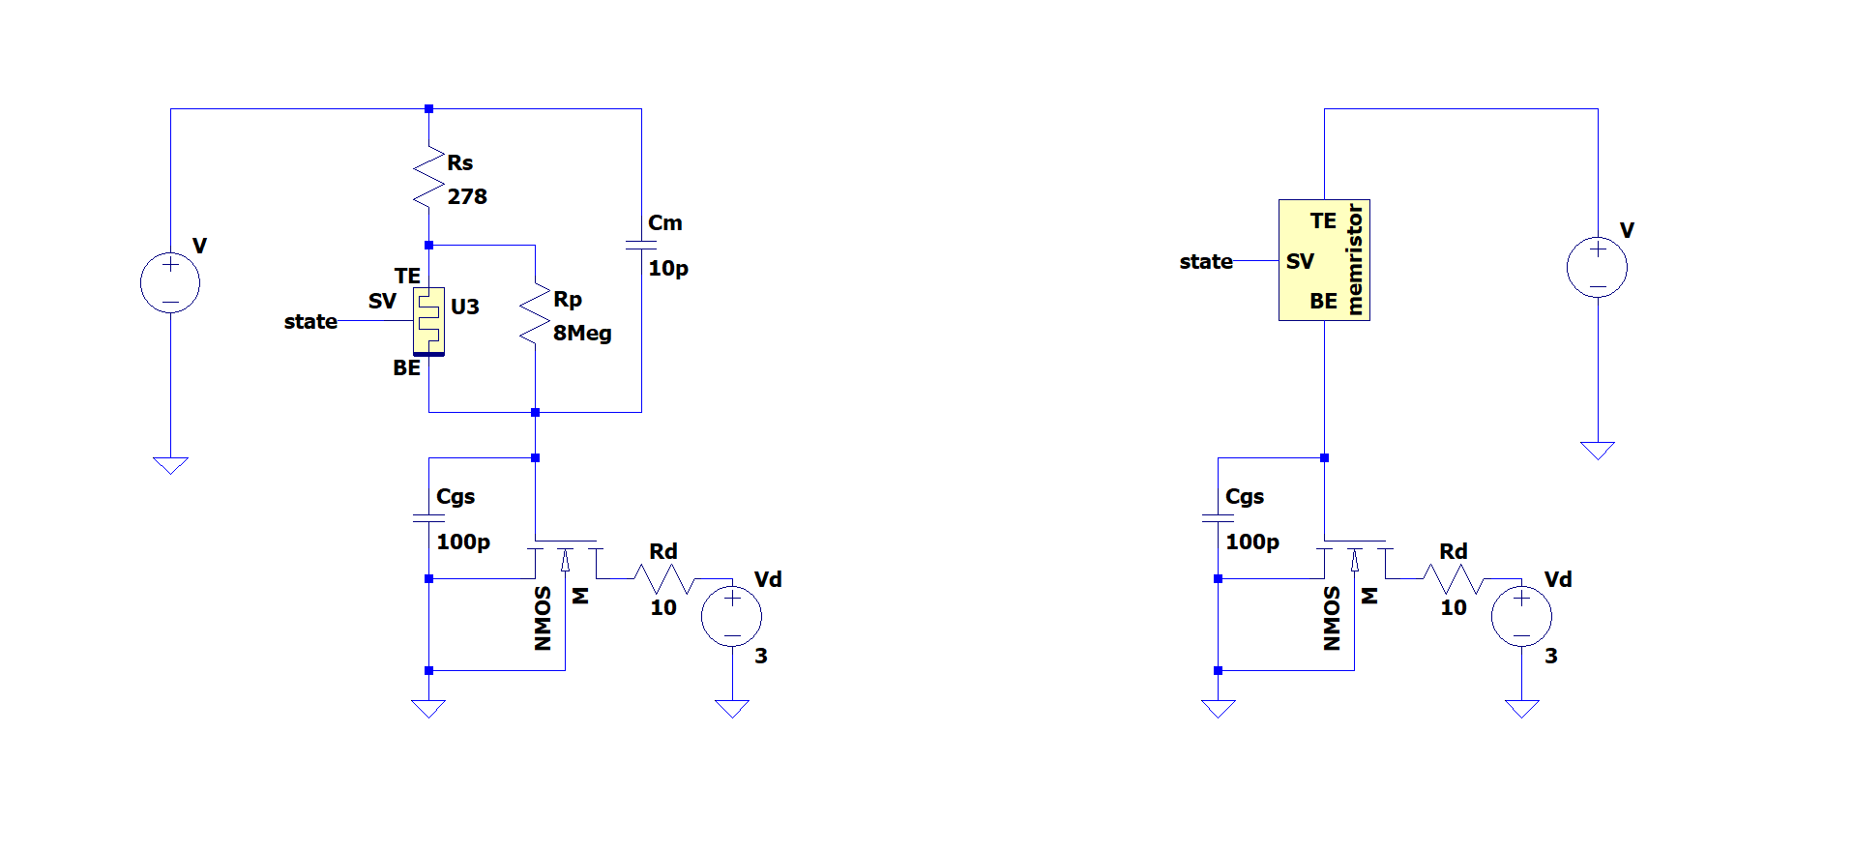
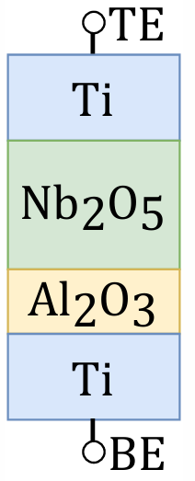
Introduction
Topic: Realization of the neuron functionality with a pseudo-memcapacitive transistor using LTSPICE
A pseudo-memcapacitive device can be formed by the memristors intrinsic parallel capacitance, and a series capacitor. This can significantly lower the power dissipation of the circuit because the signal is expressed as a voltage rather than a current.
The pseudo-memcapacitor at the gate of a transistor, can be used in leaky integrate-and-fire neuron emulator.
R. Schroedter, A. S. Demirkol, A. Ascoli, R. Tetzlaff, E. Mgeladze, M. Herzig, S. Slesazeck, T. Mikolajick, "SPICE Compact Model for an Analog Switching Niobium Oxide Memristor", International Conference on Modern Circuits and Systems Technologies (MOCAST) on Electronics and Communications, Bremen, 2022 DOI: 10.1109/MOCAST54814.2022.9837726

Slide 3
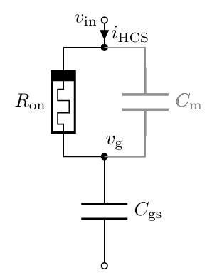
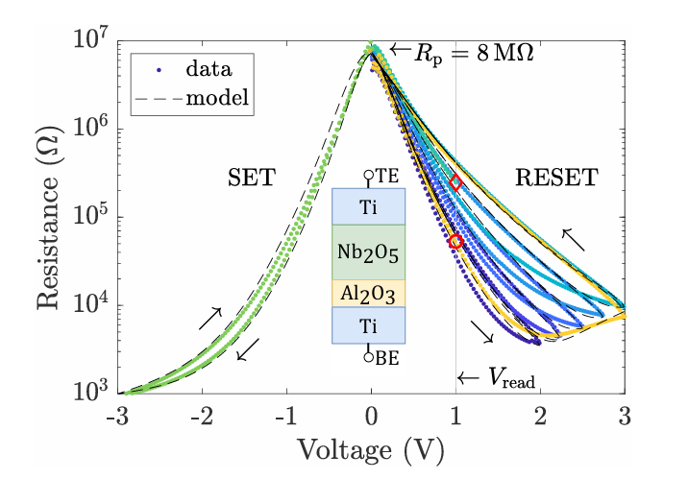
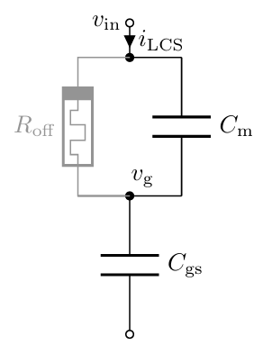
Calculations:
Calculation:
τon = Ron(Cm + Cgs)
= 45.56 kΩ x (10 pF + 100 pF)
= 5.0116 μs
Calculation:
τoff = Roff(Cm + Cgs)
= 484.97 kΩ x (10 pF + 100 pF)
= 53.3467 μs
τon = Ron(Cm + Cgs)
τoff = Roff(Cm + Cgs)
R. Schroedter, A. S. Demirkol, A. Ascoli, R. Tetzlaff, E. Mgeladze, M. Herzig, S. Slesazeck, T. Mikolajick, "SPICE Compact Model for an Analog Switching Niobium Oxide Memristor", International Conference on Modern Circuits and Systems Technologies (MOCAST) on Electronics and Communications, Bremen, 2022 DOI: 10.1109/MOCAST54814.2022.9837726
R. Schroedter, A. S. Demirkol, A. Ascoli, B. Max, F. Nebe, T. Mikolajick, R. Tetzlaff, "A pseudo-memcapacitive neurotransistor for spiking neural networks", 12th International Conference on Modern Circuits and Systems Technologies (MOCAST) on Electronics and Communications, Athens, Greece, pp. 1-4, 2023, DOI: 10.1109/MOCAST57943.2023.10176398

Slide 4
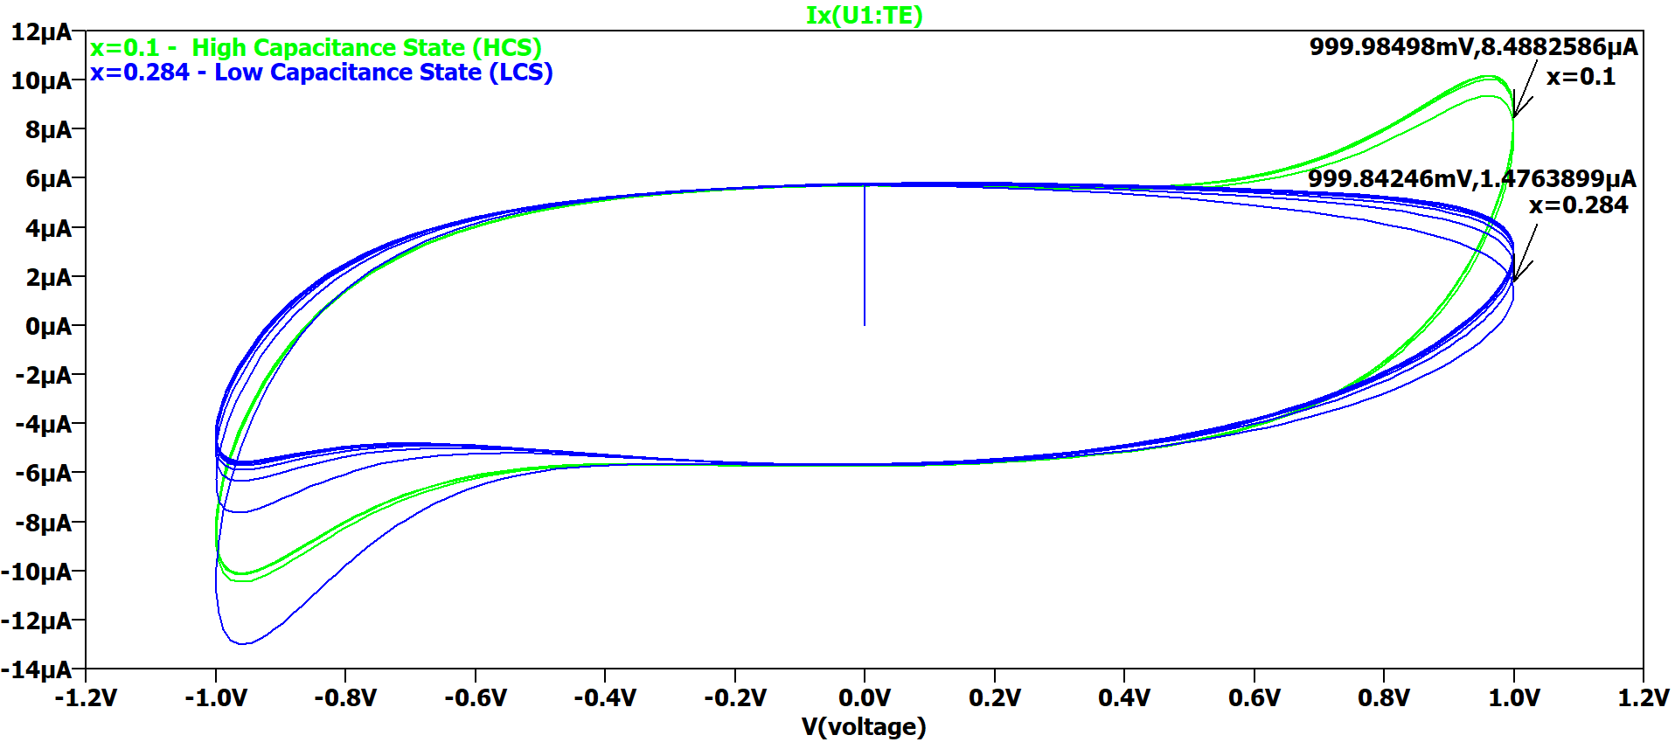
I-V Plot of LCS and HCS
For Sine input of 100KHz ± 1V, HCS current is 5.7 times greater than LCS current.
Current (A)
Voltage (V)

Slide 5
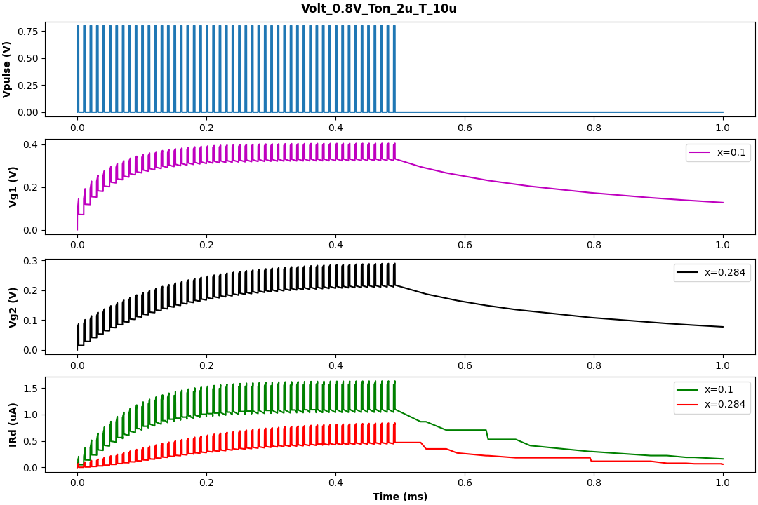
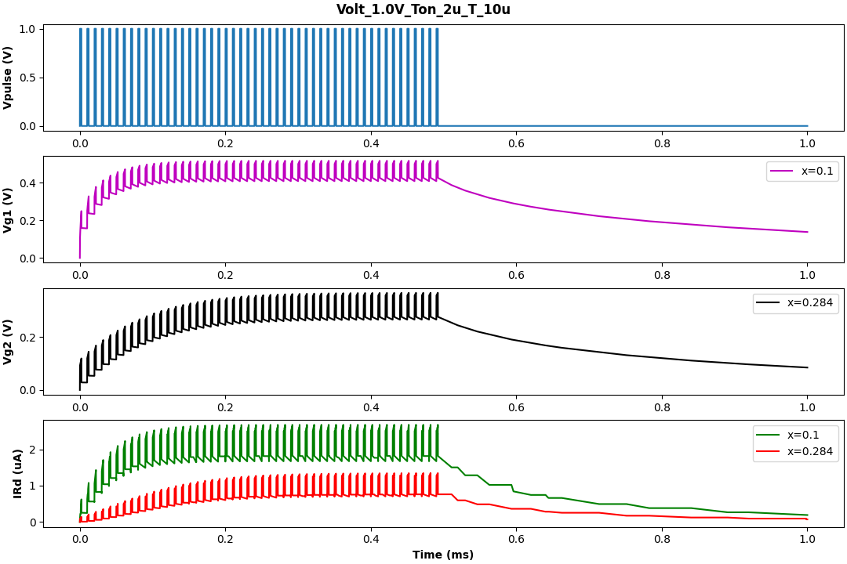
Single neuro-transistor with pulse input
Observation: Id (drain current) in ON state is approximately twice the OFF state. Integration of Id is observed until the steady state reached.

Slide 6
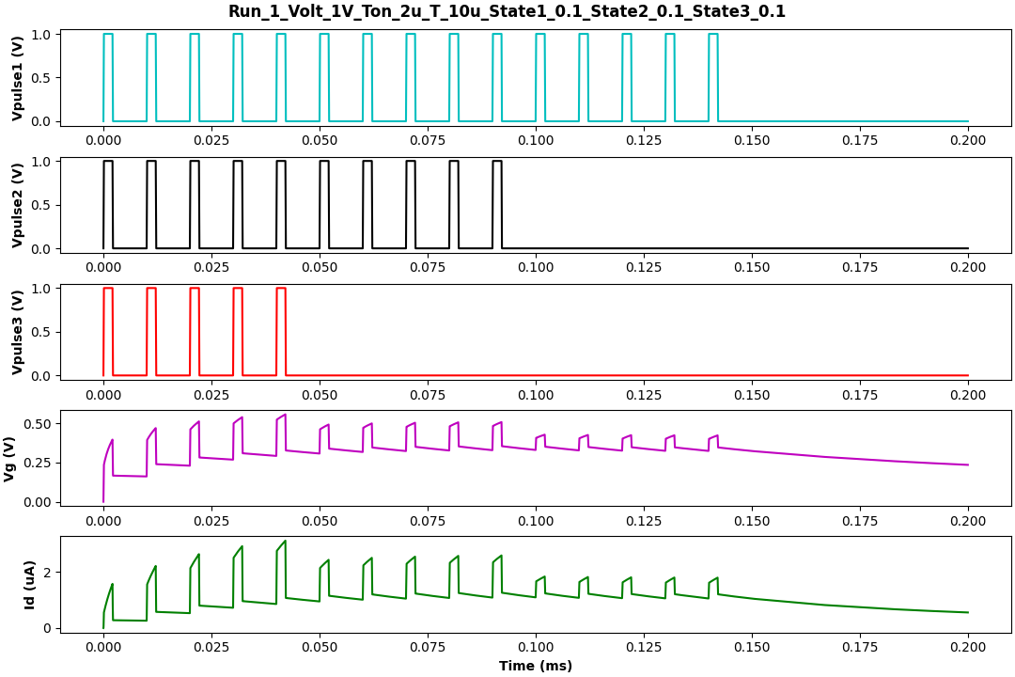
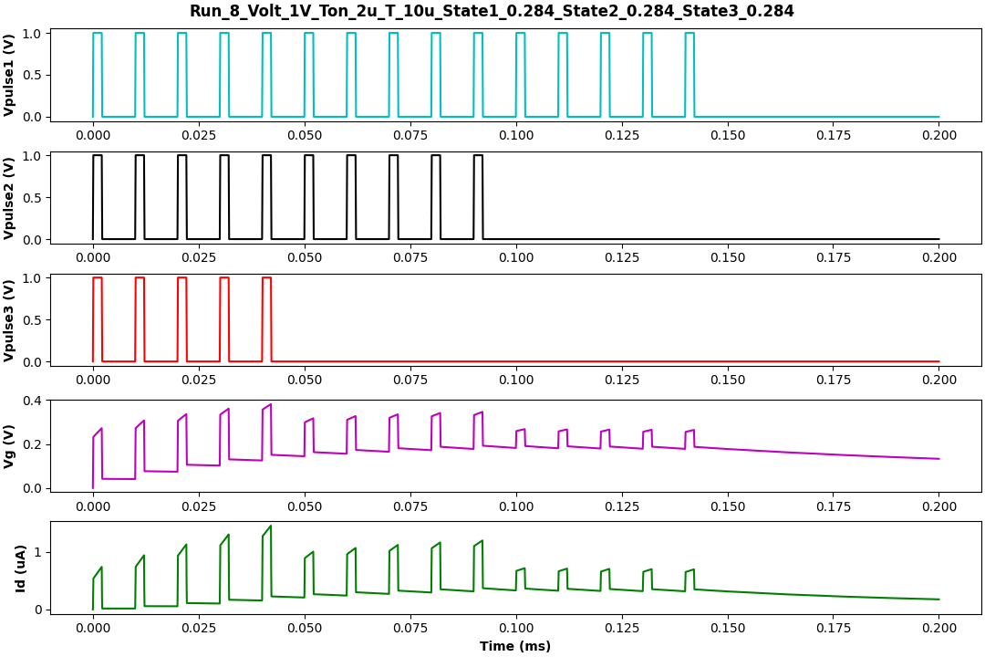
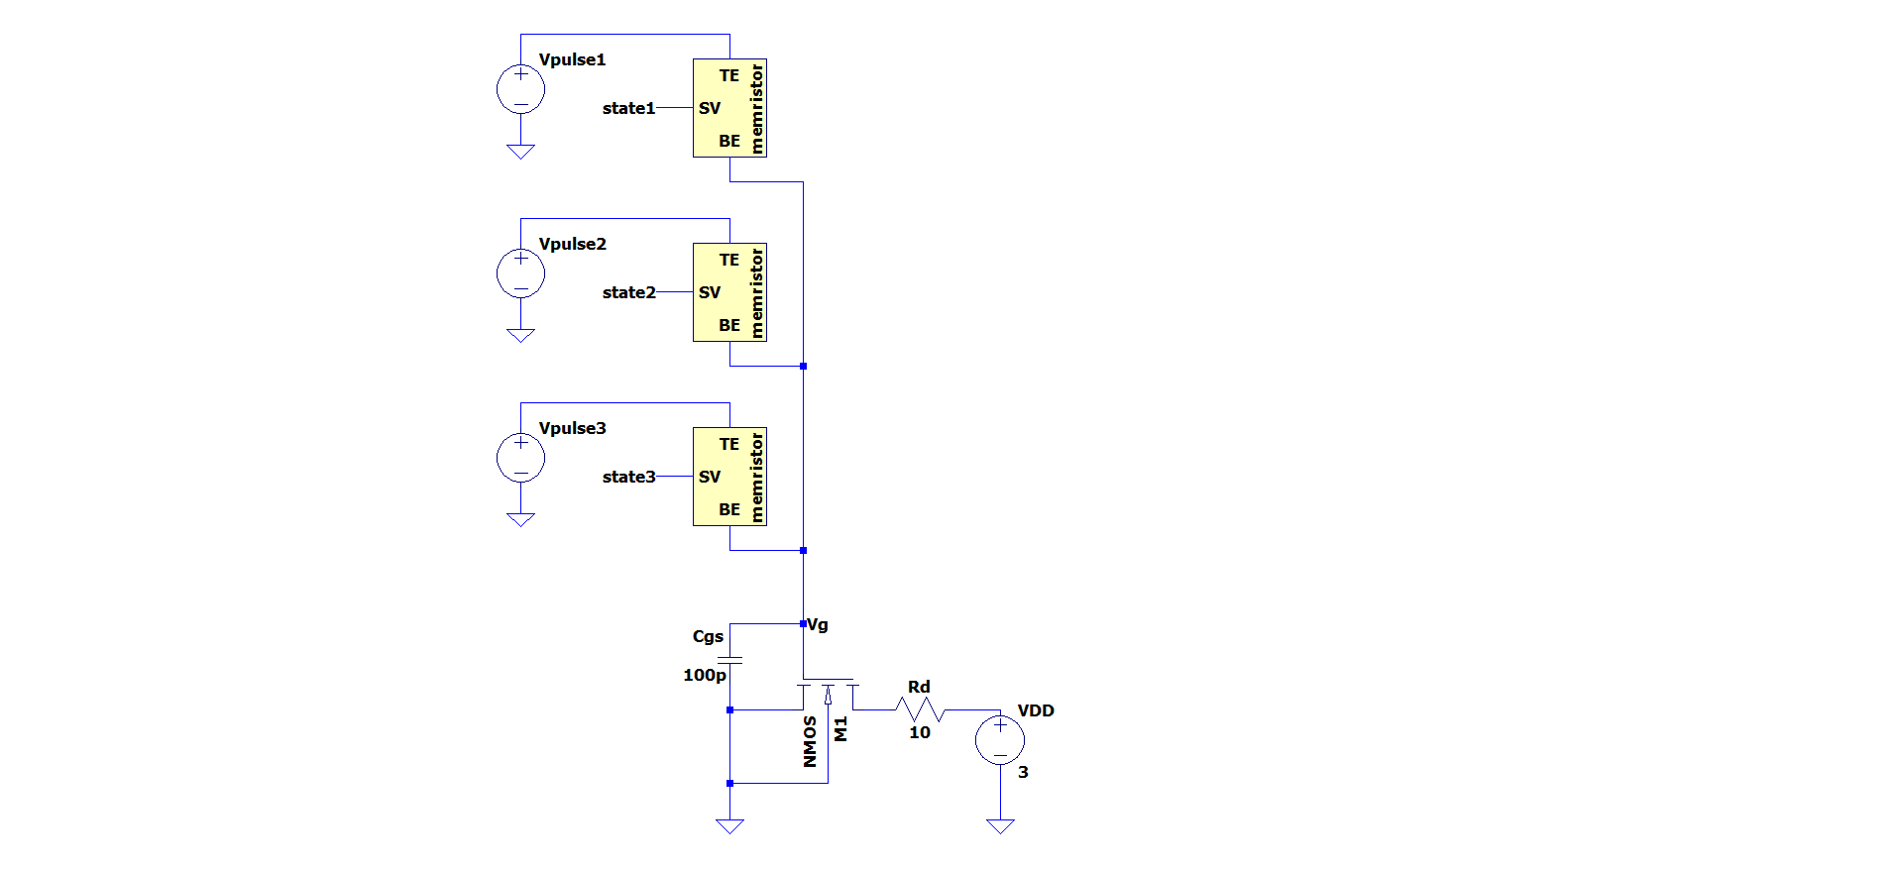
3x1 neuro-transistor with pulse input
Observation: Steady state reached faster in memristor ON state than OFF state.

Slide 7
3x1 neuro-transistor with TTFP input

Slide 8
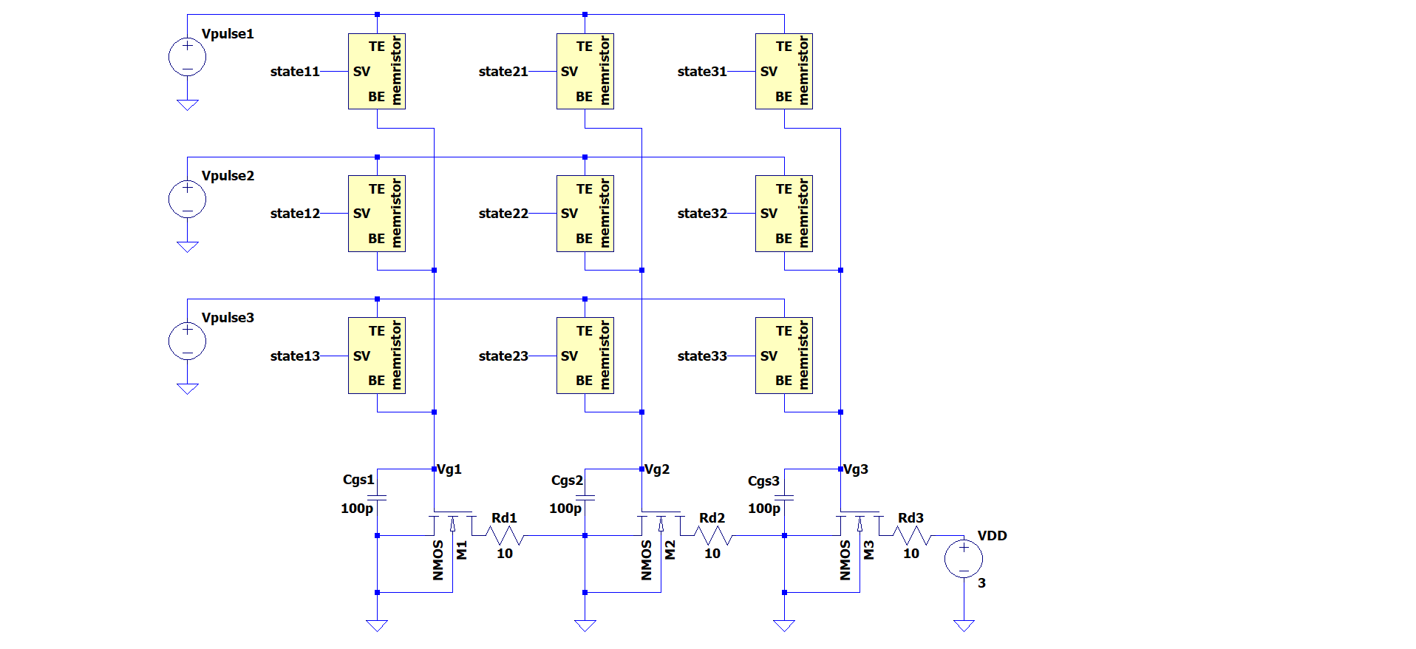
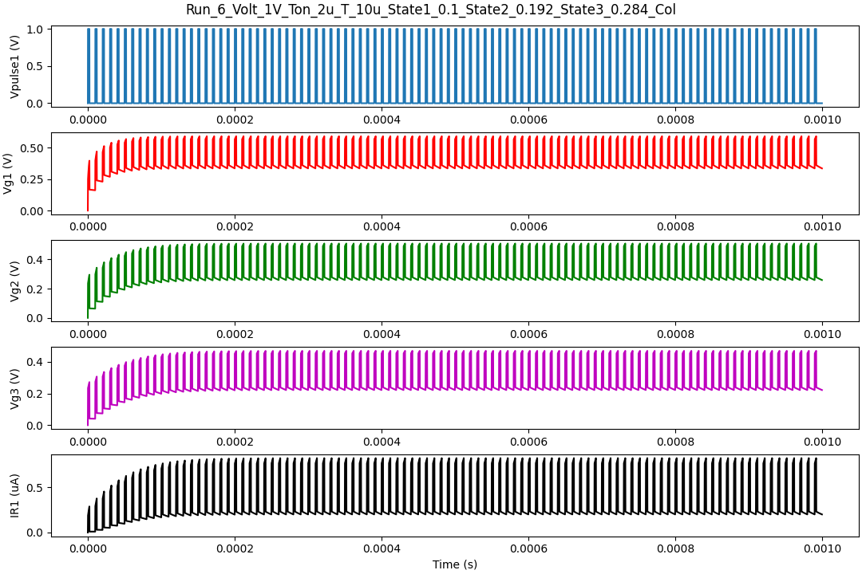
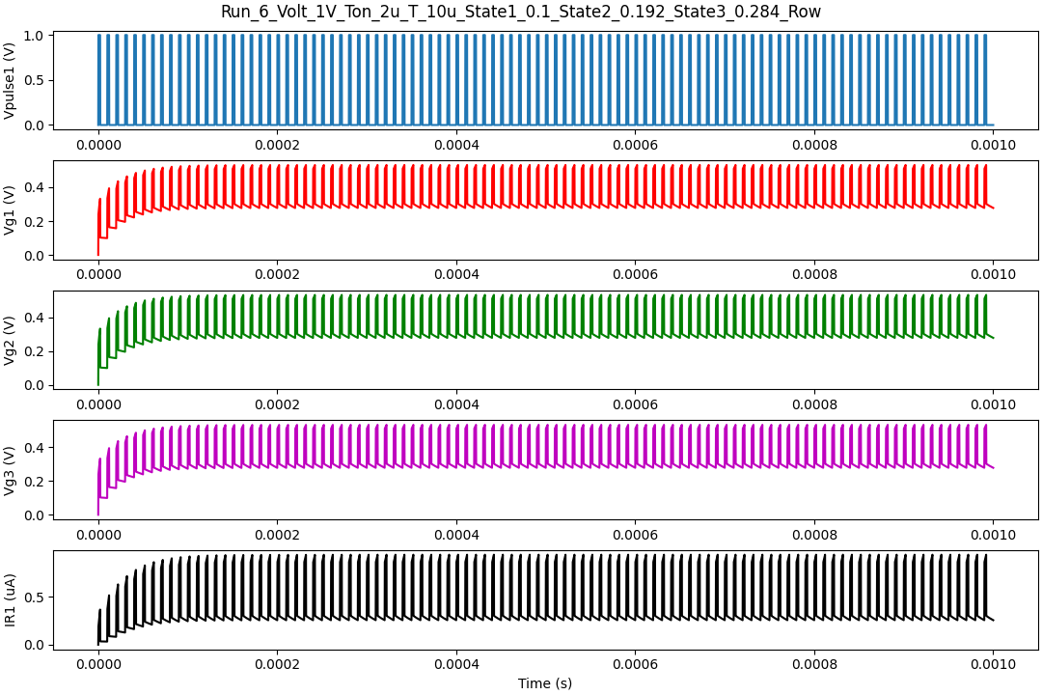
3x3 neuro-transistor
COL
ROW
U1 | U4 | U7
U2 | U5 | U8
U3 | U6 | U9
x=0.1
x=0.192
x=0.284
U1 | U4 | U7
U2 | U5 | U8
U3 | U6 | U9
Observation:
Almost Identical response in both case when steady state reached. Small difference observed at the start.
Note: Cgs name used for Cgb

Slide 9
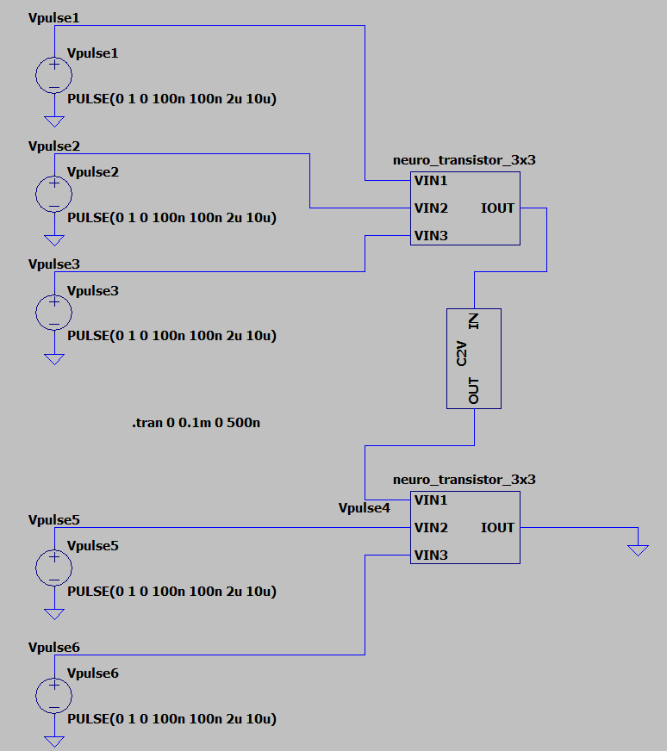
Spiking Neural Network

Slide 10
Summary
Significantly lower the power dissipation of pseudo-memcapacitor can be used to emulate leaky integrate-and-fire neuron with a transistor.
Key considerations are Roff/Ron > 10 and Cgs/Cm > 5
In single neuro-transistor, a nice gap between the On State current value and Off state current value are observed.
In 3x1 neuro-transistor, for TTFS input, observed integration of voltage at the gate of transistor.
In 3x3 neuro-transistor, observed almost Identical response in symmetric row, column arrangement when steady state reached. And a small difference observed at the start.
A current to voltage amplifier can be used to cascade neuro-transistor to realize a spiking neural network.

Slide 11
THANK YOU

