Slide 1
“Neuro-Transistor simulation with memristor based memcapacitor using LTSPICE”
Semester project presentation
Lecture “Neural Networks and Memristive Hardware Accelerators”
Students : Bibin Biju Joshua
Dhanush Harish Shetty
Nagaraj Venkatesh Reddy
Raghuveer Pundaliksa Meharwade
Supervisor: Dr. Richard Schroedter
Day of presentation: 07/02/2025
Group K

Slide 2
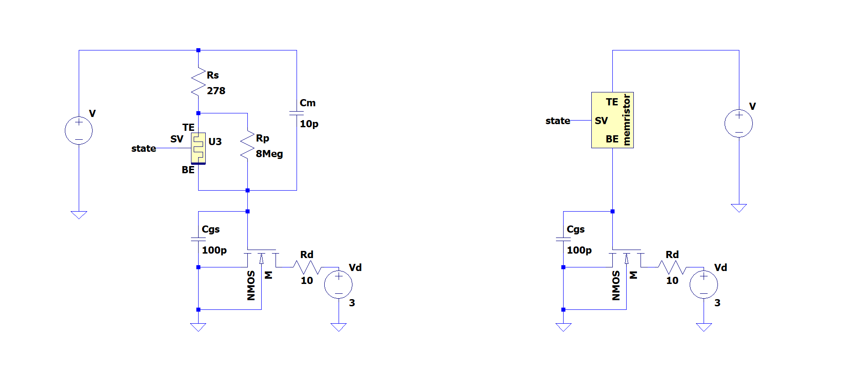
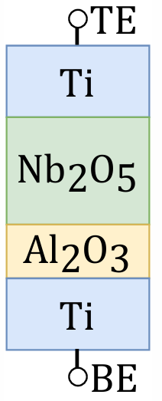
Introduction
Topic: Realization of the neuron functionality with a pseudo-memcapacitive transistor using LTSPICE
A pseudo-memcapacitive device can be formed by the memristors intrinsic parallel capacitance, and a series capacitor. This can significantly lower the power dissipation of the circuit because the signal is expressed as a voltage rather than a current.
The pseudo-memcapacitor at the gate of a transistor, can be used in leaky integrate-and-fire neuron emulator.
R. Schroedter, A. S. Demirkol, A. Ascoli, R. Tetzlaff, E. Mgeladze, M. Herzig, S. Slesazeck, T. Mikolajick, "SPICE Compact Model for an Analog Switching Niobium Oxide Memristor", International Conference on Modern Circuits and Systems Technologies (MOCAST) on Electronics and Communications, Bremen, 2022 DOI: 10.1109/MOCAST54814.2022.9837726

Slide 3
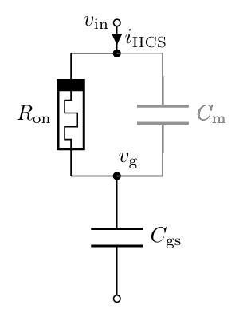
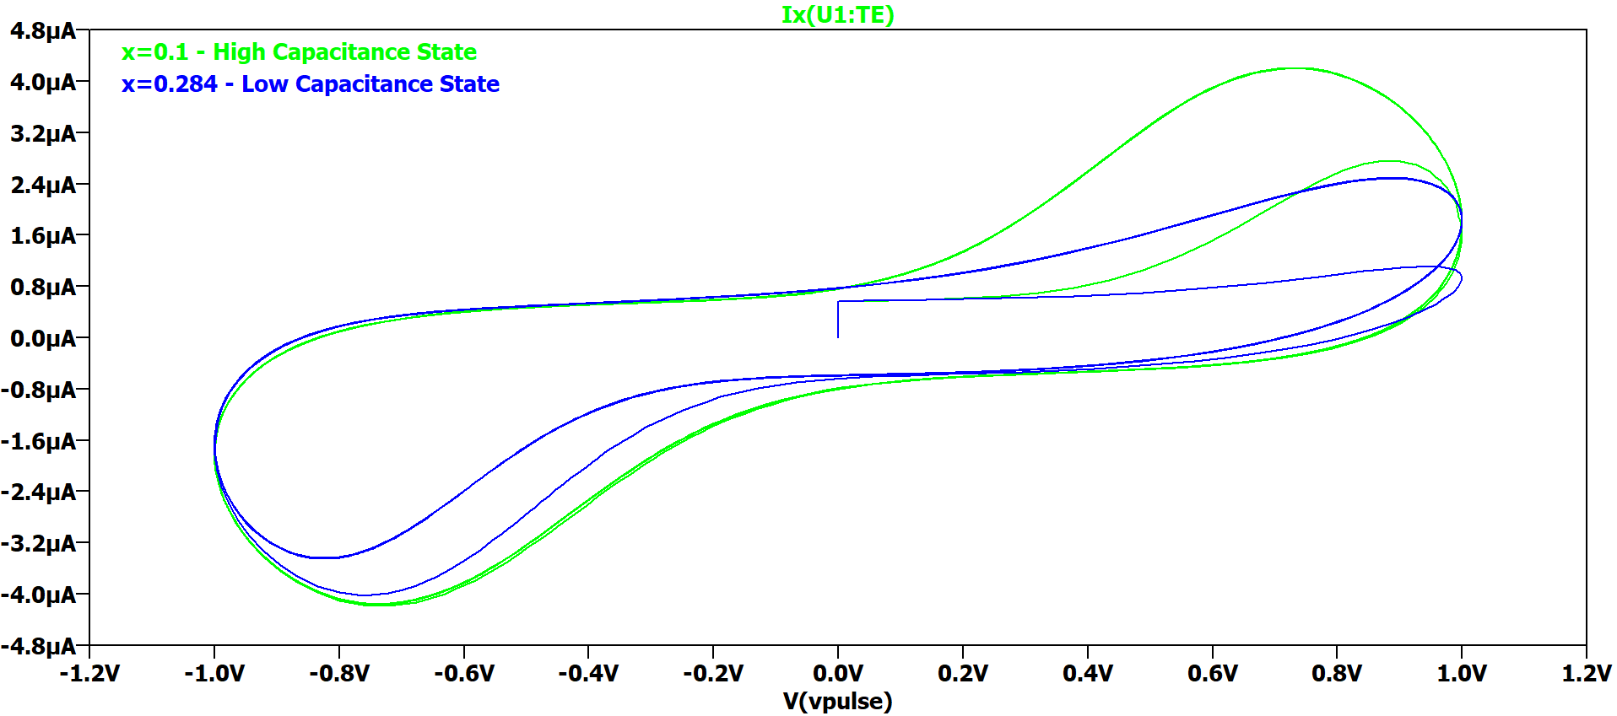
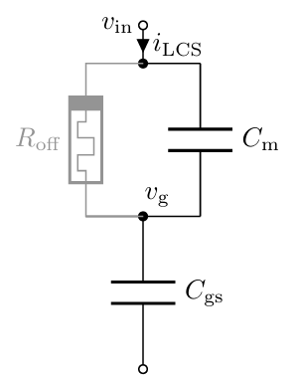
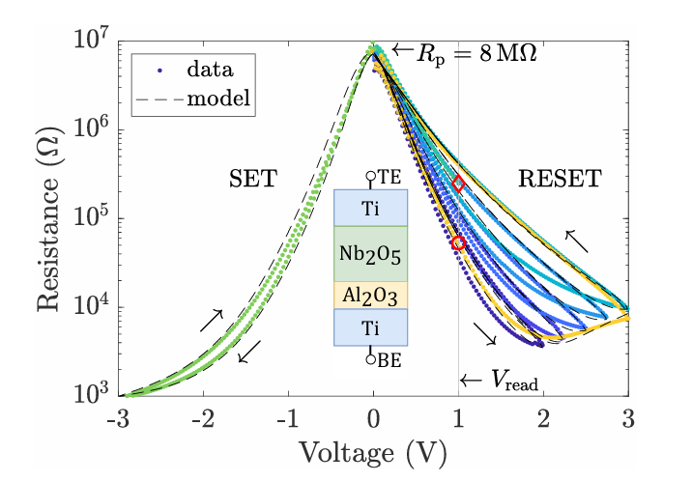
I-V Plot of LCS and HCS
Memristor in Low resistance state(LRS), corresponds to a High capacitance state (HCS) which is Cgs.
Calculation:
τon = Ron(Cm + Cgs)
= 45.56 kΩ x (10 pF + 100 pF)
= 5.0116 μs
Current (A)
Voltage (V)
Memristor in High resistance state(HRS), corresponds to Low capacitance state (LCS) which is Cm.
Calculation:
τoff = Roff(Cm + Cgs)
= 484.97 kΩ x (10 pF + 100 pF)
= 53.3467 μs
Values:
Ron at 1V = 45.56 kΩ
Roff at 1V = 484.97 kΩ
Cgs = 100 pF
Cm = 10 pF
R. Schroedter, A. S. Demirkol, A. Ascoli, R. Tetzlaff, E. Mgeladze, M. Herzig, S. Slesazeck, T. Mikolajick, "SPICE Compact Model for an Analog Switching Niobium Oxide Memristor", International Conference on Modern Circuits and Systems Technologies (MOCAST) on Electronics and Communications, Bremen, 2022 DOI: 10.1109/MOCAST54814.2022.9837726
R. Schroedter, A. S. Demirkol, A. Ascoli, B. Max, F. Nebe, T. Mikolajick, R. Tetzlaff, "A pseudo-memcapacitive neurotransistor for spiking neural networks", 12th International Conference on Modern Circuits and Systems Technologies (MOCAST) on Electronics and Communications, Athens, Greece, pp. 1-4, 2023, DOI: 10.1109/MOCAST57943.2023.10176398

Slide 4
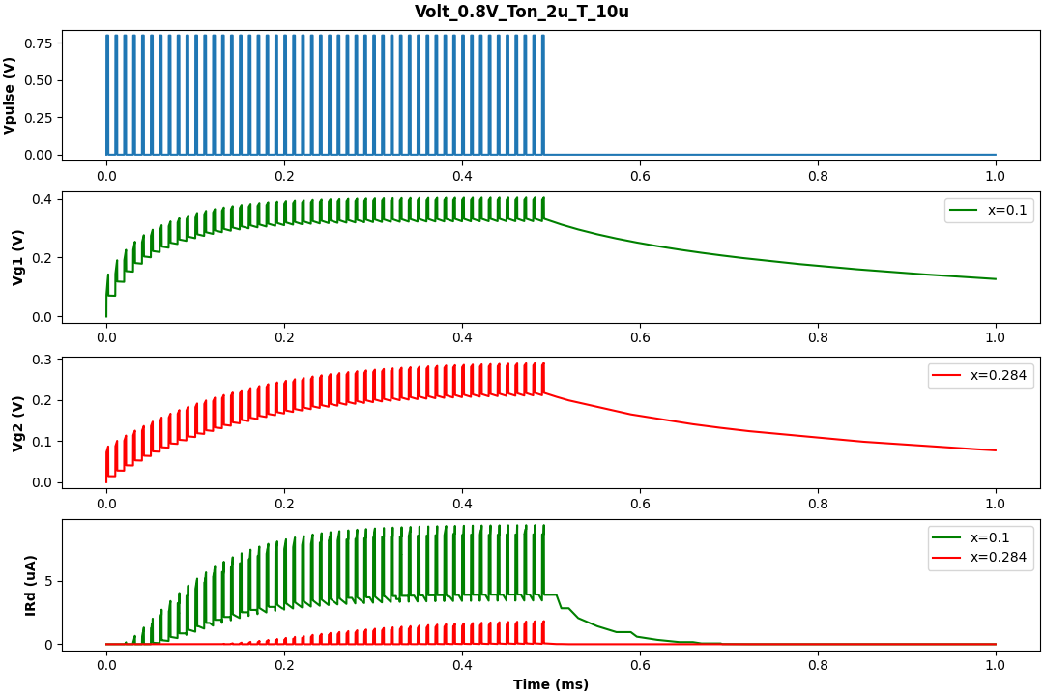
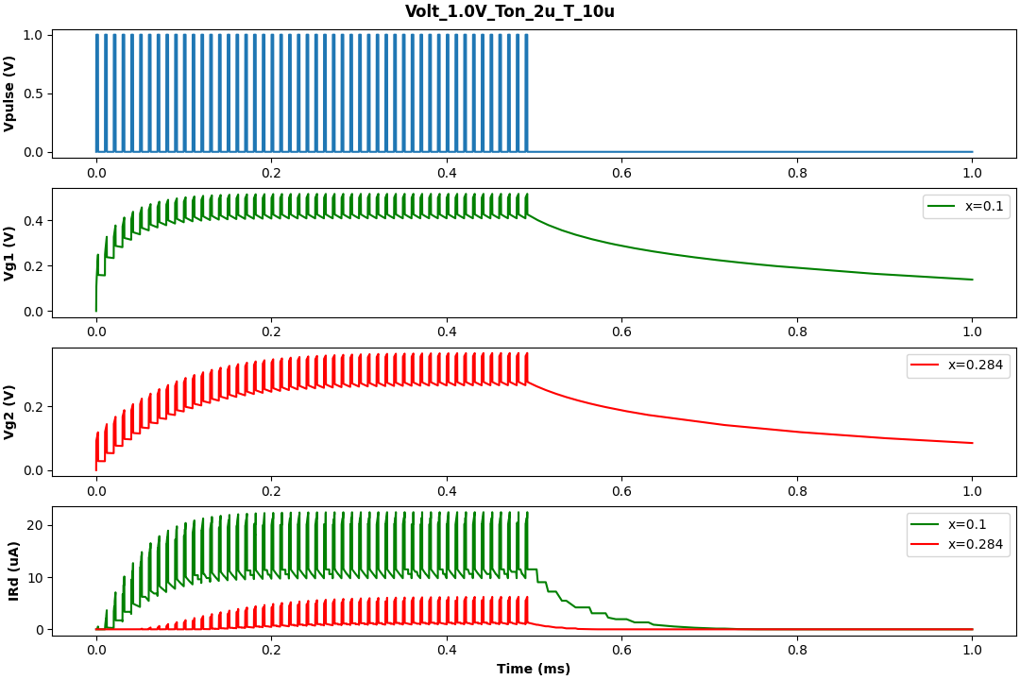
Pulse input response of single pseudo-memcapacitive transistor
The Id (drain current) spikes when gate voltage exceeds Vth of transistor = 0.2V.
For 1V pulse input of 2us the ON state Id is approximately four times the OFF state.

Slide 5
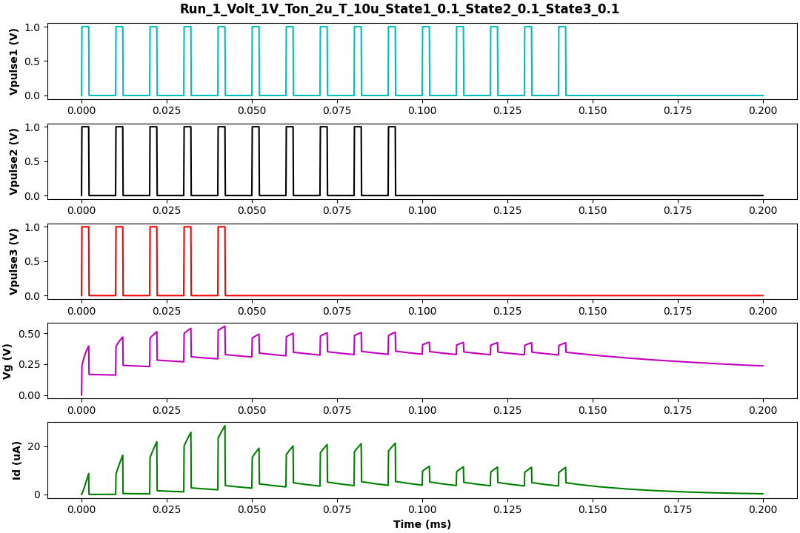
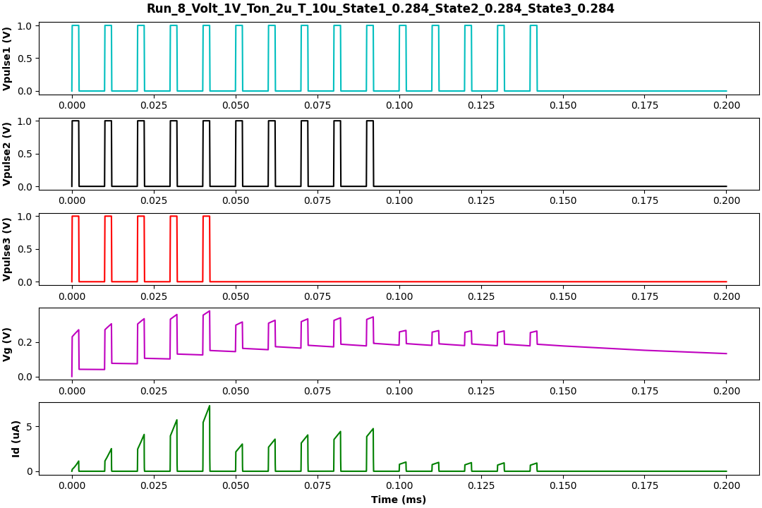
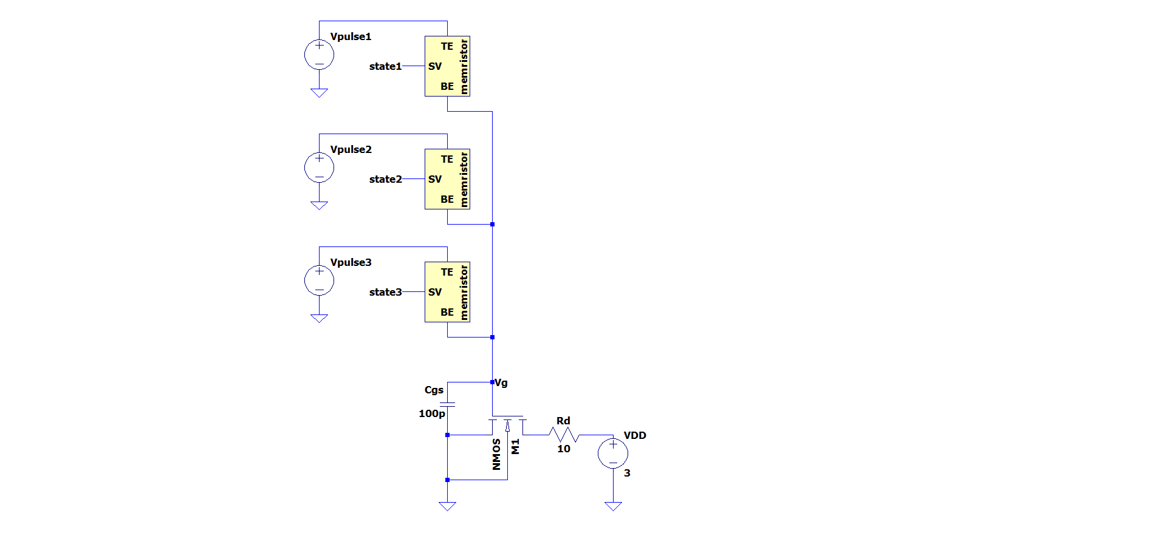
Pulse input response of 3x1 pseudo-memcapacitive transistor
CIRCUIT DIAGRAM
When all memristor state are ON, the current (Id) is about 20 µA. When all memristor state are OFF, the current (Id) is roughly 5 µA.

Slide 6
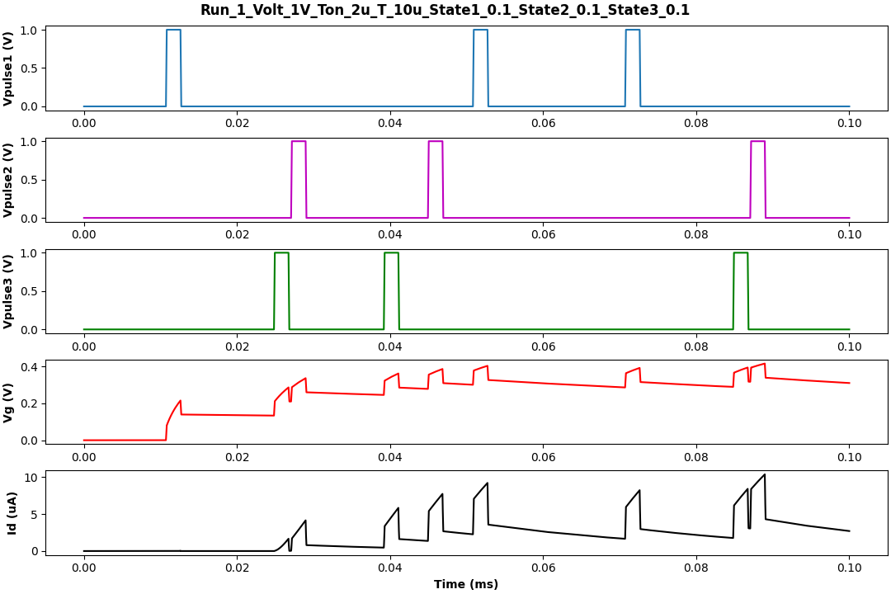
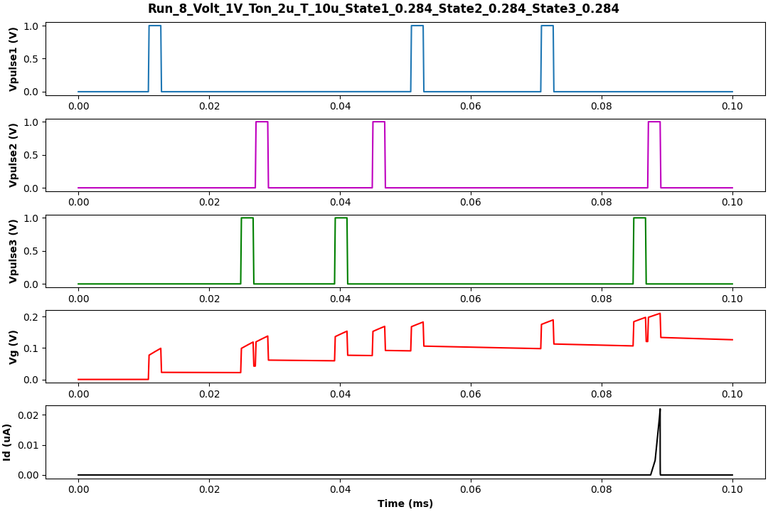
TTFP input response of 3x1 pseudo-memcapacitive transistor
TTFP (Time to First Pulse) input displays a measurable Id when all the memristors are ON, and a negligible Id when all the memristors are OFF.

Slide 7
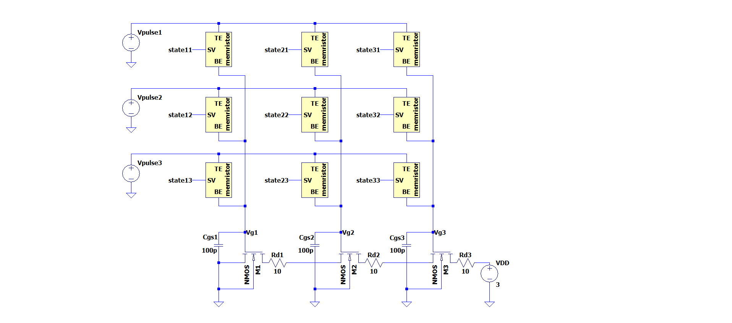
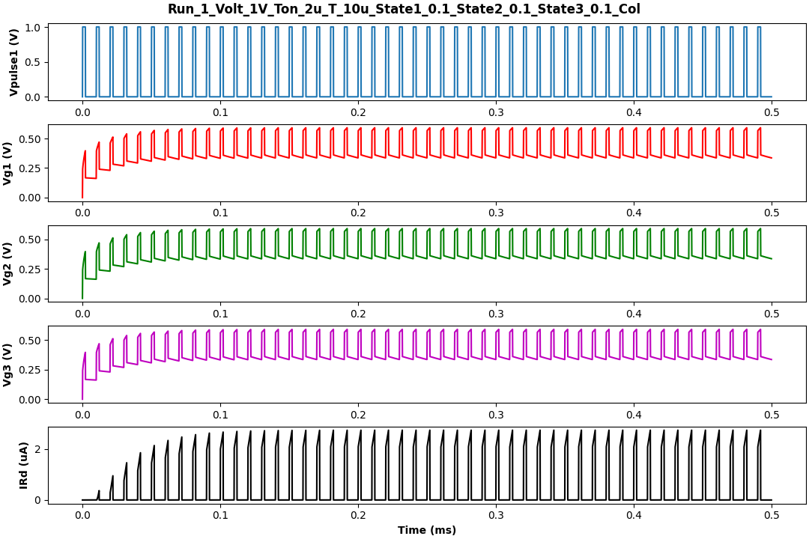
Pulse input response of 3x3 pseudo-memcapacitive transistor
3X3 Memristor State
LRS | LRS | LRS
LRS | LRS | LRS
LRS | LRS | LRS
When all the memristor are in low resistance state (LRS), an Id of approximately 2 µA flows.
Vth of NMOS transistor = 0.4V

Slide 8
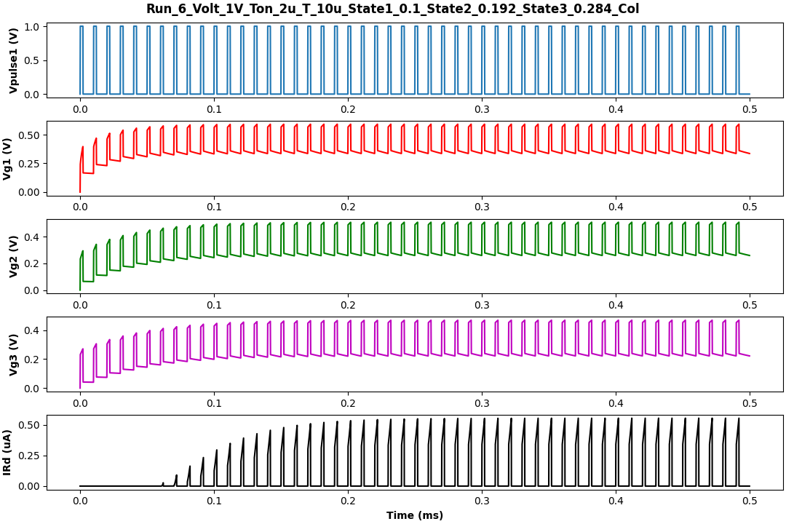
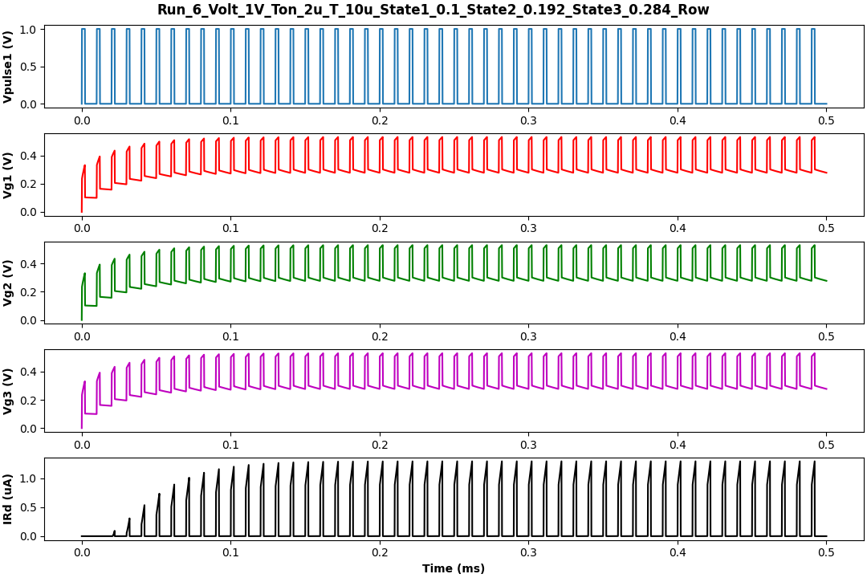
Response of 3x3 pseudo-memcapacitive transistor for different state
3X3 Memristor State
LRS | IRS | HRS
LRS | IRS | HRS
LRS | IRS | HRS
3X3 Memristor State
LRS | LRS | LRS
IRS | IRS | IRS
HRS | HRS | HRS
LRS – Low Resistance State
IRS – Intermediate Resistance State
HRS – High Resistance State

Slide 9
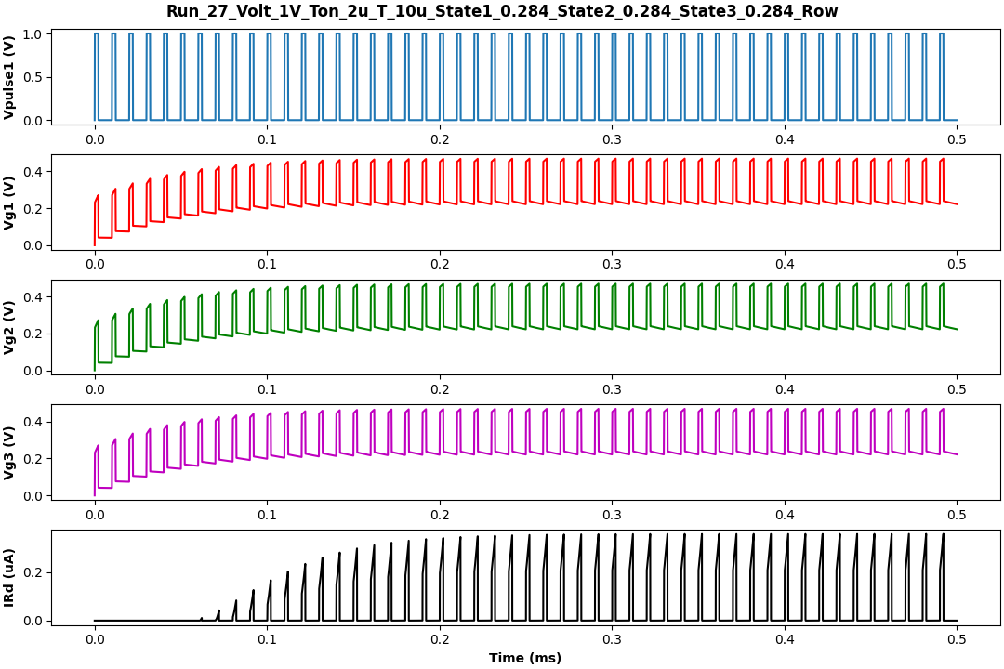
Conclusion of 3x3 pseudo-memcapacitive transistor
3X3 Memristor State
HRS | HRS | HRS
HRS | HRS | HRS
HRS | HRS | HRS
MEMRISTOR STATE | Id (µA)
All in LRS | 2 µA
3 in LRS, IRS and HRS (row) | 1 µA
3 in LRS, IRS and HRS (column) | 0.5 µA
All in HRS | 0.4 µA
The maximum current flows when all the memristors are in LRS.
The observed Id is four times greater when all the memristors are in the LRS compared to when they are in the HRS.

Slide 10
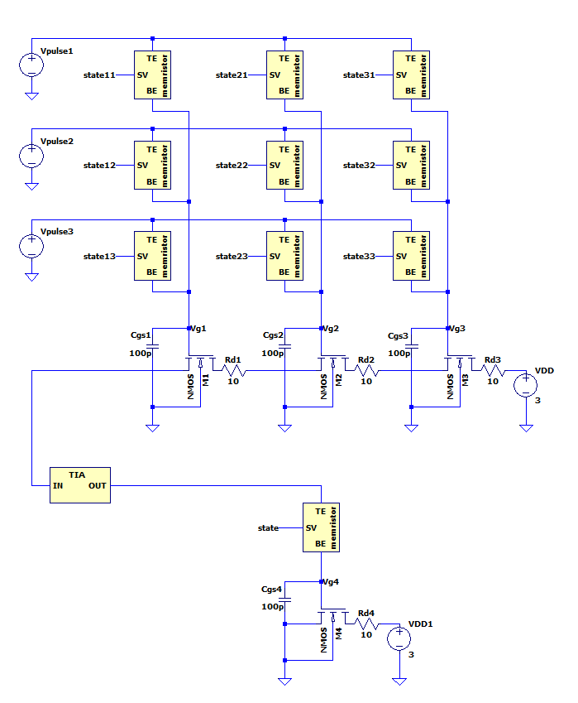
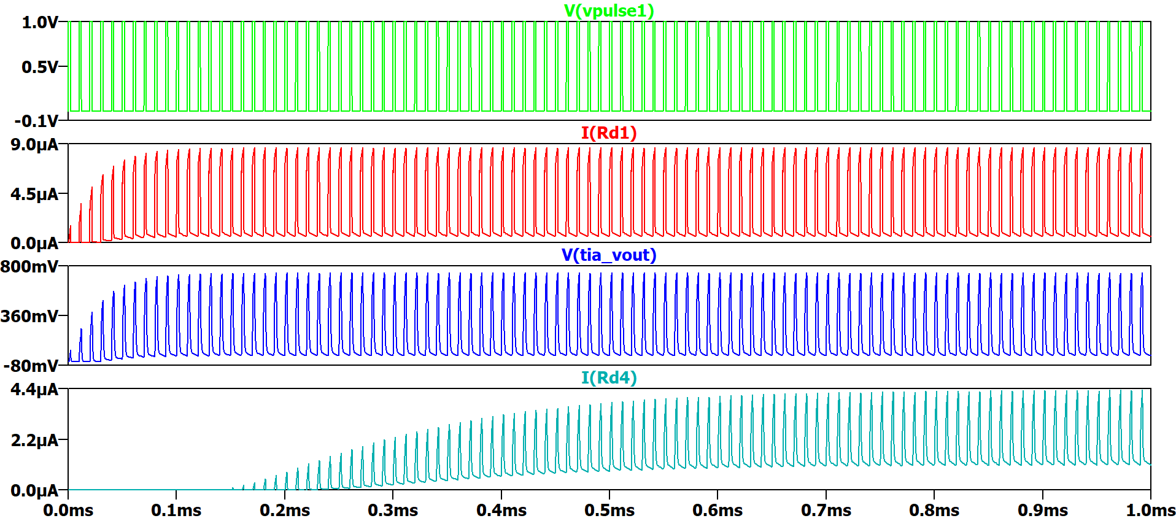
Spiking Neural Network
TIA (Transimpedance Amplifier) are used to cascade the pseudo-memcapacitive transistor to realize a spiking neural network structure.
Cascaded 3x3 pseudo-memcapacitive transistor with single pseudo-memcapacitive transistor.
Time

Slide 11
Summary
The Id (drain current) spikes when gate voltage exceeds Vth of transistor = 0.2V.
For 1V pulse input of 2us the ON state Id is approximately four times the OFF state in single pseudo-memcapacitive transistor
TTFP (Time to First Pulse) input displays a measurable Id when all the memristors are ON, and a negligible Id when all the memristors are OFF in 3x1 pseudo-memcapacitive transistor.
The maximum current flows when all the memristors are in LRS because the transistors are turned on in 3x3 pseudo-memcapacitive transistor
TIA (Transimpedance Amplifier) are used to cascade the pseudo-memcapacitive transistor to realize a spiking neural network structure.

Slide 12
THANK YOU

