Slide 1
git clone https://bitbucket.org/ibatadvweb/course-lessons.git

Slide 2
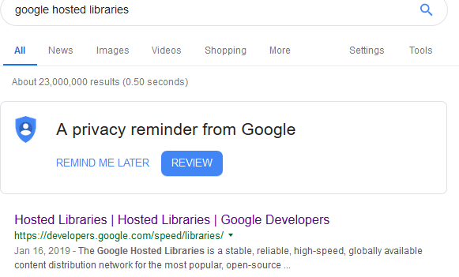

Slide 3
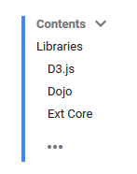
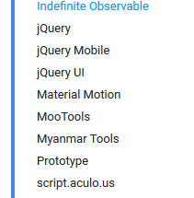
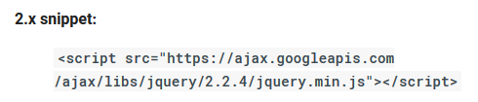

Slide 4
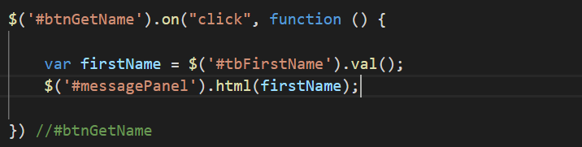
Web Task (Jquery)
Create an input box
Retrieve number from input
e.g age
Add 5
Place result in a div
e.g. messagePanel
What happens and why

Slide 5
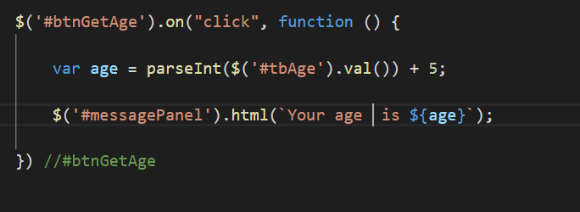

Slide 6
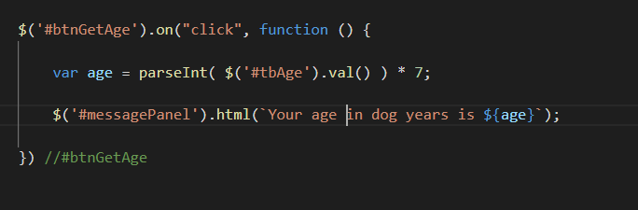
Web Task
Modify previous code to show age in dog years

Slide 7
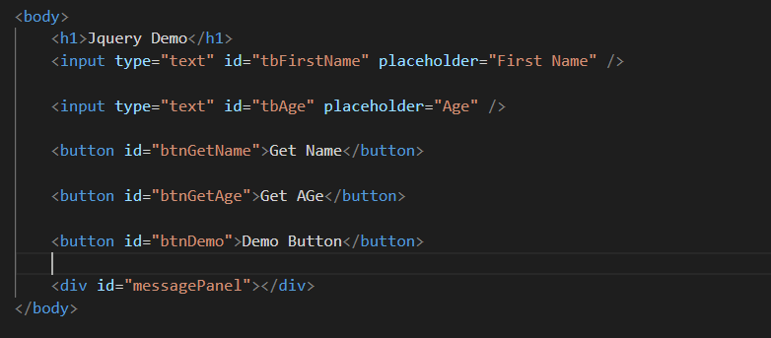

Slide 8
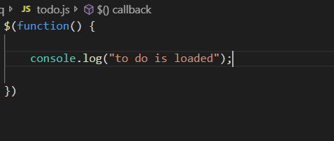

Slide 9
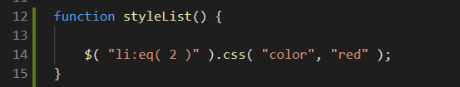

Slide 10
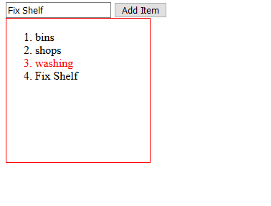
Called at end of render
How would you deal with the fact there is another list on the page that you don’t want styled?
How would you go about marking and tracking which items you have completed?
Hint: json object
How to filter to show only completed / to be completed items
Hint: array.filter

