Slide 1
git clone https://bitbucket.org/ibatadvweb/course-lessons.git

Slide 2
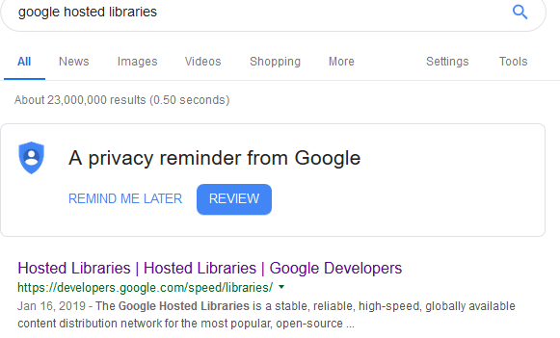

Slide 3
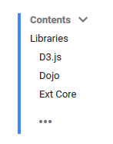
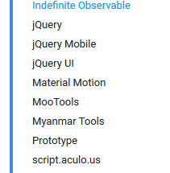
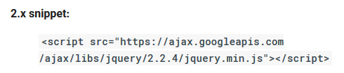

Slide 4
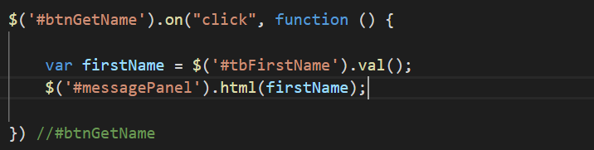
Web Task (Jquery)
Create an input box
Retrieve number from input
e.g age
Add 5
Place result in a div
e.g. messagePanel
What happens and why

Slide 5
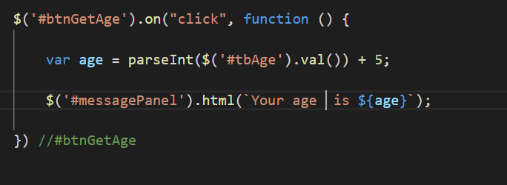

Slide 6
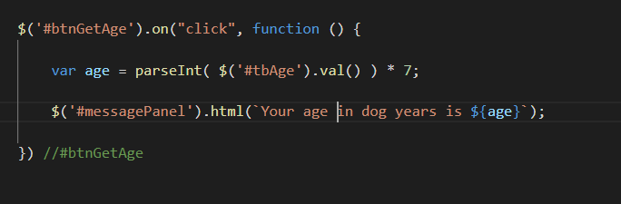
Web Task
Modify previous code to show age in dog years

Slide 7
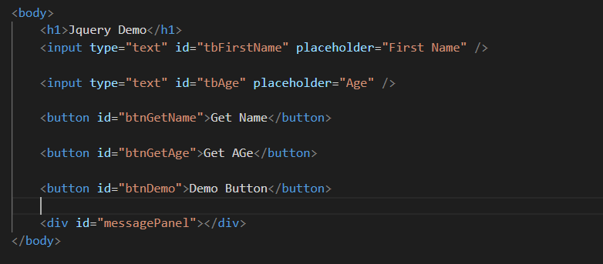

Slide 8
