Slide 1
Intro to Population Genetics: Hardy-Weinberg

Slide 2
Outline

Slide 3
Qualitative vs Quantitative Predictions

Slide 4
Blending vs Particulate Inheritance

Slide 5
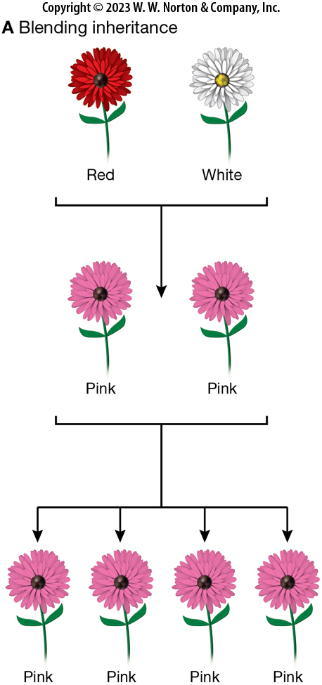
Notes:
Figure 6.2a
Blending inheritance versus particulate inheritance. Darwin, like most of his contemporaries, viewed heredity as a blending process. In this view, offspring tend to resemble their parents—and where parents differ in phenotype, offspring exhibit an intermediate value. Under this blending model, the process of inheritance irreversibly reduces variation in the population. (A) Under blending inheritance, the offspring of a red-flowered and a white-flowered parent would be pink; the offspring of these pinkflowered individuals would also be pink.

Slide 6
Notes:
Figure 6.2a
Blending inheritance versus particulate inheritance. Darwin, like most of his contemporaries, viewed heredity as a blending process. In this view, offspring tend to resemble their parents—and where parents differ in phenotype, offspring exhibit an intermediate value. Under this blending model, the process of inheritance irreversibly reduces variation in the population. (A) Under blending inheritance, the offspring of a red-flowered and a white-flowered parent would be pink; the offspring of these pinkflowered individuals would also be pink.

Slide 7
Notes:
Figure 6.2a
Blending inheritance versus particulate inheritance. Darwin, like most of his contemporaries, viewed heredity as a blending process. In this view, offspring tend to resemble their parents—and where parents differ in phenotype, offspring exhibit an intermediate value. Under this blending model, the process of inheritance irreversibly reduces variation in the population. (A) Under blending inheritance, the offspring of a red-flowered and a white-flowered parent would be pink; the offspring of these pinkflowered individuals would also be pink.

Slide 8
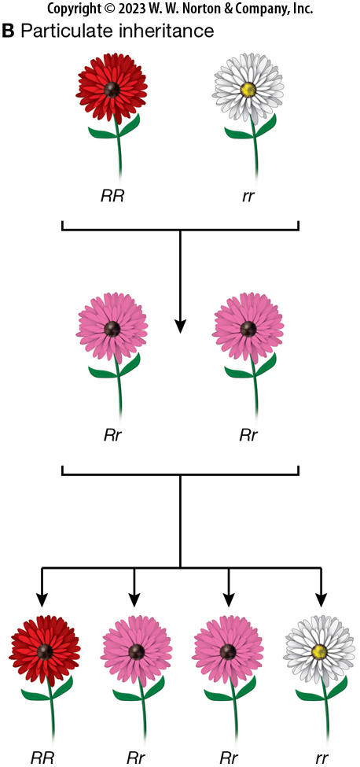
Notes:
Figure 6.2b
Blending inheritance versus particulate inheritance. Darwin, like most of his contemporaries, viewed heredity as a blending process. In this view, offspring tend to resemble their parents—and where parents differ in phenotype, offspring exhibit an intermediate value. Under this blending model, the process of inheritance irreversibly reduces variation in the population. (B) Under particulate inheritance, the offspring of redflowered (RR) and white-flowered (rr) parents might also be pink (Rr). But these pink offspring, when crossed, could re-create the red and white phenotypes among their offspring.

Slide 9
Notes:
Figure 6.2b
Blending inheritance versus particulate inheritance. Darwin, like most of his contemporaries, viewed heredity as a blending process. In this view, offspring tend to resemble their parents—and where parents differ in phenotype, offspring exhibit an intermediate value. Under this blending model, the process of inheritance irreversibly reduces variation in the population. (B) Under particulate inheritance, the offspring of redflowered (RR) and white-flowered (rr) parents might also be pink (Rr). But these pink offspring, when crossed, could re-create the red and white phenotypes among their offspring.

Slide 10
Notes:
Figure 6.2b
Blending inheritance versus particulate inheritance. Darwin, like most of his contemporaries, viewed heredity as a blending process. In this view, offspring tend to resemble their parents—and where parents differ in phenotype, offspring exhibit an intermediate value. Under this blending model, the process of inheritance irreversibly reduces variation in the population. (B) Under particulate inheritance, the offspring of redflowered (RR) and white-flowered (rr) parents might also be pink (Rr). But these pink offspring, when crossed, could re-create the red and white phenotypes among their offspring.

Slide 11
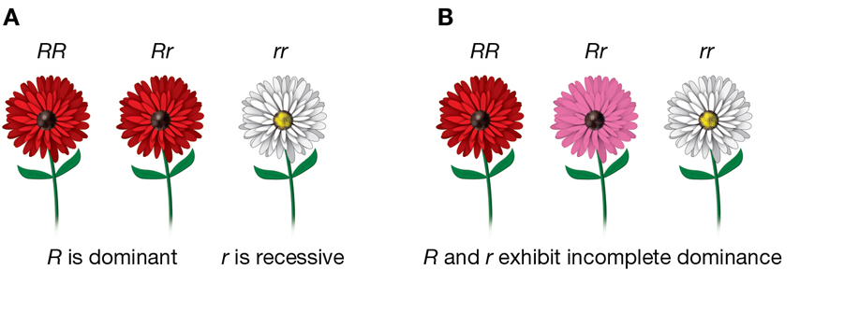
Notes:
Figure 6.9
Dominance relationships. (A) If the R allele is dominant and the r allele is recessive, then the RR homozygote and the Rr heterozygote reveal the same phenotype. (B) If the R and r alleles exhibit incomplete dominance, then the Rr heterozygote manifests a phenotype that is intermediate between that of the RR homozygote
and the rr homozygote.

Slide 12
Law of Segregation

Slide 13
Law of Independent Assortment

Slide 14
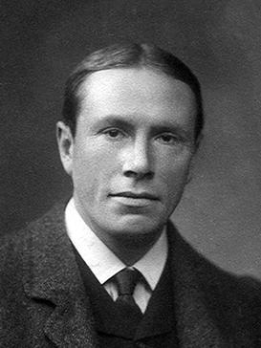
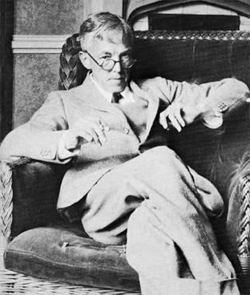
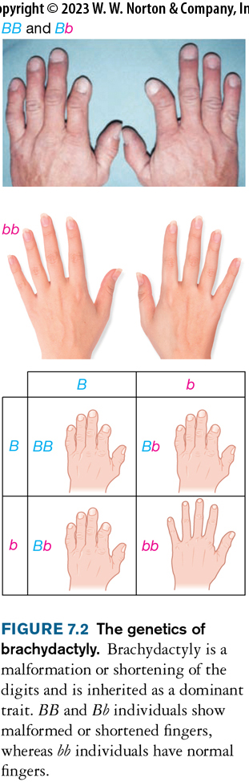
Brachydactyly, Punnett, and Hardy
Notes:
Figure 7.2
The genetics of brachydactyly. Brachydactyly is a malformation or shortening of the digits and is inherited as a dominant trait. BB and Bb individuals show
malformed or shortened fingers, whereas bb individuals have normal fingers.

Slide 15
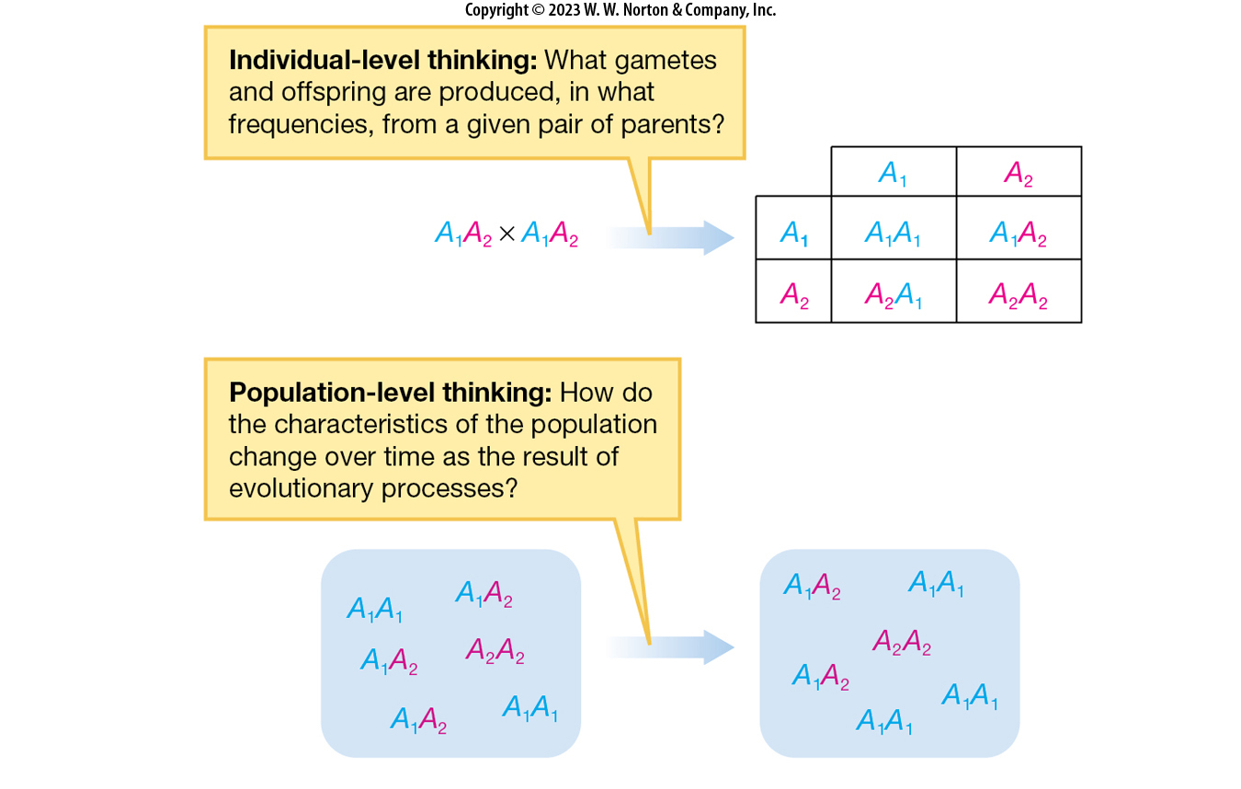
Going from the individual to the population
Notes:
Figure 7.3
Individual-level thinking versus population-level thinking. Individual-level and population-level approaches ask different questions.

Slide 16
Hardy-Weinberg: A null model for allele frequency change

Slide 17
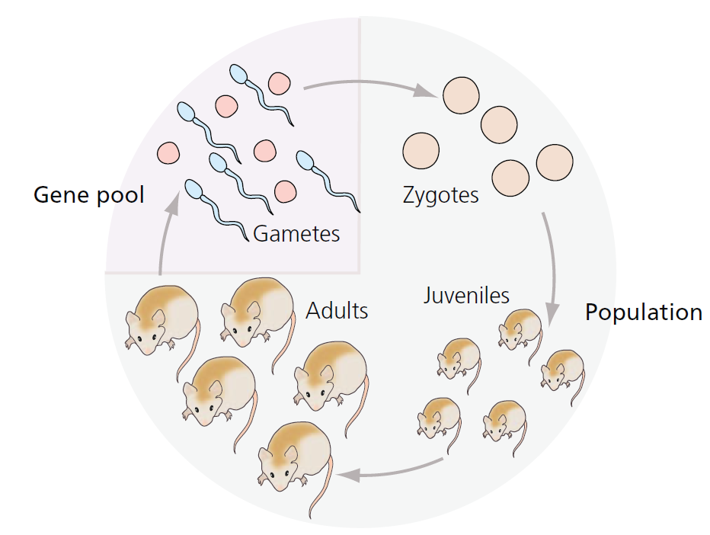
Hardy-Weinberg: A null model for allele frequency change

Slide 18
Violations of Hardy-Weinberg: Selection

Slide 19
Violations of Hardy-Weinberg: Mutation

Slide 20
Violations of Hardy-Weinberg: Drift

Slide 21
Violations of Hardy-Weinberg: Migration

Slide 22
Violations of Hardy-Weinberg: Non-random mating

Slide 23
Hardy-Weinberg: Conclusions

Slide 24
Frequencies/Probabilities: a refresher

Slide 25
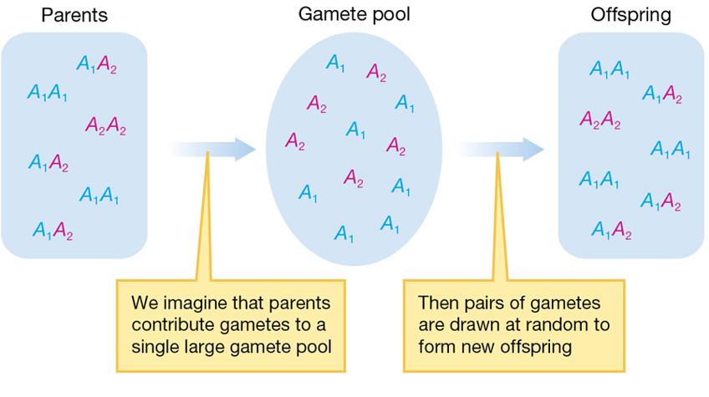
From Genotype Frequencies to Allele Frequencies

Slide 26
From Genotype Frequencies to Allele Frequencies

Slide 27
From Allele Frequencies to Genotype Frequencies

Slide 28
From Allele Frequencies to Genotype Frequencies

Slide 29
Testing for Hardy-Weinberg Equilibrium

Slide 30
Practice

