Slide 1
STA 325L Lab (Sep 30)
Midterm Review
Athena Ru

Slide 2
Exam Instructions
Exam I, Take Home Exam
Release Date: Tuesday, October 1 at 10 AM.
Due Date: Monday October 7th at 5 PM.
Content: Modules 1 – 4 and homework 1 – 3.
The TA’s will not be able to discuss exam format, etc.
There will not be lecture materials on Wednesday (Oct. 3) or Friday (Oct 5) to provide you with additional time to complete the exam or ask clarifying questions.

Slide 3
Exam Instructions Cont.
This is a taken home examination to be completed individually.
Open note, open book, and class resources (please cite, i.e., Module 4 Slide 13).
The exam is closed to talking to students (or anyone else except your instructor or TAs in the course).
We will only answer clarification questions and not anything about course material for the exam.
You may not use Google, ChatGPT, or other online resources. You may utilize any suggested books or resources listed for the course materials.
You may not talk to anyone about the exam until the grades are released to the entire class.
Clarification questions will be addressed and should be asked to the instructor (and teaching assistants privately on Canvas).
No group postings should be made regarding the exam or exam related material.
Your submission must be to Gradescope and to Canvas (in the same format) as the homework.

Slide 4
Data Cleaning Pipeline
Rebecca C. Steorts August 30, 2024
1 / 28

Slide 5
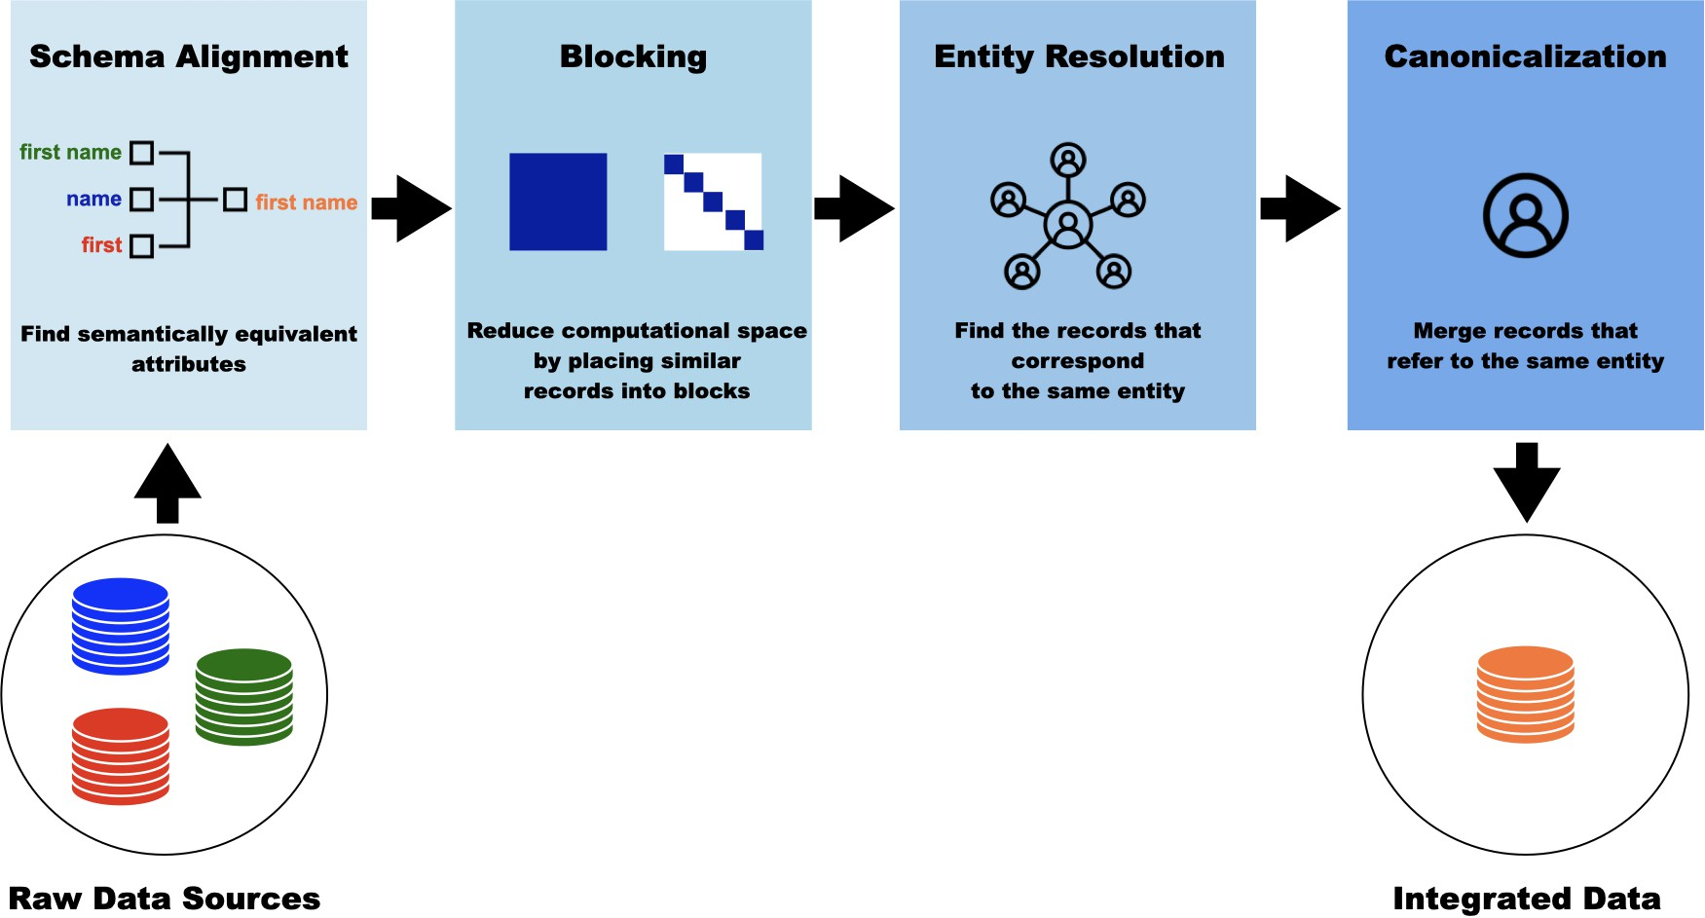
Recognize the 4 steps!
4 / 28

Slide 6
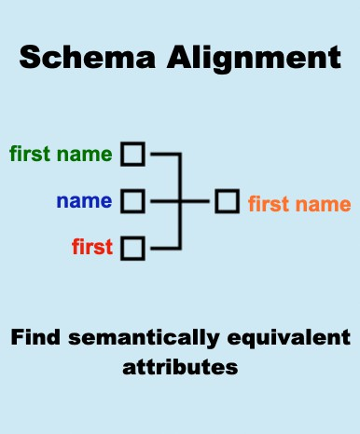
7 / 28

Slide 7
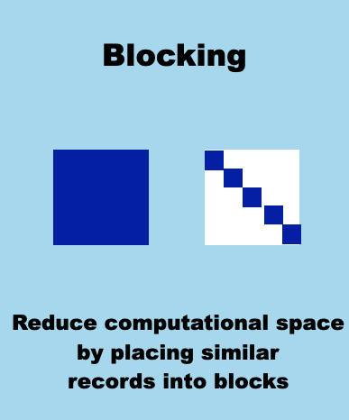
HW 2
13 / 28

Slide 8
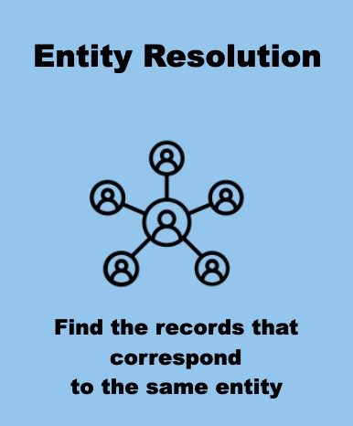
HW 3
24 / 28

Slide 9


Slide 10
Preliminaries
Rebecca C. Steorts
September 6, 2024
1 / 28

Slide 11
Entity resolution (ER) is the process of merging together noisy (structured) databases to remove duplicate entities, often in the absence of a unique identifier.
5 / 28

Slide 12
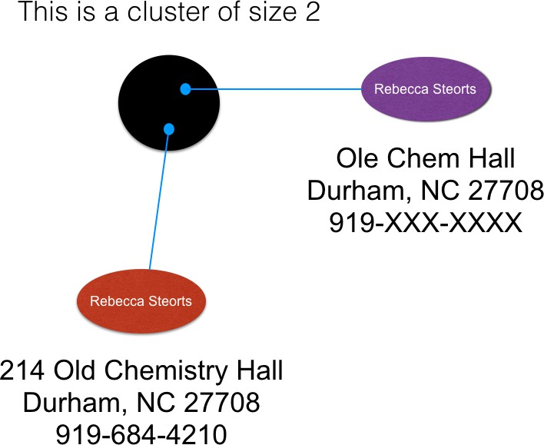
Goal of Entity Resolution
!
To find the most representative records after ER, one must perform canonicalization (data fusion or merging).
12 / 28

Slide 13
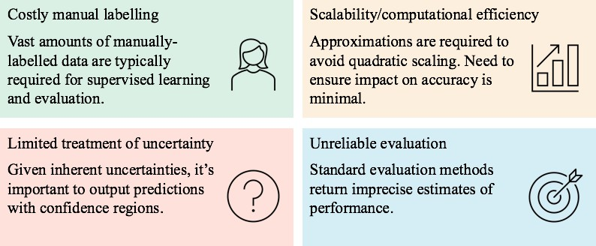
Challenges of Entity Resolution
15 / 28

Slide 14
True Positive (True Matches)
True Positive (TP): These are records that are classified as matches and are true matches.
These are pairs of records that refer to the same person (entity).
H3 Q2: Pairs in lsh_jaccard that are also in cora_gold

Slide 15
True Negatives (True Non-Matches)
True Negative (TN): These record pairs are classified as non-matches, they are true non-matches.
The two records refer to two different entities.
Pairs NOT in lsh_jaccard that are also NOT in cora_gold

Slide 16
False Positive (False Matches)
False Positive (FP): These are record pairs that have been classified as matches, but they are not true matches.
The model made a wrong decision with the record pairs and falsely declared them to be matches.
H3 Q2: Pairs in lsh_jaccard that are NOT in cora_gold

Slide 17
False Negatives (False Non-Matches)
These are record pairs that have been classified as non-matches, but they are actually true matches.
The two record pairs refer to the same entity, but the method made a mistake.
H3 Q2: Pairs in cora_gold that are not in lsh_jaccard

Slide 18
Confusion Matrix
Match (M)
Non-Match (NM)
N = total records
N | Predicted
 |  | M | NM
Actual | M | TP (true matches) | FN
 | NM | FP | TN (true non-matches)
Review H2 Q3 (a)
23 / 28

Slide 19
Evaluation Metrics
TP
Precision =
TP + FP
Measures how precise a method is in classifying true matches.
TP
Recall =
TP + FN
Measures how accurately the actual true matching pairs of records are correctly classified as matches.
Review H3 Q2

Slide 20
Evaluation Metrics
2 × Precision × Recall
F-Measure =
Precision + Recall
Harmonic mean of the precision and recall.
Attempts to summarize all aspects of the effectiveness of an entity resolution method.
If low F-measure: in general, the classifier has difficulty accurately classifying record pairs correctly most of the time.
Review H2 Q3 (e)

Slide 21
Module 3: Deterministic Blocking
Rebecca C. Steorts
joint with Olivier Binette
1 / 45

Slide 22
Blocking
Blocking places similar records into partitions/blocks.
ER (typically) is only performed within each block.

Slide 23
Traditional Blocking
Benefits: simple, easy to understand, and fast to implement.
Downsides: the blocks are treated as error free, which is not usually accurate and can lead to errors in the ER task that cannot be accounted for.

Slide 24
Evaluation Metrics
Evaluation metrics are important for ER as they help us evaluate our proposed methodology (as long as some notion of ground truth exists).
We will focus on:
reduction ratio
precision
recall
f-measure

Slide 25
Reduction Ratio
The reduction ratio (RR) measures the relative reduction of the comparison space from the de-duplication or hashing technique.
See Christen (2012), Steorts, Ventura, Sadinle, Fienberg (2014) for a formal definition.

Slide 26
Pairwise evaluation metrics
Recall = ^{TP} = 1 − FNR.
TP + FN
Precision = ^{TP} = 1 − FDR.
TP + FP
_{F-measure = 2 ×} (precision × recall) .
(precision + recall )
Review H2 Q4 (d)

Slide 27
Recall
For blocking, it is critical the recall be as close a possible to 1.
To think about why, what does it mean if we have a blocking criterion where our recall is 0.5?
50 percent of true matching pairs are correctly classified as matches – no better than a coin toss.

Slide 28

RLdata500 (Continued)
# Total number of all to all record comparisons
choose(500,2)
## [1] 124750
Total all-to-all record comparisons = $\left({n \atop 2}\right)$
24 / 45

Slide 29
RLdata500 (Continued)
What is the overall dimension reduction from the original space to the reduced space induced by blocking?

Slide 30
How do we calculate the reduction ratio (RR)?
The reduction ratio is
RR = % comparisons eliminated by blocking.
(choose(500, 2) - sum(choose(recordsPerBlock, 2))) /
choose(500, 2)
## [1] 0.8813226

Slide 31
How do we calculate the RR (via a function)?
reduction.ratio <- function(block.labels) { n_all_comp = choose(length(block.labels), 2) n_block_comp = sum(choose(table(block.labels), 2))
(n_all_comp - n_block_comp) / n_all_comp
}
reduction.ratio(last_init) ## [1] 0.8813226
This function only works for blocking (you had to write your own in HW3 Q1)

Slide 32
In summary, we have reduced the comparison space by roughly by 88 percent.
Reduction Ratio

Slide 33
Pairwise Precision
precision <- function(block.labels, IDs) { ct = xtabs(~block.labels+IDs)
# Number of true positives
TP = sum(choose(ct, 2))
# Number of positives = TP + FP
P = sum(choose(rowSums(ct), 2))
return(TP/P)
}
For blocking only!

Slide 34
Pairwise Recall
recall <- function(block.labels, IDs) { ct = xtabs(~IDs+block.labels)
# Number of true positives
TP = sum(choose(ct, 2))
# Number of true links = TP + FN
TL = sum(choose(rowSums(ct), 2))
return(TP/TL)
}
For blocking only!

Slide 35
Interpretation
The recall says that 100 percent of the true matching record pairs are correctly classified as matches.
The precision says that 0.34 percent of record pairs that are classified as matches correspond to true matches, while the rest correspond to false matches.
In summary, we would not want to use this for an entity resolution algorithm. Why is this?
37 / 45

Slide 36
Summary
Blocking is a method that puts similar records into blocks or bins.
Main metrics for blocking are recall and reduction ratio.
Balance between size of blocks and number of blocks.
45 / 45

Slide 37
Module 4: Probabilistic Blocking, Part I
Rebecca C. Steorts
1 / 30

Slide 38
Locality sensitive hashing (LSH) is a fast method of blocking for record linkage that orginates from the computer science literature.
LSH
6 / 30

Slide 39
Finding similar records
Our goal is to find similar records, where the records are assumed to be strings
How do we define similar?

Slide 40
Jaccard similarity
Consider the Jaccard similarity:
Jac(S, T ) = ^{| S ∩ T |} ,
| S ∪ T |
where
| S ∩ T |= the number of members shared between sets S, T
and
| S ∪ T |= the total number of members in both sets S, T.
How can you do this in R?

Slide 41
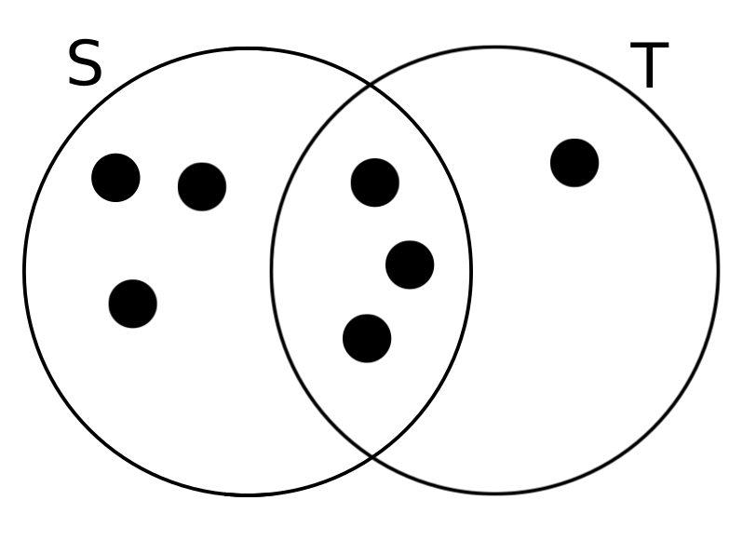
Jaccard similarity
Figure 3: Two sets S and T with Jaccard similarity 3/7. The two sets share 3 elements in common, and there are 7 elements in total.

Slide 42
How to represent data as sets?
We want to talk about the similarity of our data (records)⇒ we need to compare sets of records!
We can construct a set of short strings from the data
This is useful because similar datasets will have many common elements (common short strings)
We can do construct these short strings using shingling

Slide 43
k-shingling (how-to)
Think of the data set as a string of characters
A k-shingle (k-gram) is any sub-string (word) of length k found within the a record of the data set
Associate with each data set the set of k-shingles that appear one or more times

Slide 44
Let’s try
Suppose our data set is the string “Hello world”, then
the set of 2-shingles is {he, el, ll, lo, ow, wo, or, rl, ld}
the set of 3-shingles is {hel, ell, llo, low, owo, wor, orl, rld}

Slide 45
Your turn solution
The 2-shingles for the first record are
{mi, ic, ch, ha, ae, el, lv, vo, og, ge, el} and for the second are
{mi, ic, ch, ha, ae, el, lm, me, ey, ye, er}
There are 6 items in common {mi, ic, ch, ha, ae, el} and 15 items total {mi, ic, ch, ha, ae, el, lv, vo, og, ge, lm, me, ey, ye, er},
so the Jaccard similarity is ⁶ = ² = 0.4
15 5
3. You should have learned that this is very tedious to do by hand!

Slide 46
Useful packages/functions in R
From the exercise, you should have learned that we don’t want to do this by hand!
Here are some useful packages in R that can help us!
library(textreuse) # text reuse/document similarity
library(tokenizers) # shingles
All packages needed for the exam will be preloaded.

Slide 47
Your turn (solution)
# create shingles for both names
token.1 <-
tokenize_character_shingles("MICHAELVOGEL", n=2) token.2 <-
tokenize_character_shingles("MICHAELMEYER", n=2)
# compute jaccard similarity
# use unlist() to flatten the list into a character vector
jaccard_similarity(unlist(token.1),unlist(token.2))
## [1] 0.4
19 / 30

Slide 48
Module 4: Probabilistic Blocking, Part II
Rebecca C. Steorts
1 / 30

Slide 49
Locality sensitive hashing (LSH) is a fast method of blocking for record linkage that orginates from the computer science literature.
LSH
4 / 30

Slide 50
Hash function
We are looking for a hash function h() such that
if sim(A, B) is high, then with high prob. h(A) = h(B).
if sim(A, B) is low, then with high prob. h(A) /= h(B).

Slide 51
Hashing shingles
Instead of storing the strings as shingles, we store the hashed values.
These are integers (instead of strings).
We do this because the integers take up less memory, so we are performing a type of dimension reduction.

Slide 52
Characteristic matrix (continued)
We can visualize the records (columns) and the hashed shingles in a large, binary characteristic matrix.

Slide 53
Characteristic matrix (continued)
# inspect results
kable(char_mat[1:10, 5:10])
 | Record | Record | Record | Record | Record | Record
 | 5 | 6 | 7 | 8 | 9 | 10
466016402 | 1 | 1 | 1 | 1 | 1 | 0
- 1270983012 | 1 1 | 1 1 | 1 1 | 1 1 | 1 0 | 0 0
- | 1 | 1 | 1 | 1 | 0 | 0
1170519627 2082481628 | 1 | 1 | 1 | 1 | 0 | 0
60115271 | 1 | 1 | 1 | 1 | 0 | 0
- | 1 | 1 | 1 | 1 | 1 | 0
883068501 - | 1 | 1 | 1 | 1 | 1 | 1
1062212181 - | 1 | 1 | 1 | 1 | 1 | ⁰ 11 / 30
105604907

Slide 54
Similarity preserving summaries of sets
Sets of shingles are large (larger than the original data set)
If we have millions of records in our data set, it may not be possible to store all the shingle-sets in memory
We can replace large sets by smaller representations, called
signatures
We can use the signatures to approximate Jaccard similarity

Slide 55
Apply the Minhash
We want to create the signature matrix through minhashing
Permute the rows of the characteristic matrix m times
Iterate over each column of the permuted matrix
Populate the signature matrix, row-wise, with the row index from the first 1 value found in the column
The signature matrix is a hashing of values from the permuted characteristic matrix and has one row for the number of permutations calculated (m), and a column for each record.

Slide 56
Minhash Example
Element | S₁ | S₂ | S₃ | S₄
a | 1 | 0 | 0 | 1
b | 0 | 0 | 1 | 0
c | 0 | 1 | 0 | 1
d | 1 | 0 | 1 | 1
e | 0 | 0 | 1 | 0

Slide 57
Minhash Example
Element | S₁ | S₂ | S₃ | S₄
b | 0 | 0 | 1 | 0
e | 0 | 0 | 1 | 0
a | 1 | 0 | 0 | 1
d | 1 | 0 | 1 | 1
c | 0 | 1 | 0 | 1
Step 1: Permute rows

Slide 58
Minhash Example
Element | S₁ | S₂ | S₃ | S₄
b | 0 | 0 | 1 | 0
e | 0 | 0 | 1 | 0
a | 1 | 0 | 0 | 1
d | 1 | 0 | 1 | 1
c | 0 | 1 | 0 | 1
Step 2 & 3: Find row index with first “1” in each column
First row of Signature Matrix: [3, 5, 1, 3]

Slide 59
Minhash Example
Repeat m times to create signature matrix.
Minhash function basically permutes (re-orders) the rows of the characteristic matrix

Slide 60
Signature matrix and Jaccard similarity
The relationship between the Signature matrix and the Jaccard Similarity is
Pr {min[π(A)] = min[π(B)]} = ^{|A ∩ B|}
|A ∪ B|
Min-hashing two sets gives same value
We use this relationship to approximate the similarity between any two records
The number of agreements over the total number of combinations is an approximation to Jaccard measure

Slide 61
Locality Sensitive Hashing (LSH) to the Rescue
We want to hash items several times such that similar items are more likely to be hashed into the same bucket.
Divide the signature matrix into b bands with r rows each so m = b ∗ r where m is the number of times that we drew a permutation of the characteristic matrix in the process of minhashing
Each band is hashed to a bucket by comparing the minihash for those permutations
If they match within the band, then they will be hashed to the same bucket
If two documents are hashed to the same bucket, they will be considered candidate pairs
We only check candidate pairs for similarity
20 / 30

Slide 62
HW 3 Q2 Partial Solutions
# vector of candidate lsh pairs
lsh_pairs <- paste(lsh_jaccard$a, lsh_jaccard$b)
# vector of ground truth record pairs
cora_gold_pairs <- paste(cora_gold$id1, cora_gold$id2)
true_positive <- sum(lsh_pairs %in% cora_gold_pairs) # 58629
# lsh predicts a record pair but it's not a true pair
false_positive <- sum(!(lsh_pairs %in% cora_gold_pairs)) # 69082
# lsh predicted these to be not matches but they are true matches
false_negative <- sum(!(cora_gold_pairs %in% lsh_pairs)) # 5949
recall <- true_positive / (true_positive + false_negative)
precision <- true_positive / (true_positive + false_positive)
19 / 30

Slide 63
General tips
Review HW (especially HW 3 partial solutions on GitHub)
All packages needed will be loaded for you
You do not need online sources to solve the exam – everything can be found in HW or course slides
Do what the Hint tells you to do (you might think there’s a quicker/easier way, but you will likely get a different number!)
If you have a clarification question when taking the midterm, please post privately to Canvas
Good luck!

