Slide 1
典型人物和场景
邹欣
构建之法 – 现代软件工程
2014

Slide 2
Agenda
Class business
Review scores so far
Project review
It’s ok to do “small” projects
Requirement Analysis
Persona and Scenarios
Work Break-down Structure
Exercise
Notes:
TA and I will check:
The TFS work items (or other forms in equivalent tools).
One typical end-to-end scenario, and break it down to detail work items.
Assignment of work items to each person.
Scrum Chart, the “remaining work report” in TFS, or other equivalent form.

Slide 3
Persona
Requirement analysis -> Persona (典型用户)
3 examples
Visual Studio
Academic Search
Discuss your own persona
Present the personas in your project
With name, picture, personal bio
Why such personas will use and love your software?

Slide 4
Persona – used in Visual Studio
Challenges for Visual Studio Team
there are millions of customers, using the software in different ways, for different purpose…
VB, C#, C++, MFC, asp.net, J#, TFS, .Net Framework
Hobbyist, students, professionals,
Server, PC, embedded, web,
Team size – 1..1000
Different culture and country
how to design the next version to satisfy most of them?
How to make sure the target customers get the benefit from end-to-end?
There are 500 developers working in VS team, how do we convince all of them agree on serving the same group of customers?

Slide 5
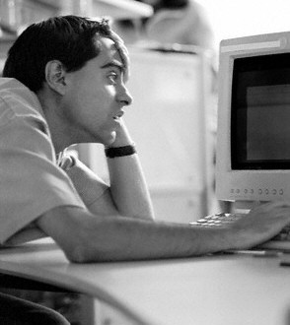
Mort
Mort, the opportunistic developer, likes to create quick-working solutions for immediate problems and focuses on productivity and learn as needed.
Mort is someone who doesn't consider programming their main job. Maybe they are a statistician, biologist, or construction estimator, who also knows quite a bit about programming. They are opportunistic, using whatever tool comes to hand that will get the job done.
Notes:
http://blogs.msdn.com/ericwhite/archive/2006/05/11/595693.aspx

Slide 6
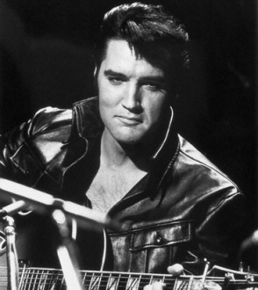
Elvis
Elvis the pragmatic programmer, likes to create long-lasting solutions addressing the problem domain, and learning while working on the solution.
Elvis: journeyman developer.
You can scope out a job and give it to them, and the job will get done. In general, Morts don't become Elvises. Morts want to do their main job; they don't WANT to become a professional developer. Elvises go to school and get CS degrees.

Slide 7
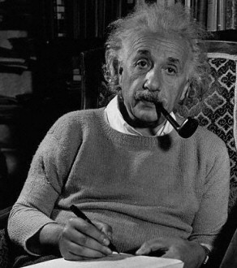
Einstein
Einstein, the paranoid programmer, likes to create the most efficient solution to a given problem, and typically learn in advance before working on the solution.
Einstein is a smart Elvis who has lots of experience.
Einstein can see the big picture. An Einstein often is in a position of responsibility, choosing technologies and designing large software systems.

Slide 8
Personas
In a way, these personas have helped guide the design of features during the Whidbey (Visual Studio 2005) product cycle.
Examples:
a library that makes explicit use of parsers and abstract expression trees
Einstein
forms library that allows developers to set properties to connect to database tables
Elvis
A set of Excel macros
Mort
Notes:
http://blogs.msdn.com/ericwhite/archive/2006/05/11/595693.aspx

Slide 9
用户/需求分析
找到典型用户
我们就是研究院的研究员，难道我们还不是典型用户?
不是！
典型用户
Senior Researcher
Junior Researcher
Students
专业人士研究用户的UX/UI 需求
找到还没有被满足的需求

Slide 10
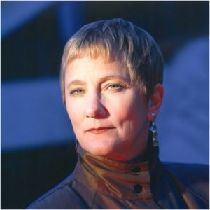
Anita – Senior Research
Researcher working in industrial lab (e.g. MSR researcher)
Education: PhD, Age: >=35, h-index > 20,
PAIN:
Hiring someone / check background
As Chair person, pick reviewers, PC member
Read/organize paper
Care about “my rank” in the domain, and correctness, completeness of my profile,
Care about rank of my dept.
Already know lots of people in such domain, knowing people is not top priority
Big influencer

Slide 11
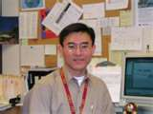
John – Junior Researcher
College assistant professor
Handling both teaching and research
PAIN:
How to let more people know about my work?
Show my performance
Write paper with good reference
Generate a list of paper for a class / curriculum
organize, browse, and attending the right events.
Heavy user
Influencer – can influence students and peers to use our site.
Notes:
If I wan to see the trend and decide my next direction.

Slide 12
John - Scenarios
Scenario
Show my network (co-author, co-occurrence) in my home page
Show my “publication list” via simple javascript.
Track Conferences
See the timeline of a field (e.g. the up and down in papers about “Machine Learning”).
User contribution:
John finds that Libra doesn’t cover all of his papers, he provides a URL via libra UI, and a couple of days, he is happy to find out that libra covers his new papers.

Slide 13
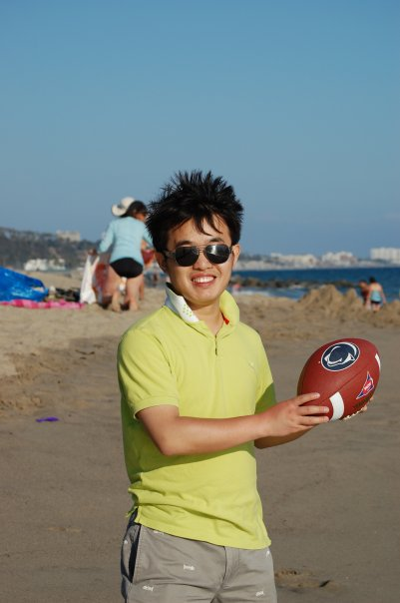
Brian – student
PhD student major in CS
Frequently go online looking for paper for his/her own research,
PAIN?
Working on his 1st or 2nd important paper
Need a comprehensive source of papers for homework and project
Check out researcher profiles (to help apply for advanced study)
Keep track of new papers
Job hunting
English as 2nd language
500K IT students in China

Slide 14
Brian - Scenarios
Notify me when something happens
Get all papers in one field
Related papers
Check the importance of journals, conferences
Name disambiguation
Find Michael Cohen
Find out the “family tree” of a scholar, to understand his/her impact

Slide 15
Persona & Scenario
Persona interact with software
Persona has a “need”
Persona uses the software to solve the “need”, in multiple steps.
Persona’s need is solved, he/she is happy

Slide 16
阿里巴巴 – 卫哲
http://iamsujie.com/8000/8018/
需求是从哪里来的？目标客户是谁？
有多少人有这样的需求？这个需求紧迫吗？
他们的痛是什么？场景是什么？（用产品之前/之后）
解决之后在网站数据上会有什么表现？

Slide 17
Persona Example
Someone designs a teleconference webcam, and it will scan the whole meeting room to locate face and show all attendees to remote attendees
Design without persona
Assume everyone sitting at the table can be visible
Design with persona
Persona – program managers who goes to meeting all the time
Andy – has laptop with him all the day, he would use laptop in the meeting.
Issues: when Andy opens his laptop, the webcam can’t see Andy’s face, blocked by the laptop screen. The scenario will fail.
The webcam position is not high enough!

Slide 18
Some text and picture from the web

Slide 19
WBS – Work Break Down
Divide and conquer
Top level (a product)
Mid-level (features) - user perspective, scenario
Lower level (feature implementation) – team perspective
Lowest level (module) – dev perspective
Change perspective from user to team member

Slide 20
WBS – different levels
software
Scenario
feature1
Feature2
Scenario
UI
Market
End user
Feature3
Logic
DB
UI
Logic
DB
UX designer
Dev
Test
Dev
Test
Architect
Dev
Proj mgmt
Design level
Role (dev/test/designer/PM)
Notes:
对于市场来说，某软件团队发布了一款软件，有某种定位和目标人群
对于用户来说，这个软件解决了他的一些需求（场景）
对于PM 来说， 这个软件要用一系列互相合作的功能来实现用户的场景
对于各种层次的设计者来说，这个软件就是一些架构，设计模式，逻辑，数据库的Schema，用户信息架构
对于每个角色来说，他们要处理软件开发的各项细节，用任务，bug 来表示

Slide 21
WBS Exercise
WBS your Team project
Pick one typical scenario
Coordinator (PM), team member
Coordinator layout the requirement.
Member provides WBS and estimation.
Loop
Analysis, Coordinator lead the team to focus biggest estimation delta
Estimate again
Coordinator lead the team to consensus
Consensus!
Team report (30 minutes later)

Slide 22
Persona Exercise
Our perception to the outside world - estimate our user base
Exercise
What’s the browser usage percentage in this class – a quick draw (FF, IE11, IE10, IE9, IE8, IE7, IE6, Opera, Chrome)
What’s your estimation of browser distribution for users of www.renlifang.com? If a feature doesn’t work ONLY in IE6, should we care?
Each team come up with a distribution, 2 rounds of discussion.

Slide 23
Persona Exercise
Conclusion:
We’re not the target user!

Slide 24
Team Exercise
First 15 minutes are very important for an app!
Tell a story about how user loves your app during the first 15 minutes!
Your Team project WBS
Estimation of major work items of your team project

Slide 25
We’re Checking:
The TFS work items (or other forms in equivalent tools).
One typical end-to-end scenario, and break it down to detail work items.
Assignment of work items to each person.
Scrum Chart, the “remaining work report” in TFS, or other equivalent form.
Share your WBS of your whole project, in your team blog.

Slide 26
Scrum
Stay focused, avoid distraction
When we understand a set of tasks we use SPRINT to get it done.
During a SPRINT, your tasks remain fixed, rarely changed.
After a SPRINT, team member re-exam the requirement, and create work items, them prepare for next SPRINT
SCRUM meeting
What you did yesterday (which work item)?
What you plan to do today? (which work item)?
What’s blocking you? (how can we help)?
Run SCRUM for 10 days

Slide 27
Reports
Report can tell us interesting facts about the project
As long as all data were input into TFS,
And updated regularly to reflect the activity of the team

Slide 28
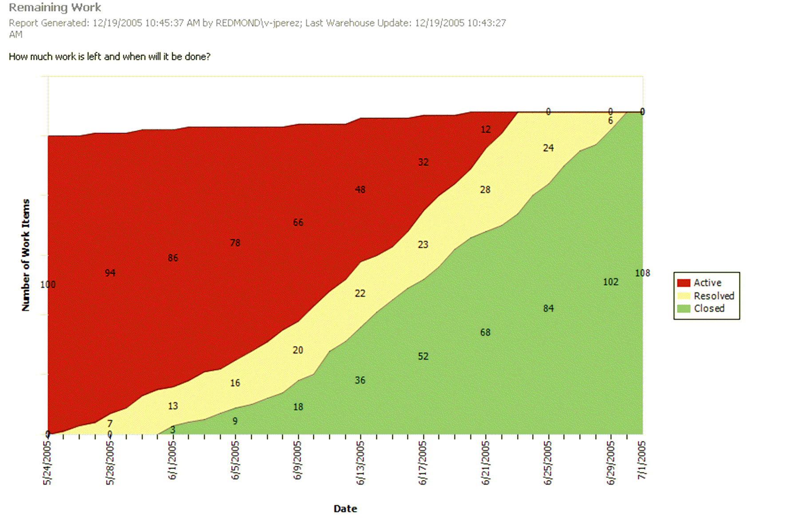


How Far Can We Get In The Available Time?
Work planned
Work completed

Slide 29
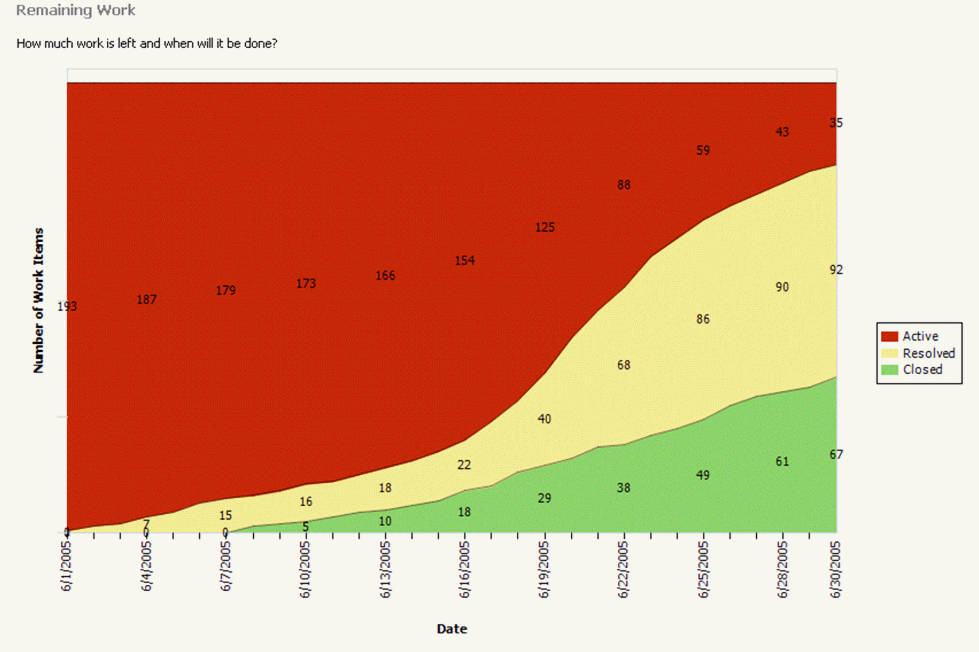

Where Do We Need To Shift Resources?
Bulge in work in process (i.e. in testing) indicates inadequate resources or inadequate incoming quality

Slide 30
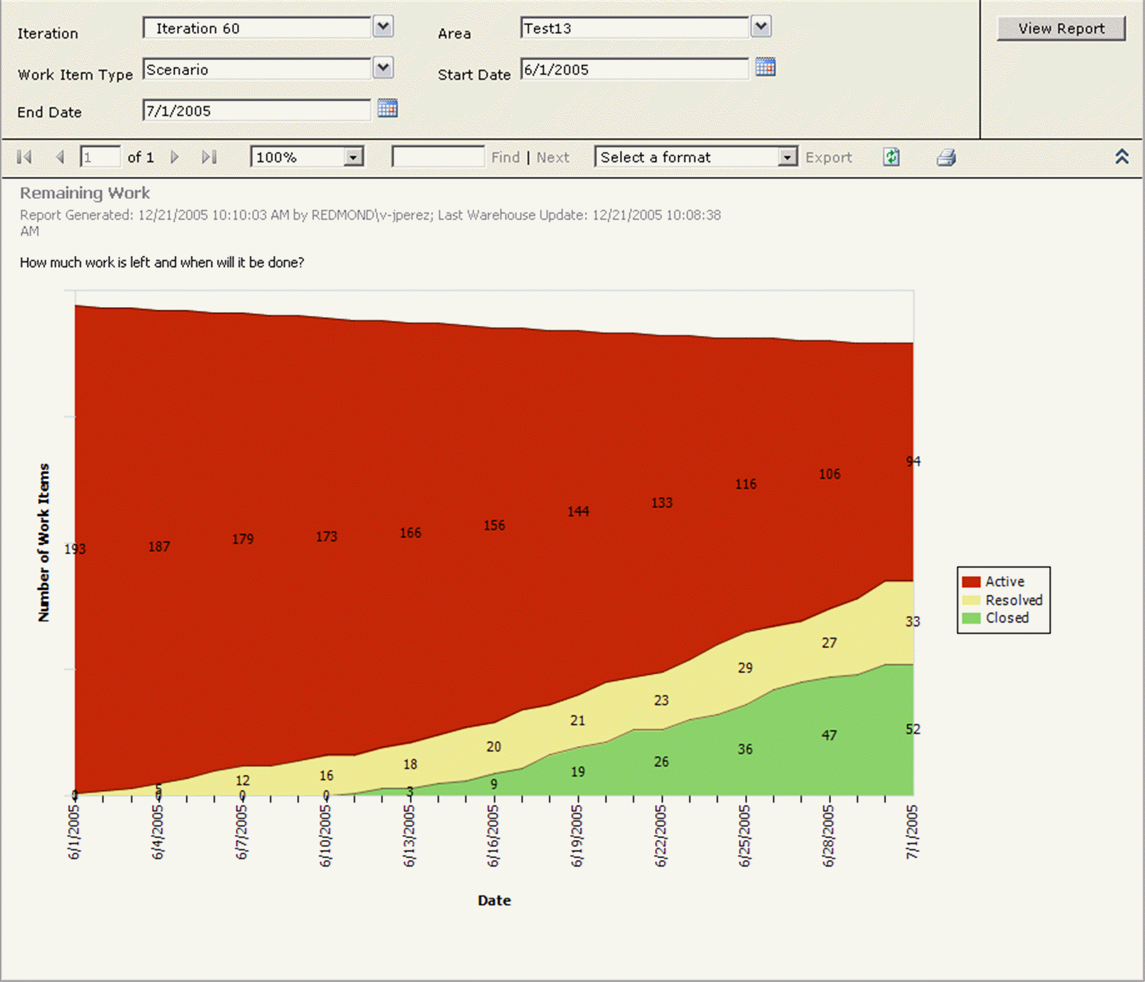


Underestimating
Slow progress leading to cuts in planned work, but not enough cuts
Steady rates of progress, but slope too shallow

Slide 31
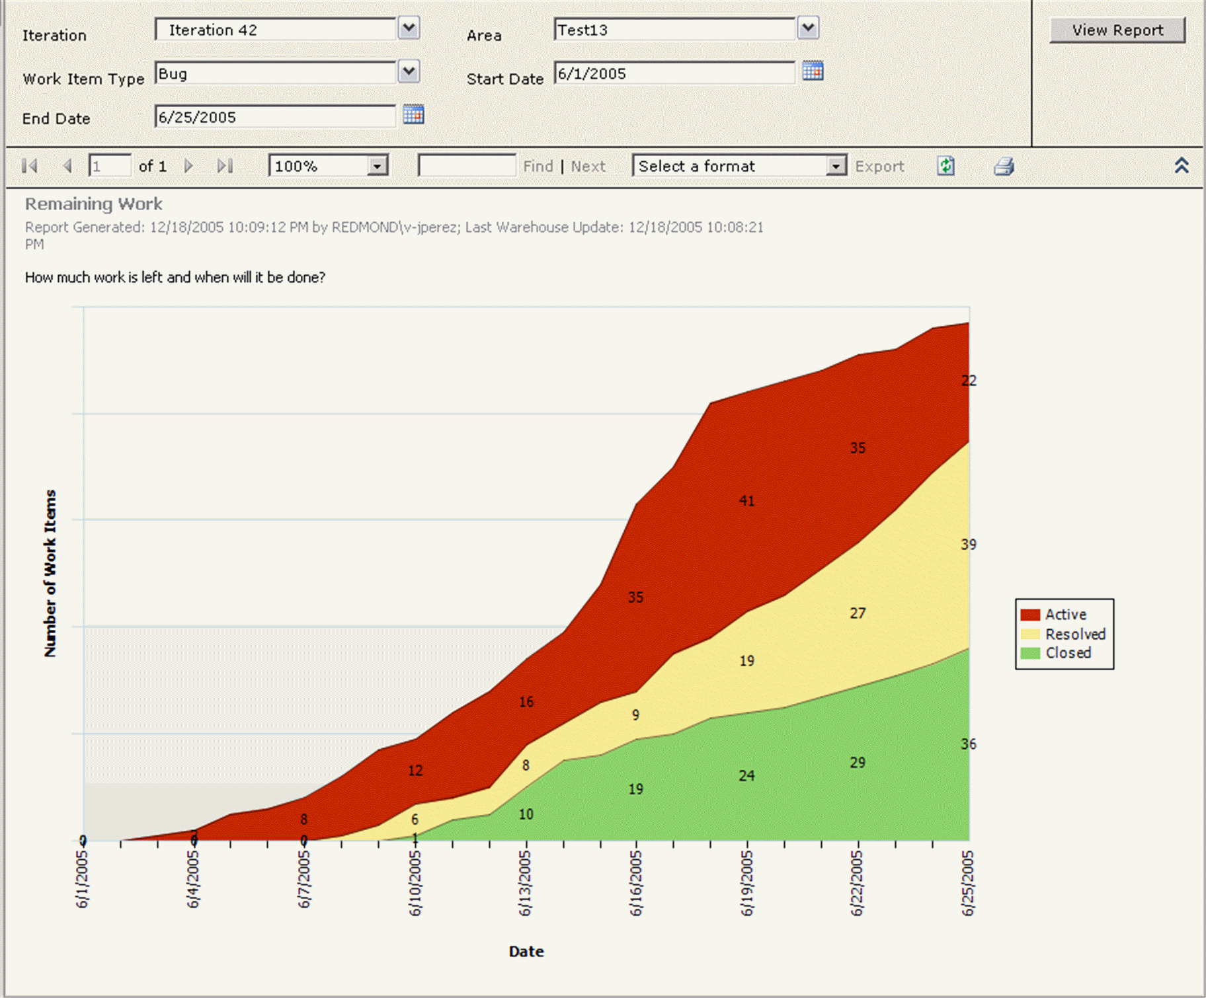

Inadequate Bug Allotment
New work not planned at iteration start

Slide 32
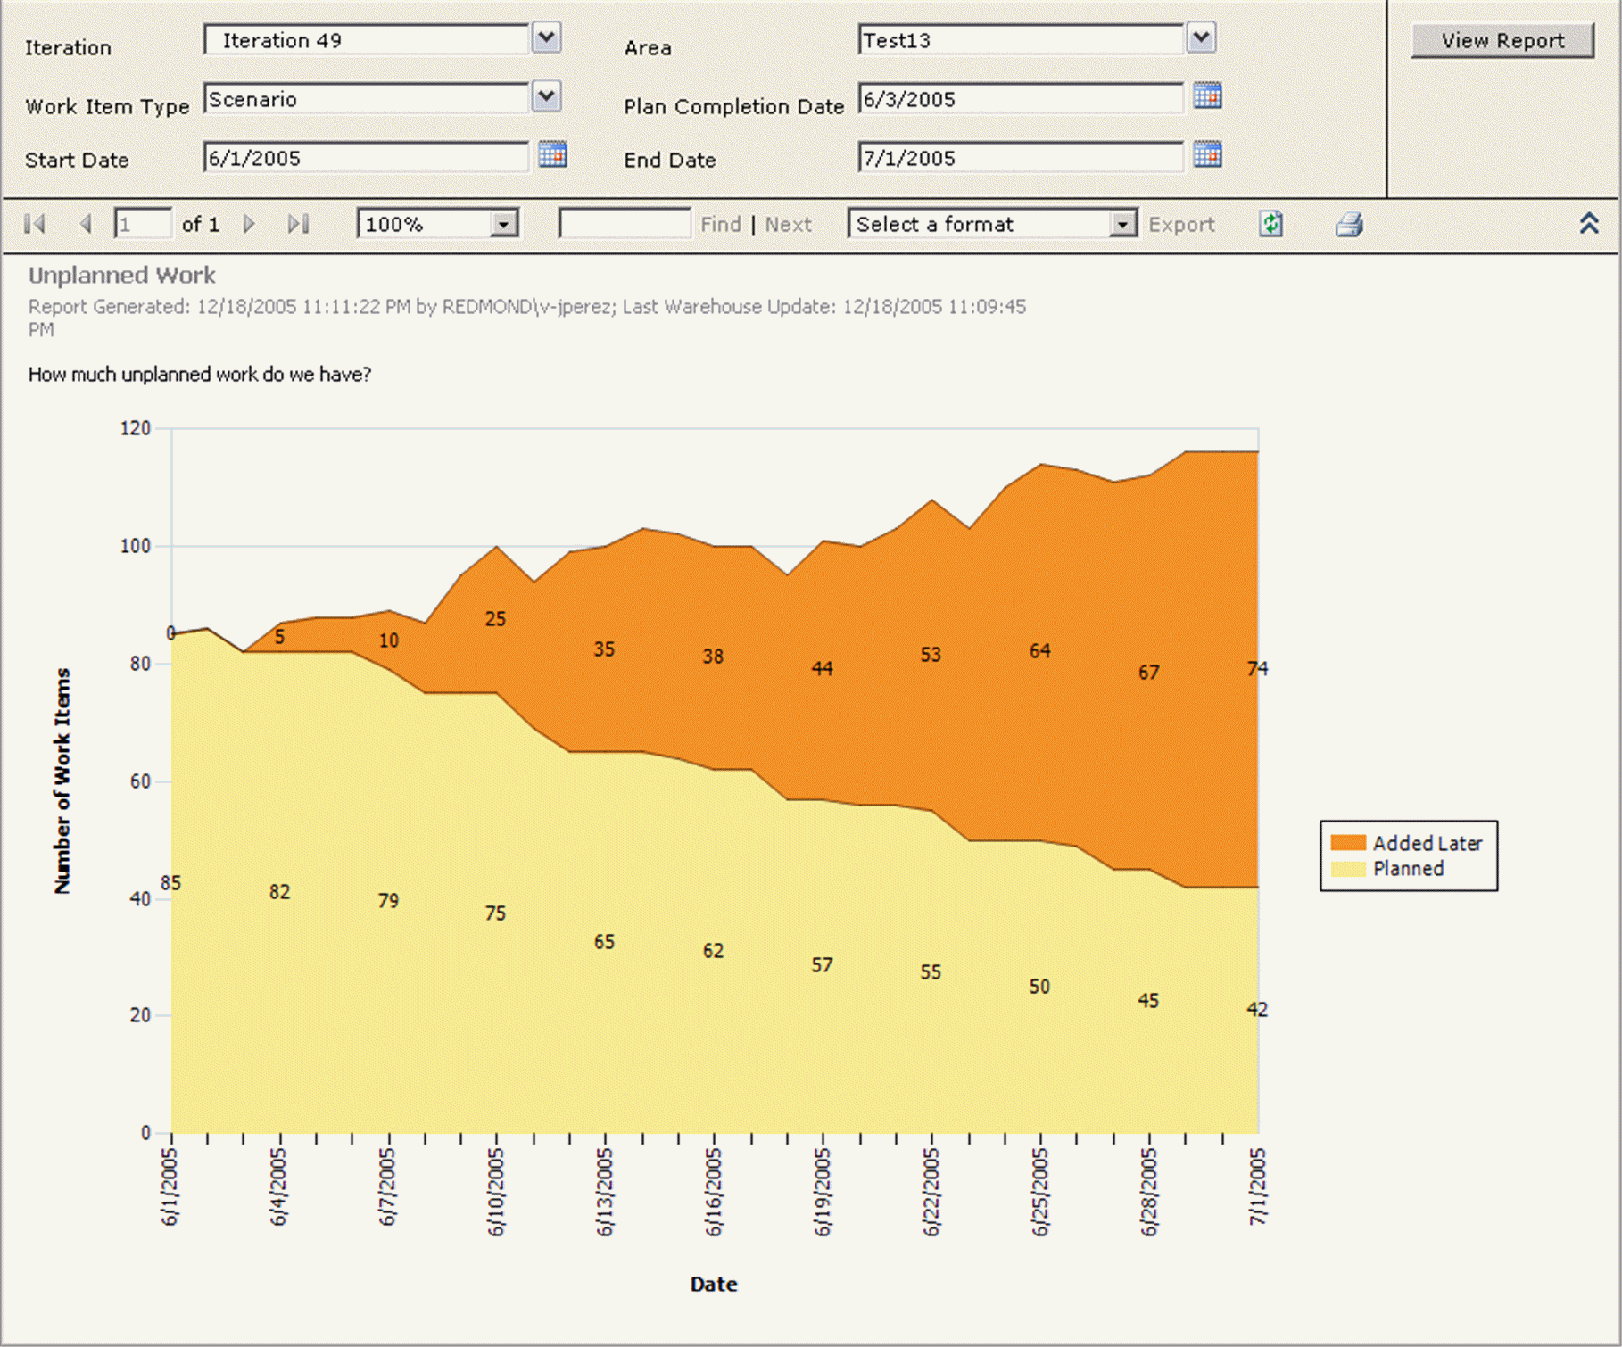


Scope Creep
“Dark matter” emerging during iteration
Planned work is squeezed out

Slide 33
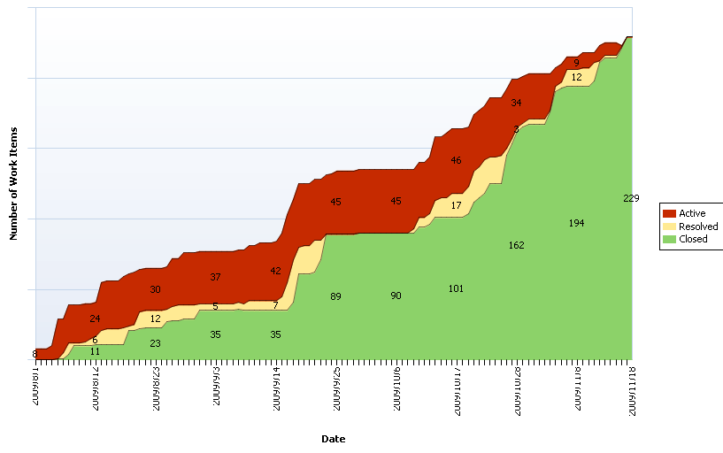
A real example

